Slide 1
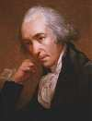

Lectures on Medical Biophysics
JAMES WATT
19.1.1736 - 19.8.1819
Thermodynamic principles

Slide 2
Lecture outline
understanding basic concepts of thermodynamics, work and heat, 1st and 2nd Law of thermodynamics
explanation of the relationship between entropy and disorder of a thermodynamic system, the Boltzmann principle

Slide 3
Thermodynamics – physical discipline dealing with transformations of energy in macroscopic systems.
Development: 18th to 19th century – steam engines, combustion engines, turbines.
At the end of 19th century and the beginning of 20th century it became solid basis of physical chemistry.
Key to understanding uniqueness of life today: non-equilibrium thermodynamics.

Slide 4
THERMODYNAMIC SYSTEM
Definitions:
Thermodynamic system can be considered as any macroscopic body or a large set of interacting particles (an example of a thermodynamic system is the human body) bounded in some way.
Isolated system: one which cannot exchange particles or energy with its environment.
Open system: one which can exchange both particles and energy with its environment.
Closed system: can exchange energy but no particles.
An isolated system always reaches an equilibrium state in which it does not change macroscopically (~visibly). Open systems do not reach the equilibrium state in general.
LIVING SYSTEMS ARE OPEN SYSTEMS

Slide 5
Basic terms
Quantities sufficient to fully describe the “thermodynamic” properties of the system at equilibrium are called state quantities (sometimes also mentioned to as state variables).
A defined set of state parameters is necessary for full description of a thermodynamic system.
These parameters are related to each other in the equations of state.

Slide 6
Reversible process:
is one in which a second process could be performed so that the system and surroundings can be restored to their initial states with no change in the system or surroundings.
Irreversible process – in principle, any real process
Cyclic process: the initial and final states of the system are identical (but not necessarily the surroundings)

Slide 7
Work done by/on thermodynamic systems
Gas and piston system W = p·ΔV
- This can be called mechanic or pressure-volume work.
electric system W = Q·U
- This is the work necessary to transfer an electric charge Q between places with potential difference U.
chemical system W = μ·Δn
- This is the work necessary to increase or decrease amount of a chemical compound Δn in chemical reaction. μ is chemical potential.

Slide 8


Other important quantities:
One of the most important state quantities is temperature. It is understood as a measure of the "thermal" state of matter and quantitatively expresses the degree of hotness or coldness. Temperature is related to the motion of matter and its parts down to the elementary level.
Thermodynamic (Kelvin) temperature T is a quantity which indicates the average kinetic energy W_{KS} of the particles in a system e.g., for an ideal monatomic gas, k is the Boltzmann constant:
Internal energy of the system is the sum of all kinetic and potential energies of all particles forming the system.
Heat (thermal energy) is the part of internal energy of the system which can be exchanged between systems because of their different temperatures.

Slide 9
0th and 1st law of thermodynamics
The zeroth law of thermodynamics states: If systems A and B are each in thermal equilibrium with a third system C, then A and B are also in thermal equilibrium with each other.
The first law of thermodynamics:
(a formulation of the law of conservation of energy used in thermodynamics):
ΔU = W + Q
We can read it, for example: Internal energy U of the system increases with the work W done on the system, and the heat Q transferred from the environment to the system.
Sign convention: energy given to a system and work done by an external force on the system are positive, energy lost from the system to its surroundings and work done by the system on its surroundings are negative.
Internal energy is a state parameter, heat and work are not.

Slide 10
2nd law of thermodynamics
2nd law of thermodynamics
It is impossible to construct a cyclically operating engine that would only take heat from a reservoir and convert it to equivalent work without transferring a certain amount of heat from a hotter to a colder body, so it is impossible to construct a so-called perpetuum mobile of the second kind. (Note: A perpetuum mobile of the first kind contradicts the law of conservation of energy.)
There is an additive state function S, entropy, defined by the relation:
where ΔS is change in entropy and Q is the amount of heat added to the system at temperature T.
The total entropy of any isolated thermodynamic system (ΔQ = 0) tends to increase over time, approaching a maximum value i.e.,
ΔS ≥ 0.
As a result, the second law of thermodynamics is sometimes referred to as the law of entropy increase. This law determines the “direction” of natural processes, one of the most important natural principles.
(ΔS = 0 for reversible processes only)

Slide 11
Entropy and disorder
Entropy is also related to statistical probability, that is, how many different ways a system can be arranged, and we also refer to it as the measure of disorder of the system.
Physics knows the exact relationship between statistical probability W (not to be confused with work) and entropy S. It is called Boltzmann's principle:
where k is Boltzmann constant, equal to the ratio of the universal gas constant R to the Avogadro constant N_{A}. The subscript “0” relates to the initial state.
Derivation of the above formula is lengthy and relatively difficult. Next slides show rather simplified qualitative explanation.
In following considerations, we suppose that the total energy of particles and their number do not change.

Slide 12


„An experiment with balls“
The balls can be labelled by means of letters.
We draw a line parting bottom of a shoe box into two equal halves.
We shake the box and note positions (distribution) of balls.
Simplification: we deal only with positions of the balls, their momentum or energy is ignored.

Slide 13
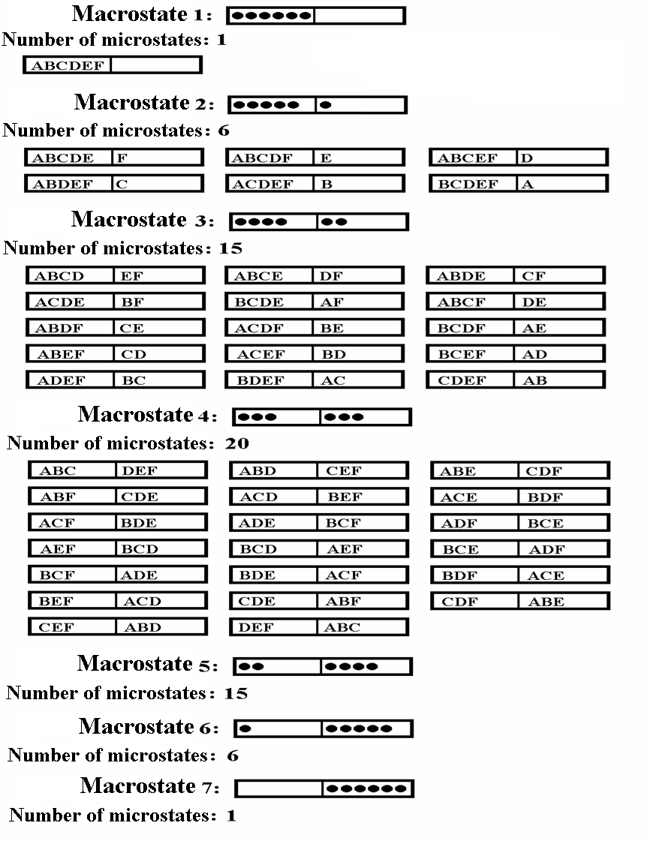

Slide 14
A few terms of statistical physics:
phase space (the bottom of the box ☺)
cell of phase space (halves of the bottom ☺)
“occupation number” (number of balls in one of the halves ☺)
distribution function
microstate and macrostate
Supposed and verified in practice:
Probability of formation of an arbitrary possible microstate is the same.
In the isolated systems, the macrostates of highest probability are formed by largest number of microstates.
The number of microstates forming the same macrostate, is called thermodynamic probability (P).
Macrostates differ one from another by their „occupation numbers“.

Slide 15
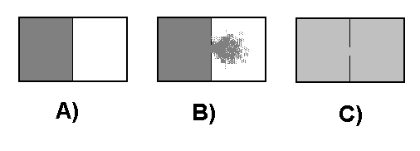
Free expansion of gas:
(time course of an irreversible process in the ideal gas)
A) A box is divided into two parts by a wall. In one of them, there is compressed ideal gas in equilibrium state.
B) We make an opening in the wall, and the gas expands in the second part of the box – an irreversible process is in progress.
C) After certain time, in both parts of the box tmd. equilibrium is reached.

Slide 16
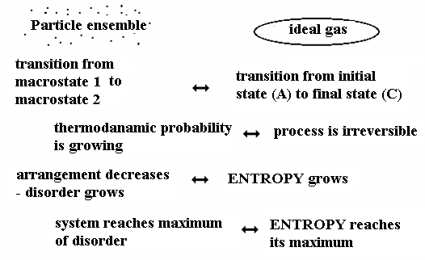
Analogy between both experiments:
4

Slide 17
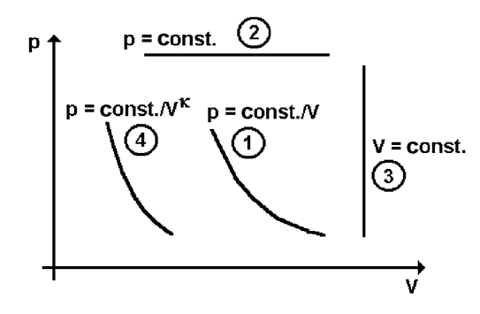
Basic processes in gases
The simplest thermodynamic system is an ideal (perfect) gas.
Equation of state for the ideal gas (universal gas law):
p·V = n·R·T
[Pa, m³, mol, J·K⁻¹·mol⁻¹, K]
Four special thermodynamic processes can be distinguished:
isothermal
isobaric
isochoric
adiabatic

Slide 18
Authors: Vojtěch Mornstein Daniel Vlk Language revision: Carmel J. Caruana Last revision: September 2025

