Slide 1
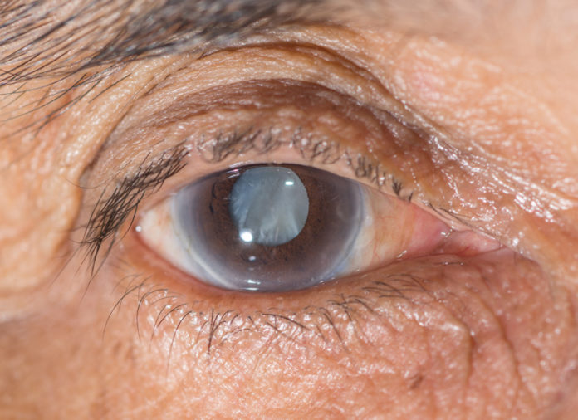
Cataract
Lenka Michalcová, MD PhD
Marek Michalec, MD PhD
Department of Ophthalmology
Faculty Hospital Brno
Faculty of Medicine, Masaryk University

Slide 2
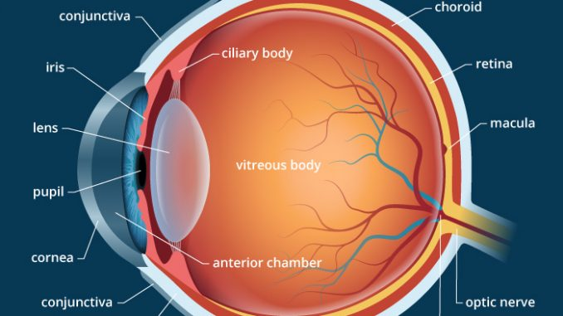
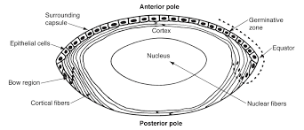
Lens
one of two main refractive structure (the other is cornea)
optical power around 10-20 D - depending on individual accomodation
biconvex shape
thickness 4 mm
diameter 12mm
optically transparent structure
metabolism changes - water decreases with the age

Slide 3
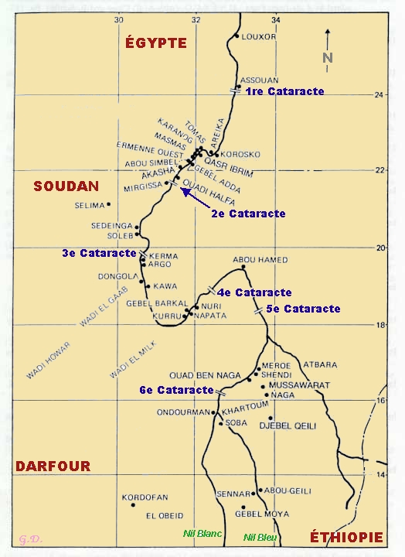

Cataract
Clinical signs
reduced transparency of the lens
decrease of visual acuity, blurred vision
decrease of contrast sensitivity, shades of gray
glare, monocular diplopia
„cataract“
cataract = waterfall
(greek) „καταρράκτης“

Slide 4
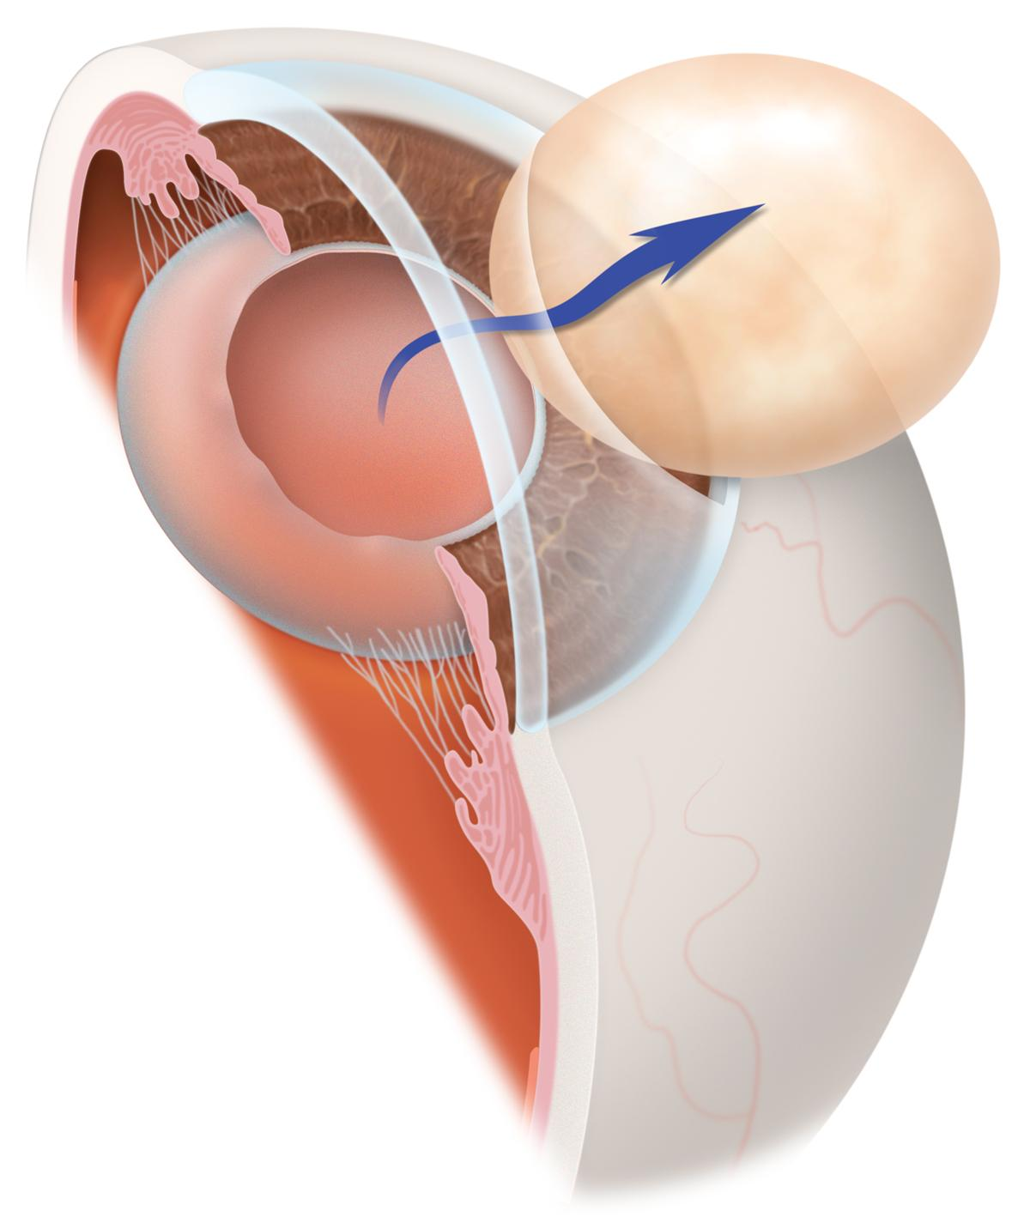
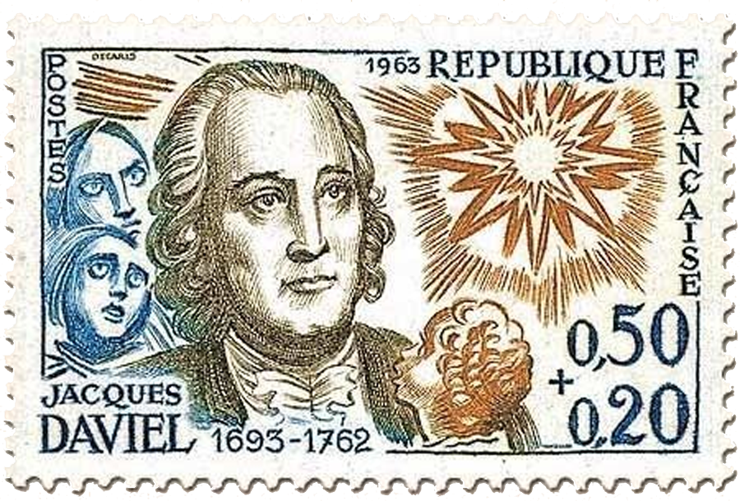
History
Jacques Daviel (1696-1762) – limbal incision, lens extraction
Extracapsular extraction (ECCE)- opening of anterior capsule,
removal of cortex and nucleus of the lens
Intracapsular extraction (ICCE)- entire lens is frozen and removed from the eye
Charles Kelman, 1967 – phacoemulsification – revolution in cataract surgery

Slide 5
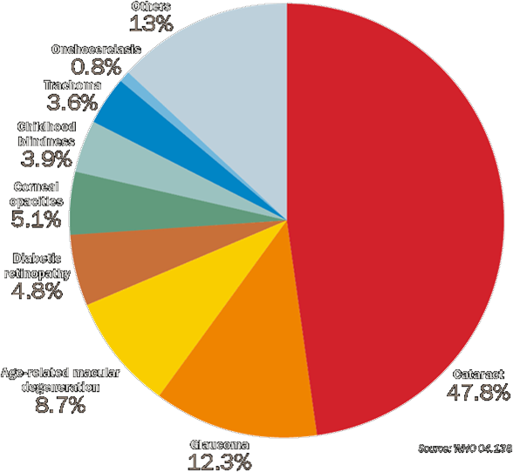
Epidemiology
World
30-45 millions of blindness worldwide
  45% of all caes - cataract
Prevalency
increase by age
Age 65-74 – 50%
Age >75 – 70%

Slide 6
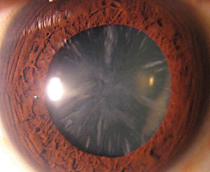
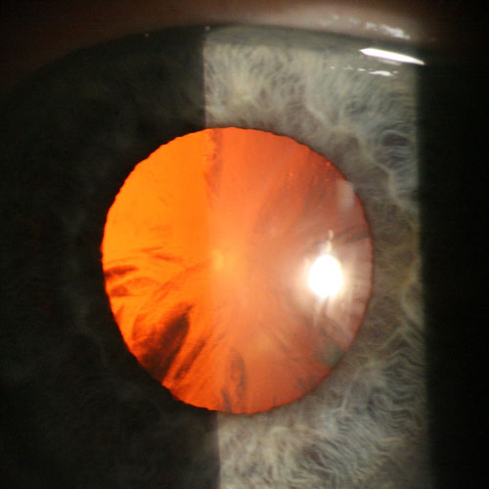
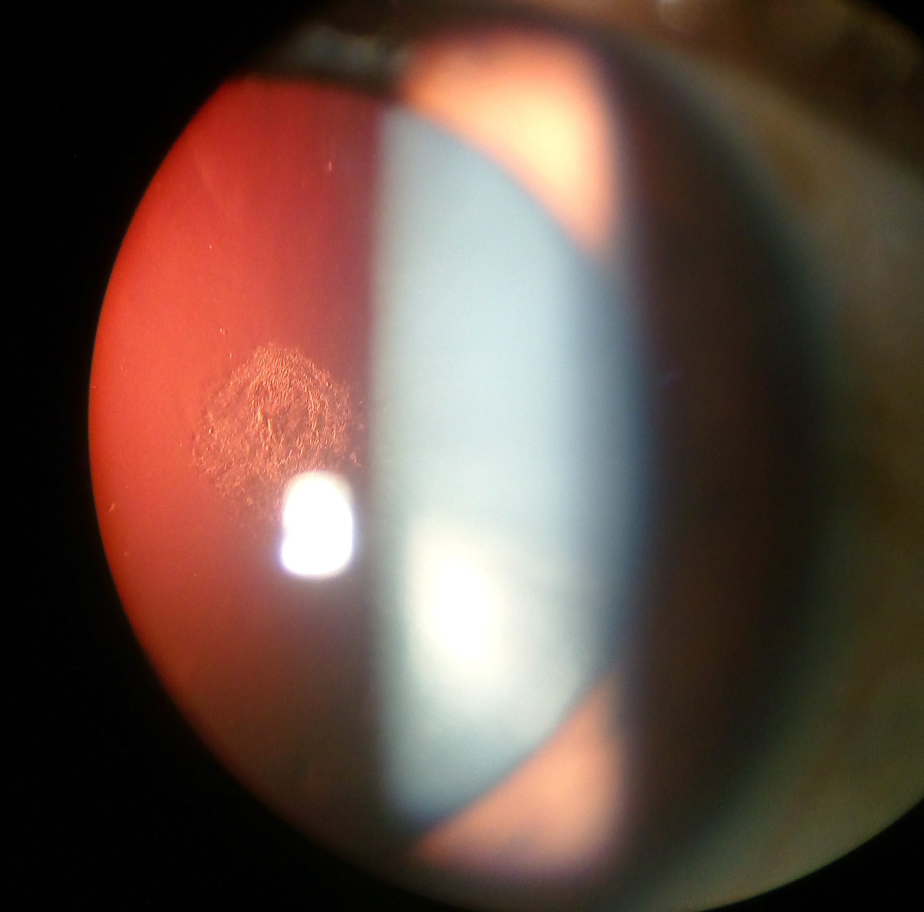
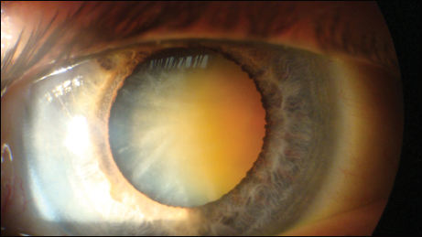
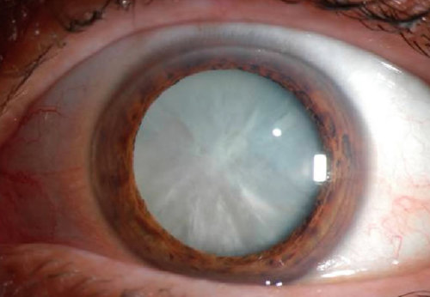
Classification of cataract
1.Acguired
Senile – 90%
Systemic disease
DM, galactosemy, Fabry disease,
Wilson disease, chronic
iridocyclitis, postsurgical,
traumatic, toxic, drug induced
2. Congenital – lamellar , zonular, coronary, cerulean
Type
Nuclear - tend to be myopic, color of nucleus
Cortical - tend to be hyperopic, changes of cortex
Anterior subcapsular
Posterior subcapsular
Mature , hypermature
cortical cataract
in retroillumination
cortical cataract
posterior scutellar cataract
nuclear cataract
mature (intumescent) cataract

Slide 7
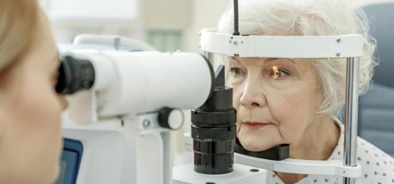
Examination before cataract surgery
Medical history
  diabetes, hypertension
  cardiac conditions
  medication
  allergy
Ocular history
  ocular disorders
  strabismus
  amblyopia
  glaucoma
  operation
  refractive surgery
Examination
  Anterior part
  position of eyelids
  tear film
  conjunctiva
  cornea
  anterior chamber
  iris
  pupil
  lens
  Posterior part
  vitreoretinal interface
  retina (including periphery)

Slide 8
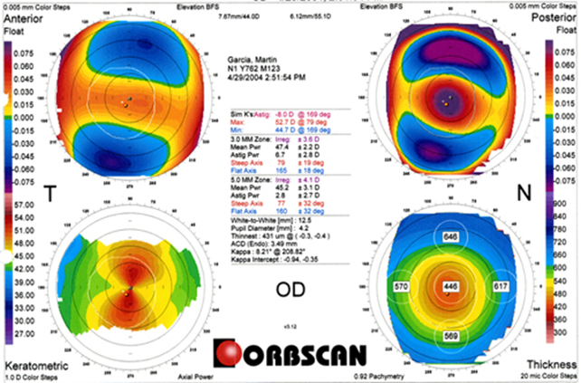

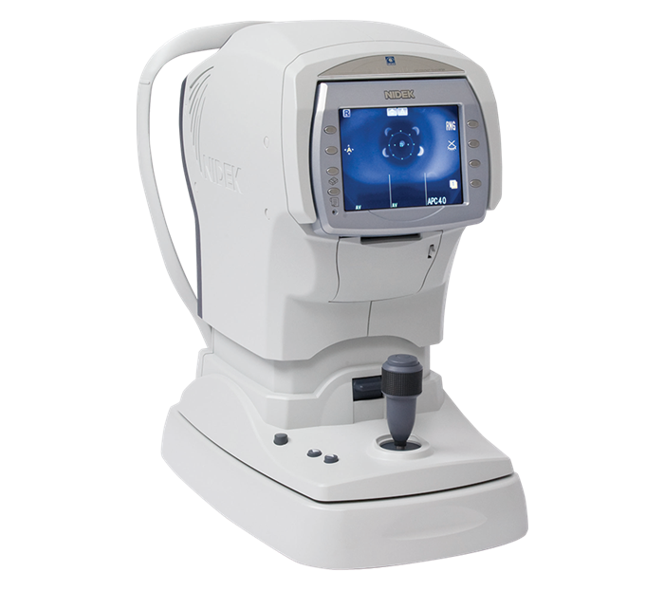
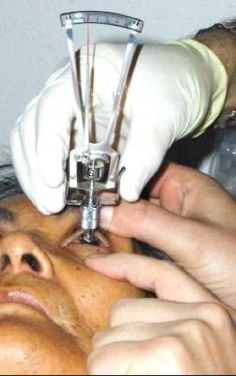
Examination
intraocular pressure
UCVA, BCVA
biometry, keratometry
corneal topography
ultrasound, OCT (optical coherence tomography)
postoperative refractive status
type of IOL

Slide 9
Treatment of cataracts
Surgical
  microsurgical technique using microscope
  topical anesthesia, general anesthesia

Slide 10
Cataract surgery step-by-step
1) desinfection
2) topical anesthesia (oxybuprocaine, lidocaine, tetracaine)
3) corneal incision (1,8-2,2mm)
4) viscoelastic material
5) capsulotomy
6) hydrodisection, hydrodelineation
7) phacoemulsification
8) implantation of IOL
9) viscoelastic material removement

Slide 11
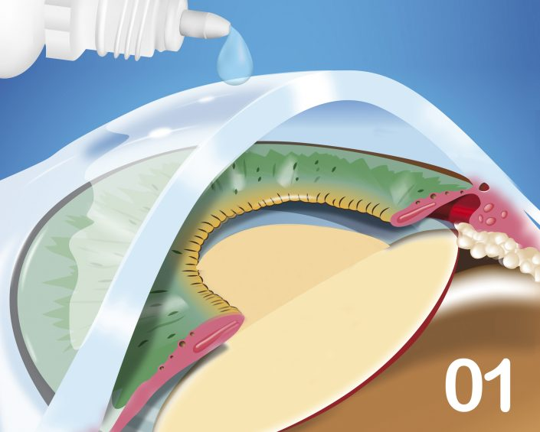
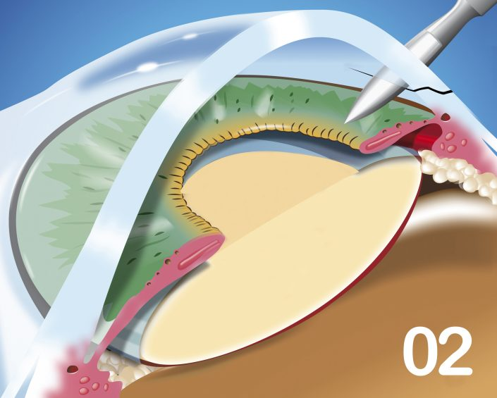
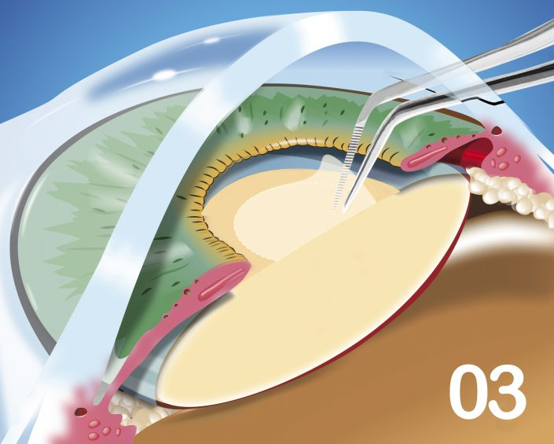
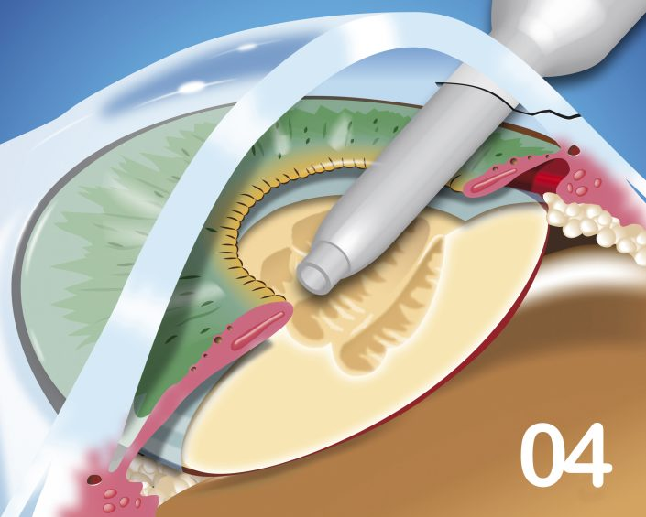
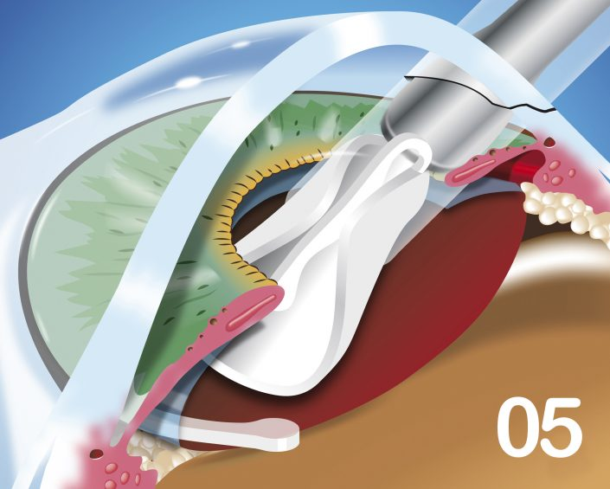
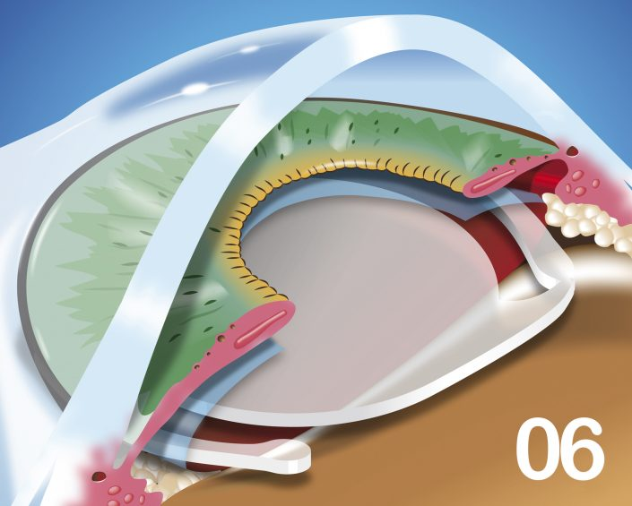
katarakta
Zdroj: http://www.ranelle.com/cataract-surgery/
Topical anesthesia
Incision (corneal tunnel)
Capsulorhexis
Phacoemulsification
Implantation of IOL
finalisation

Slide 12
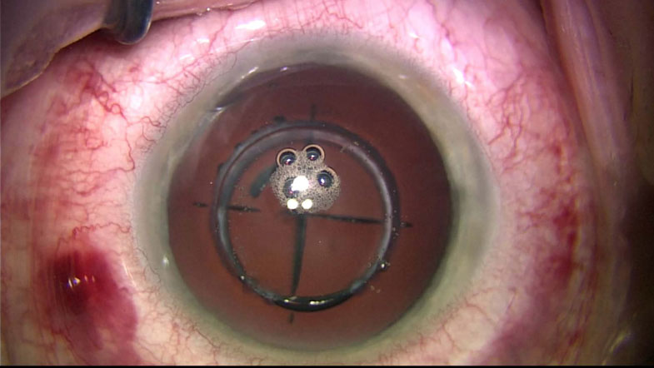
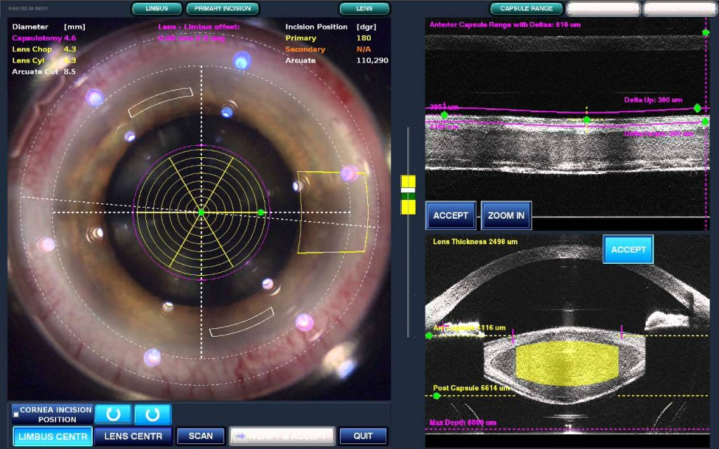
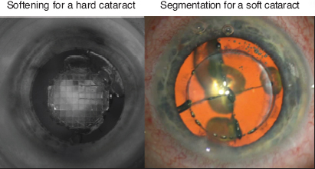
Femtosecond laser-assited cataract surgery
incision, capsulotomy and lens fragmentation using femtosecond laser
phacoemulsification still necessary

Slide 13
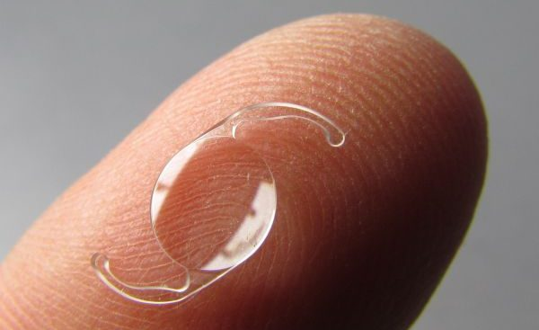
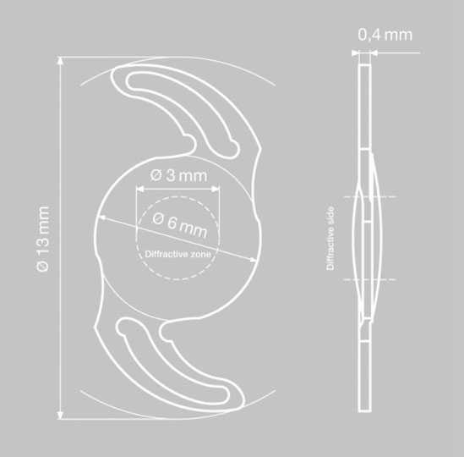
Intraocular lens
Design of IOL
Optical part 6mm
haptic 13mm

Slide 14
Types of IOL
Types of IOL
  monofocal / monofocal toric
  multifocal / multifocal toric
    bifocal
    trifocal
Design
  One piece
  three pieces
Material
  „Hard“ (PMMA)
  Soft (acrylate)
    hydrophobic
    hydrophilic (HEMA)

Slide 15
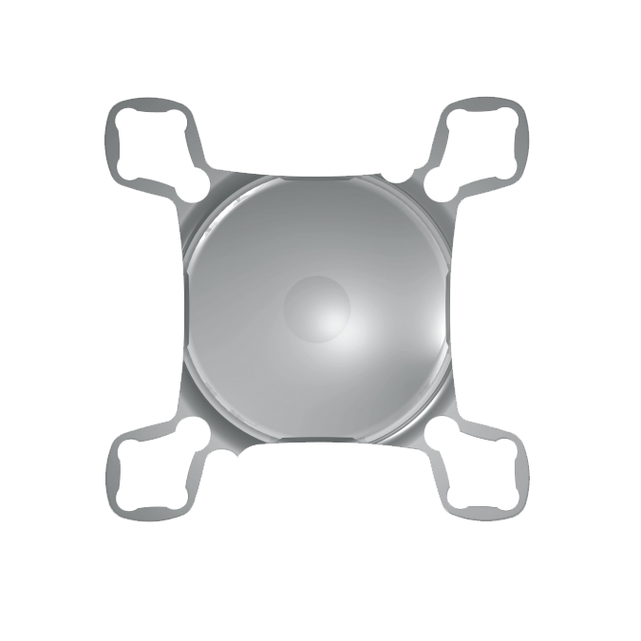
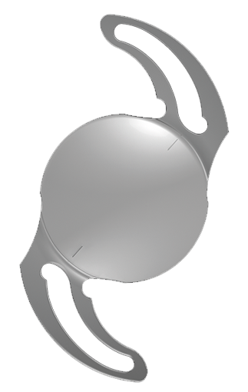
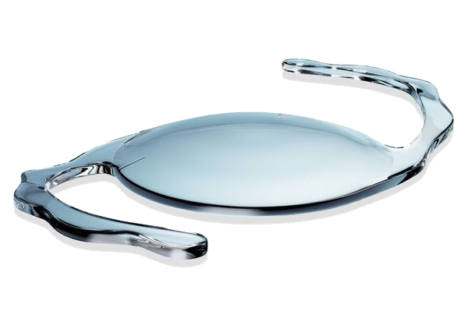
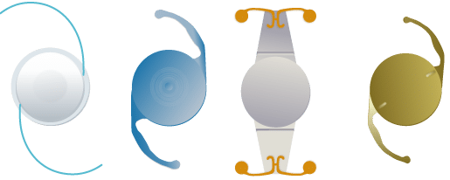
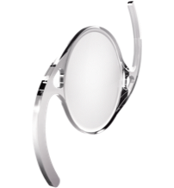
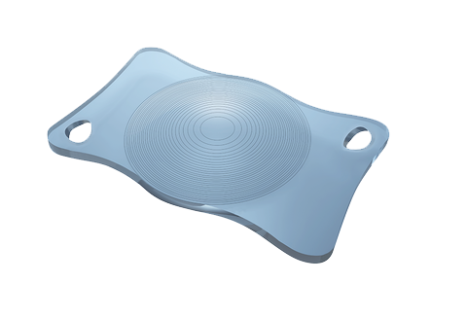
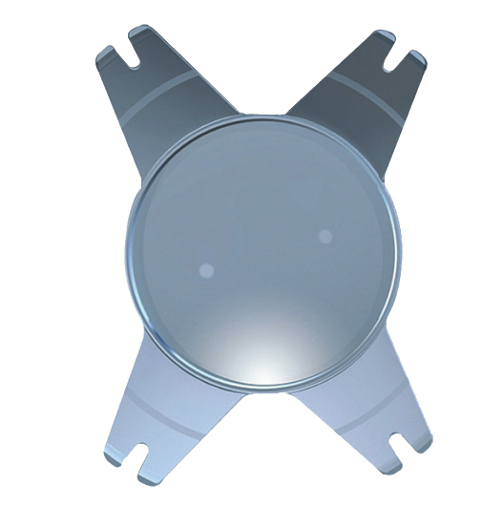
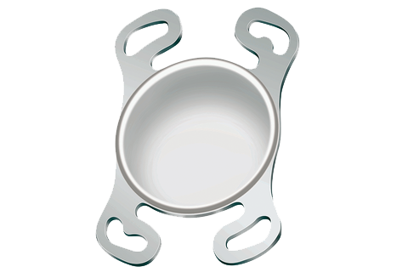
Various design of IOL

Slide 16
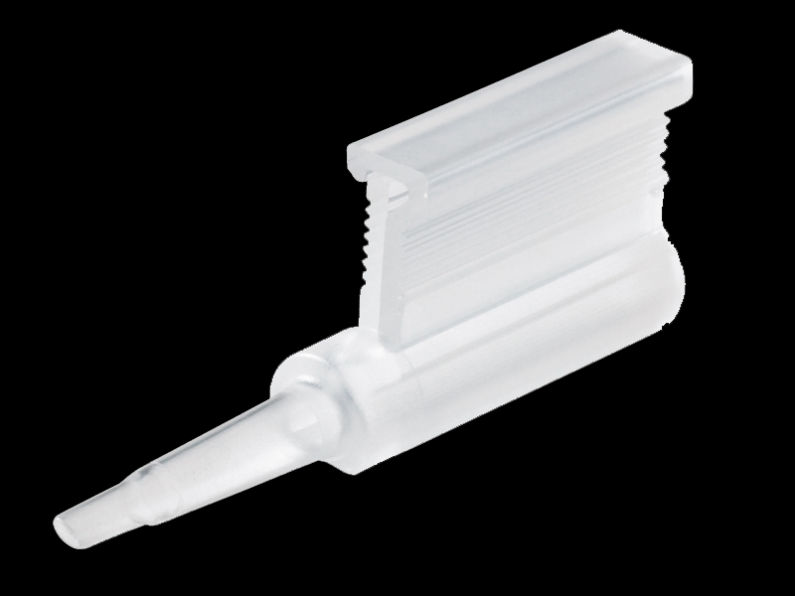
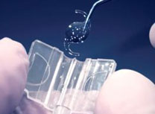
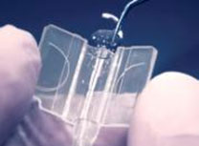
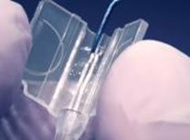
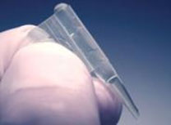
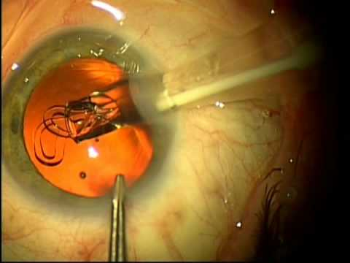
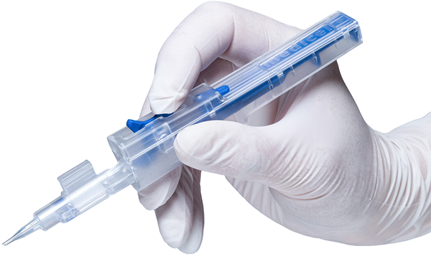
Implantation of IOL

Slide 17
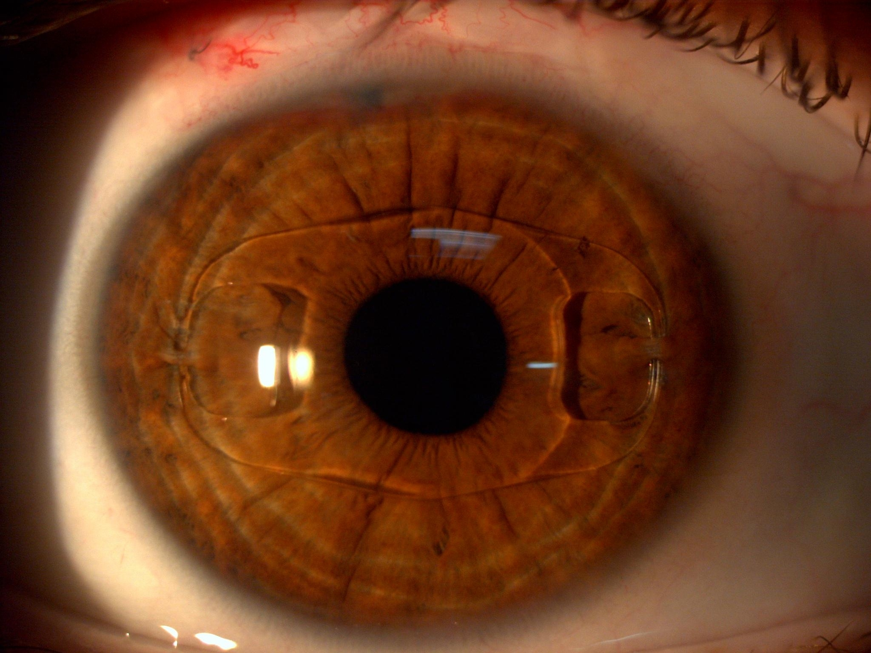
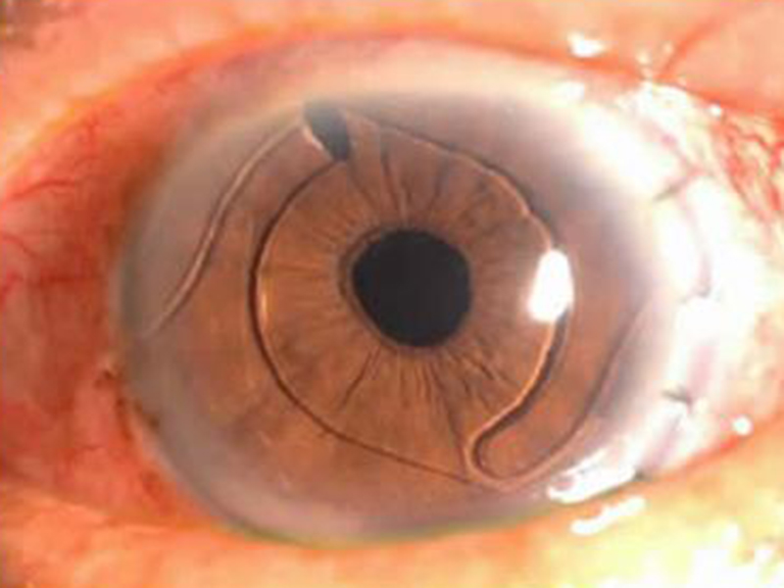
Anterior chamber IOL

Slide 18
Intraoperative Complications
Rupture of the posterior capsule
posterior migration of lens material; therapy: removal of all fragment of the lens, anterior vitrectomy, PPV
IFIS (intraoperative floppy iris syndrome)
atonic iris after chronic tretment with tamsulosine (benign prostatic hyperplasia)
Suprachoroidal haemorrhage
bleeding into the suprachoroidal space, shallowing of anterior chamber; increase of intraocular pressure, vitreous extrusion, treatment - closure of the incision; rare complication after small incision cataract surgery

Slide 19
Postoperative Complications
Early
  TASS (toxic anterior shock syndrome) - elevation IOP, hypopyon, 24 hours after operation)
  Endophthalmitis – 2 to 5 days after operation (pain, hypopyon, decrease of visual acuity)
  Secondary glaucoma – elevation of intraocular pressure
  Macular oedema – mostly in pacients with diabetes
Late
  Retinal detachment
  Posterior capsule opacification – pearls, fibrosis
  Lens dislocation

Slide 20

Secondary cataract
Secondary cataract
in mydriasis
Secondary cataract
in retroillumination
Secondary cataract with window after YAG capsulotomy

Slide 21
Thank you for your attention!

