Slide 1
GLAUCOMA

Slide 2
Part 1: glaucoma essentials

Slide 3
GLAUCOMA ESSENTIALS
Glaucoma ≠ elevated IOP!!
BUT, glaucoma is usually associated with high IOP (x normal tension glaucoma)
Late symptoms onset
Affects 60.5 million people worldwide

Slide 4
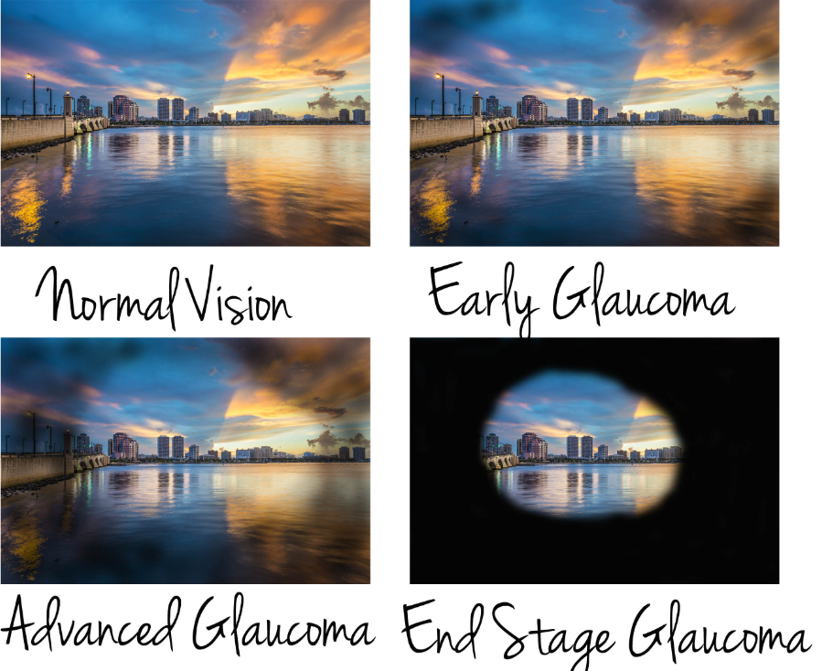
GLAUCOMA ESSENTIALS
accounts for 8% of all cases of blindness and is the leading cause of irreversible blindness worldwide
Early detection is essential

Slide 5
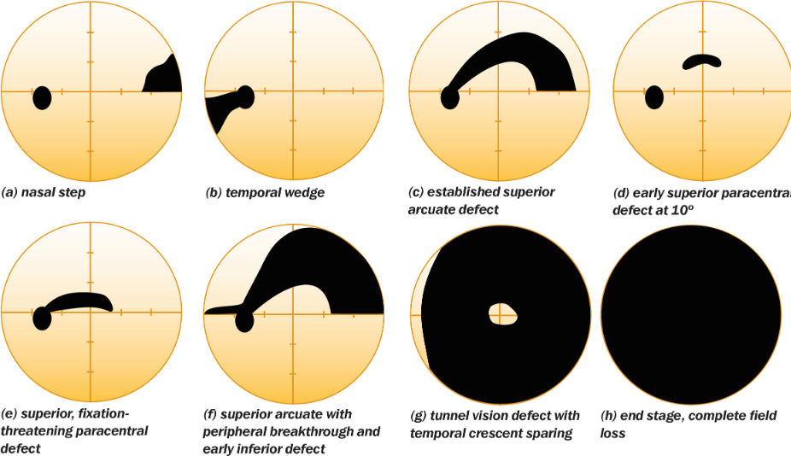
GLAUCOMA ESSENTIALS (OS)

Slide 6
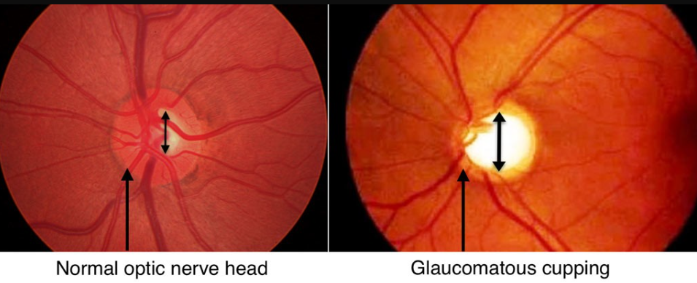
GLAUCOMA ESSENTIALS
Optic nerve damage.

Slide 7
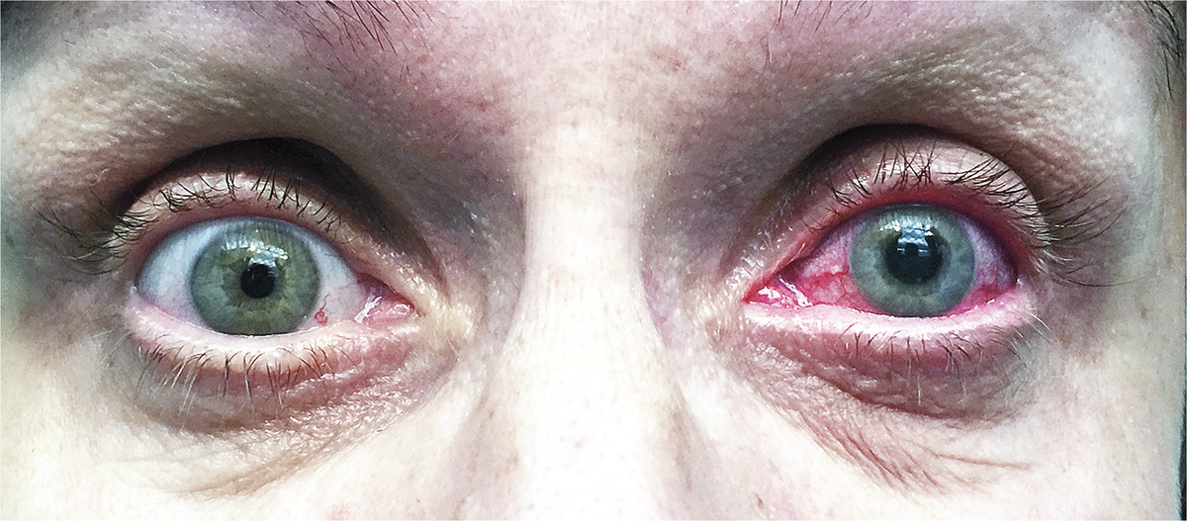
GLAUCOMA ESSENTIALS

Slide 8
Part 2: definition, anatomy, patophysilogy

Slide 9
Definition
a group of diseases defined by a characteristic irreversible optic neuropathy
  remodeling of the connective tissue elements of the optic nerve head
  loss of neural tissue (ganglion cells)
    associated with the eventual development of visual dysfunction.
intraocular pressure (IOP) level is one of the primary risk factors for development of glaucoma, BUT does not have a role in the definition of the disease
Glaucoma ≠ elevated IOP!!

Slide 10
Glaucoma is not fully understood
Susceptibility to glaucoma
determined by the resilience of the optic nerve to the multiple pathogenic mechanisms involved in the neuropathy
progressive injury may occur at low IOP levels whereas in other cases with higher pressures, injury never occurs.
  the optic nerve may continue to be damaged despite decreasing the IOP

Slide 11
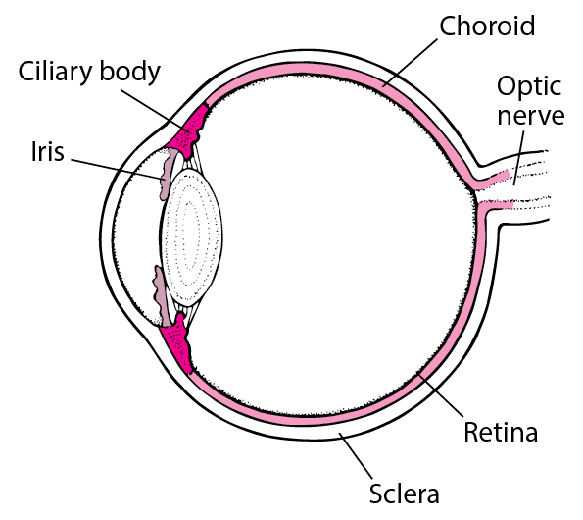
Aqueous Humor Dynamics
aqueous humor composition:
  is protein free (optical clarity)
production: ciliary body - 80 ciliary processes, rich supply of fenestrated capillaries
3.6 ml per day

Slide 12
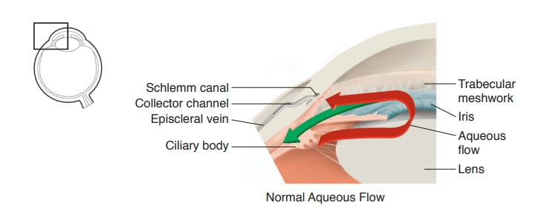

Slide 13
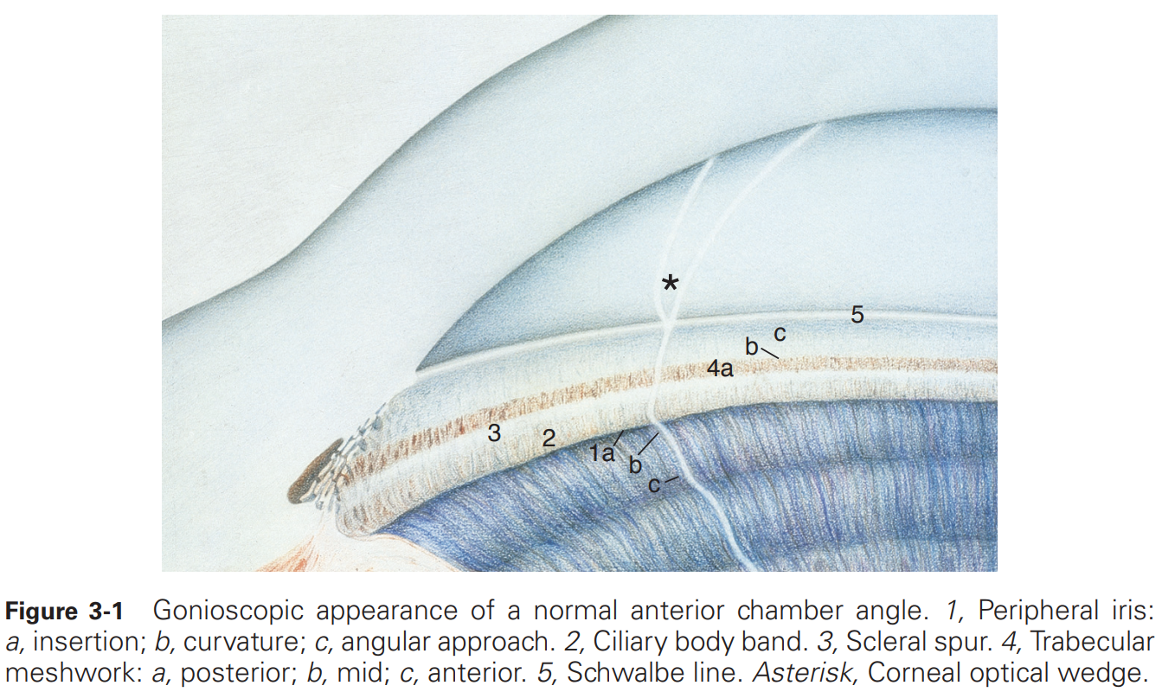

Slide 14
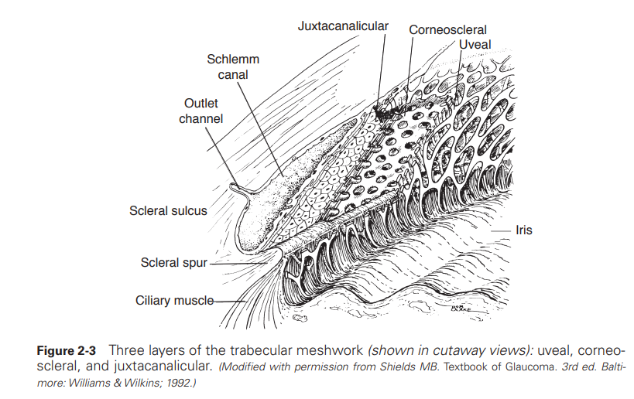

Slide 15
Aqueous Humor Dynamics
Trabecular Outflow
  pressure-sensitive outflow and functions as a one-way valve
Uveoscleral Outflow
  up to 45% of total aqueous outflow.
  pressure-insensitive outflow
  aqueous passage from the anterior chamber into the ciliary muscle and then into the supraciliary and suprachoroidal spaces
  decreases with age and is reduced in patients with glaucoma
  increased by cycloplegia, adrenergic agents, and prostaglandin analogues but decreased by miotics

Slide 16
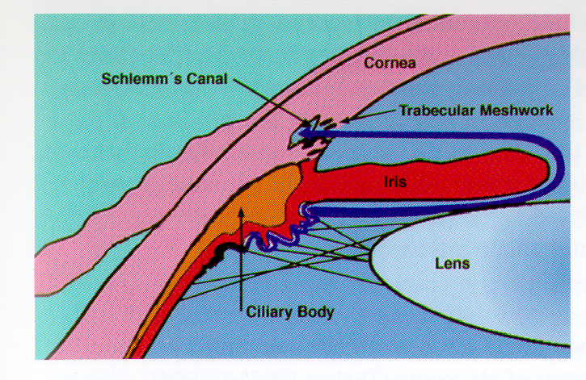
Trabecular outflow

Slide 17
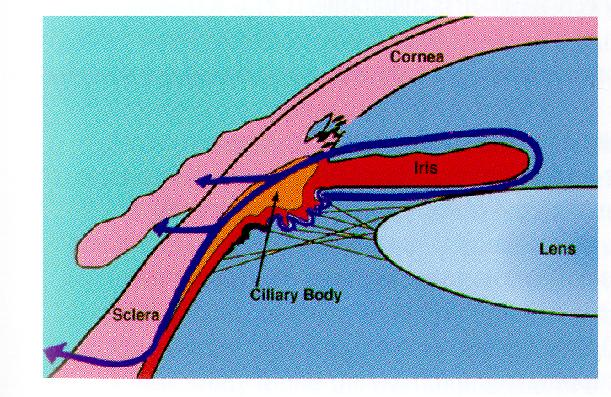
Uveoscleral outflow

Slide 18
Part 3: Classification

Slide 19
Glaucoma classification
Main classification
  Open angle glaucoma
  Angle closure gl.
  Childhood gl.
By cause
  Primary, secondary
By time
  Acute
  Chronic
  Intermitent

Slide 20
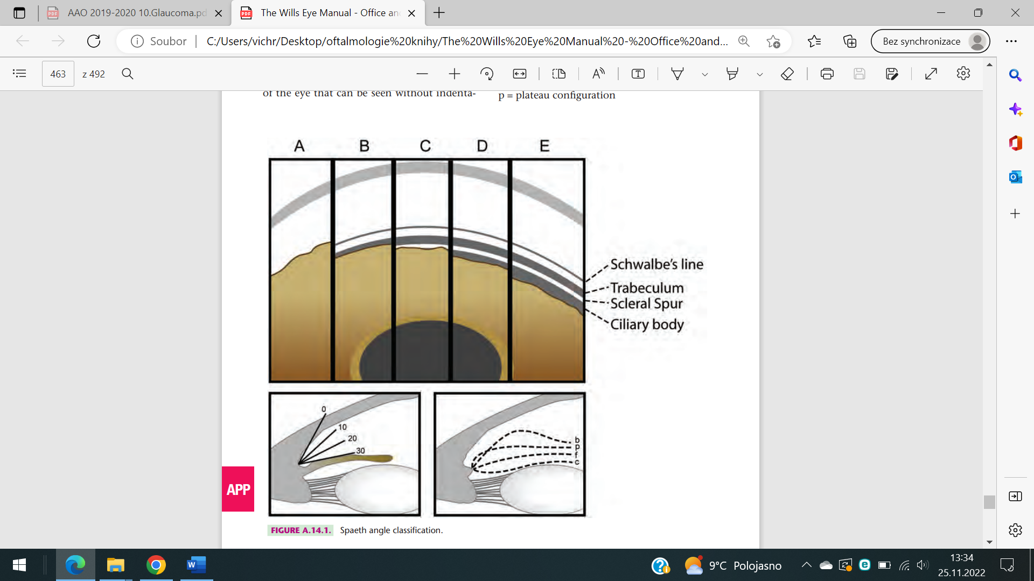
Open angle gl.
Primary (more common)
  POAG – primary open angle gl.
  NTG – normal-tension gl.
  JOAG – juvenile open angle gl.
  OHT – ocular hypertension
  Glaucoma suspect
Secondary
  Pigmentary, pseudoexfoliation, uveitic…

Slide 21
Angle closure gl.
Primary
  PACS – primary angle closure suspect - narrow angle no nerve damage
  PAC – primary angle closure - narrow angle, elevated IOP, no nerve damage
  PACG – primary angle closure glaucoma - elevated IOP, nerve damage
  Primary angle closure without pupilary block (plateau iris)
  Chronic angle closure (angle permanently closed by PAS)
Secondary
  With pupillary block
    Other mechanism than anatomical configuration (intumescent lens, secluded pupil..)
  Without pupillary block
    Pushing forward (choroideal tumor)
    Pulling forward (NV glaucoma)

Slide 22
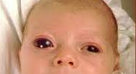
Childhood gl.
PCG
  presents within the first few years of life
Glaucoma associated with congenital anomalies
  Associated with local (aniridia) or systemic (neurofibromatosis..) disorders
Secondary glaucoma in infants and children
  Inflamation, retinoblastoma, trauma..

Slide 23
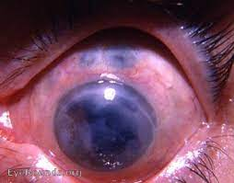
Terminology: absolute glaucoma
Any type of glaucoma at its terminal phase – practical or total blindness
Main goal of therapy = pain elimination
  Cyclocryo/photocoagulation
  Retrobulbar alcohol application – sensitive inervation block
  Enucleation

Slide 24
Part 4: Emergency cases: acute angle closure + malignant glaucoma

Slide 25
ACUTE ANGLE CLOSURE

Slide 26
Pupillary block
the most common mechanism leading to acute angle-closure (glaucoma)
  the flow of aqueous humor from the posterior chamber to the anterior chamber is. obstructed by a functional block between the pupillary portion of the iris and the lens
  Iris root is then pushed against trabecular meshwork
Risk factors:
  Narrow angle, hypermetropia, age related lens swelling (cataract)
  Mydriasis
    Nighttime (less light)
    Emotions

Slide 27
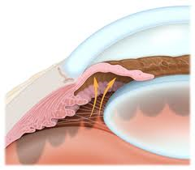
Pupillary block

Slide 28
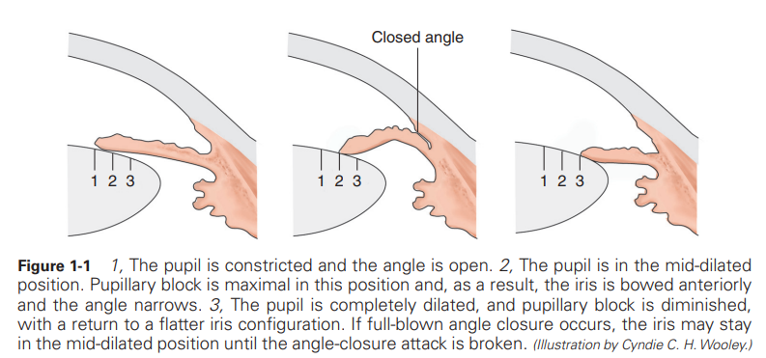
Pupillary block

Slide 29
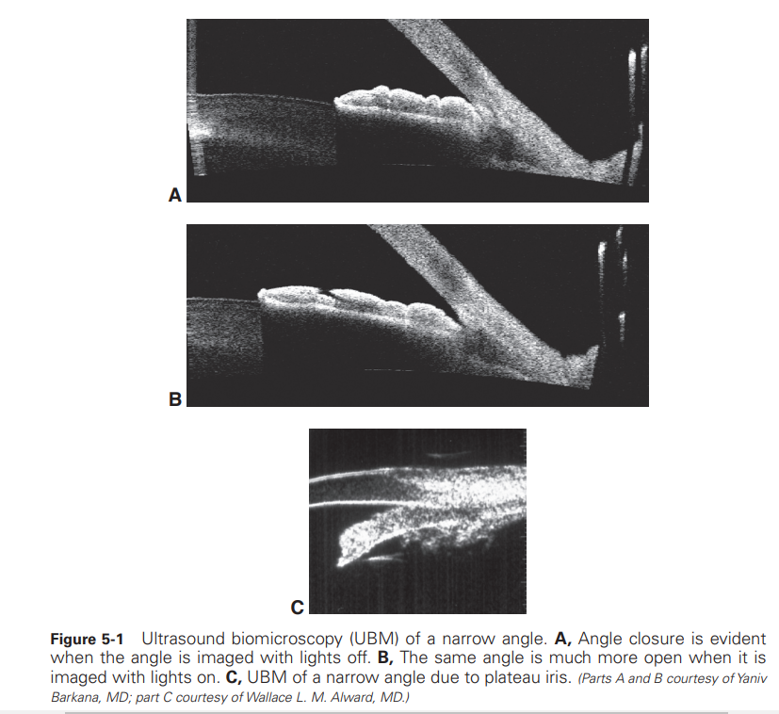

Slide 30
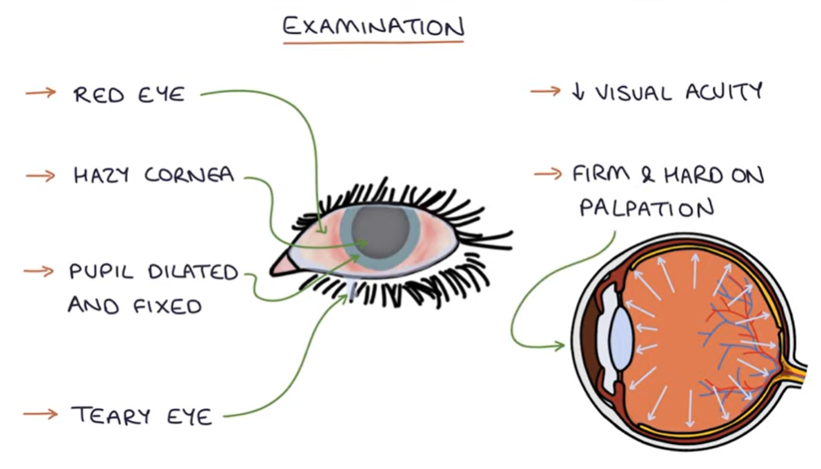
Acute angle closure - signs
Unilateral (usually)
IOP (usually) over
60 mmHg

Slide 31
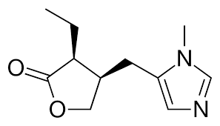
Acute angle closure – primary care
Miotics
Other local antiglaucomatics
Systemic therapy:
  Osmotics
  Carbonanhydrase inhibitors
  Analgetics
  Antiemetics

Slide 32
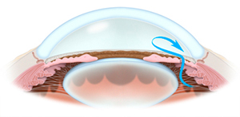
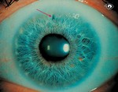
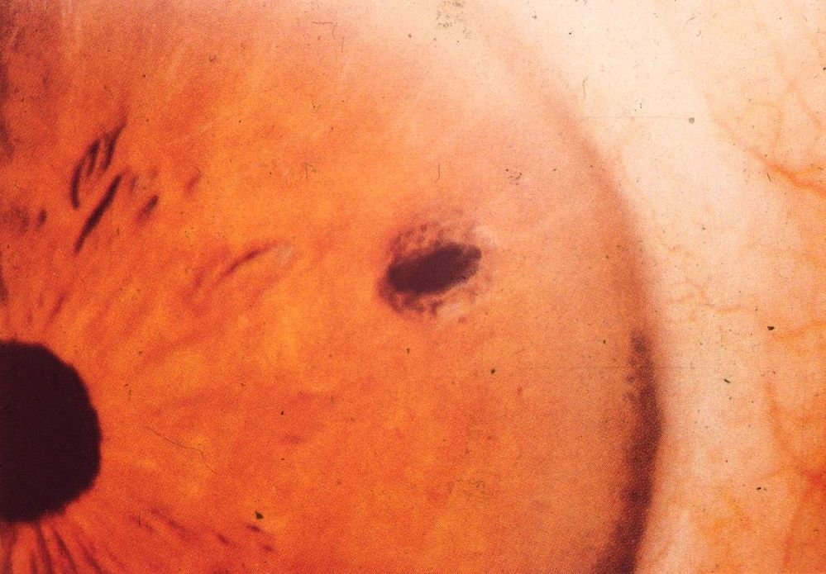
Acute angle closure – secondary care
Laser iridotomy (Nd:YAG laser)
  (neodymium-doped yttrium aluminum garnet)
  Little hole in the iris periphery
  Help to equal the pressures between posterior and anterior eye segment
Cataract extraction

Slide 33
Laser iridotomy video
https://www.youtube.com/watch?v=pNpzdYA3TqI

Slide 34
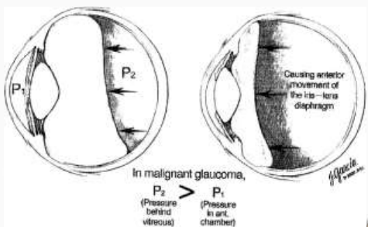
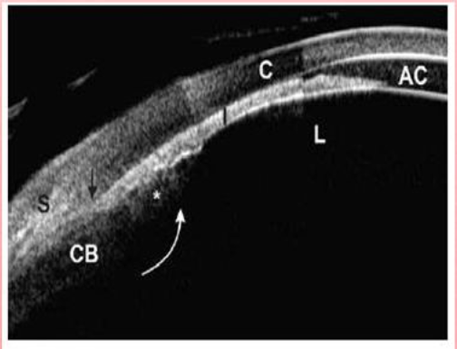
Special case: Malignant glaucoma

Slide 35
Part 5: Examination

Slide 36
Examination in glaucoma
History
Slit lamp examination
  gonioscopy
IOP measurement
Perimetry
Imaging
  OCT RNFL
  Ganglion cells
  HRT

Slide 37
Medical history in glaucoma
Typically no symptoms for chronic glaucoma in early stages
Risk factors:
  age, family history, high IOP, hyperopia, DM, previous eye injury, thin cornea, race
Important in medical history
  Past ocular surgery
  Refractive error
  General medical history (corticosteroid use – steroid induced gl.)
  Past medical history (DM, AB, AI, heart diseases, raynauds phenomenon)
  Glaucoma in family

Slide 38
Slit lamp examination
External adnexae (lashes)
Pupils – may differ in size
Conjunctiva – hyperaemia, scarring due to decreased tear production..
Cornea – epithelopathy (mediacal toxicity), microcystic oedema (IOP), Kruckenbergs spindle (pigmentary gl.), precipitates (uveitic gl.)
AC – van Herick method (width)
Iris – translumination defects (pigmentary gl), ectropion uveae, rubeosis iridis..
Lens – intumescent cataract, pseudoexfoliation, subluxation…
Fundus – optic nerve head, retinal haemorrhages, masses…

Slide 39
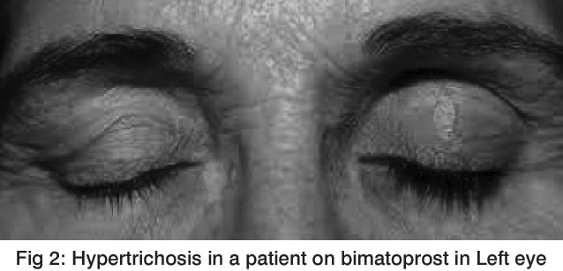

Slide 40
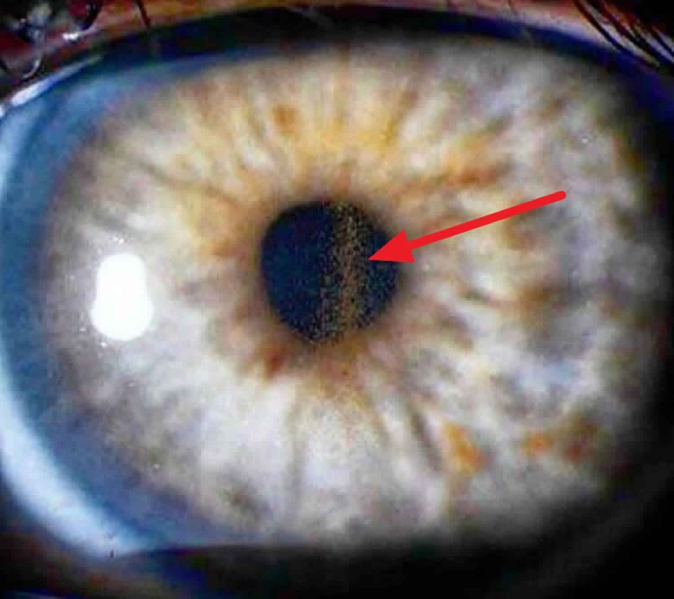

Slide 41
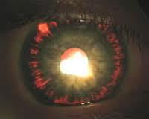
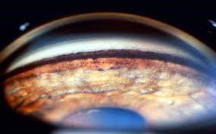
Pigmentary glaucoma (secondary open angle)

Slide 42
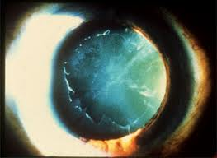
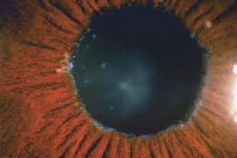
PEX glaucoma (secondary open angle)

Slide 43
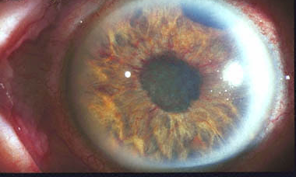
Neovascular gl. (secondary angle closure)

Slide 44
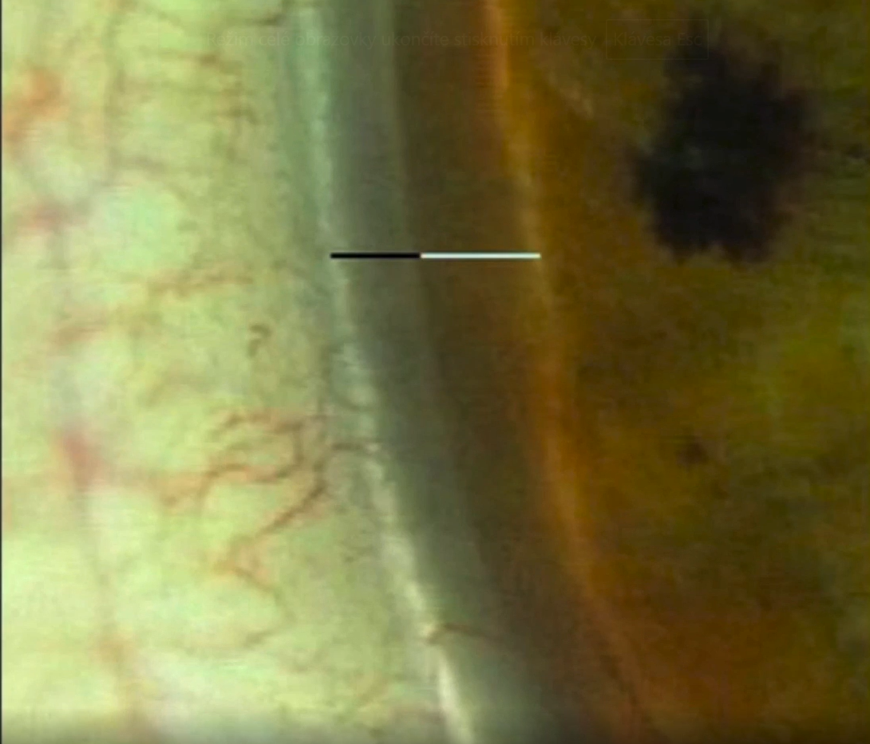
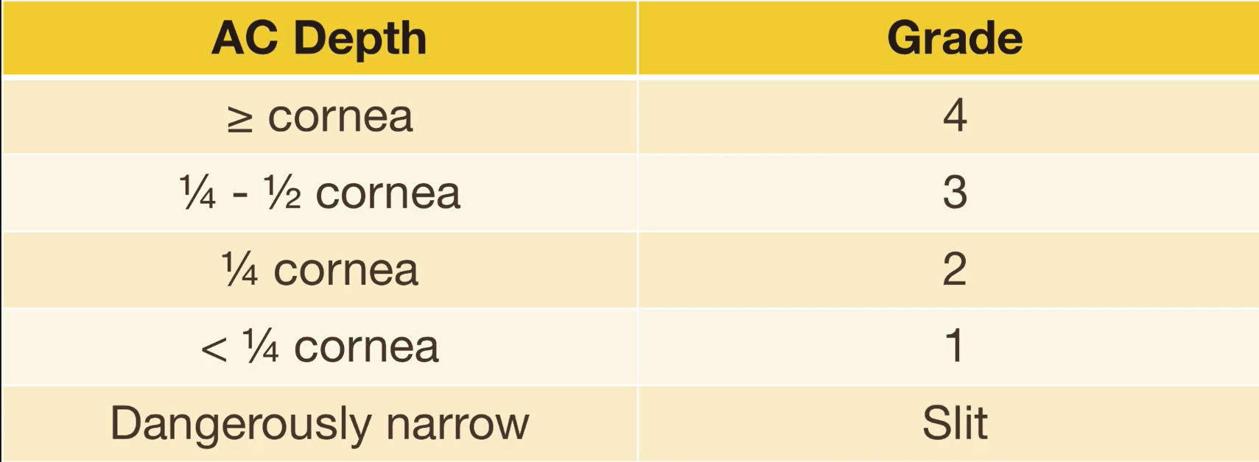
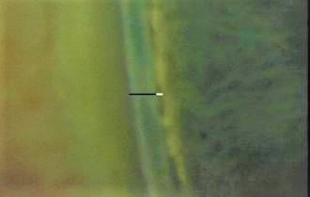
Van Herick grading
Under ¼ = high risk of angle closure

Slide 45
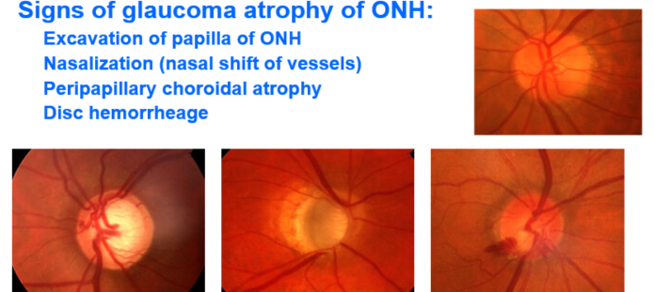
Slit lamp examination

Slide 46
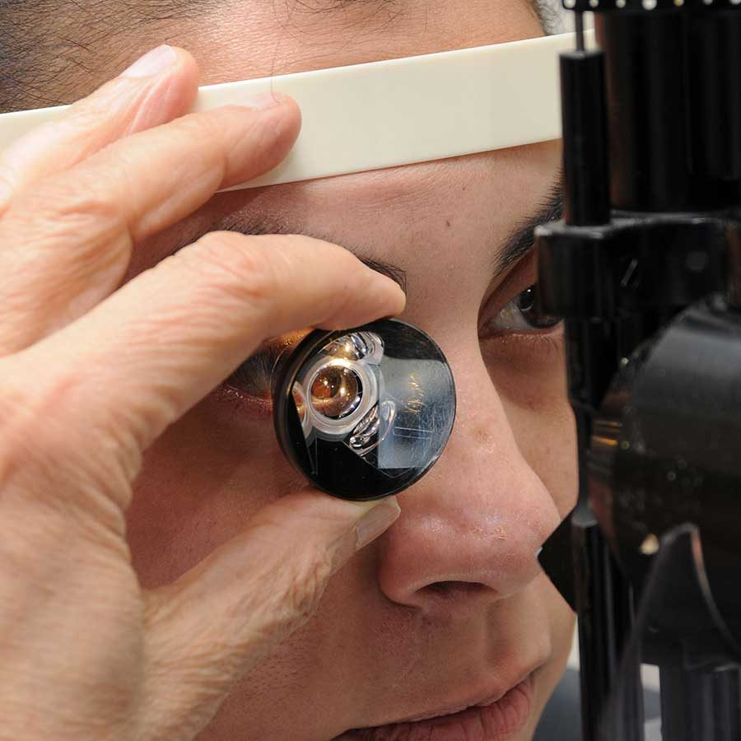
Gonioscopy
Visualisation of the anterior
chamber angle

Slide 47
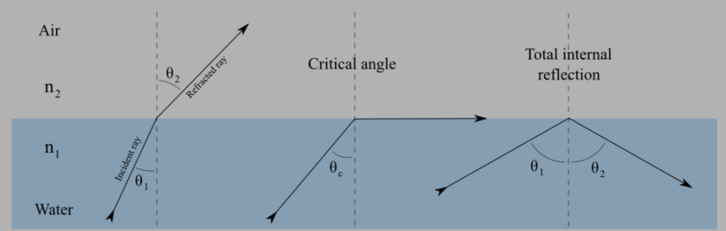

Slide 48
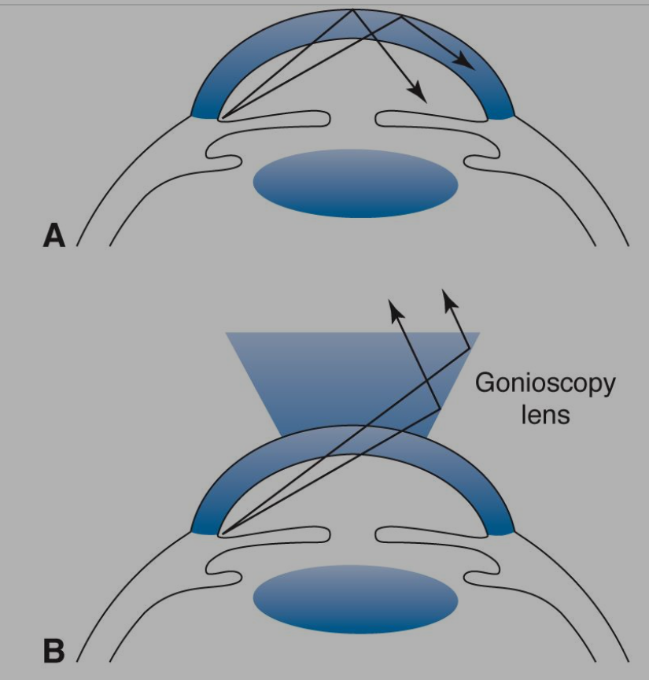

Slide 49
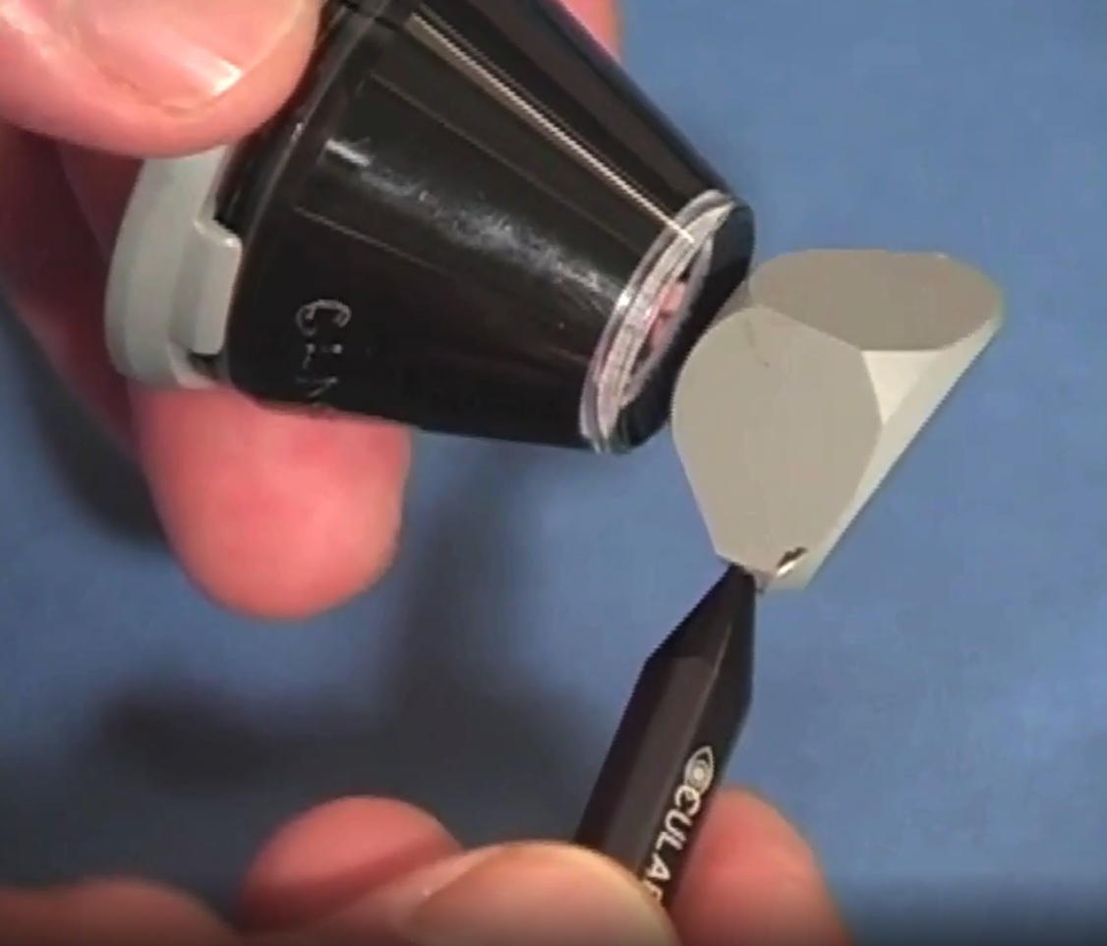
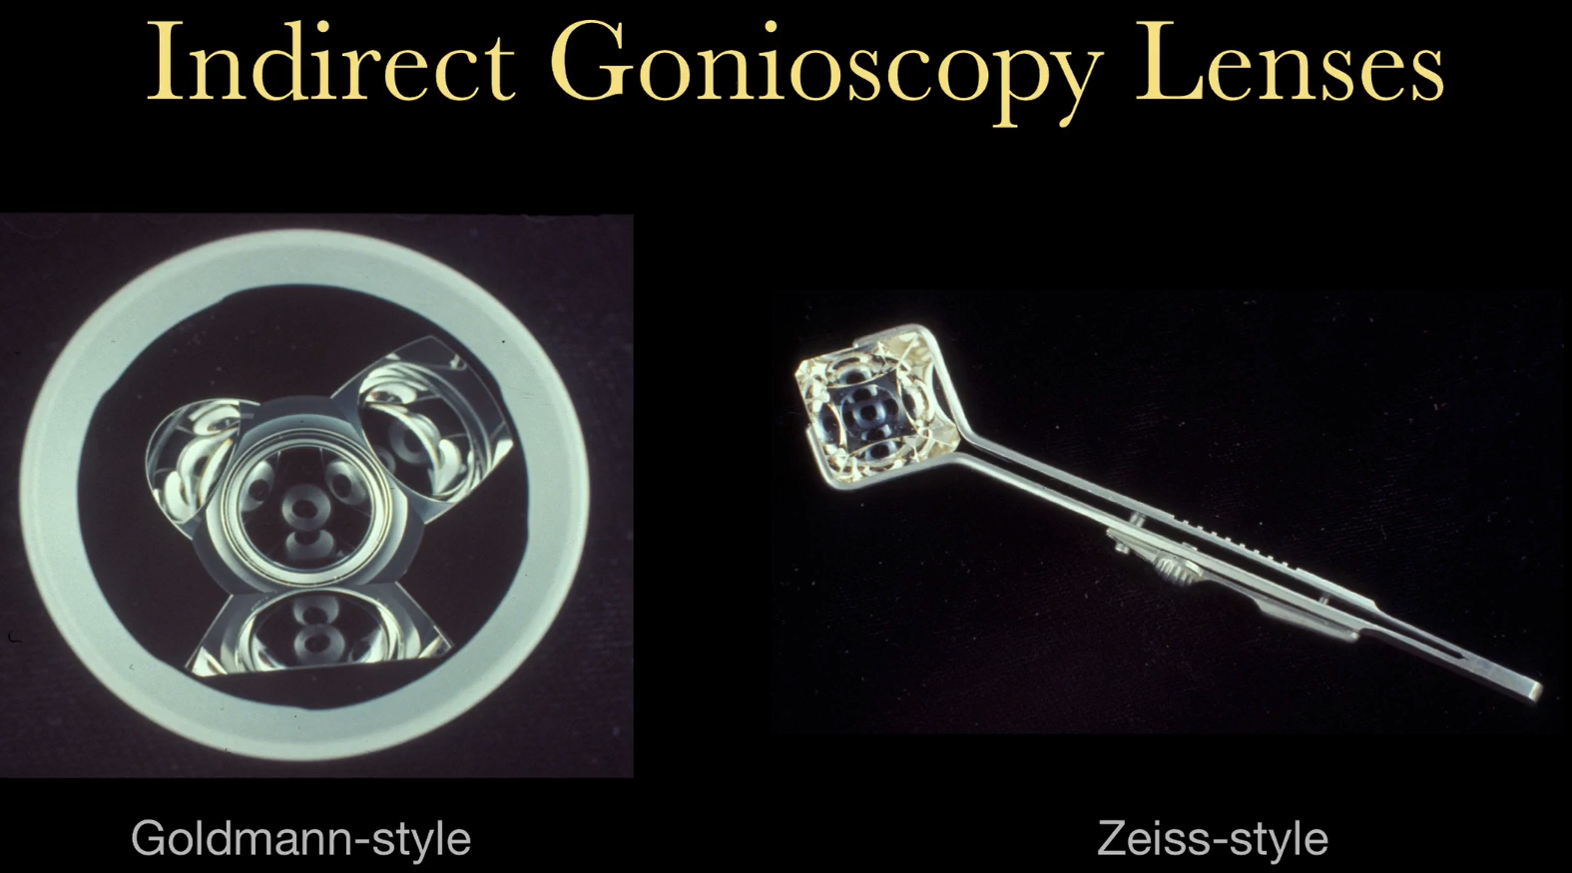

Slide 51
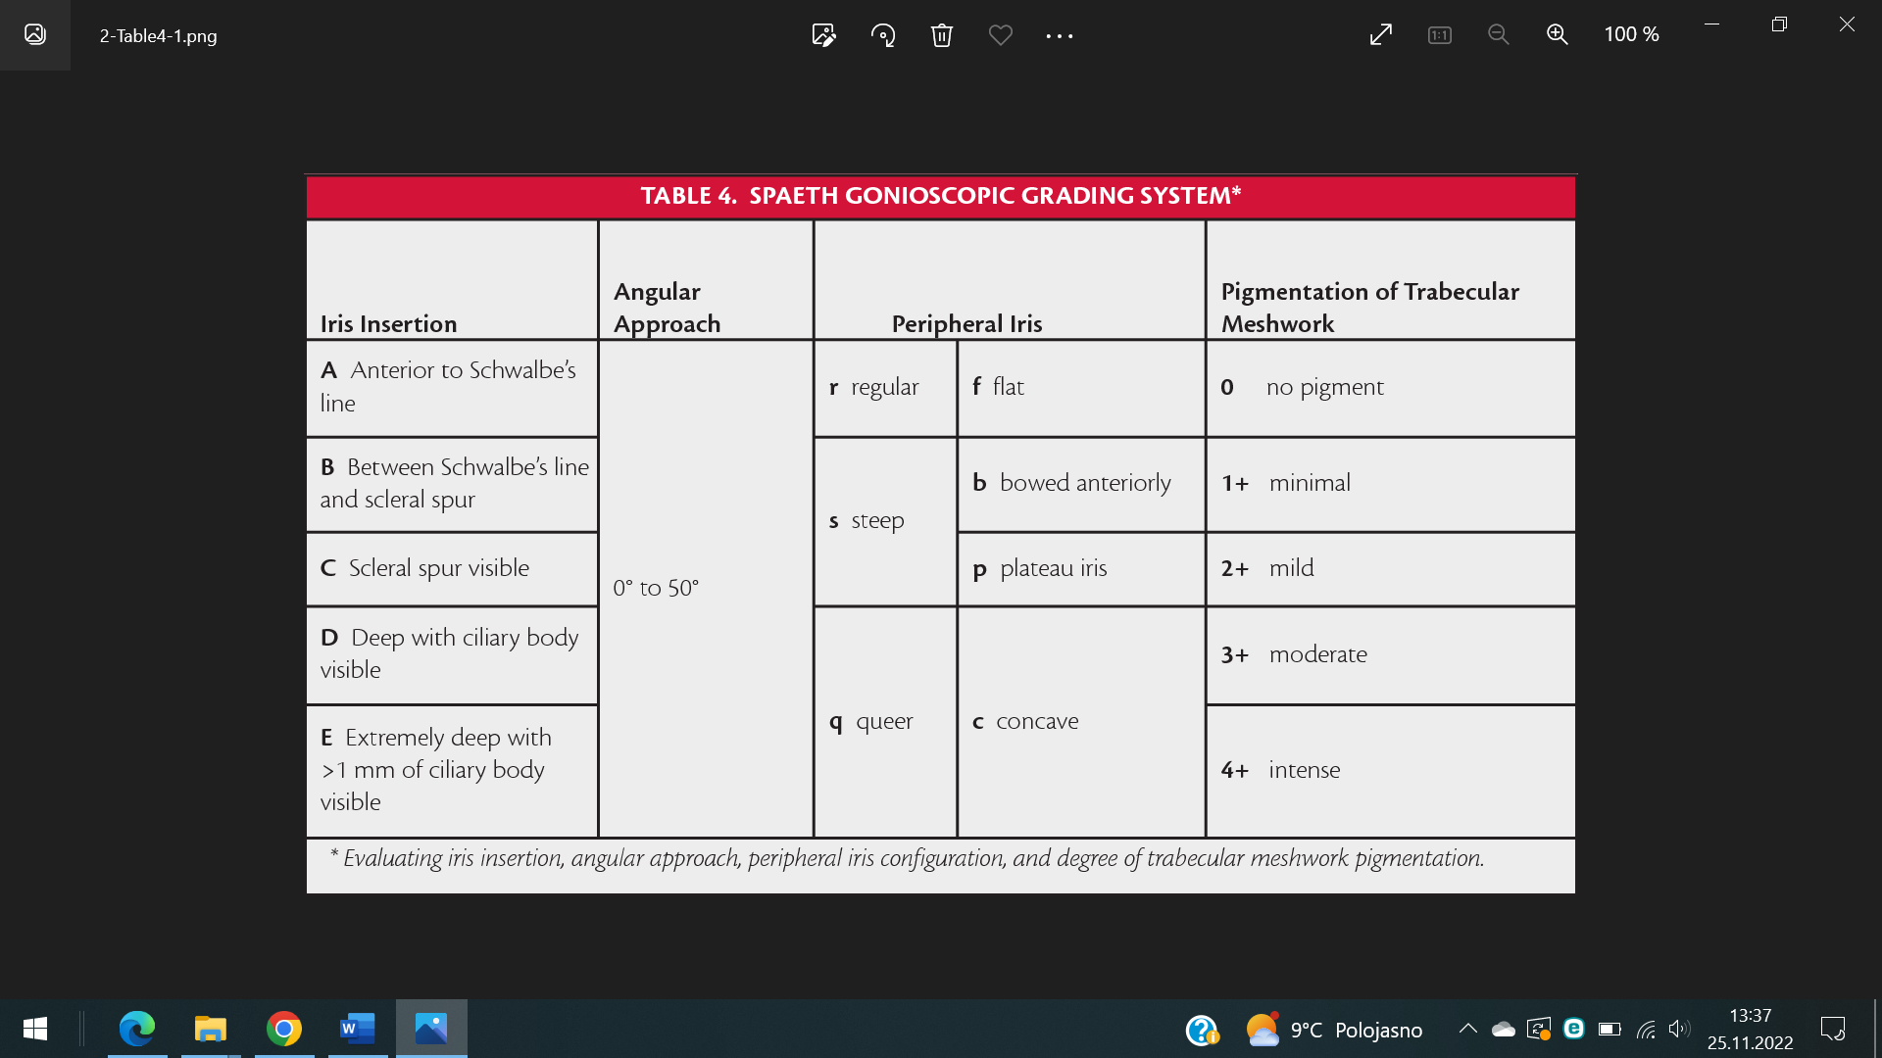
Spaeth grading system

Slide 52
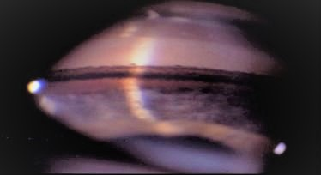
Pigmentary glaucoma: E60c 4+ ptm
CB

Slide 53
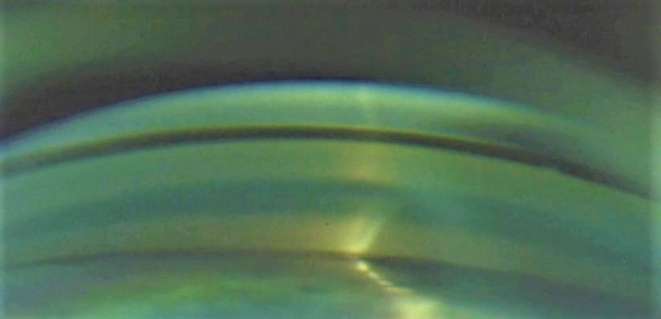

Slide 54
IOP MEASUREMENT - „NORMAL“ IOP?
in the general population of Europe: approximately 15.5 mm Hg, with a standard deviation of 2.6 mm Hg
Circadian variation: IOP varies by 2–6 mm Hg over a 24-hour period, peak is indvidual, often in the morning
High IOP is often first sign of glaucoma
factors that may increase intraocular pressure:
  Playing a wind instrument, Valsalva maneuver, Blepharospasm, Corticosteroids…
Factors that may decrease intraocular pressure
  Pregnancy, alcohol, cannabis, aerobic exercise…

Slide 55

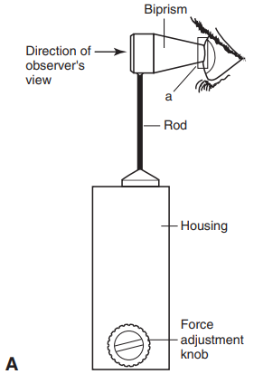
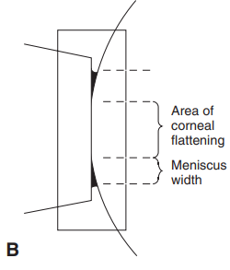
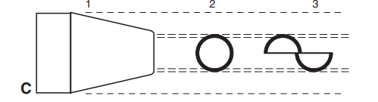
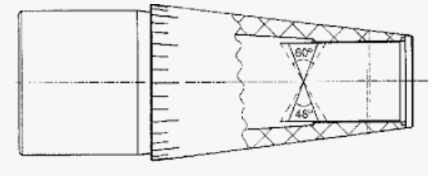
IOP measurement
Goldmann applanation tonometer
  the most widely used method
  Imbert-Fick principle: pressure inside an ideal dry, thin-walled sphere equals the force necessary to flatten its surface divided by the area of the flattening
  Circular menisus is converted into 2 semicircles by the prism

Slide 56
Aplanation tonometry - video
https://www.youtube.com/watch?v=KOHe9wzM4ns&embeds_euri=https%3A%2F%2Fhubblecontent.osi.office.net%2F&source_ve_path=MjM4NTE&feature=emb_title&ab_channel=EyeDoc

Slide 57
IOP measurement
Noncontact (air-puff) tonometers
  measuring the force of air required to indent the cornea to a fixed point
  Pachymetry
  Corneal hysteresis
  Advantage: no risk of infection, no need of local anesthaesia
  Disadvantage: less accurate
Schiøtz tonometry
  The amount of indentation is read on a linear scale on the instrument and converted to mm Hg by a calibration table
  Due to a number of practical and theoretical problems, Schiøtz tonometry is now rarely used in the developed world.

Slide 58
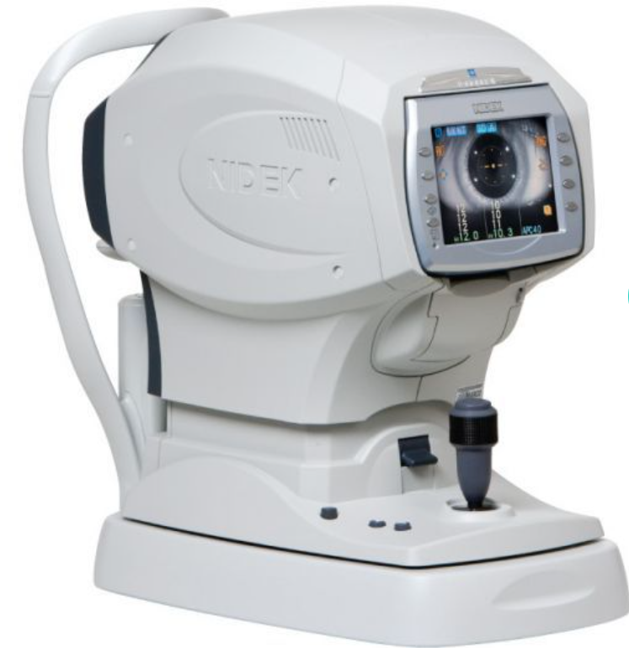
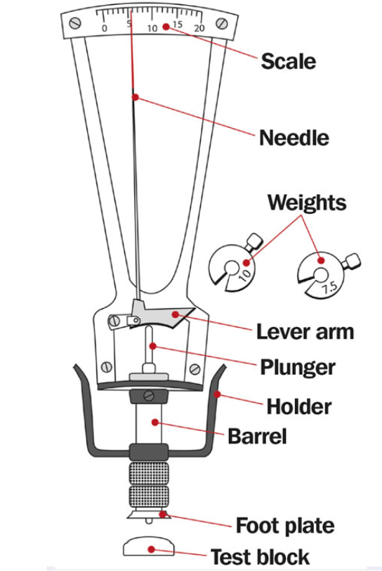

Slide 59
Perimetry
Kinetic perimetry
  Older method, still used in terminal cases
Static (computer) perimetry
  More accurare
  Absolute/relative scotomas
  Usually takes several tries to learn
  Indicates false positive, false negative responses and fixation loss
  Special glucoma indexes and evaluation (GHT, MD..) to map the progression

Slide 60
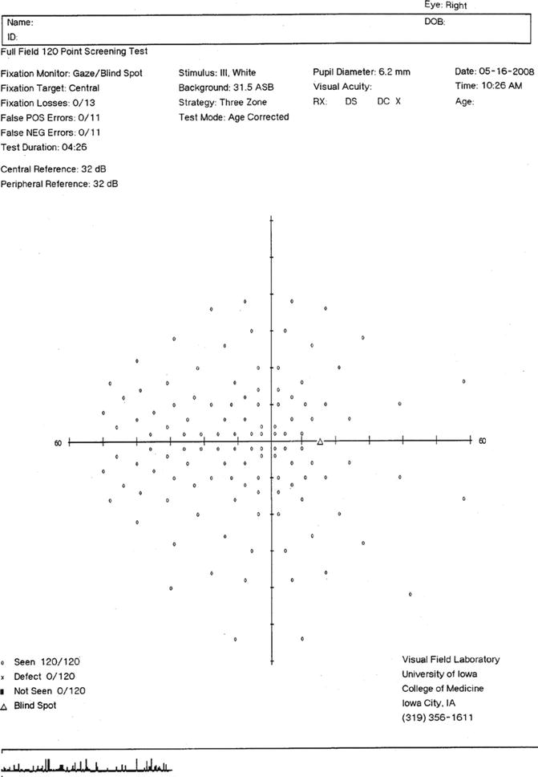
OD full field
120p

Slide 61
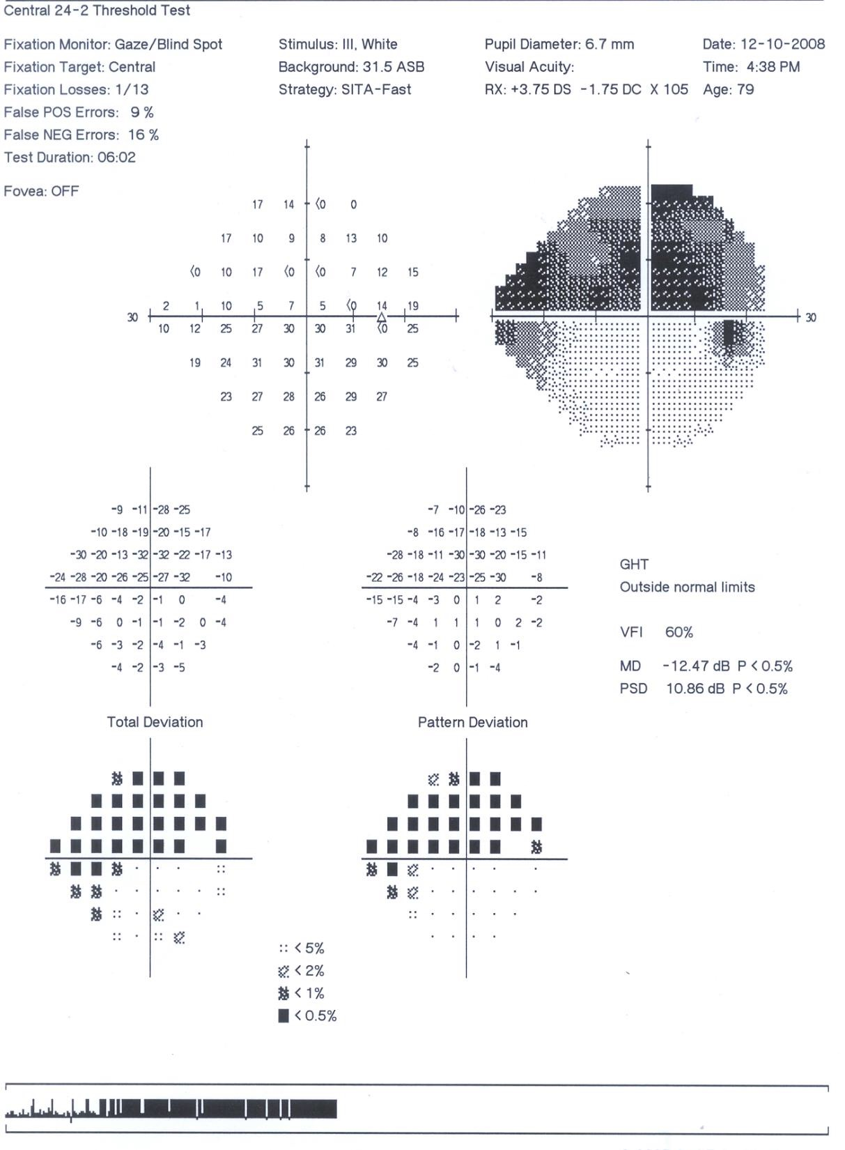
OD threshold
24-2
BLIND SPOT
RELATIVE SCOTOMA
ABSOLUTE SCOTOMA
NORMAL SENSITIVITY

Slide 62


Slide 63


Imaging

Slide 64


Slide 65
Part 6: Therapy

Slide 66
Therapy = lowering IOP
Pharmacotherapy
  Antiglaucomatics
  Neuroprotectin (Citikolin)
Surgery
Laser therapy
Therapy selection depends on glaucoma type:
Open angle
  Pharmacotherapy
  Surgery
Angle closure
  Surgery
  Pharmacotherapy (pilocarpine)

Slide 67
Antiglaucomatics
For local use
  Monotherapy/combined therapy (up to 4)
For systemic use
  Carbonanhydrase inhibitors
    decrease of aqueous humor production
    CI: kidney/liver failure, gravidity
  Osmotics
    Vitreuous dehydratation – leads to retraction of iridocorneal diaphragma backwards – anterior chambre deepening)
    CI: heart/kidney failure

Slide 68
Antiglaucomatics
Prostaglandins
  Drug of first choice
  Used once a day (evening), long effect, best compliance, 30% IOP decrease
  Mechanism – higher outflow through uveoscleral pathway
  Contraindication: inflamation, surgery…

Slide 69
Antiglaucomatics
Beta-blockers (nonselective)
  Mechanism: decrease of aqueous humor production (vasoconstriction – beta 1 and 2 rcp)
  Contraindications: arrhythmia, COPD, AB
  1-0-1
Beta-1 selective betablockers

Slide 70
Antiglaucomatics
Alpha-2 selective agonists
  decrease of aqueous humor production (vasoconstriction in ciliary body), increase of uveoscleral outflow
  CI: IMAO use, children

Slide 71
Antiglaucomatics
Parasymphatomimetics (pilokarpine)
  Increase of a.h. outflow by contracting ciliary body
  Increase of a.h. outflow by „angle opening“ (miosis)
  CI: uveitis, bradycardia, hypotension, recent heart attack, gastrintestinal ulcers, epilepsy, parkinson disease

Slide 72
Antiglaucomatics
Carboanhydrase inhibitors
  decrease of aqueous humor production (CA is an enzyme in ciliary body processes)
  CI: cornea diseases (endothelial cells decrease)

Slide 73
Antiglaucomatics
RHO kinase inhibitors
  New drugs, targeting TM
  Unavailable in CZ

Slide 74
LASER THERAPY
LASER IRIDOTOMY

Slide 75

Laser trabeculoplasty
Argon laser
50-100 strikes into the trabeculum in order to make it more permeable for a.h.
  A space between the strikes is left intact so it opens a little

Slide 76

Cyclophotocoagulation
a laser procedure that helps lower the eye pressure by targeting the part of the eye that produces fluid (ciliary processes)
  Destroying part of the ciliary body by laser coagulation
  Transscleral apliccation of laser beam
  Indicated in most advanced cases with poor prognosis of vision
Cyclocryocoagulation
  Even stronger
Retrobulbar alcohol application
  Terminal cases

Slide 77


Slide 78
Cyklocryocoagulation - video
https://www.youtube.com/watch?v=D5CRcJO3U9M

Slide 79


Surgery
Classical filtration surgery
  Trabeculectomy
  Filtration implants
  Deep sclerectomy (non penetrating)
MIGS
  High safety profile
  Minimal disruption of normal anatomy
  Ab interno approach

Slide 80


Trabeculectomy
Main goal is to make arteficial pathway for the a.h. outside of the eye

Slide 81


Express implant

Slide 82
Express implant - video
https://www.youtube.com/watch?v=Eay9oxuCosM&ab_channel=Dr.Adri%C3%A1nHern%C3%A1ndezMart%C3%ADnez

Slide 83

MIGS – Xen implant

Slide 84

MIGS – Preserflo implant

Slide 85
Part 7: glaucoma essentials

Slide 86
GLAUCOMA ESSENTIALS
Glaucoma ≠ elevated IOP!!
BUT, glaucoma is usually associated with high IOP (x normal tension glaucoma)
Late symptoms onset
Affects 60.5 million people worldwide

Slide 87
GLAUCOMA ESSENTIALS
accounts for 8% of all cases of blindness and is the leading cause of irreversible blindness worldwide
Early detection is essential
  Educate patients with positive
  family history

Slide 88
GLAUCOMA ESSENTIALS

Slide 89
Thank you

