Slide 1
Anaphylaxis
Pavel Suk

Slide 2
Definition
serious allergic reaction with rapid onset (minutes to hours)
diagnosis is mainly clinical
trigger - local anestetics
  esters (high allergenic potential)
  amids (safer)

Slide 3
Pathophysiology
massive release of histamine (+other mediators) from mast cells and basophils
activation:
  specific IgE depenent = true anaphylactic reaction
  other immunologic pathways
  non-immunologic (opiods, exercise, …)
  idiopathic
histamin effects
  contraction of smooth muscles
  vasodilation, capillary leakage (oedema)
  myocardial depression

Slide 4
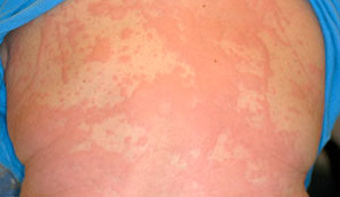
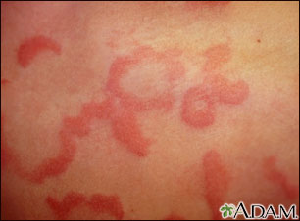
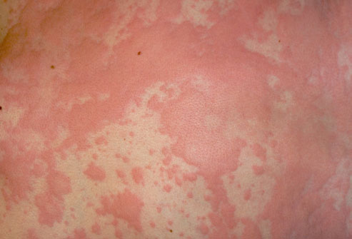
Skin
Hives (utricaria)
Flushing
Itching
absent in 20 % cases

Slide 5
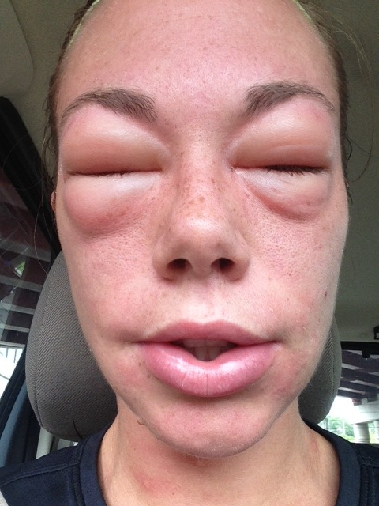
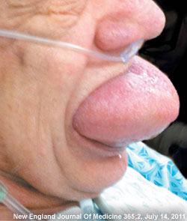
Facial swelling
eyelids / lips /
tongue / uvula

Slide 6
Systemic symptoms
respiratory (up to 70 %)
  tachypnoea
  wheezes
  stridor
  hypoxia
  nasal discharge
  voice change
  throat closure

Slide 7
Systemic symptoms
cardiovascular (up to 50% cases)
  tachycardia
  hypotension
  dizziness
  syncope (hypotonia)
  incontinence
gastrointestinal (up to 50% cases)
  crampy abdominal pain
  nausea/vomiting
  diarhoea

Slide 8
Biphasis course
  reccurence of symptoms within 10 (up to 72) hours

Slide 9
Risk factors
concomitant medication
  alpha and beta-blocker – resistence to treatment
  ACE-I – more severe hypotension
  antihistamines – mimicked symptoms
comorbidities
  astma – increased incidence
  COPD, severe pulmonary desease
  cardiovascular disease - severe course
  acute infection (respiratory)

Slide 10

Treatment
remove antigen
call for help
oxygen
supine/semi-recumbent postion with eleveted lower limbs

Slide 11
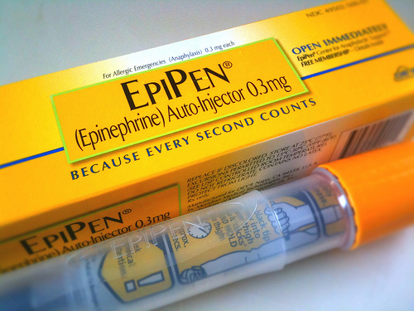
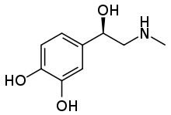
Epinephrine
decreases histaminerelease from mast cells
intramuscular (thigh)
dose 0.3 to 0.5 mg
0.01 mg/kg for children
may be repeated in 10-15 min intervals

Slide 12
Other drugs
H1/H2 antihistamines
  relieve itching and hives
  do not improve other symptoms
glucocorticoids
  effects onset in hours
  methylprednisone 1-2 mg/kg IV
bronchodilators (salbutamol, …)
  adrenaline has strong BDL effect
IV fluids

Slide 13
Follow-up
observation 4-8 hours
  with risk factors longer (> 12 hours)
lab diagnostics - serum tryptase
  ideally within 3 hours from symptoms onset
pathogen identification
  specific IgE
  skin testing
Epipen for high-risk patients

