Slide 1
Race and Slavery
Rasa a otroctví

Slide 2
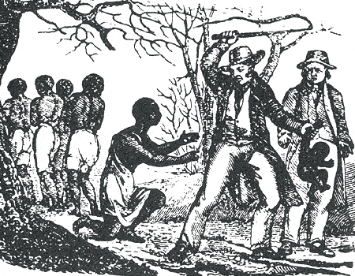
three “eras”
slavery, 1619-1865
“Jim Crow”, 1865-1965
integration, 1965-

Slide 3
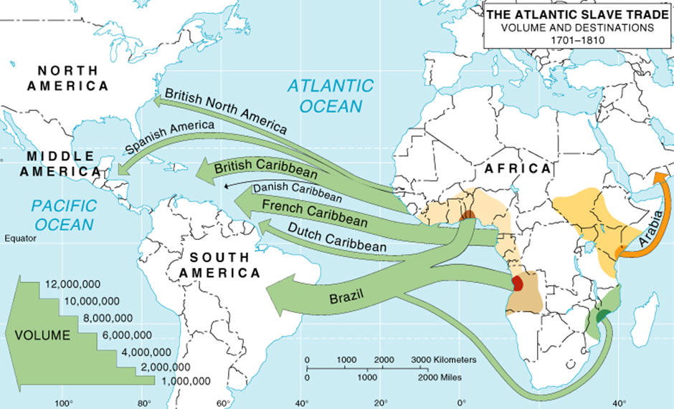

Slide 4
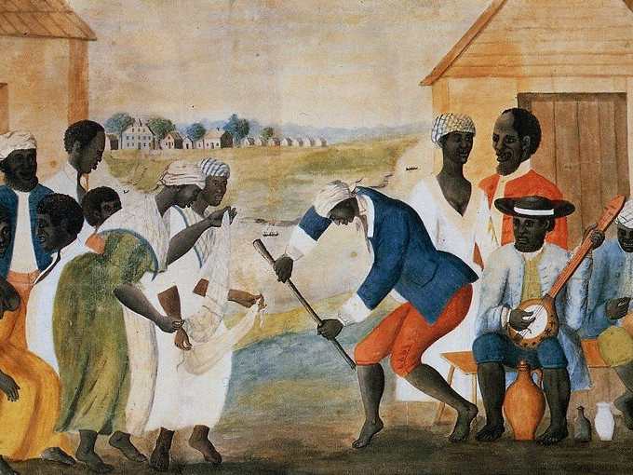
wedding? unknown artist, about 1700

Slide 5
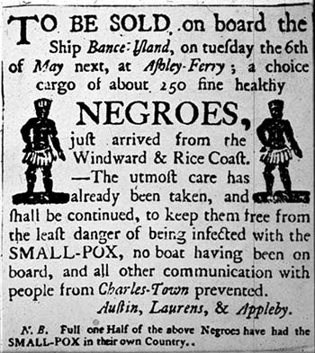

Slide 6
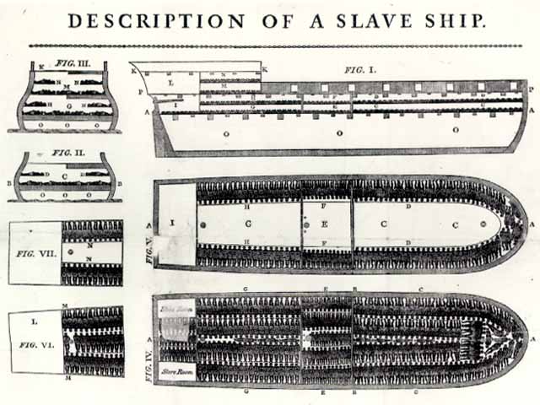

Slide 7
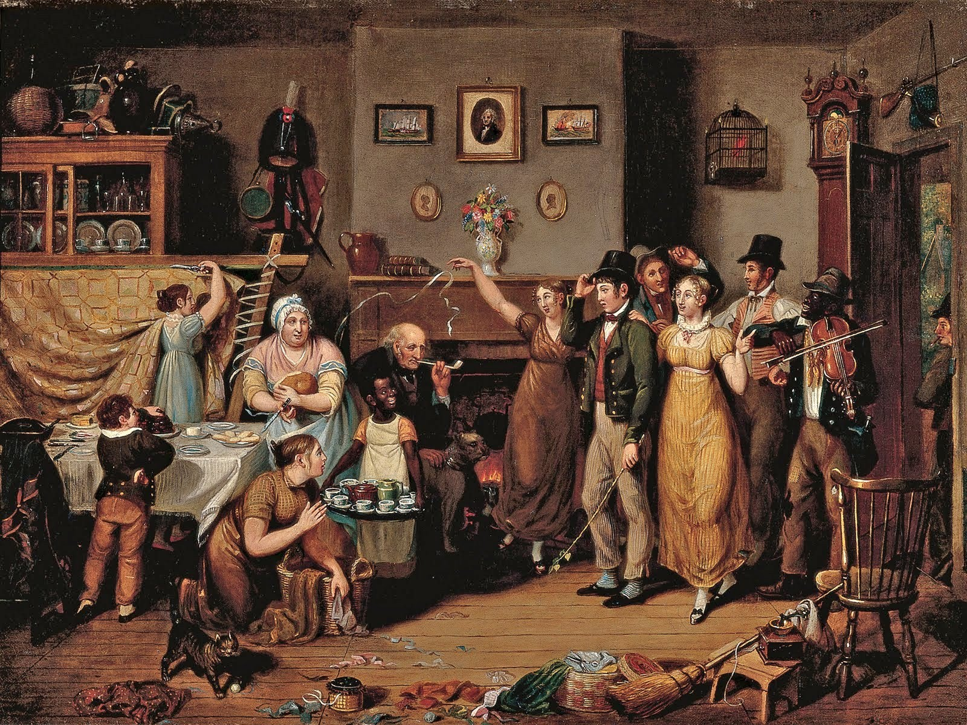
John Lewis Krimmel, Quilting Frolic, 1813 (prošívaná pokrývka)

Slide 8
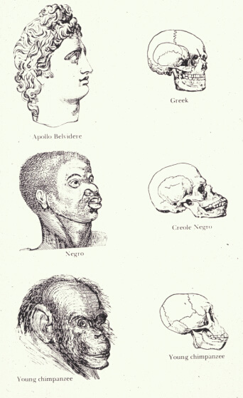
“scientific” racism
Dr. Samuel Cartwright of Louisiana attributed slave misconduct to a disease, Dysaesthesia Aethiopica, which others simply called “rascality.” Cartwright insisted that this disease caused slaves to misbehave, and the “malady” also brought about “stupidness of the mind and insensibility of the nerves.” The doctor said this disease resulted from poor sleeping habits. All blacks, he argued, slept with their heads under the covers, forcing them to breathe “warm, impure air, loaded with carbonic acid and acqueous vapor.” According to Cartwright, this habit resulted in the “improper atmospherization of the blood” that led to a lethargy that provided “one of the heaviest chains that binds the Negro to slavery.”

Slide 9
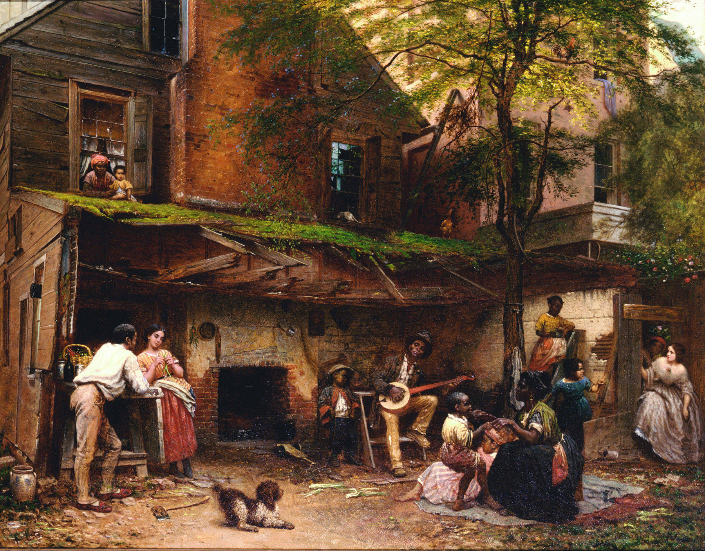
Eastman Johnson, Negro Life in the South (Kentucky Home), 1859

Slide 10
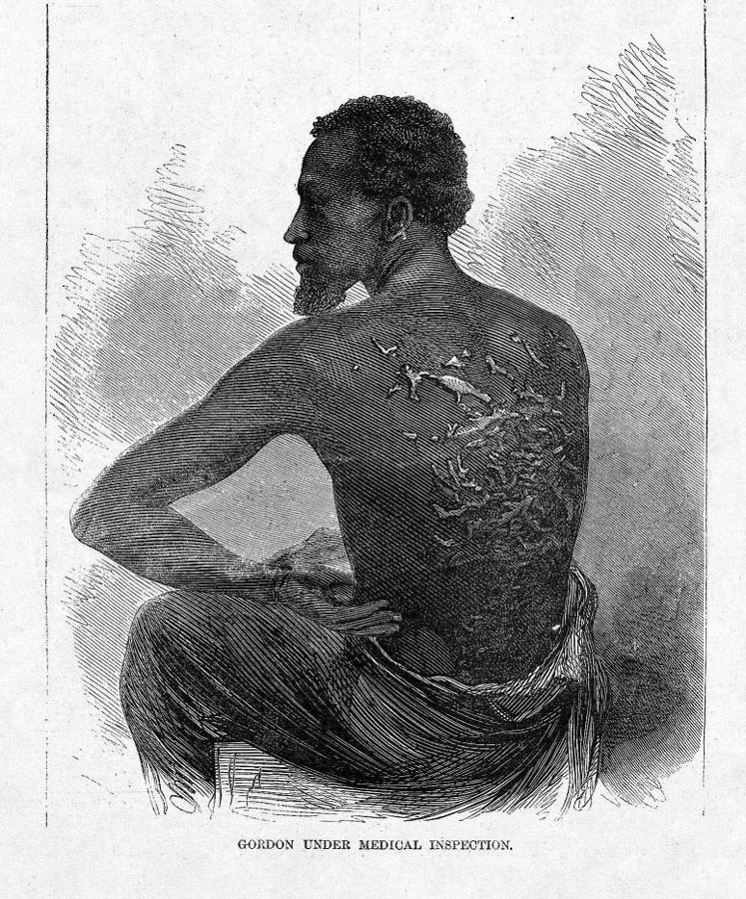
in 1972, historian John Blassingame (who was black) published The Slave Community, the first real effort by an historian to look at slavery through the slaves' eyes. Understandably, the book was highly controversial. Blassingame suggested three types of slave: "Nat," the slave who never accepted being a slave, and constantly fought back or ran away (maybe 5% of all slaves); "Jack," who never really accepted slavery, but pretended to in order to survive (90%), and "Sambo," who was brainwashed by slavery and really did believe he was inferior (5%). Blassingame suggested - and was violently criticized for it - that the "Sambo" mentality still survives today among some (mostly elderly) blacks, and also that the "Jack" mentality is very common today: most African-Americans will talk and behave in one way around other blacks, and entirely differently when dealing with whites.

Slide 11
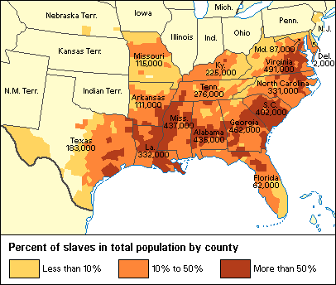

Slide 12
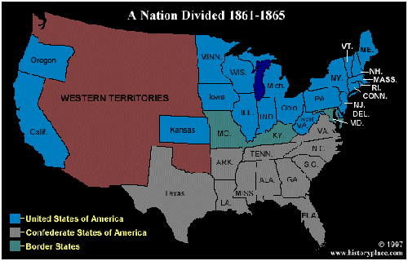

Slide 13
Thirteenth Amendment:
The Thirteenth Amendment officially abolished slavery, with limited exceptions regarding criminal punishment. Before it was ratified, slavery was still legal in Delaware, Kentucky, Missouri, Maryland and New Jersey. All other states had fallen under the jurisdiction of the Emancipation Proclamation. The Amendment, ratified December 6, 1865 states:
"Section 1. Neither slavery nor involuntary servitude, except as a punishment for crime where of the party shall have been duly convicted, shall exist within the United States, or any place subject to their jurisdiction.
Section 2. Congress shall have the power to enforce this article by appropriate legislation."

Slide 14
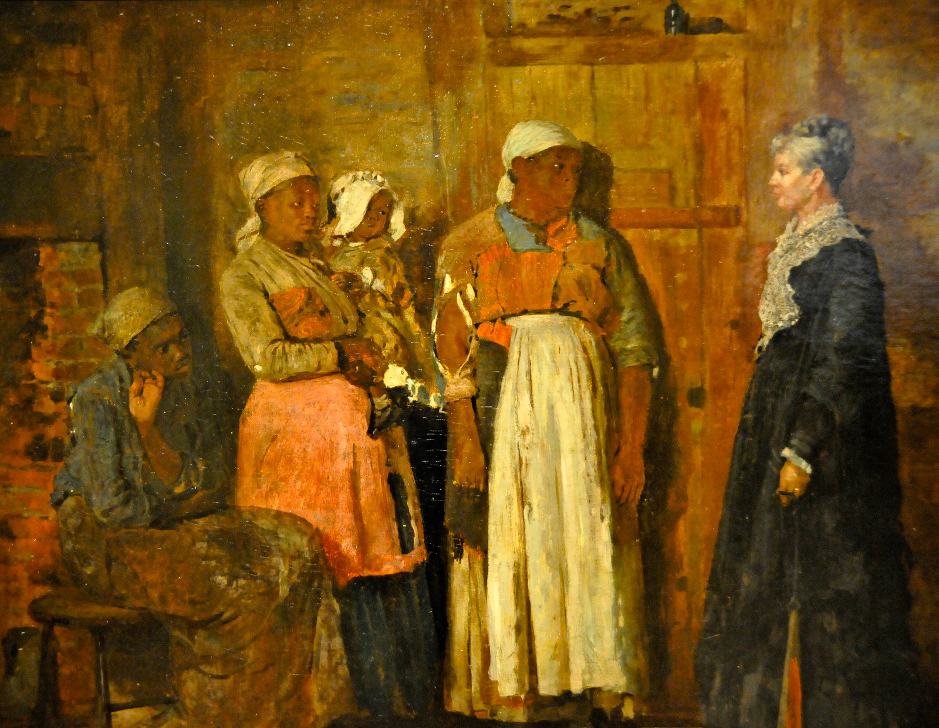
Winslow Homer, A Visit from the Old Mistress, 1876

Slide 15
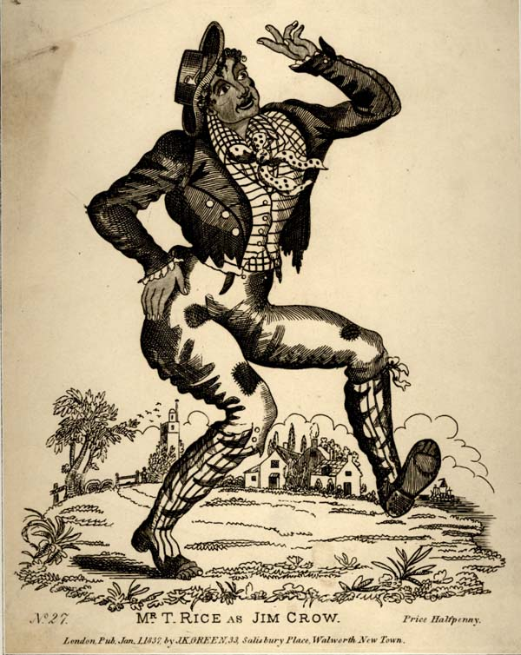
“Jim Crow”
Jim Crow laws, or Jim Crow for short, maintained racial segregation in the South beginning in the late 1800s. Under Jim Crow, whites and blacks drank from different water fountains, used different restrooms and sat separately on public transportation and in restaurants. Jim Crow owes its name to a 19th century minstrel song called “Jump Jim Crow,” popularized by a minstrel performer named Thomas “Daddy” Rice who appeared in blackface.

Slide 16
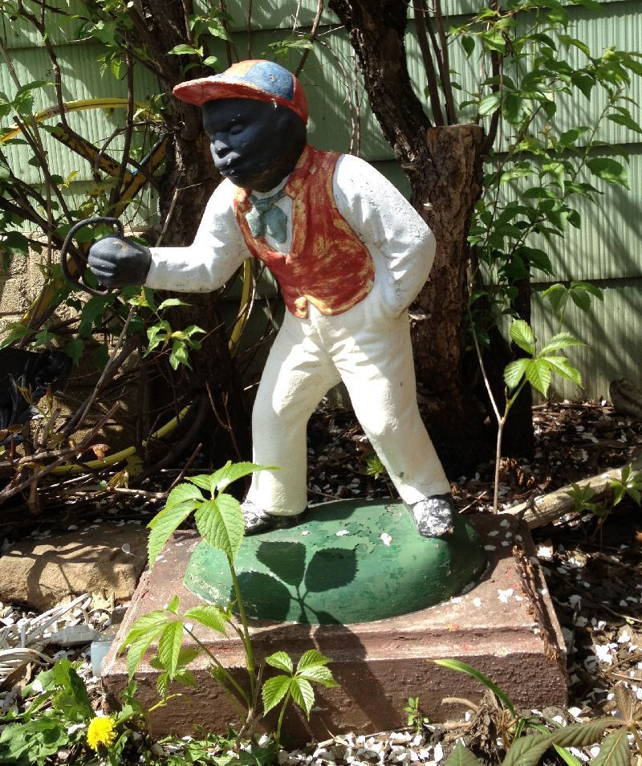
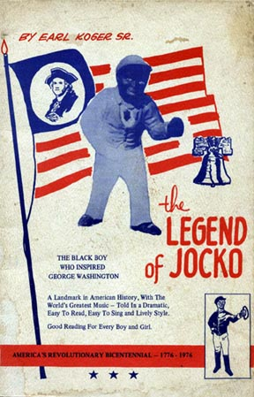
“lawn nigger”

Slide 17
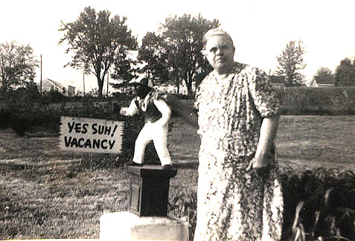
Aunt Minnie, about 1940

Slide 18
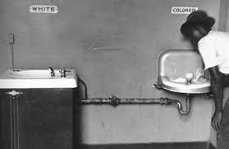

Slide 19
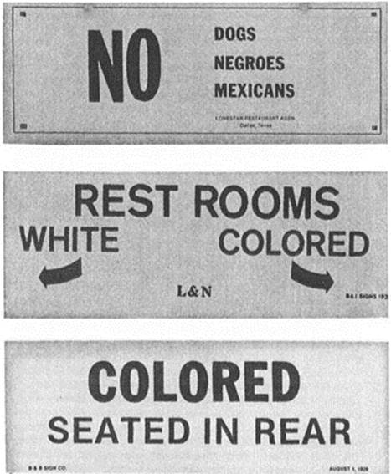

Slide 20
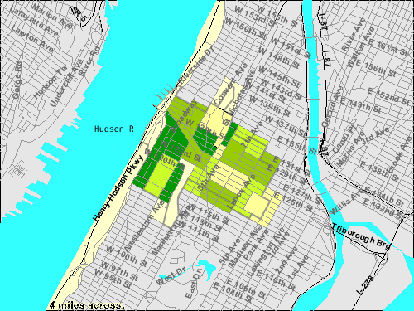
Harlem renaissance – 1920s

Slide 21
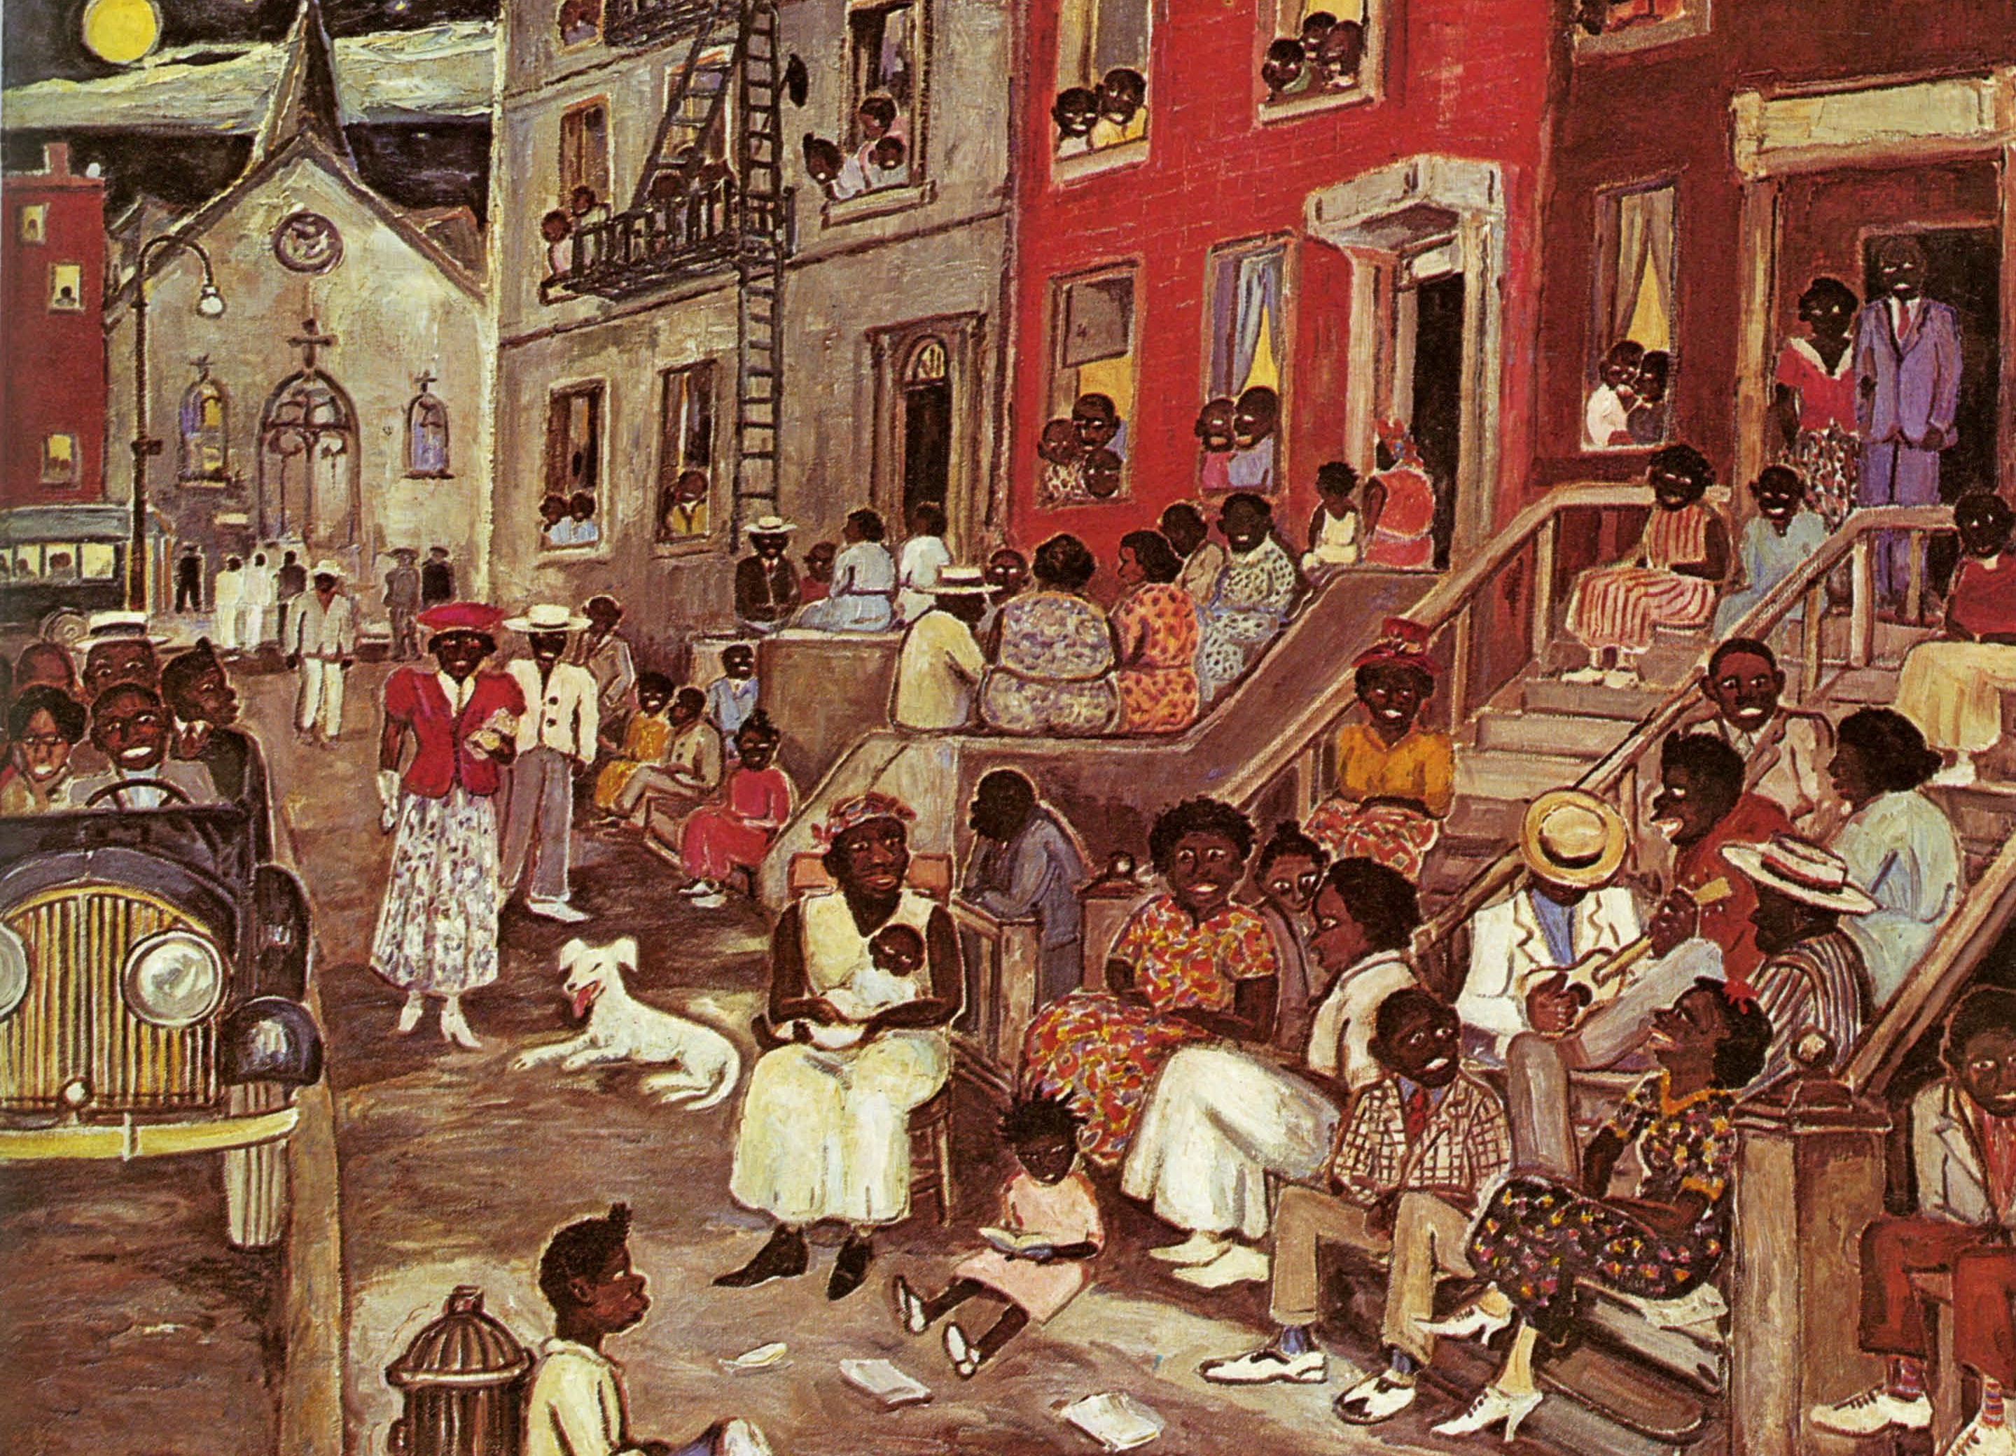
Palmer Hayden, Midsummer Night in Harlem, 1936

Slide 22
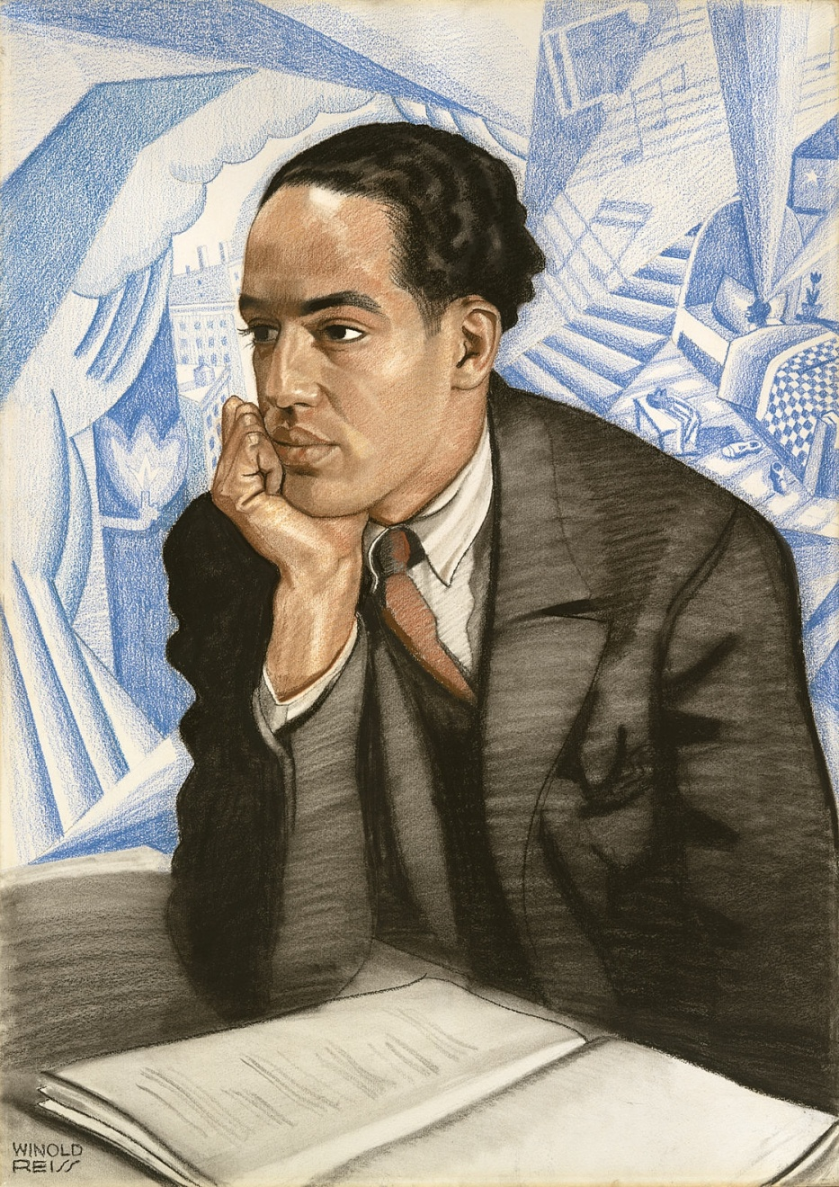
Winold Reiss, Portrait of Langston Hughes, c. 1925
Langston Hughes was born on February 1, 1902, in Joplin, Missouri. He published his first poem in 1921. He attended Columbia University, but left after one year to travel. His poetry was later promoted by Vachel Lindsay, and Hughes published his first book in 1926. He went on to write countless works of poetry, prose and plays, as well as a popular column for the Chicago Defender. He died on May 22, 1967.

Slide 23
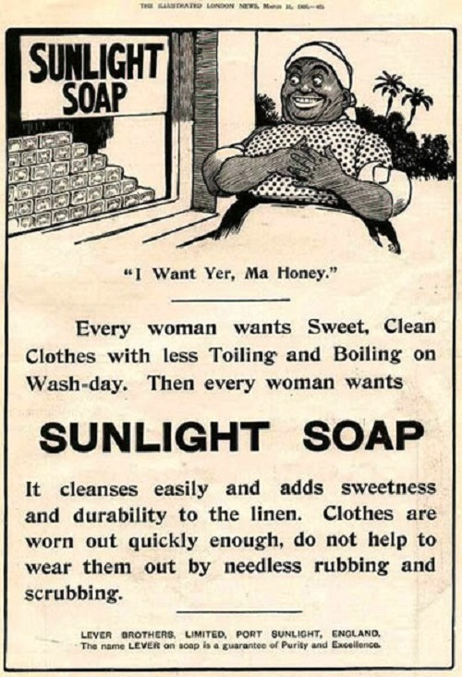

Slide 24
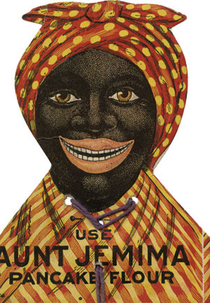
Aunt Jemima
In 1890, a former slave named Nancy Green was hired to be the spokesperson for Aunt Jemima brand food products. Nancy Green was born into slavery in 1834 in Montgomery County, Kentucky. In 1889 the creators of Aunt Jemima, Charles Rutt and Charles Underwood, sold the company to R.T Davis, who soon found Nancy Green in Chicago. The previous owners had already agreed upon her ‘look’ of a bandana and apron. Davis combined the Aunt Jemima look with a catchy tune from the Vaudeville circuit to make the Aunt Jemima brand.
Green’s identity was first uncovered at the Worlds’ Columbian Exposition in 1893. There were so many people interested in the Aunt Jemima exhibit, police were called for crowd control. Green served pancakes to thousands of people. People loved her warm personality and friendly demeanor, not to mention her cooking. Green was given an award for showmanship at the exposition. As a result of her dedication, Aunt Jemima received 50,000 orders for pancake mix. Not only did flour sales soar, but Green received a lifetime contract to serve as spokesperson. She was a living legend of the brand until she died in a car accident in September 1923.

Slide 25
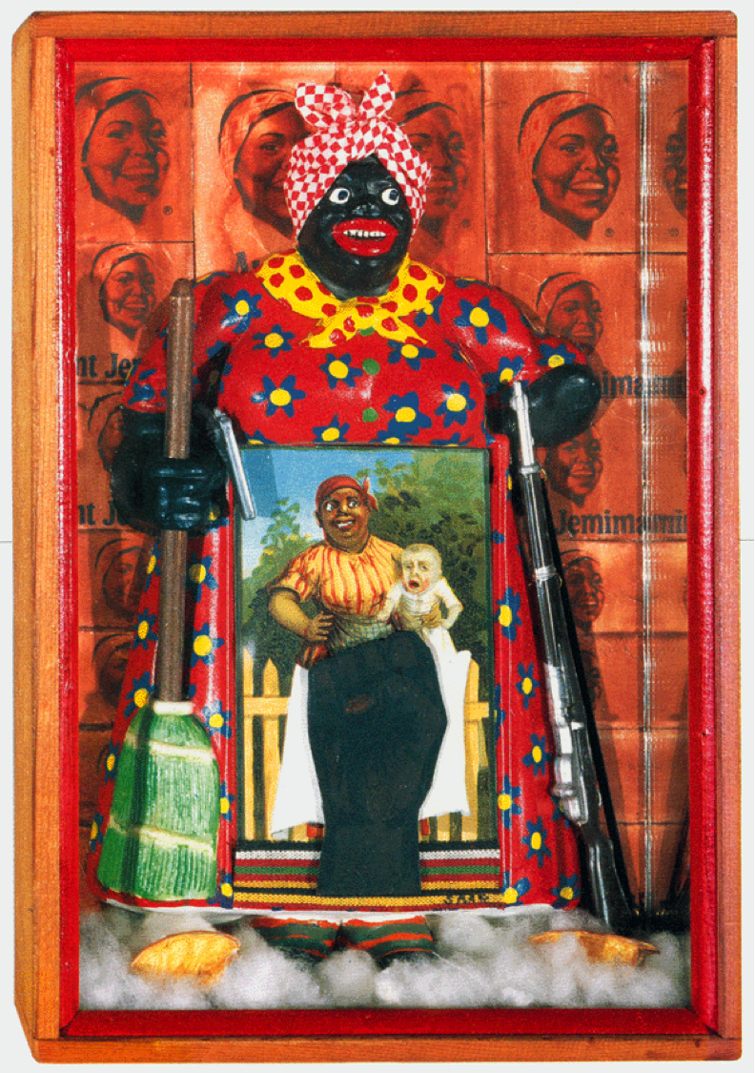
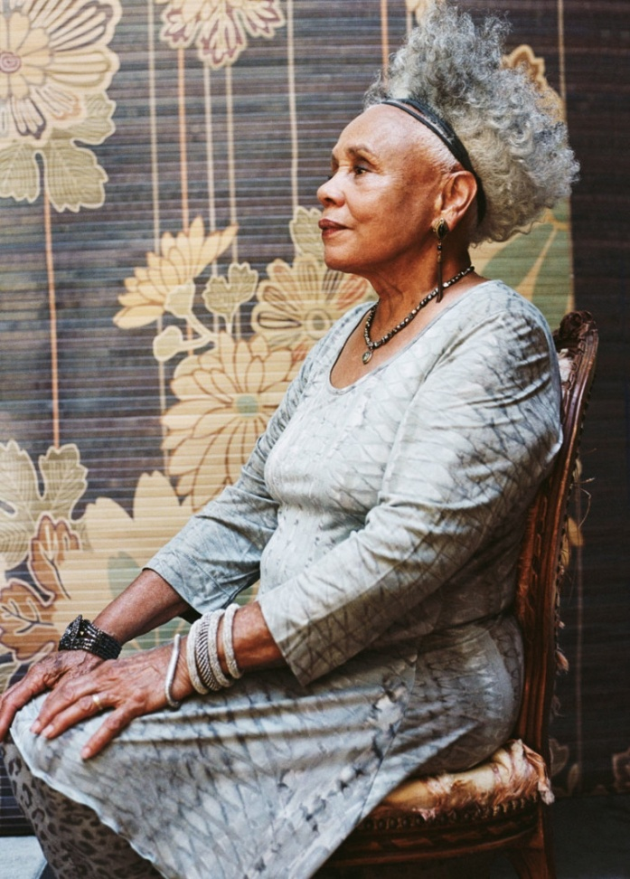
Betye Saar, The Liberation of Aunt Jemima, 1972

Slide 26
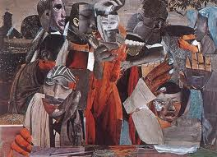
The Prevalence of Ritual: Baptism, 1964, Romare Bearden

Slide 27
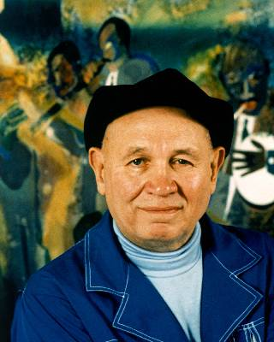
Romare Bearden
1911-1988
Recognized as one of the most creative and original visual artists of the twentieth century, Romare Bearden had a prolific and distinguished career. He experimented with many different mediums and artistic styles, but is best known for his richly textured collages, two of which appeared on the covers of Fortune and Time magazines, in 1968. An innovative artist with diverse interests, Bearden also designed costumes and sets for the Alvin Ailey American Dance Theater, and programs, sets and designs for Nanette Bearden's Contemporary Dance Theatre.

Slide 28
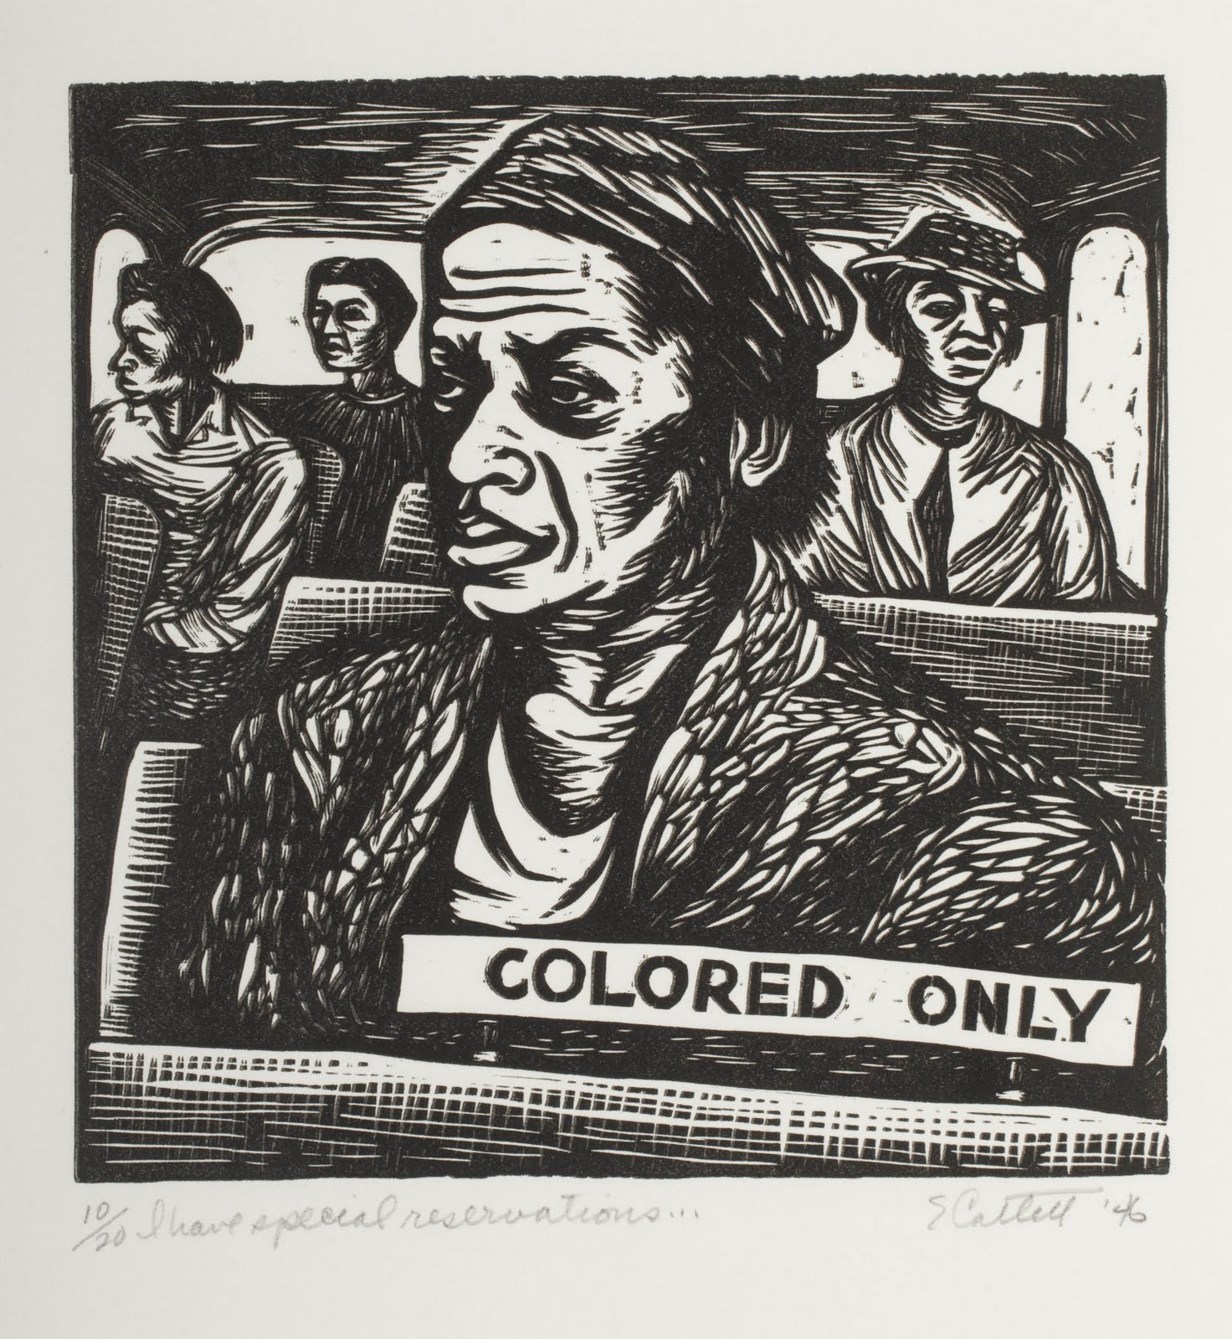
“Colored Only,” 1946
Elizabeth Catlett 1915-2012
Washington Post obituary:
Although she had lived in Mexico since 1946, Ms. Catlett was one of the few remaining links to the Harlem Renaissance of the 1920s and 1930s. Her friends included such storied African American thinkers and artists as W.E.B. Du Bois, Langston Hughes, Paul Robeson, Thurgood Marshall and Jacob Lawrence.
“I have always wanted my art to service black people — to reflect us, to relate to us, to stimulate us, to make us aware of our potential,” Ms. Catlett told author Samella Lewis in her 1978 book “Art: African American.”
For years, Ms. Catlett was denied entry to the United States because of suspected Communist sympathies, and her art was seldom seen in the land of her birth. Yet, in the past 25 years, her prints and sculptures have been exhibited worldwide and have entered the collections of major museums, including the Smithsonian American Art Museum, the Museum of Modern Art and the Metropolitan Museum of Art in New York, and the Baltimore Museum of Art.

Slide 29
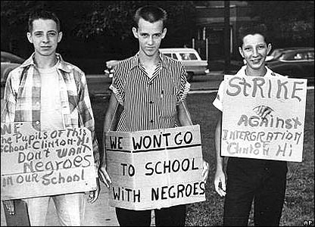
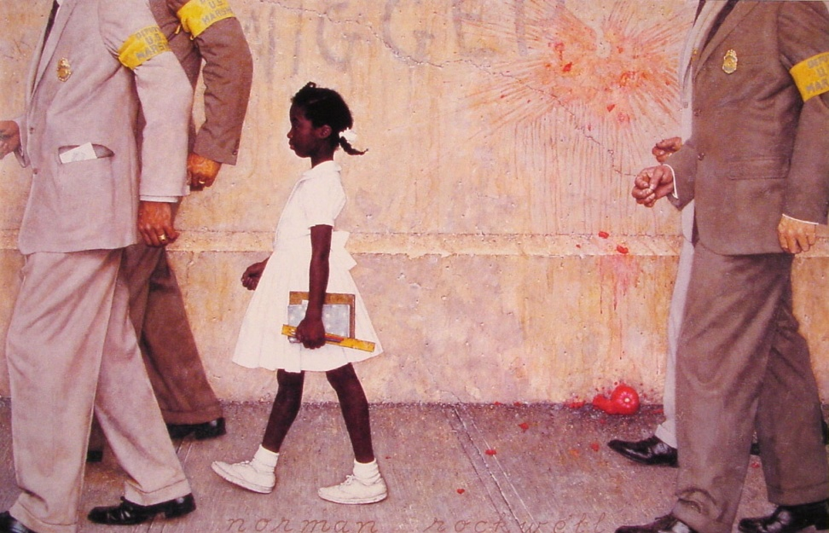
civil rights movement
Little Rock, 1957
Norman Rockwell, The Problem We all Live With (1935)

Slide 30
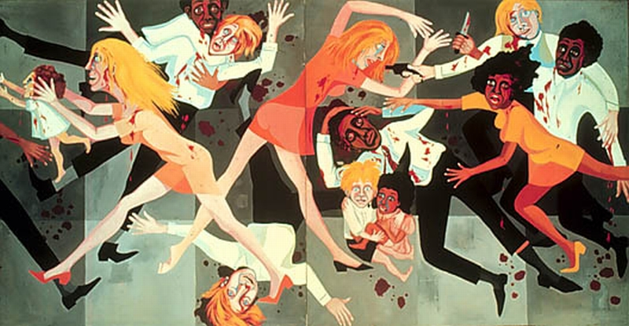
Faith Ringgold, Die, 1967

Slide 31

post-racial America?

Slide 32
