Slide 1
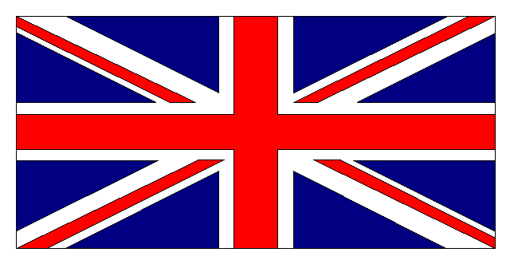
HOLIDAYS – THE UNITED KINGDOM
2015
* National holiday

Slide 2
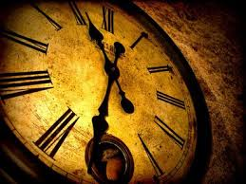
...a little bit of history
The Bank Holidays Act in 1871 established the first bank holidays in the United Kingdom - four in England, Wales and Ireland (then wholly part of the UK), and five in Scotland. (Liberal MP John Lubbock was the man who suggested it to the Parliament.)
England, Wales and Northern Ireland
Easter Monday
Whit Monday (which could fall anywhere between 11 May and 14 June)
The first Monday in August (later changed to the last Monday)
Boxing Day (26th December)
Scotland
New Year's Day
Good Friday
The first Monday in May
The first Monday in August
Christmas Day

Slide 3
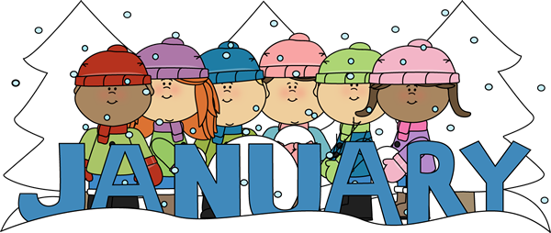
January 01 New Years Day *
first Monday in January if 1st is Saturday or Sunday
January 02 Day after New Years Day Scotland only

Slide 4

February 14 St.Valentine´s Day
February 17 Pancake Day
Shrove Tuesday

Slide 5
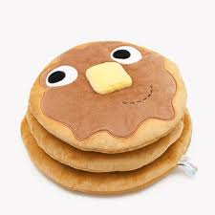
Pancake Day
Lent - During the 40 days before Easter, Roman Catholics are supposed to abstain from all bodily pleasures, including the consumption of meat.
The Tuesday before lent is the last chance to feast for 40 days. This evening would be an opportunity for families to eat certain foods that would be banned during Lent, such as Meat, Eggs, Flour, Milk and fatty foods. Ticking many of the boxes for these foods in its ingredients, Pancakes became popular in England as way of using up such items that remained in pantries.
Shrove Tuesday gets it's name from the practice of 'shriving', an older term for the practice of confession. Before the onset of Lent, Christians would confess and receive forgiveness from sins so that they could enter Lent guilt-free

Slide 6
Olney´s world famous pancake race
On Shrove Tuesday every year the ladies of Olney, Buckinghamshire compete in the world famous Pancake Race, a tradition which dates back to 1445
https://www.youtube.com/watch?v=eNrlS5Ke5XI

Slide 7

March 1 St. Davids Day –
Wales only
March 15 Mothering Sunday
3rd Sunday in Lent
March 17 St.Patrics Day – Nothern Ireland only

Slide 8

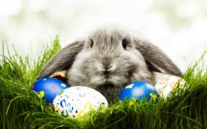
April 03 Good Friday *
Friday before Easter Sunday
April 06 Easter Monday *
Monday after Easter Sunday
April 23 St.George´s Day
England only

Slide 9
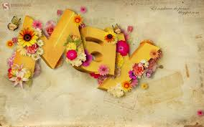
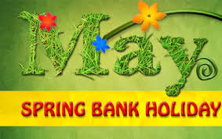
May 04 Early Bank Holiday *
first Monday in May
May 25 Spring Bank Holiday *
last Monday in May

Slide 10

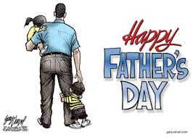
June 21 Father´s Day
3rd Sunday in June

Slide 11
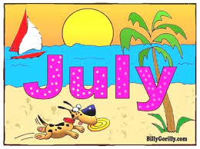
July 13 Battle of Boyne
Northern Ireland only

Slide 12
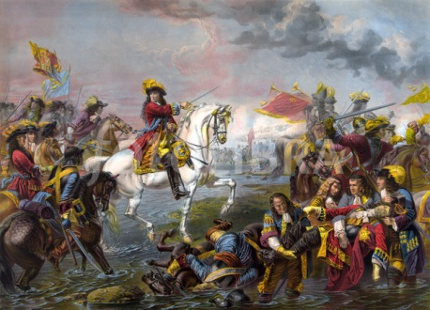
Battle of Boyne
- an annual public holiday observed in Northern Ireland
on July 12th, or Monday after, if 12th falls on a weekend.
History of the holiday
Events on the day commemorate the Battle of the Boyne, fought on July 1st 1690 by King William of Orange against King James II.
The victory of William and his Orangemen was seen as a key moment in the 'Glorious Revolution' when the Protestant (but not very English) William overthrew the Catholic James with the support of the English Parliamentarians.
How is it celebrated?
The day is marked by marches by the Orange Order across Northern Ireland. As a significant proportion of the population of Northern Ireland are Catholic. On the Eleventh night, huge bonfires are lit in Protestant areas

Slide 13

August 3 Summer Bank Holiday *
            Scotland only. The first Monday in August
August 31 Summer Bank Holiday *
            Last Monday in August (except Scotland)

Slide 14
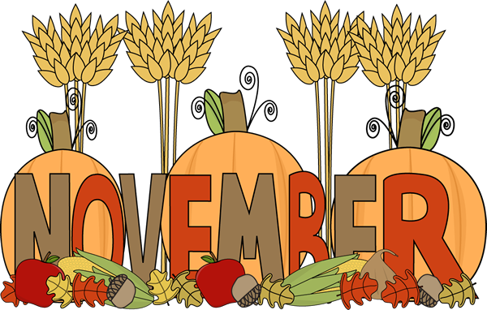
November 05 Guy Fawkes Night
                England only
November 30 St. Andrew´s Day
Scotland only. If November 30 falls on weekend, the following Monday is a bank holiday instead.

Slide 15
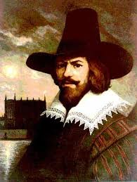
Guy Fawkes Night
When is Guy Fawkes Night?
Guy Fawkes Night is held annually on 5 November. It may also be called Fireworks Night or Bonfire Night.
It commemorates the arrest of Guy Fawkes and the failure of the so-called 'Gunpowder plot' to blow up the English Houses of Parliament in 1605.
History of Guy Fawkes Night
On the night of 4 November 1605, following a tip off through an anonymous letter, Guy Fawkes was caught guarding thirty-six barrels of gunpowder in a cellar beneath the Houses of Parliament in London.
The conspirators of the Gunpowder Plot were Roman Catholics who opposed the lack of religious tolerance under King James I. Their plan was to assassinate James and his government by blowing up the House of Lords during the State Opening of Parliament on 5 November 1605. Fawkes and seven others were tried and convicted of treason, and executed in January 1606. His head was among those displayed on pikes at London Bridge.
Within months Parliament established 5 November as a national day of thanksgiving.
A tradition was that children would make a dummy of Guy Fawkes and ask people for money (' A‘Penny for the Guy'’) which they spend on fireworks.
Fireworks displays and bonfire parties are still common across England

Slide 16
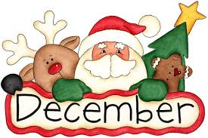
December 25 Christmas Day *
December 26 Boxing Day *
(December 28 in leiu)

Slide 17
Quizz
Britain has fewer public holidays than any other country in Europe. Which countries, with up to 15 days, have the most?
Which country has a same number of public holidays as Britain?
On which bank holiday is the Notting Hill Carnival celebrated each year?
TASK 1: Write as many adjectives connected with the word MOTHER as possible.
TASK 2: Part of British Easter Tradition is so called EGG HUNT. Can you find any in your classroom?

Slide 18
Answers
Cyprus (15), Spain and Malta (14) and Austria and Portugal (13)
Holland
Summer Bank Holiday (The carnival started back in 1964 when race relations in Britain were very poor. Afro-Caribbean communities got together with a mixture of song, dance, food and creative costumes, leading to an explosion of sound in what was normally a quiet borough in London. Although smaller than the carnival at Rio de Janeiro, the Notting Hill Carnival in north London now attracts approximately one million visitors each year.)

Slide 19
Resources
http://www.officeholidays.com/countries/united_kingdom/index.php
http://www.dailymail.co.uk/news/article-2073511/Workers-UK-fewest-public-holidays-Europe-generous-statutory-holiday-entitlement.html
http://resources.woodlands-junior.kent.sch.uk/customs/bankholidays.html
http://www.thisismoney.co.uk/money/news/article-2331681/The-man-gave-Bank-Holidays-Why-banker.html

