Slide 1
National public holidays in USA

Slide 2
1st January, New Year´s Day
New Year's Day falls on January 1 and marks the start of a new year according to the Gregorian calendar. It marks the end of New Year's Eve celebrations in the United States and gives many Americans a chance to remember the previous year.
What do people do?
The start of New Year's Day, at midnight, is heralded by fireworks, parties and special events, which are often televised. Very few people have to work on the day itself. For many it is a day of recovery from the New Year's Eve celebrations the previous night. Many people make New Year's resolutions. These are usually promises to themselves that they will improve something in their own lives. Common New Year's resolutions are to stop smoking or drinking alcohol, to lose weight, exercise more or to live a healthier lifestyle.

Slide 3
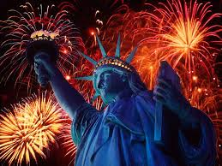

Slide 4
Martin Luther King Day
Martin Luther King, Jr. Day is an American federal holiday marking the birthday of Martin Luther King, Jr. It is observed on the third Monday of January each year, which is around the time of King's birthday, January 15. The campaign for a federal holiday in King's honour began soon after his assassination in 1968. It was officially observed in all 50 states for the first time in 2000. It is mainly celebrated by a volunteer work.

Slide 5
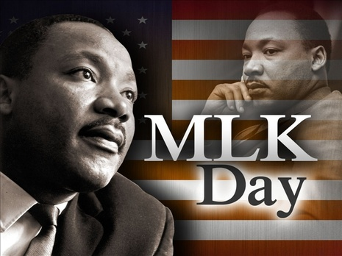

Slide 6
Groundhog Day – not a national holiday
Groundhog Day is a day celebrated on February 2. According to folklore, if it is cloudy when a groundhog emerges from its burrow on this day, then spring will come early; if it is sunny, the groundhog will supposedly see its shadow and retreat back into its burrow, and the winter weather will persist for six more weeks.
In south-eastern Pennsylvania, Groundhog Lodges (Grundsow Lodges) celebrate the holiday with social events in which food is served, speeches are made, and one or more g'spiel (plays or skits) are performed for entertainment. The Pennsylvania German dialect is the only language spoken at the event, and those who speak English pay a penalty, usually in the form of a nickel, dime or quarter per word spoken, with the money put into a bowl in the centre of the table.
https://www.youtube.com/watch?v=6VF5P7qLaEQ

Slide 7
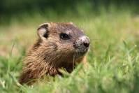

Slide 8
Presidents Day
Presidents Day is a federal holiday celebrated on the third Monday of February.
The original version of the holiday was in commemoration of George Washington's birthday
Then along came Abraham Lincoln, another revered president and fellow February baby (born on the 12th of the month).
While the holiday in February is still officially known as Washington's Birthday (at least according to the Office of Personnel Management), it has become popularly (and, perhaps in some cases at the state level, legally) known as "President's Day." This has made the third Monday in February a day for honoring both Washington and Lincoln, as well as all the other men who have served as president.

Slide 9
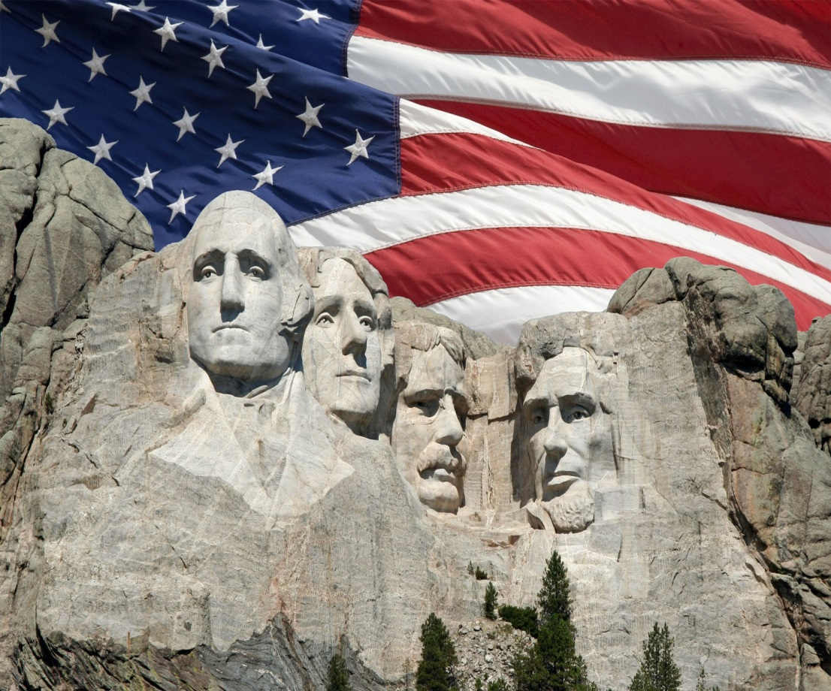

Slide 10
Memorial Day
A United States federal holiday observed on the last Monday of May.
Memorial Day, originally called Decoration Day, is a day of remembrance for those who have died in military service for the United States.
By 1890, it was recognized by all of the northern states. The South refused to acknowledge the day, honouring their dead on separate days until after World War I (when the holiday changed from honouring just those who died fighting in the Civil War to honouring Americans who died fighting in any war).
Since the late 1950’s, on the Thursday before Memorial Day, the 1,200 soldiers of the 3rd U.S. Infantry place small American flags at each of the more than 260,000 gravestones at Arlington National Cemetery. They then patrol 24 hours a day during the weekend to ensure that each flag remains standing.

Slide 11
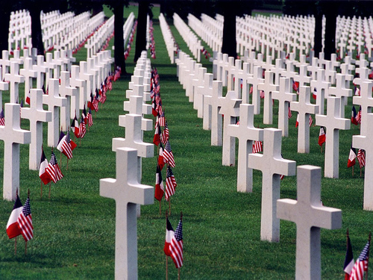

Slide 12
Independence Day 4th July
On July 4, 1776, the United States of America proclaimed its independence from England by signing the Declaration of Independence.
While the signing of the Declaration itself was not completed until August, the Fourth of July holiday is seen as the official anniversary of U.S. independence.
"Independence Day" wasn't until 1791 and Independence Day celebrations only became common after the War of 1812.
By the 1870’s, Independence Day had become the most important secular holiday on the American calendar and has transformed into what is known as the 4th of July today.
Did you know? The Declaration of Independence was signed by only two people on July 4 1776 - John Hancock and Charles Thomson. Most added their signatures on August 2, but the final signature wasn't added until five years later.

Slide 13
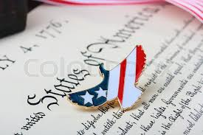

Slide 14
Labour Day
Labor Day, is a legal holiday celebrated on the first Monday in September in the United States, Puerto Rico, the Canal Zone, and the Virgin Islands.
Canada also celebrates Labour Day on the same day.
What Labor Day Means
For most people, Labor Day means two things: a day off and a chance to say goodbye to the summer. But why is it called Labor Day? Labor Day is a day set aside to pay tribute to working men and women. It has been celebrated as a national holiday in the United States and Canada since 1894.

Slide 15
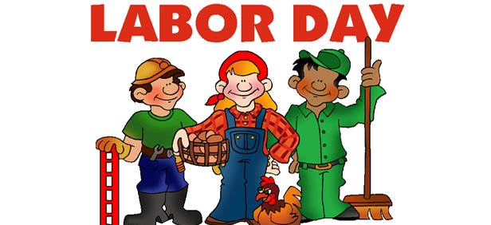

Slide 16
Columbus Day
Honors Christopher Columbus, traditional discoverer of the Americas.
The day commemorates the date when Christopher Columbus first set foot in the Americas. In the USA it is observed on the Second Monday in October.
Instead, while trying to find a sea route to India, he made landfall on an island in the Bahamas that he named San Salvador.
It is now generally accepted that Columbus was not the earliest European explorer to reach the Americas and that Viking sailors had ventured as far as Newfoundland around 1000 AD.
Though Columbus Day is one of the 10 US legal federal holidays, it is not considered a major one. All government offices are closed, but most businesses remain open. Retail stores may run special sales.

Slide 17
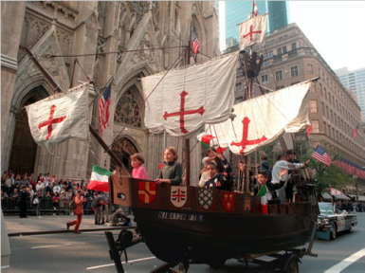

Slide 18
Veterans Day
Veterans Day is a federal holiday and a state holiday in all states. It is observed on the weekday nearest to November 11th.
The holiday honours all veterans of the United States armed forces.
A traditional observation is a moment of silence at 11 AM remembering those who fought for peace. (Commemorates the cease-fire in the 1918 armistice which was scheduled for "the eleventh hour of the eleventh day of the eleventh month.")
In the USA, there are an estimated 20 Million veterans. Of these, Veterans from the Vietnam war are the largest group numbering over 7 million. There are 5.2 million veterans who served during the Gulf War Era.

Slide 19
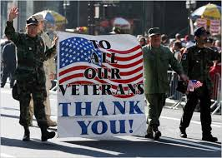

Slide 20
Thanksgiving
Celebrated on the last Thursday in November in the US. The Friday is not a public holiday but is given as a day off by most employers.
The holiday has evolved into what Americans now know as Thanksgiving. It is a day to gather with loved ones, celebrate, give thanks for many blessings and, of course, eat. The traditional American Thanksgiving meal includes, turkey, mashed potatoes, stuffing, cranberry sauce, yams, and pumpkin pie. The meal stems from that eaten by the pilgrims at the first Thanksgiving.

Slide 21
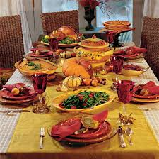

Slide 22
Christmas Day
Christmas Day celebrates the Nativity of Jesus which (traditionally, but unlikely in reality) took place 25 December 1 BC. 25 December will be a public holiday in most countries around the world. If 25 December falls on a weekend, then a nearby week day may be taken as a holiday in lieu.
Did you know?
22% of men leave their Christmas shopping until the last two days before Christmas. Only 9% of women do the same. And 12% of us don't even start our Christmas shopping until the January sales.
Did you know? The use of 'Xmas' isn't necessarily a secularisation of Christmas; it is said to date from the ancient practice of using a cross as a symbol for the word 'Christ'.

Slide 23
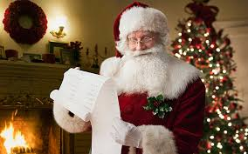

Slide 24
Sources and links
http://www.officeholidays.com/countries/usa/
www.google.cz/search
https://www.youtube.com/watch?v=6VF5P7qLaEQ

