Slide 1
Lecture 3:
Communication system used by the deaf in Nigeria

Slide 2
Lesson objectives:
By the end of the lesson, students should be able to:
Identify the geographical location of Nigeria in a map
Mention the six regions of Nigeria
Differentiate between: SEE1; SEE2; SSS; Contact Signs, and Pidgin Singed English.
Converse using ASL.

Slide 3
Group assignment
Group 1: (a). Adamcová, Beáta; (b). Berg, Heidi; ( c). Koláčná, Kristýna
Group 2: (a). Birnkammer, Stefan; (b). Linhová, Marie; ( c). Straková, Monika
Group 3: (a). Glavanics, Gerda; (b). Vajdíková, Zuzana; ( c). Sunday, Akaninyene Arnold; (d). Štibrányiová, Marína
*** Each group will pick a topic of interest to them on issue bordering on deaf people (in their countries) and write an essay of between 3-5 pages. Each group will present their study on Wednesday April 29 in form of seminar.

Slide 4
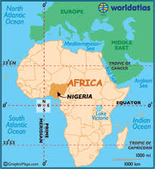
Map of Africa

Slide 5
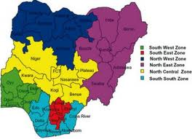
Map of Nigeria showing the 6 regions

Slide 6
Communication methods used by the deaf in Nigeria
Seeing Essential English (SEE1): it is a communication method that involves adding morphologies, suffices, and prefixes in a signed word. Examples: (1). I am going to school. (2). My teacher has gone home. (3). He comes here every week. (4). There is a mis-under-stand-ing among them.
Signing Exact English (SEE2): It is a form of SEE1, but compound words are signed as a unitary word, example: (1). His birth-day is next week.
Sign Supported Speech (SSS)/Simultaneous communication (simcom): speaking as you sign the equivalent of every spoken word you made.

Slide 7
Communication methods contd:
Contact Signs: this is called “universal sign language” in the Czech Republic. It is the form of sign communication used when people from different sign language communities meet.
Pidgin Signed English (PSE): this is an English worded sign that is tinged with locally made signs.

Slide 8
Discussion Questions:
Can there be communication without language?
What ways do you think will be best in helping a deaf child learn language?

Slide 9

7 minutes break.

Slide 10
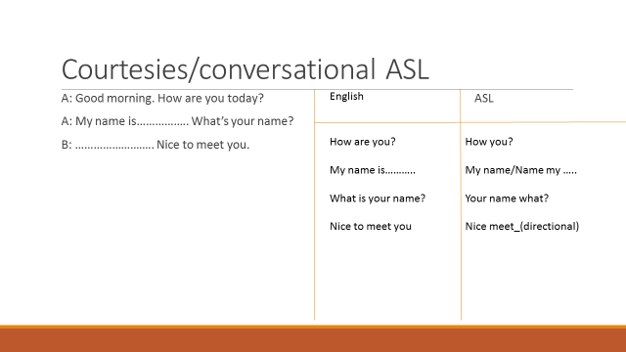
ASL Conversational skill

Slide 11
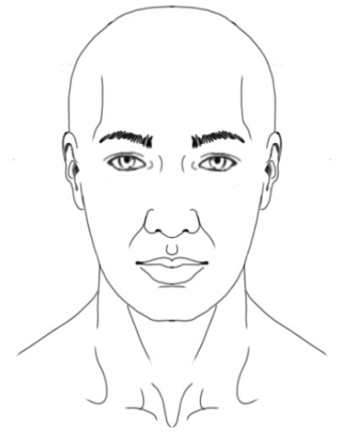
Male and female sign locations
Male sign location
Female sign placement

Slide 12
Family relationship
Father Mother Parent Child/children
Brother Sister Boy Girl
Man Woman Husband Wife
Son Daughter Grand Father Grand Mother
Born Baby Sex Dating
Boyfriend Girlfriend Married Divorced/Separated
Uncle Aunt Nephew Niece
Cousin In-Law Love Hate
Friend Old Young Single
Couple Sweetheart Step Father Step Mother

