Slide 1
Essentials of disability studies for special educators
Lecture 1
Victoria Shmidt,
PhD, MSS in Social work
320753@mail.muni.cz

Slide 2
Aims and objects
Disability studies and education: two options for juxtaposing
Criteria (ideas) and procedures (institutions) of educational system in the context of disability studies
Functionalism,
three further approaches, humanist, radical, and reflexive, will be discussed next time

Slide 3
Disability studies
An example of new type for producing knowledge:
Transforming previous object of study to the subject (participative and interactionist researchers)
Involving studies into social movements in favour of implementing better standards of Human Rights
Highlighting dilemmas and conflicts, provoking reflexivity among various actors, integrating them in teams

Slide 4
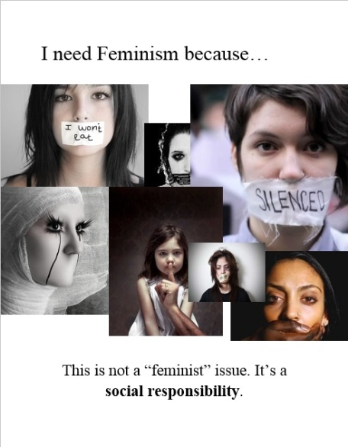

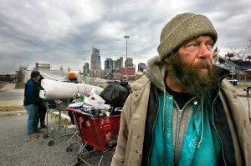
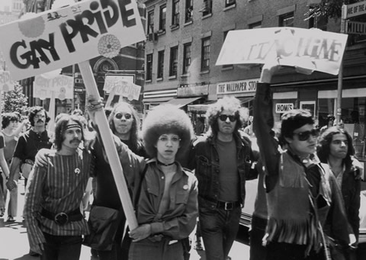
Disability studies among Studies

Slide 5
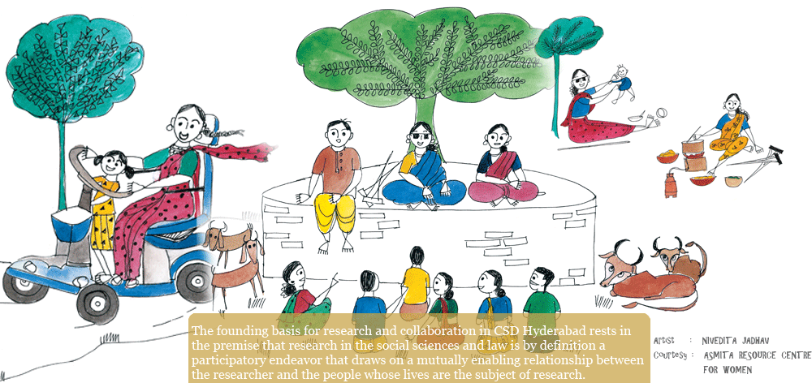
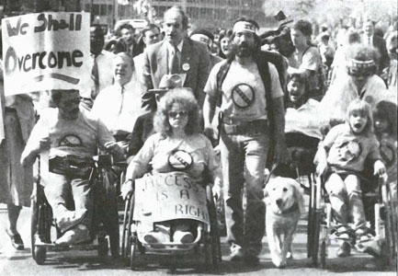
Disability studies

Slide 6





Education as an agent of segregation or anti-oppressive practice
Educationalisation as an element of colonisation and the instrument of obedience
Deschooling society or transforming schools into agents of changes

Slide 7
Task 1: strands for self-evaluation
What do we analyse (what exists in our analysis)
Criteria (idea, discourses)
Practices, institutions, procedures
On which level do we explore an issue
Macrolevel of explaining (policy, culture, economical reasons, idea of progress/backwardness)
Mesolevel (separate groups of actors, relations between people and groups: community level, lack of embeddedness)
Microlevel (behaviour of certain people, trend to be out of changes)
Connections between levels
How do we know what we know about society, disability, people with disability?
Facts, behaviours, numbers observable things
Feelings, attitudes, process of meaning making

Slide 8
The connection between criteria and procedures
Who does what and under which reasons
Agents, actors, groups of interests
Practices, strategies, policies
Discourses, communicative (translating to public) and coordinative (used within creating and implementing policies)

Slide 9
Two trajectories between education and disability studies
Educational system as an area of applying disability studies
Wide range of methodologies for exploring education and planning its transformation
Testing disability studies in the context of education
Achieving more coherent approach in evaluating the impact of education on exclusion
How could you define the meaning of each of the trajectories for special education?

Slide 10
Task 2: redefining education for disabled children
Agents | Practices | Discourses
 | Family placement of disabled children (foster care, adoption, reintegration with birth families)
 | Transparent decision making related to the trajectory of education
 | Early intervening with disabled children, continuity between early intervention and further education

Slide 11
Disability studies as providers of meta-methodological approach
Meaningful dichotomies for constructing our own approach in consistent way
Accepting the diversity of approaches
Accepting the necessity to indicate our own position towards disability

Slide 12
The division of social theories regarding disability
approaches
Interpretivism
(meaning and the physics)
Functionalism
(pathology and norms)
Radical humanism
(desire and shared)
Radical structuralism
(action and the social)
Two dichotomies:
Society is understood as regulated vs. Society is understood as in conflict
Subjective entities in society vs. Objective things in society

Slide 13
The key question of disability studies: what is more important
Human rights
Process of education
Meaning of here and now
the collision of interest groups
Human capital
Outcomes of education
Meaning of future results
over-utilitarian and very traditional approach

Slide 14
Functionalism: ideas
Education as an element of social order
Norms as regulators of the balance between individuals and society
Disability as an abnormality (potentially) destroying social order
Variety of approaches
focus on biological factors
Focus on social factors
Coinciding both perspectives

Slide 15
The case of eugenics
Selective strand
Main focus: the threat of reproducing low-value people and two alternatives to solve the issue:
the isolation from mainstream society (placement into institutions)
sterilization
Assimilative eugenics
Main focus: the mode of life as a key determinant of the national health
all diseases are the result of inappropriate mode of life;
the sustainable improvements of the quality of life are indispensable for the health of nation

Slide 16
The framework of arguments in favour of residential care in eugenics
close connection between physical/mental disability and deviant behaviour
indispensable role of institutions and professionals in re-educating
incapability of parents of delinquent children to provide care and control

Slide 17
Combining both domains of eugenics into consistent scheme in education
Main elements of the approach to re-educating | Selective stream | Assimilative stream
connection between disability and deviant behaviour | Both need to be under control and restrictions, common hereditary factors | Common strategies for correction, without which deviance becomes inevitable
incapability of parents to provide care and control | Mostly, parents of children with disorders are the core source of bad heredity | The disorder of child is a result of inappropriate family upbringing
indispensable role of institutions and professionals | Better knowledge and the ability to differentiate the degree of disorder. Working out classification with various types of disorders relevantly to the main source of disorder’s origin: heredity, social circumstances, or the mix of both

Slide 18
Combining both domains of eugenics into consistent scheme
Main elements of the approach to re-educating | Selective stream | Assimilative stream
connection between disability and deviant behaviour | Both need to be under control and restrictions, common hereditary factors | Common strategies for correction, without which deviance becomes inevitable
incapability of parents to provide care and control | Mostly, parents of children with disorders are the core source of bad heredity | The disorder of child is a result of inappropriate family upbringing
indispensable role of institutions and professionals | Better knowledge and the ability to differentiate the degree of disorder. Working out classification with various types of disorders relevantly to the main source of disorder’s origin: heredity, social circumstances, or the mix of both

Slide 19
Roma children in residential care: the first day in children home and after 5 months

Slide 20
Functionalism: selective procedures
Differentiating norms and abnormality
Assessment centres
Tests and the art of psychodiagnostics
Methods of pathopsychology
Correcting deviance towards norms
Special schools
Special programmes
Correction

Slide 21
Actors
Professionals vs. parents
The knowledge belongs to experts
Parents are posed as a main threat for child up bringing
Children vs. society
What transforms ‘dangerous’ children into socialised entities?
What are expectations of the society from next generations?

Slide 22
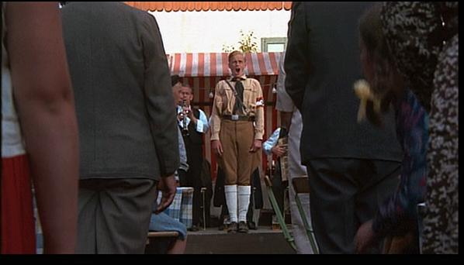
Two views on functionalist approach and the education based upon it
Total unacceptance because of the apology of naturalness
Critique towards monopolising the space of approaches by functionalism, the call for diverse methodologies and practices
http://www.youtube.com/watch?v=29Mg6Gfh9Co

Slide 23

Home task: Whistleless http://www.youtube.com/watch?v=42CPf-RXgUM
What symbolises the ability to whistle?
Who teaches the bird to whistle?
In which reasons do they have the right to teach?
What are differences between teachers?
How does the movie describe the social order in “the pink town”?
What are consequences of stealing the whistle by policeman?
Which attitude towards functionalist approach does movie provide?

