Slide 1
self-expressing
5th Mar 2018

Slide 2
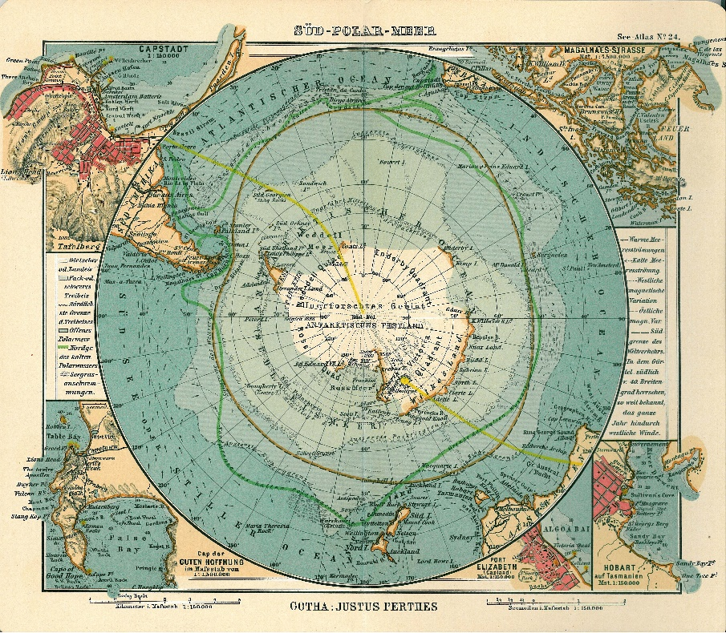
mind-map
sharing

Slide 3
mind-map
sharing
specifying a (language) goal

Slide 4
mind-map
sharing
specifying a (language) goal
Tato fotka od autora Neznámý autor s licencí CC BY-SA

Slide 5
express yourself

Slide 6
express yourself
write a message to yourself - the goal in one paragraph:
open with what (clear goal)
reason(s) why
plan(s) how
how will you know you have succeeded
summarize

Slide 7
video

Slide 8
7 barriers

Slide 9
tips for overcoming the barriers
don´t be scared / scary?
be responsive
challenge yourself / step out of your comfort zone
try to help if you can
never give up
live your dream
don´t lie to yourself
don´t be selfish / contribute
…

