Slide 1
Week 4

Slide 2


Slide 3
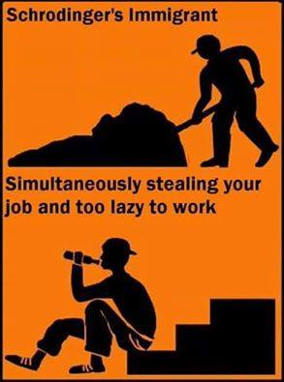

Slide 4
Watch the video and answer the questions.
1. What is Mare Norstrum?
2. Why did the UK want to stop it?
3. What changed the perception of the migrant crisis?
Video link: https://www.youtube.com/watch?v=XTQHKnYm_YY

Slide 5
The video looks at the facts behind four migration fears: Islam, high birth rates, crime, and the collapse of social systems. Make notes on the facts for each fear.
1. Islam 2. High birth rates
3. Crime 4. Collapse of social systems

Slide 6
This video was made in 2015. Has the situation changed since then?
The video producers removed it from their YouTube channel (the clip you watched is a re-upload by a different user). Why do you think they did that? Why did someone re-upload it?
For an explanation see:
https://www.youtube.com/watch?v=JtUAAXe_0VI&t=

Slide 7
Ten million
Six hundred and thirty seven thousand
Eight hundred
0.2 – naught point two

Slide 8
How many foreigners live in the CR?
(in 2017) 516,983
Where do foreigners in the CR come from?
Ukraine, Slovakia, Vietnam
Which regions do most foreigners live in?
Prague/Central Bohemia/ Brno
What % of the immigrant population is aged between 20 and 39?
Are there more male or female immigrants in the CR?
(in 2015) 75% men – aged 14-34
Do foreigners need a residence permit to stay in the CR?
EU citizens no, 3rd country – yes, after 90 days
How can foreigners get permanent residence? / How can a foreigner get permanent residence? EU working/paying tax for at least 3 years to get permanent residency.
9) Can a foreigner get citizenship If they marry a Czech citizen? If a foreigner marries a Czech citizen, can they get Czech citizenship?
10) Can a foreigner get unemployment benefits?

Slide 9
2) Make an educated guess

Slide 10
3) Use your device to find the answer. Summarise the information and share with the class.

Slide 11
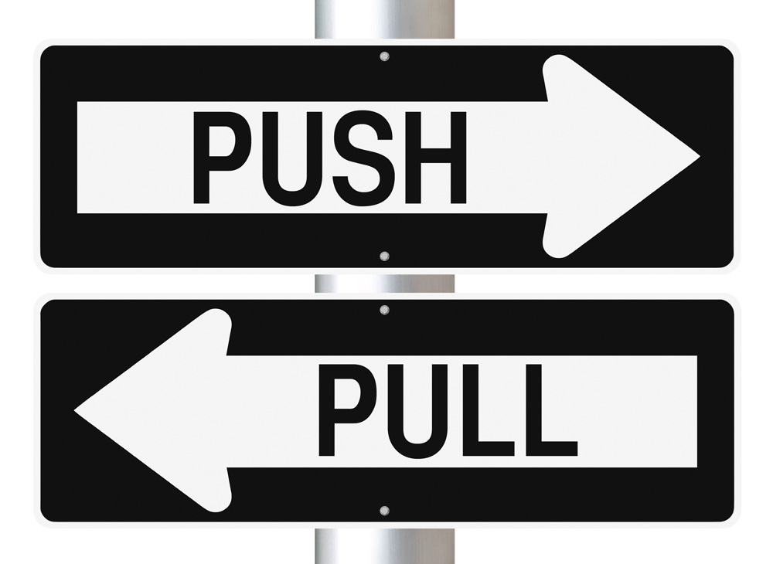

Slide 13
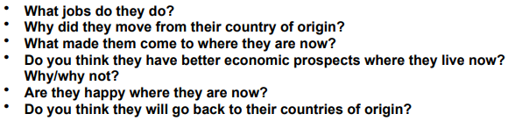

Slide 14
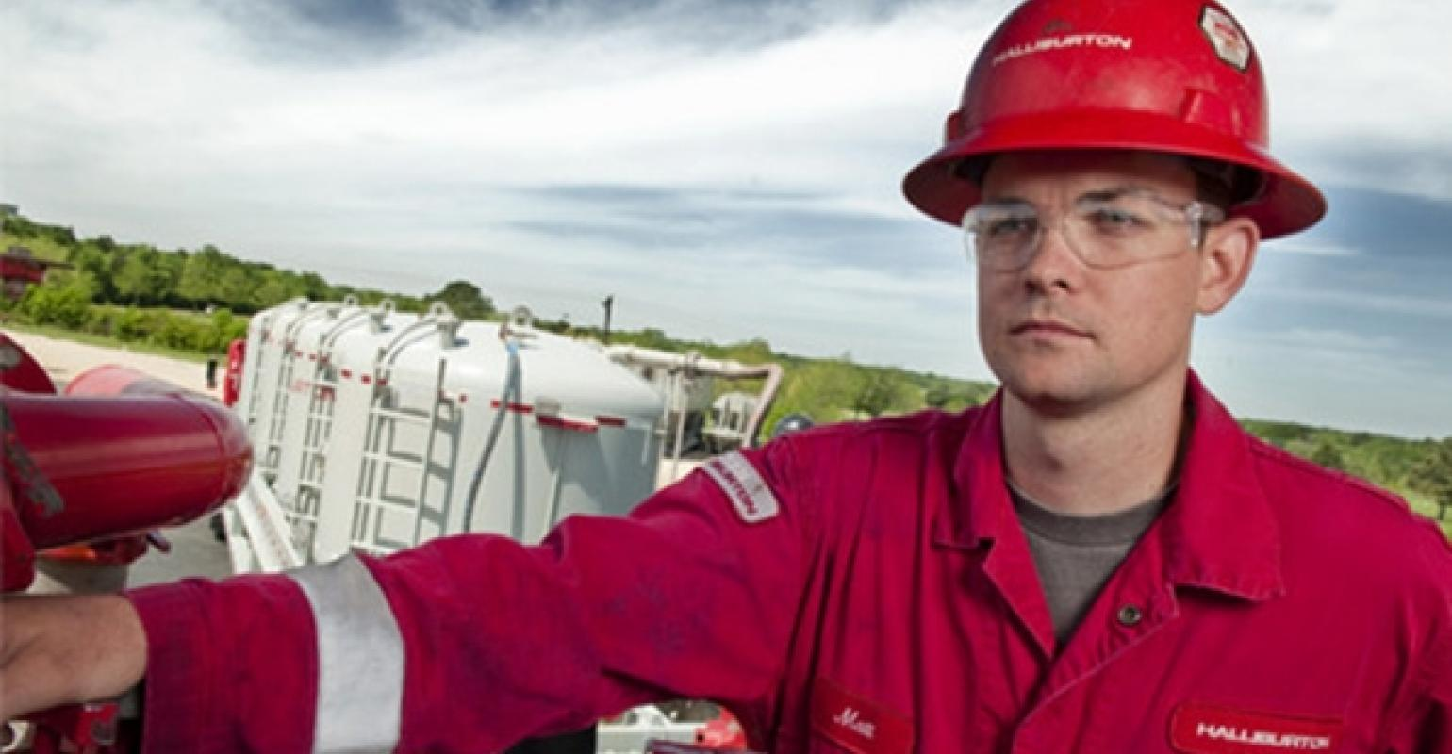
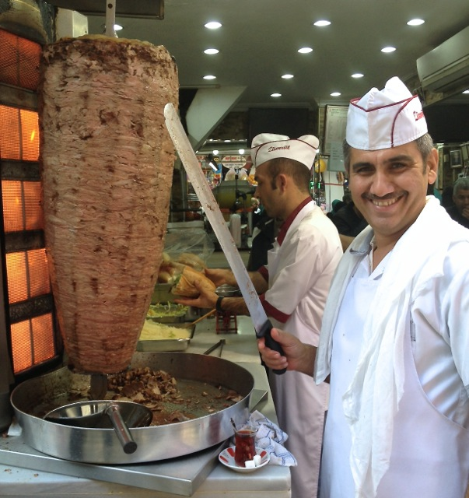
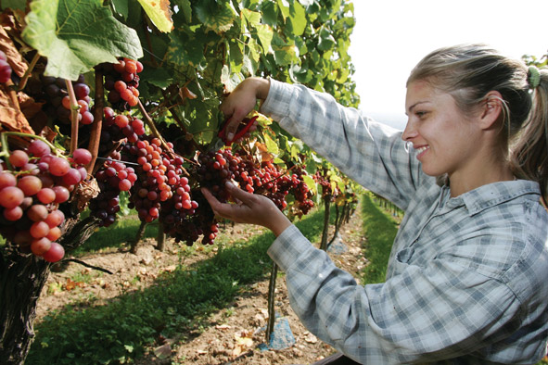
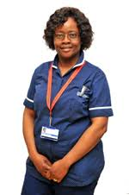

Slide 16
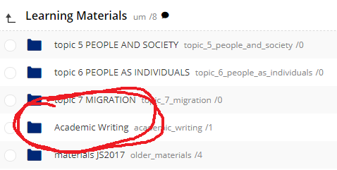
Homework
1) Academic Writing - Task 2C
2) What’s your thesis/dissertation? Come prepared to explain your final project - in English!

