Slide 1
Week 5

Slide 2
Phun with phrasal verbs
What do they mean?
look forward to take up run out of
look up/for let sb down = to disappoint sb
get over smth = to recover from/to get better
To pick on sb = to tease-make fun of

Slide 4
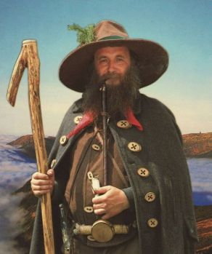

Slide 5
Homework
1) Academic Writing - Task 2C - check your answers with your partner

Slide 6
Limitations in other words
2) Observors paradox
4) Correlation doesn’t always mean causation
10) Statistically insignificant

Slide 7
Which of those words and phrases apply to your dissertation?

Slide 8
Explaining your project
Round 1
Explain it to your partner
Partner - do you understand? If not, ask them to explain.
Change roles
Both spoken? Switch partners
Round 2
The same again - this time, more fluently and confidently
Final round
Flawlessly present your dissertation to the group.

Slide 9
Writing an abstract
What is an abstract?
An abstract gives your reader a brief summary of the contents of your dissertation. When writing the abstract, focus on including: the research topic, research questions, participants, methods, results, data analysis and conclusions.
Information on the following slide taken from: https://blogs.lse.ac.uk/impactofsocialsciences/2011/06/20/essential-guide-writing-good-abstracts/

Slide 11
Social exclusion
What is it?
Why and how can people be socially excluded?
Lenka, religion, different appearance, age, social background
Watch the video and make notes on the following*: (https://www.youtube.com/watch?v=OMbYEyBeSsU)
How is the word exclusive perceived?
What was the positive thing about her experience?

Slide 12
Do the numbers reflect your concerns?

Slide 14
Watch and listen. Make notes on the following:
1. What are the features that make people different?
2. What could and should be flat and smooth?
3. The neural pathways that we use are the same for ourselves and for who?
4. What is the presenter´s image of a competent pilot?
(https://www.youtube.com/watch?v=zdV8OpXhl2g) to 4m23
(https://www.youtube.com/watch?v=YPkKEttKIQU) Monkey Dust

Slide 15
Homework
1) Write a draft abstract - save it in the homework vault (it’s open now)
2) More phrasal verbs next week -revise the phrasal verb grammar sheet.

