Slide 1
Self-reflection and professional development of pre-school teachers
Lucie Grůzová
Zora Syslová
Izrael, 2017

Slide 2
Programme
What does professional development mean?
Self-reflection in teacher's work.
Portfolio as a tool for career development.

Slide 3
What does "professional development„ mean for you?

Slide 4
1. Professional development is
"A set of activities leading to the improvement of student learning outcomes. It includes self teacher training, self-study, and sharing of expertise among teachers. It is not the development of professional skills that lead to the only ideal approach to teaching pre-school children, but to using a wide range of educational styles and strategies that support the diverse learning styles of each individual child. "
Starý et al., 2012, s. 12

Slide 5
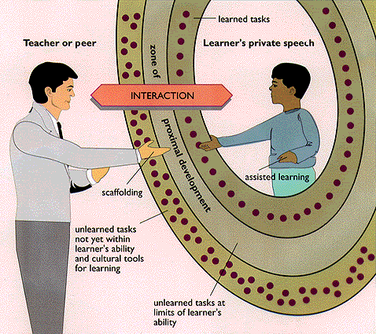

Slide 6
2. Self-reflection is …
... an internal process that helps teachers to analyze and evaluate their pedagogical activities, opinions and attitudes, and to use this assessment to improve their educational work. It is a prerequisite for the professional growth of teachers and the acceptance of professional and human responsibility.

Slide 7
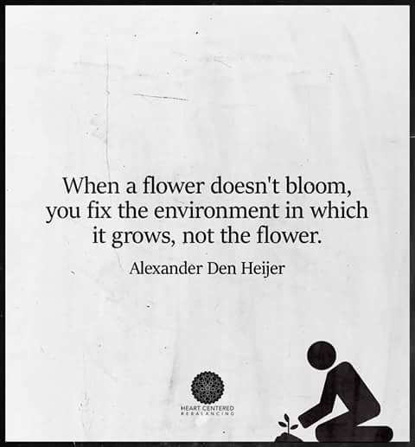

Slide 8
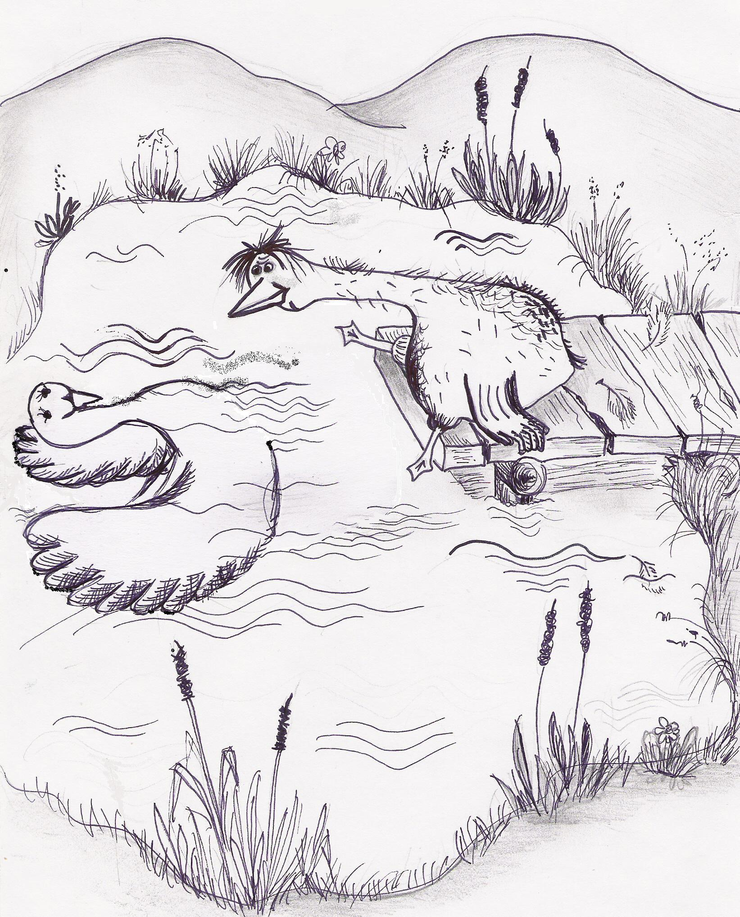

Slide 9
TOOLS:
Self-reflective diary
Self-reflective conversation
Video recordings
Questionnaire
Mutual visits with colleagues

Slide 10
Meaning of self-reflection
prevents stereotype work
allows teachers to test new methods
to learn to predict possible consequences
contributes to informal and systematic self-education
stimulates professional growth of teachers

Slide 11
Summary: Who is (reflective) teacher?
(Reflective Teacher) is such a teacher who honestly and at the same time effectively reflects critically upon their teaching practice, especially his/her own thinking, actions and consequences.

Slide 12
https://www.youtube.com/watch?v=PopVTQa1bp4&list=PLHbOV2qW4DYZU5Wz-YBhsI6I4n0Q3zI5M&feature=iv&src_vid=sFwjPFHQEI0&annotation_id=annotation_4292923193

Slide 13
3. Proffesional portfolio
a tool not only for reflection and self-reflection, but also
for self-presentation of a teacher,
to present progress, status, or change.

Slide 14
Examples of documents:
on continuing education in pedagogy, didactics and methodology;
documents showing the creation of teaching matherials;
documents showing the reflection of teacher´s work;
evidence of work complying with the career development plan;
records of regular parent consultations;

Slide 15
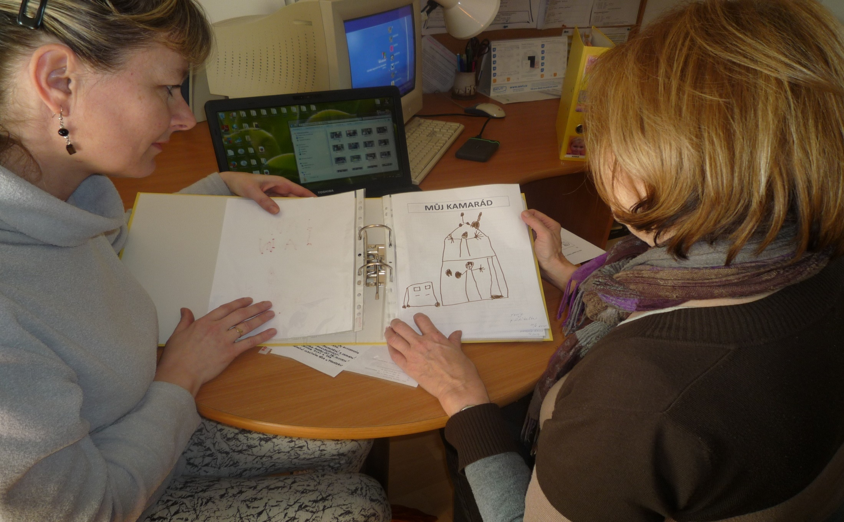

Slide 16
… other documents:
evidence of the use of innovative teaching methods;
evidence of creating optimal learning opportunities;
examples of use of formative assessments;
evidence of the use of differentiation and individualization of education ...

Slide 18
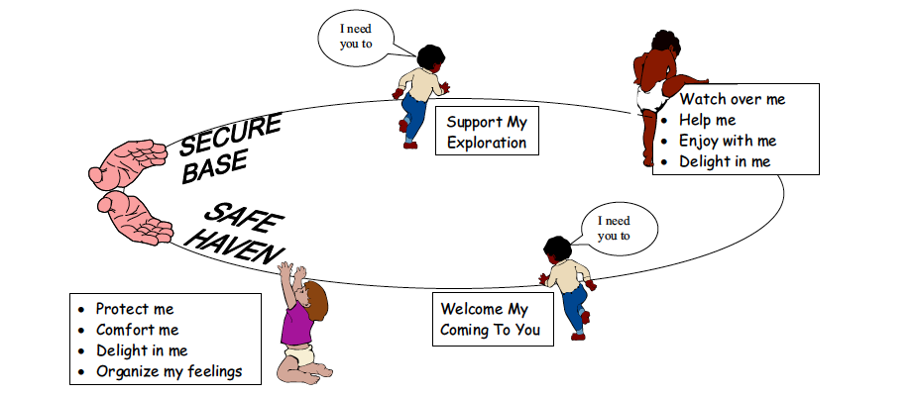

Slide 19
Thank you
for
your attention

