Slide 1
Week 8

Slide 2
Prepositional phrases
What was that client complaining ______?
I’ve never heard of Miloš Zeman, what’s he famous ______?
I’m sorry, but I can’t rely ___ you anymore – you’re fired!
If you don’t like the service, you should complain ____ the manager.
Generally, I’m not very keen ___ seafood, but I do like tuna.

Slide 3

What are they/he/she looking forward to?
Where is he going to pick her up from later? – or vice-versa
What did they/he/she last complain about?
What have they/he/she recently taken up?

Slide 4
Choose a word pair and write a sentence to demonstrate the difference between the words.
Example:
1a. I was humiliated when the head teacher called me an idiot in front of my students.
1b. I felt embarrassed when I realised that I should have blown my nose before opening the door.

Slide 5
Academic Writing - Task 5A – E

Slide 6
Watch the video
What are examples of inappropriate workplace behaviour?
New words or phrases? Write them down! We’ll share and discuss them at the end of the clip.
https://www.youtube.com/watch?v=wz_hyeK5fBE&feature=related

Slide 7
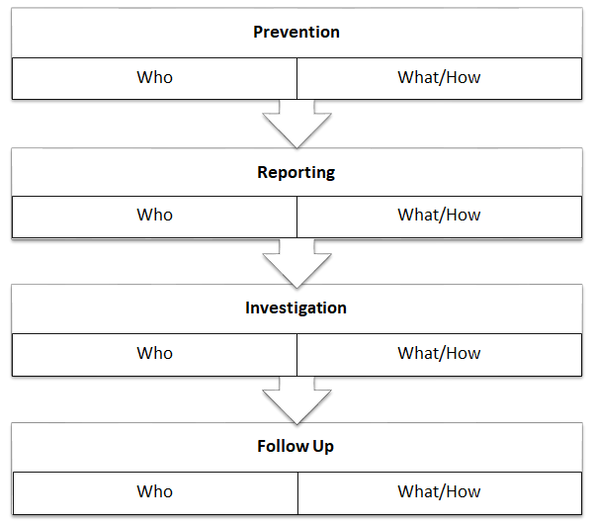

Slide 8
Background (Describe the situation)
1. Identify the key players.
2. Identify the actions/ behaviours.
3. Identify the impact of the behavior.
Evaluation (Analyze the situation)
1. Determine if the details are fact or opinion.
2. Determine if the behavior is acceptable or bullying.
3. Determine if the impacts are mild or severe.
Recommendations (Suggest how to solve the problem)
1. Determine if any action is necessary.
2. If not, explain why the behavior is acceptable and of mild impact.
3. If so, suggest a specific course of action to address the situation.
4. Suggest strategies for preventing this situation from re-occurring.

Slide 9
To insist
To be short staffed
To confront

Slide 10
