Slide 1
Where to find information about oncological diseases?
Teaching lesson 10
Written by: Zdeňka Smejkalová, Jitka Slaná Reissmannová

Slide 2
Organizations and foundations
League Against Cancer
General focus of neoplastic diseases
Flower day
www.lpr.cz, www.onko.cz
Masaryk Memorial Cancer Institute
General focus of neoplastic diseases
www.mou.cz

Slide 3
Mamma Help
Breast cancer
Information of self-examination of breasts
www.mammahelp.cz
Vize 97 Foundation
Colorectal cancer
Dagmar and Václav Havel Foundation
www.vize.cz

Slide 4
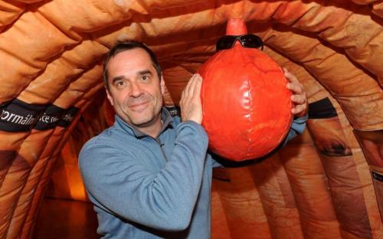
Projects
MOT for Men
Colorectal cancer
Testicular cancer, prostate cancer
“Instructions for men maintenance”
www.stkprochlapy.cz
The Colon Tour
Colorectal cancer
Inflatable model of the colon in Czech cities
www.onkomajak.cz/strevo-tour

Slide 5
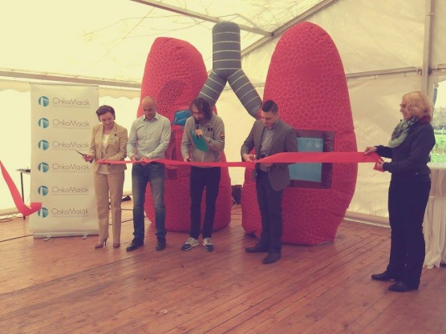
Healthy Lungs
Lung cancer
Model of the lungs in Czech cities
www.onkomajak.cz/zdraveplice
Healthy Balls
Breasts and testicular cancer
Delivered in the school environment
www.zdravekoule.cz
Project 35
Breast cancer
www.projekt35.cz
Spiral
Cervical cancer
http://www.vychovakezdravi.cz/
Rakovinavarlat.cz
Testicular cancer
Professional information about the disease
www.rakovinavarlat.cz

Slide 6
Campaigns
Hands on the Breasts
Breast cancer
Self-examination of the breasts, video
Use of the same name as a reminder of the self-examination day
www.rucenaprsa.cz
Avon – Healthy Breasts
Breast cancer
Symbol – pink ribbon
www.zdravaprsa.cz

Slide 7
Cancer Month
Cervical cancer
www.mesicraka.cz
Got Balls?
Testicular cancer
Self-examination of testicles, video
www.maskoule.cz
Ball Guard
Mobile application as a reminder of the testicle self-examination day
www.hlidackouli.cz
Look after Me!
Breasts and testicular cancer
www.dialog-jessenius.cz/projekt/hlidej-si-me
Note: figures were retrieved from the referenced internet links

