Slide 1
Oncological disease of the breast
Teaching lesson 4
Written by: Zdeňka Smejkalová, Jitka Slaná Reissmannová

Slide 2
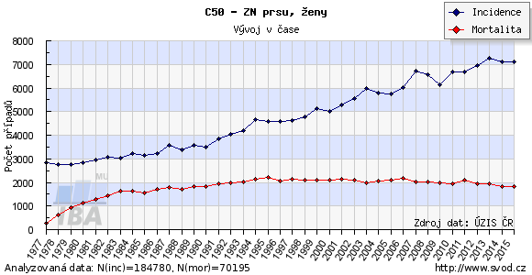
Occurrence of breast cancer
Breast cancer is the most frequent neoplastic disease in women!
(1)

Slide 3
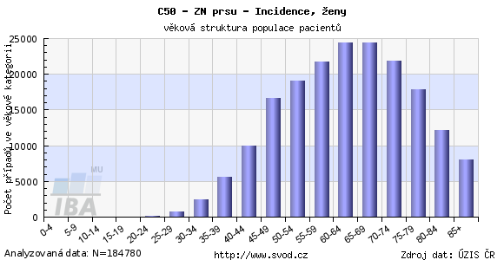
(2)

Slide 4
Risk factors and symptoms
In case any change is observed, a gynaecologist or general practitioner must be consulted!
Risk factors
Symptoms
Sex, age
Inheritance
Hormonal substitution treatment
Inadequate diet
Obesity, low physical activity
Smoking
Absence of breastfeeding, late or no pregnancy
Early menstruation, late menopause
Painless lump – most frequent symptom
Pain, enlargement of breast
Retracted skin or nipple
Pockmarks, scales, swelling of breast
Discharge or bleeding from the nipple
Long-term eczema on the breast, redness
Enlargement of lymph nodes above the collar bone and in the armpit

Slide 5
Primary and secondary prevention
Primary prevention
Observing general principles of prevention of neoplastic diseases
Secondary prevention
Breast cancer screening = mammography
Self-examination of breasts

Slide 6
Mammographic examination
Regular preventive examination of breast cancer
Examination of the mammary gland in women without symptoms
Early detection of breast tumour
Examination based on screening of both breasts
Free of charge for women over 45 years
Performed once every two years
(3)

Slide 7
Self-examination of breasts
During self-examination, focus is on any changes in breasts, especially the mentioned symptoms.
Performed regularly every month, ideally on the second or third day after menstruation when the breasts are not subject to tension.
Self-examination should be performed after showering with warm water.

Slide 8
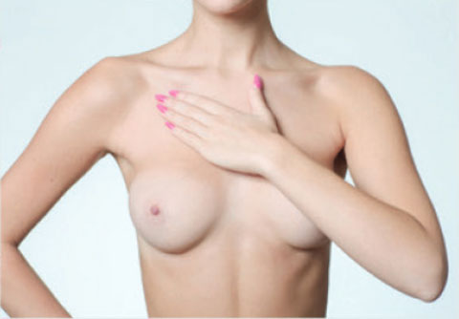
The first step is visual inspection, appearance of the breasts is checked in front of the mirror. Then palpation is performed, first in the standing position in front of the mirror, then in the lying position.
The nipple is examined by gently pressing it to check for any discharge.
The examination is performed by the pads of the three middle fingers, the whole breast is examined, each breast separately.
It is necessary to examine the armpit and the area around the collar bone. Lymph nodes in the armpit are palpated, then the pit above the collar bone and the region above the sternum.
Self-examination of breasts – video
One hand is placed behind the head and the whole beast is examined by the other hand using circular movements.
(4)

Slide 9
References
Rakovina prsu. Vitalion [online]. c2018 [cit. 2018-06-19]. Retrieved from: https://nemoci.vitalion.cz/rakovina-prsu/
Samovyšetření prsu – návod pro ženy. Mamma Help [online]. c2017 [cit. 2018-05-04]. Retrieved from: http://www.mammahelp.cz/prevence/samovysetreni-prsu/samovysetreni-prsu-navod-pro-zeny/?gclid=EAIaIQobChMI48aWifjf2wIV1oKyCh2oogAQEAAYAiAAEgIfePD_BwE
Mamografické vyšetření. Mamo.cz [online]. 2018, 20. 8. 2014 [cit. 2018-05-08]. Retrieved from: http://www.mamo.cz/index.php?pg=pro-verejnost--mamograficke-vysetreni
Mamma Help [online]. c2017 [cit. 2018-05-10]. Retrieved from: http://www.mammahelp.cz/
Figures:
(1), (2): Novotvary 2015 ČR [online]. Praha: Ústav zdravotnických informací a statistik ČR, 2015. [cit. 30/04/2018]. Retrieved from: http://www.uzis.cz/publikace/novotvary-2015
(3), (4): Mamma Help [online]. c2017 [cit. 10/05/2018]. Retrieved from: http://www.mammahelp.cz/

