Slide 1
AJ5415 Storytelling for Young Learners Kateřina Tomková, 2060@mail.muni.cz Block 1 Saturday, March 20, 2021

Slide 2
Our schedule today
0830-1000 Intro to Storytelling
1000-1030 Coffee break & 1st research task
1030-1200 Interactive block
1200-1230 Lunch break & 2nd research task
1230-1300 Summary, conclusion
1300-1330 Individual consultations

Slide 3
Resources
All in the course‘s site in the IS:
- this presentation
- Rowling speech with gaps
- Tomková Segmental pronunciation of English
- Tomková Suprasegmental pronunciation of English
- Tomková The best videos for teaching English pronunciation

Slide 4
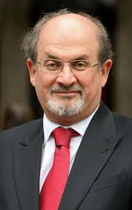
Storytelling as a basic human need
Salman Rushdie Teaches Storytelling and Writing | Official Trailer | MasterClass – YouTube

Slide 5
History of Storytelling

Slide 6
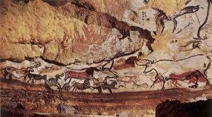
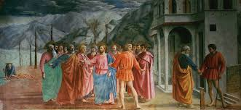
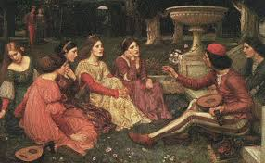
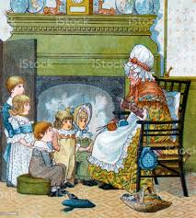
Storytelling since times immemorial

Slide 7
The world‘s greatest storytellers
Homer, Virgil, Aesop
Bocaccio, Dante
Chaucer
Shakespeare
Němcová
Čapek
Tolkien, Lewis, Pratchett
…………………………………………………………………

Slide 8
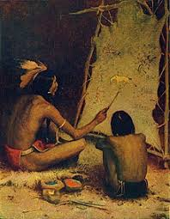
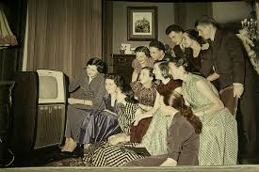
The same or different?

Slide 9
Storytelling today
In business: brands sharing their messages in ways that engage audiences and drive them to take a desired action (like making a purchase, calling a sales person, downloading or subscribing to content, etc.).
In politics: Political narrative as a term used in the humanities and political sciences the way in which storytelling can shape fact and impact on understandings of reality.
In teaching: Storytelling is the oldest form of teaching. It bonded the early human communities, giving children the answers to the biggest questions of creation, life, and the afterlife. Stories define us, shape us, control us, and make us. Not every human culture in the world is literate, but every single culture tells stories. =Failure stories are the best=
In law: ‘Liar Liar‘

Slide 10
Storytelling for chidren
Vital for developing their imagination
Important for their spatial and time awareness
Crucial for developing their passive language sensitivity and active speaking skills
Integral for family/community bonding and solidarity among generations
Sapir-Whorf hypothesis

Slide 11
Storytelling for children in foreign language teaching
… at their state of cognition
The use of people, narratives and realities they know in their mother tongue
The use of the great sense of formal structure, repetition, rhythm
Experientiality, well-being
Narrator‘s pronunciation and diction
Narrator‘s attention
Listener‘s personal involvement

Slide 12
Kinds of narratives
Rhymes and songs=memorised formats
(Budulinek, Father Abraham)
Fairy-tales
Simple real-life stories (Meurig)
Family/community legends (Roots)
Urban legends (Mammoth‘s trap)

Slide 13
The story of my life
Medlovice n/H
Ždánice
The poor farmer‘s wife
Ottawa (‘Say it for me‘; recording)
Somalia; Michael Jackson; fertilise mum
Qué será
Meine Laterne
My Fair Lady of the Vegetable Market
A moment of enlightment

Slide 14
Coffee break
Research tasks: Rushdie, Rowling, fertility rites in ancient Rome, how Sylvia Plath met Ted Hughes, your own favourite storytellers, the origins of St. Patrick‘s Day, Hamlet‘s monologue, Beckett x Moree

Slide 15
Interactive block
Results of research discussed in breakout rooms
Back in the main session: secondary presentations of research results
‘Awnie‘s House‘ pandemic video

Slide 16
Lunch break
Research task: fertility rites in ancient Rome

Slide 17
Summary, conclusions, questions, plans for Block 2
Homework: submit a 2- minute recording in the File Vault (Poskytovna), by May 9 (=Mothers‘ Day)

Slide 18
So long… Have a pleasant, covid-free EASTER!
I am free for individual/group consultations.

