Slide 1
Project-based learning (PBL) in the primary education And its importance in the curriculum of the pregradual programme of the teachers' training for primary education

Slide 2
The subject is compulsory and it takes place in the spring semester of 4th semester
Criteria for Completion: Written preparation of the project and its reflection
Opening seminars are based on theory, especially on defining the terms „project-based learning“ and „integrated thematic learning“
Preparation and realization of the projects
Students can use it in the continuous teaching practices
students reflect their projects In The Final seminars

Slide 3
Reasons for project-based learning in the primary education
National curriculum (The General Educational Programme) For basic schools (1st – 9th degree) – since 9/1/2007
New strategies of education are oriented to the „near-life-situations“
Individualization, differenciation, a palette of different methods and forms of work, optional subjects, disposable lessons, evaluation and self-evaluation and other student-teachers vocational training in the framework of the pregradual study
A natural support of students‘ curiosity and activity that are natural sources of learning.

Slide 4
On the project-based learning, generally
This learning method maybe seems to be new although its base has been constructed a long time ago. We speak about methods inspired by the work of John Dewey and William Kilpatrick (early 20th century).
PBL implements a complex of methods that develop a good working clima in a class and help pupils to develop key competencies.
PBL focuses on methods that change the role of teacher and apply personal developing and interactive learning model.

Slide 5
The Project
Komplex, real a meaningful problem, theme and objective
Student identifies himself/heself with the project and takes all responsibility for it.
Stutent acquires theoretical knowledges and practical experiences during the work on the project
Combination of knowledge and abilities in different fields and areas
The achievement is concrete output, product

Slide 6
Project as a Heart of the Project-based Learning
Organized system of student's and teacher's acts. The emphasis laids on the domain role of student's learning activities and teacher's facilitating and guiding role; these two roles together fulfill the goals and sense of the project.
The complexity of acts demands using many different learning methods and forms of work.
For example: Kašová, Maňák, Václavík, Průcha, Kratochvílová aj.

Slide 7
Project-based Learning Objectives
Form student's personality in all ways equally.
Lead students to be independent, creative and active.
Teacher should define targets of the project and its benefits in the domains of ability, knowledge and attitudes.

Slide 8
Role of the teacher
Teacher as a facilitator, guide, companion, „non-executive“ supervisor, adviser, helper, moderator, conlustant.
Teacher pays attention to creative a suitable clima in class that is indispensable condition for succesful realization of the project
Project offers a wider space for pedagogical communication.
Project also allows teacher and student to recognize not only what child/student do and know but also how he/she perceives, how he/she learns, how he/she thinks, how he/she understands and how he/she communicates.

Slide 9
Integrated Thematic Learning (ITL)
Integrated Thematic Learning is related to the term integration – as a content of teaching.
L. Podroužek speaks defines ITL: „a synthesis of the curriculum of particular subjects or cognitive near domains into a single unit with an emphasis on complexity and global aspects of recognition, where the inter-subject relationships“. are applied.
Activity in ITL is gravitated around the core (theme).
Each theme in ITL is to be considered carefully, so the proposed content creates a certain system of findings, that are importatnt, motivating and useful for students.

Slide 10
Integrated Thematic Learning (ITL)
The integration of curriculum in the form of theme is the core of the ITL concept by American teacher Susan Kovalik
Integration of the subject matter content is the core of the (ITL) by American teacher Susan Kovalik. It is based on new memes for the education for 21st century, that are based on brain researches and developmental psychology.
All the process of ITL therefore depends on an year-round theme, that has to fulfill certain conditions and is divided into several (mostly) monthly themes.
The year-round theme is the connecting bridge between particular subthemes. The subthemes can be structured in further thematic parts (for example realized weekly).

Slide 11
Integrated Thematic Learning (ITL)
ITL demands a lot of time
ITL Represents the choice of the key curriculum and application tasks based on activities that lead pupils to use acquired knowledge and abilities
Thematic parts are step-by-step implemented into particular lessons and teaching acts. ordering lessons to the thematic frameworks and learning activities leads (again step by step) to achieve the long-terms goals.

Slide 12
Integration in Nursery School
There is something called integrated blocks. It is a form of education that slowly settles in the Czech nursery schools. Particular themes have to be presented to children in context. For example Easter egg.
We can begin with an appearance of the egg. Is it possible to stay on the spike? What is its color, shape and surface? What can we do with an egg? Trundling? Throwing? Can we break it? Can we blow the yolk out of the egg? And what happens if we perfore the yolk? We can the egg dip into the glass of vinegar and observe what happens for few days. We can boyl or fry the egg – and look at the great meal! And we can bear the shell back to chicken in the farm. And if wé are lucky we will se young just hatched chicken.
And after all children recognize what an egg really is. Not by teacher's description and presentation. Chilren experience it! And – immediately – we have the theme of birth of a new life, theme of Easter, theme of happiness – so let's dance and sing: we can learn an Easter carol too. So that is an egg – the symbol of Easter. Can you already tell why we decore the Easter eggs?
(Eva Sůrová, absolventka specializačního studia pro koordinátory EVVO v MŠ, realizováno SEV Toulcův dvůr Praha, 2010–2011, Ekoškolka Rozárka, Praha)

Slide 13
Project vs. thematic learning
PROJECT LEARNING
- solving a task or problem
- purpose, meaning and goal: formulated by the teacher
- outcome: product, known since the begin
- intrinsic motivation
- activities are not planned in detail, depend on student´s incentives and experiences of students
- teacher is in the background
- independence, creativity, aktivity
- supporvive, safe and cooperative clima
- the preparation is less difficult, no details
- teacher‘s flexibility is necessary
- managing the lesson is not difficult
THEMATIC LEARNING
- solving the theme/topic
- purpose, meaning and goal: formulated by the teacher
- outcome: to learn the theme, only smaller products sometimes
- extrincit motivation in the begin, however intrinsic motivation is a requirement for success in the further stages
- activities are planned to details and connect schools with outer reality as well as PL
- teacher manages students‘ activities and their progress, however he/she plays a role of a facilitator as well
- students are less independent and creative, although they have to be aktive
-- supporvive, safe and cooperative clima
- preparation is diffucult and detailed
- managing the lesson is difficult průběh, less demands on teacher‘s flexibility

Slide 14
Choosing the project topic with brainstorming
- What are you interest in?
- What problem do you want to solve?
- What do you want to change in your class or enviroment?
- What do you want to organize?
- Why or how does anything work?

Slide 15
It is acceptable to convey the proposal verbally, however the written form is recommended – for example: flipchart or flashcards – students can look at them and manipulate with them anytime.
Children in the 3th grade or younger mostly demand leading: verbal brainstorming (questions like why? how?...) The older children are able to write down their questions on the paper more independently. We recommend to write down just one question on every single piece of paper because of easier voting later in the group project.
Subsequently, we reccomend to read the ideas together again, to classify them, to scrap the dubbled ones, and to explain their meaning and purpose and to convey – immediately in the begin – what is the outcome of the project.

Slide 16
Setting the purpose
Purpose of the project is the answer on the question „Why should we realize the project?
We recommend to construct it on two levels:
Students‘ level – Is the answer to the question „why to realize the project?“ and it helps with the definition of the outcome. It is the space for raising students‘ motivation.
Teachers‘ level – A place for teacher‘s analysis of the project. The analysis should be based on teacher‘s experiences to develop students‘ personality on the cognitive, psychomotor and affetcive level. Teacher should realize which outcomes of curriculum and key competencies the project develops.

Slide 17
Outcomes
Even the problem itself is a meaningful outcome. The problem should be interesting and should arise form the needs of participants (pupils), who would make decision about the project together. Participants can apply their invention and originality.
Think about the question: „What is my role now?“
Teacher can play a role of the person who looks after the choice of the suitable and feasible outcomes.
Is possible to realize projects in the 1st grade?
There is no clear answer. It depends on our ability to prepare the class for a project and to choose the adequate type of project. It is important to realize that you should lead children to some cometencies for succesful completion of the project.
Anyway, you can see some examples of good projects in the table above.

Slide 18
Choosing the participants of the project
It is neccessary to decide who will participate on the project and to give roles during the planning of the activities.
The decision should be made by pupils themself.
Mostly, pupils actively take the roles they want, so groups of the similar roles are often created naturally – and that is the natural way to arise the cooperative learning.

Slide 19
Schedule of the project
Think about (together with pupils):
- the time schedule
- the subjects the project will be implemented in
- if is the best to realize the project in one just block as a short term action, or is it better be realized within subsequent events in some intervals

Slide 20
Where? Enviroment of the project
1) Enterior: Think up all possibilities you can use: corridors, library, computers, laboratories, hall…
2) Exterior: Consider the best place to visit: city hall, city library, dog pound… You can cooperate with after-school club, parents, NGOs…

Slide 21
What we need? Appropriate material aids.
Appropriate conditions for project means material aids too.
If is the project meaningluf for the children and becomes popular in class they will bring their own materials and parents maybe will help with material background too.

Slide 22
How to evaluate the project?
It is necessary to provide the objectives (outcomes, key competencies) you want to achieve and what are the requirements for process and outcomes of the project.
Requirements for finishing the project mostly contains:
Presentation of the project oucomes and its results and assessment of the all process of the project

Slide 23
Examples of some project titles of projecs:
Is It Always Female Who Gives the Birth?
What Do I Know about the River in My Neighbourhood?
Our Class or Our Way to Shool
Pet Adoption
Should My Class Look Better?
An Insect Hotel
What is Goin‘ on in the Clay?
I‘d Like to Be a Singer
Life in the Grass or Who Does Run Just Under Your Feets?
Why Don‘t You Take a Drug

Slide 24
Example of a project: Animals (mammals, birds, reptile, amhibian, fish and insect)
Motivation: A scene
A visitor in ZOO is bored of seeing still the same animals. So the director decides to purchase some new animals. Now he needs to find a seller.
The sellers were children. Their role was to make an advertisement poster to attract the director‘s attention on their animal.
The poster had to be colourful with pictures and texts.
There had been the criteria created by the children written down on the blackboord.
Triple member groups.
Chilren had to bring a book or a magazine to find some informations about their animals. Children were supposed to lend their books and magazines to each other.
Then the children drawn a card with an animal and – for the better orientation – we gave thema paper with the basic informations about the animal.
Every group could use two wild cards to find an information on the internet.
Sefl-reflection (brief): We worked 2 hours today. I seemed everyone participated. Just one group was little problematic but even they have something made. The other groups worked well. They were trying to find some informations in books. We had told them to choose a leader, everything else was made by themselves. They have to present their project shortly to attract our attention on Wednesday and Thursday . In the end they have to evaluate their work in group.

Slide 25
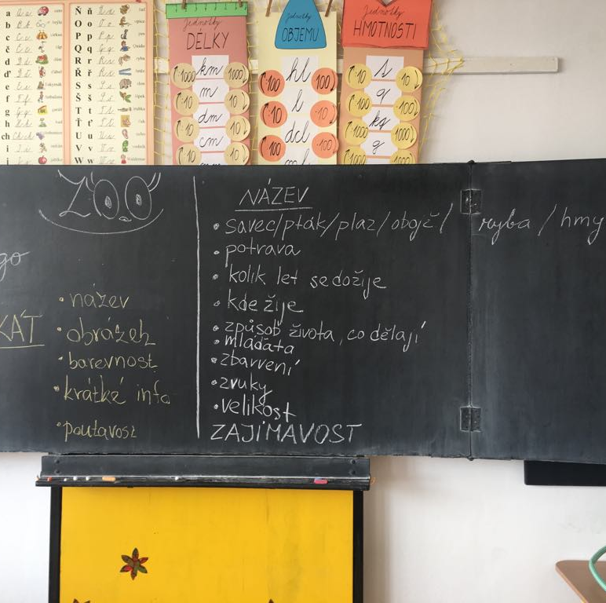
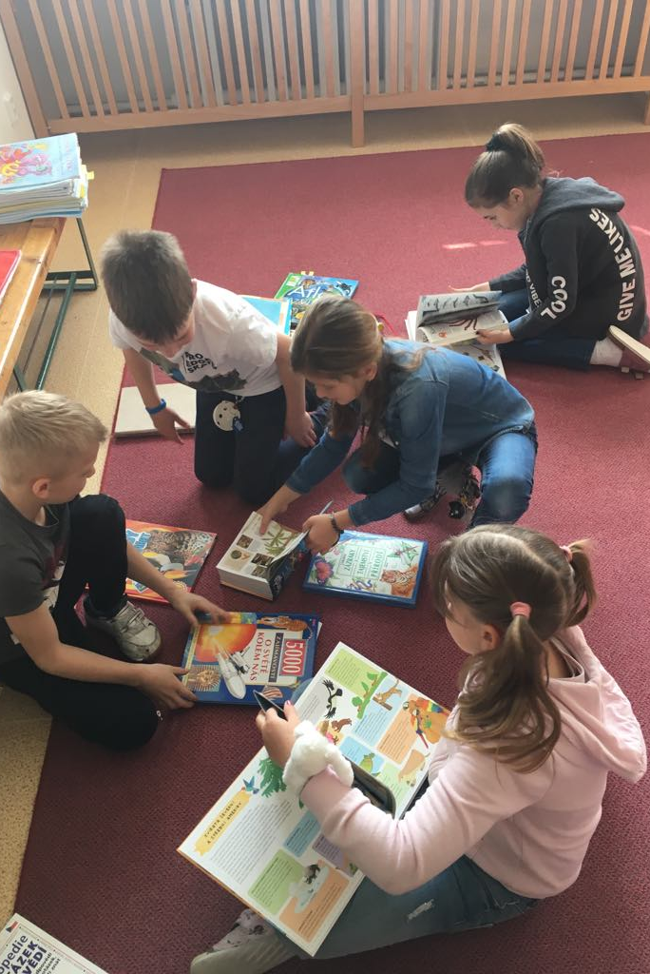
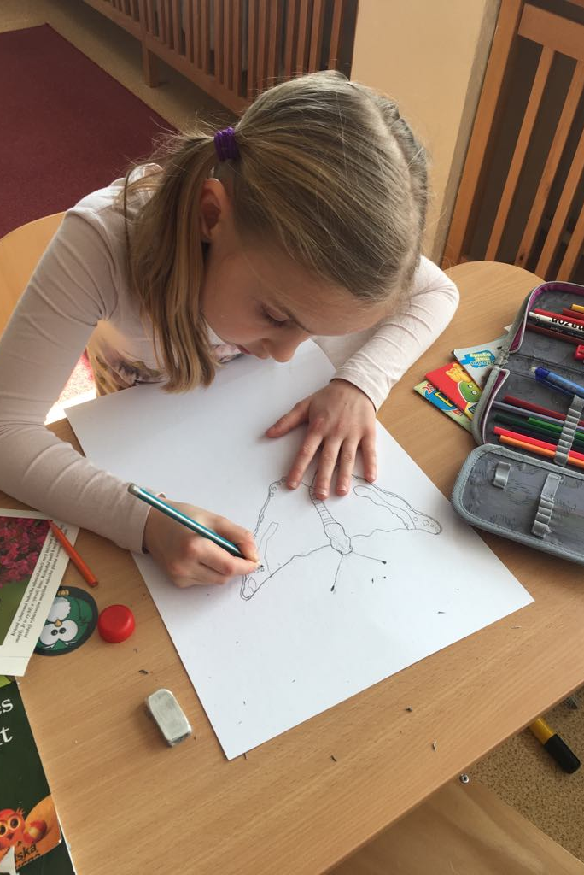
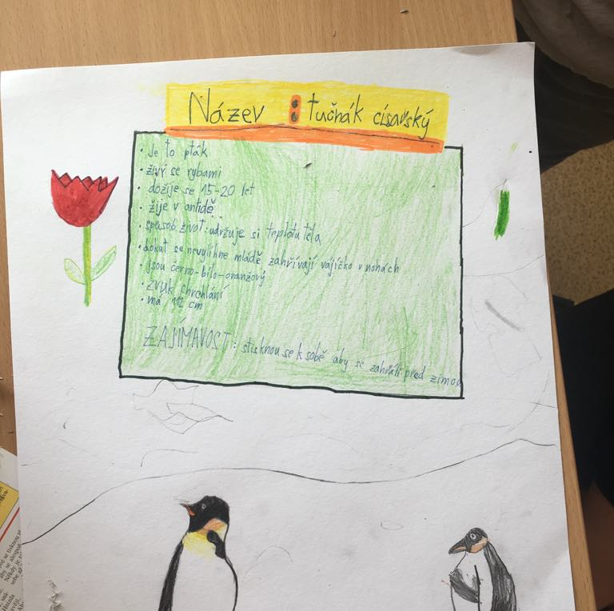

Slide 26
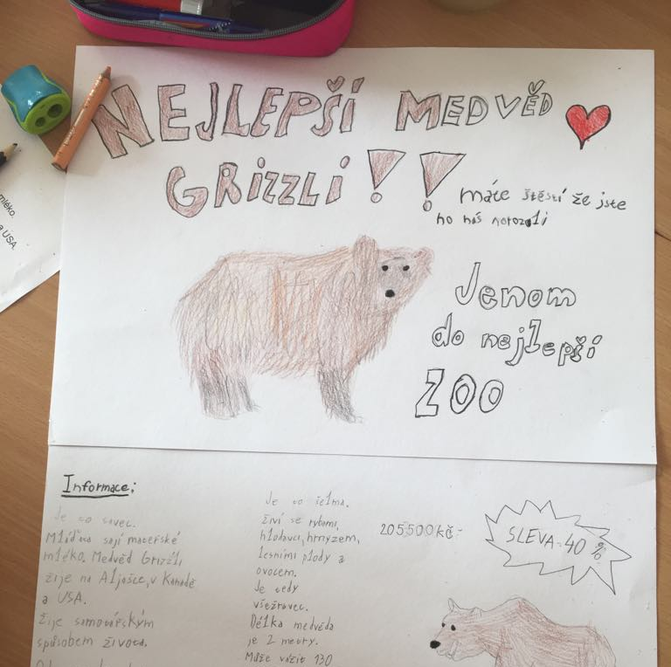
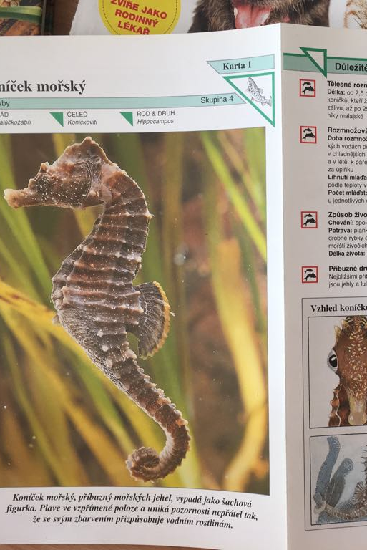
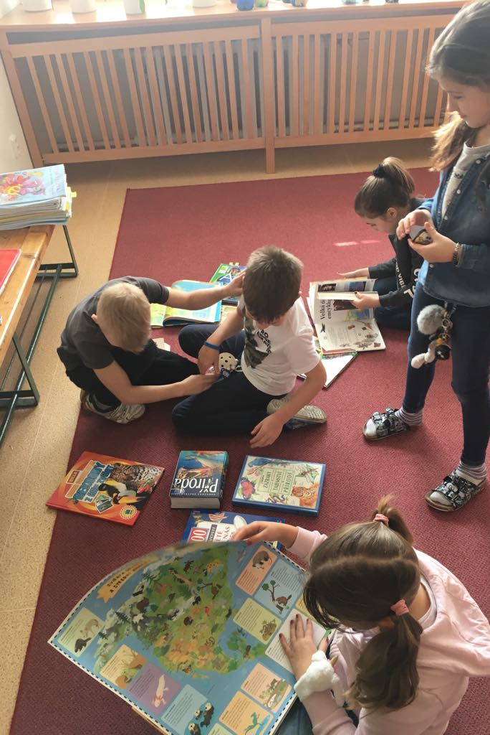
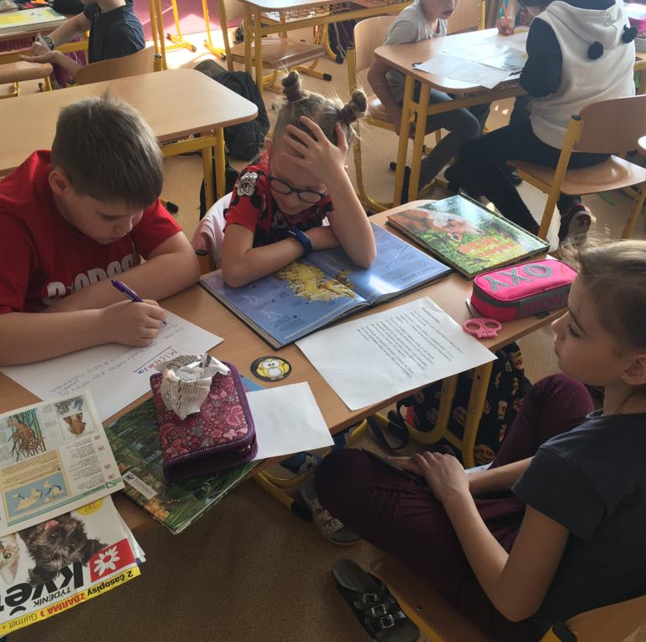

Slide 27
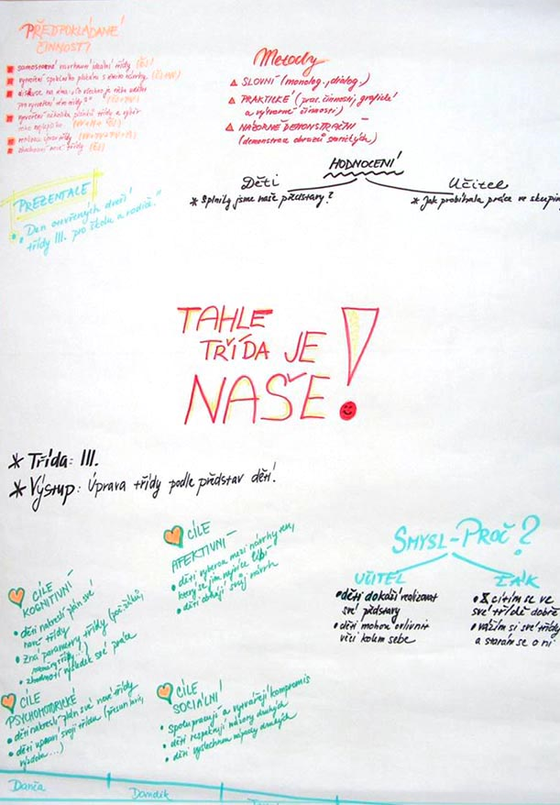
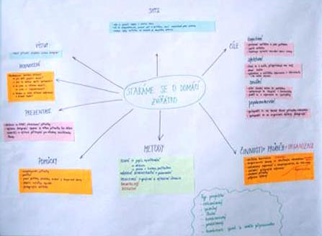

Slide 28
Thanks for your attention.

