Slide 1

The experience with artistic intervention in Finland
Pavel Sochor, Lucie Hájková
Spring 2021

Slide 2
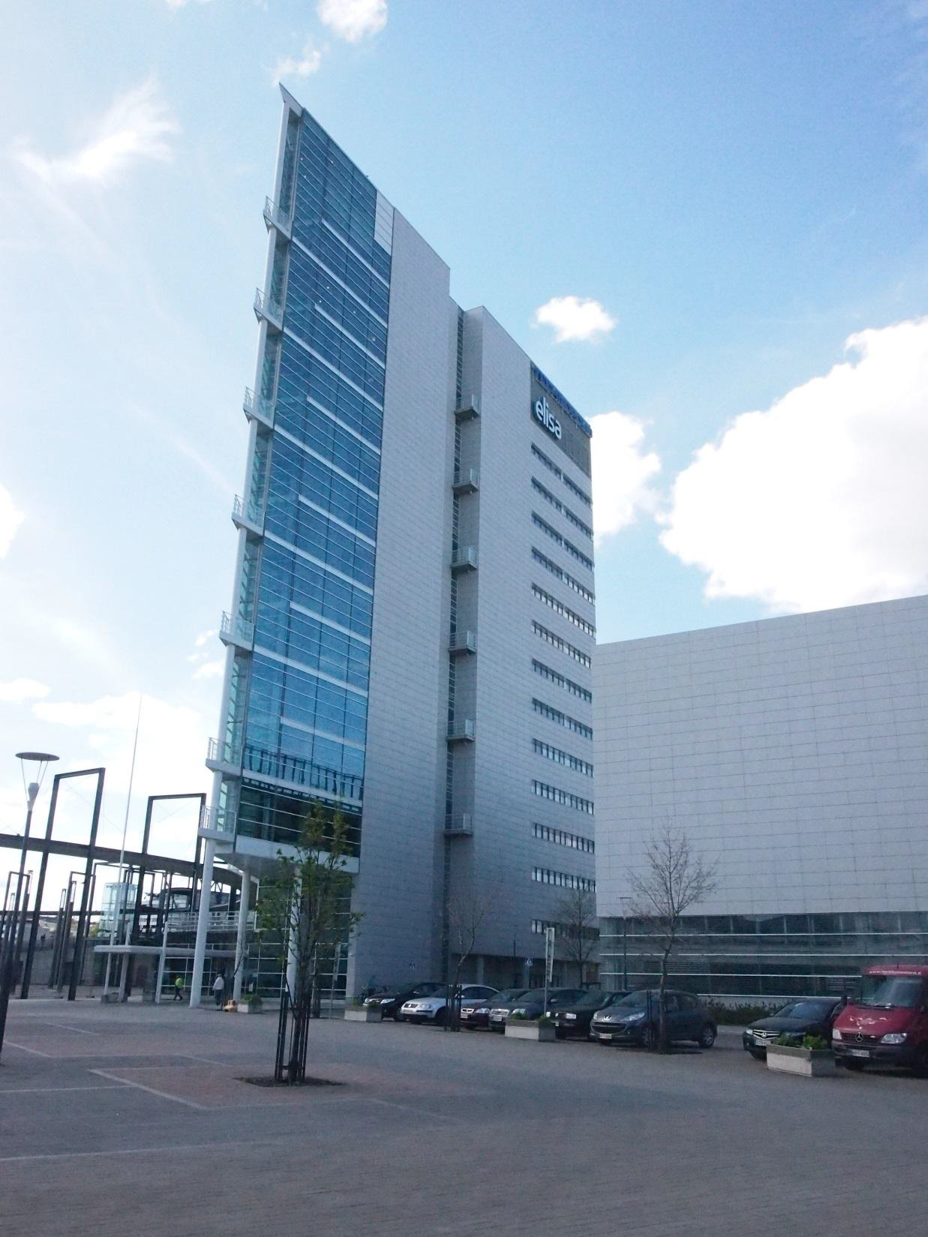



Slide 3
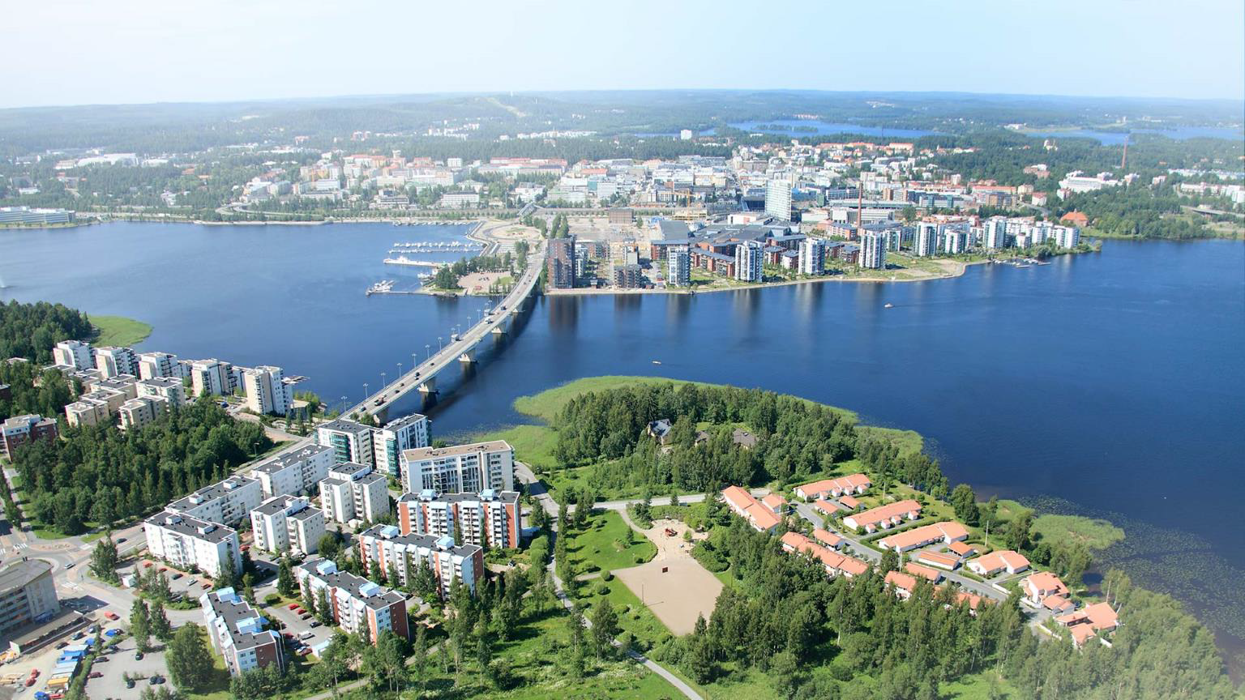

Slide 4
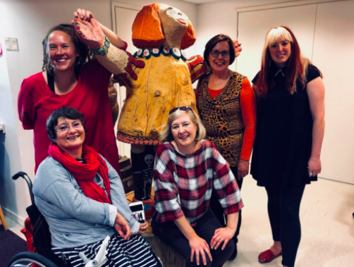

Slide 5
Here is the network for the support of non-professional artists with disabbilites in Finland.
Association for Rural Culture and Education
Kettuki is Finland’s nationwide studio network for artists from outside the mainstream art world;
Kaarisilta is Finland’s nationwide studio, art center, education center, social services ;
The Arts Promotion Centre Finland is a national funding, expert and service agency for promoting the arts;

Slide 6


Slide 7
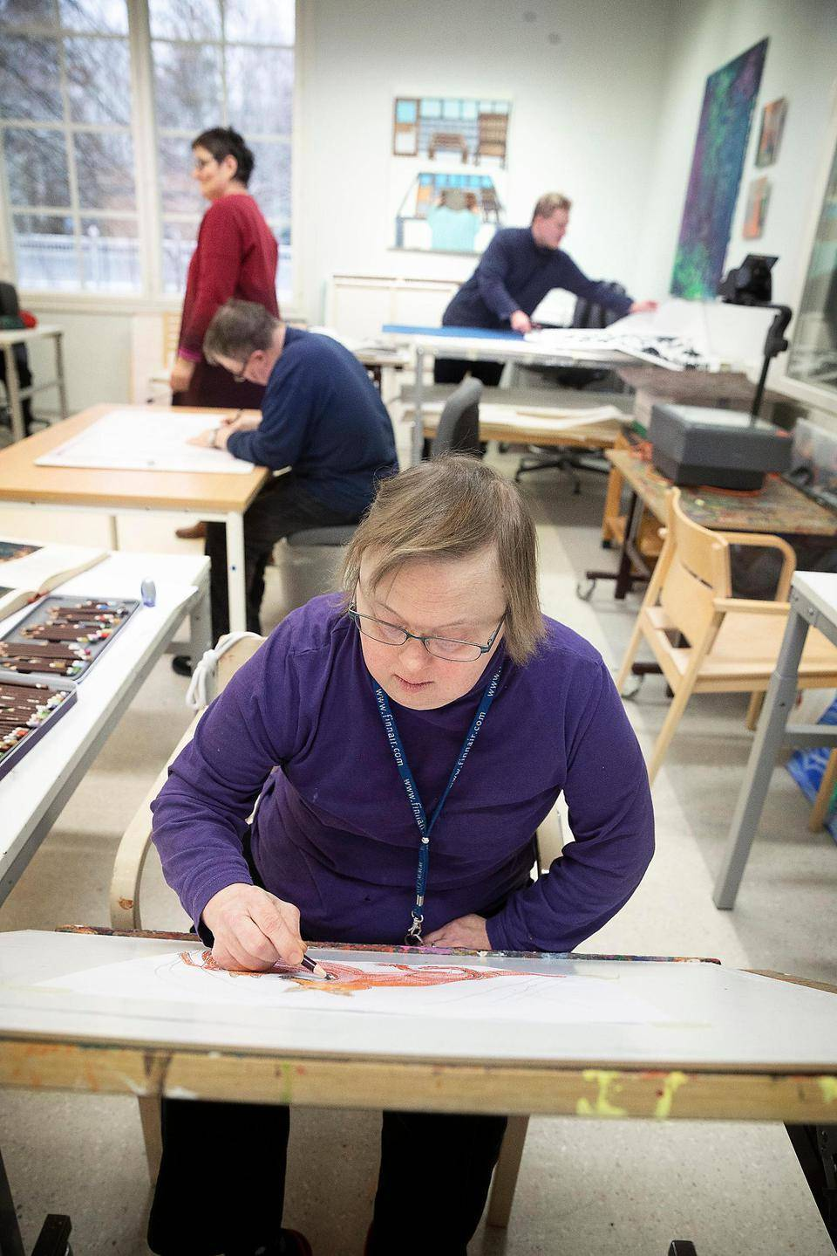

Slide 8
ART AND ACTIVITY CENTER KAARISILTA
Kaarisilta r.y. is a private association, providing specialized social and educational services. Close to the city of Lahti, it maintains an art and activity center for physically and/or mentally disabled young people.
The ideological principles of Kaarisilta are based on ethic and esthetic values, respect of life and each person’s individuality .
Their core activities are visual arts, crafts, music, drama, sports and all-round education. Teaching is mainly organized in groups, always taking into account the preferences and eventual limitations of each individual involved in the activities.
In 2003, vocational cultural education was included to the Kaarisilta activities. Their three year study program has two line options, music and visual arts. Every other year Kaarisilta also take in new students for one year prestudies to learn necessary skills to enter the vocational education program.

Slide 9


Slide 10
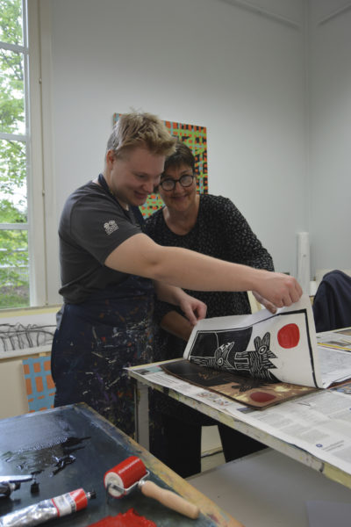

Slide 11
Kettuki
As the association was founded in 2002. The association consist of artists, art experts, professionals and 23 organizations in the field of art, culture and social services.
Outsider Art network Kettuki’s main goal is equality in art. Kettuki network aims to improve opportunities for people with intellectual and learning disabilities to study and practice art in both professional and recreational contexts.

Slide 12
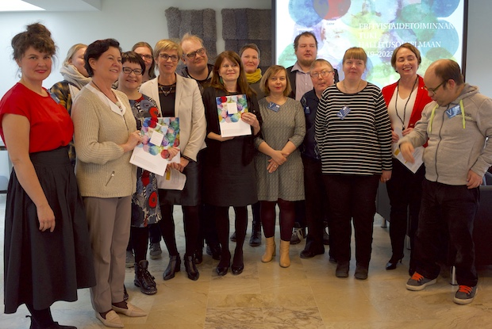

Slide 13
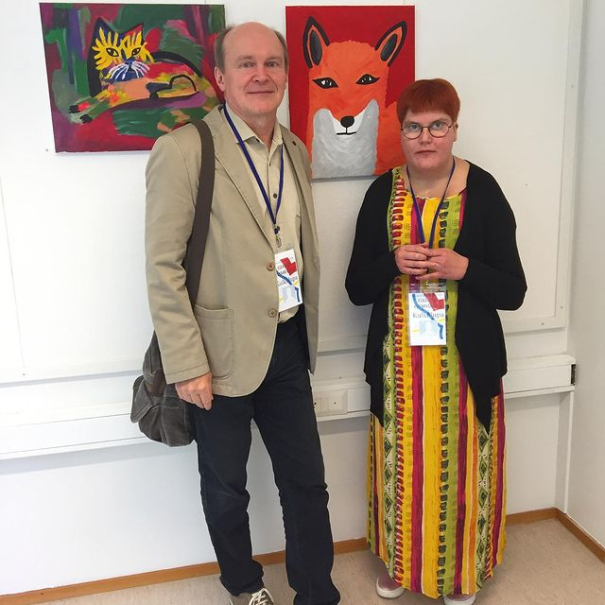

Slide 14
The main concept of the activities of studies and centers can be described as follows by a series of questions and answers:
It is allowed to talk about disability?
Different support for different needs?
Who decides?
The importance for art.
Publicity.

Slide 15
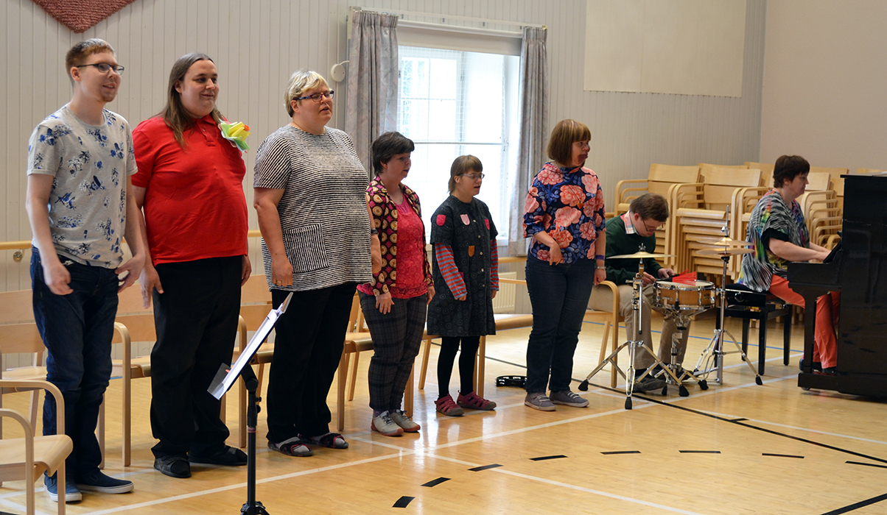

Slide 16
In art speech, the artist‘s biographical experience and knowledge provides an important background. Through that , the viewer of the art may identify with the artist and gets the opportunity not only to perceive the artist´s life, but also to understand their art. Disability is often a big part of the identity of people with disabilities.

Slide 17
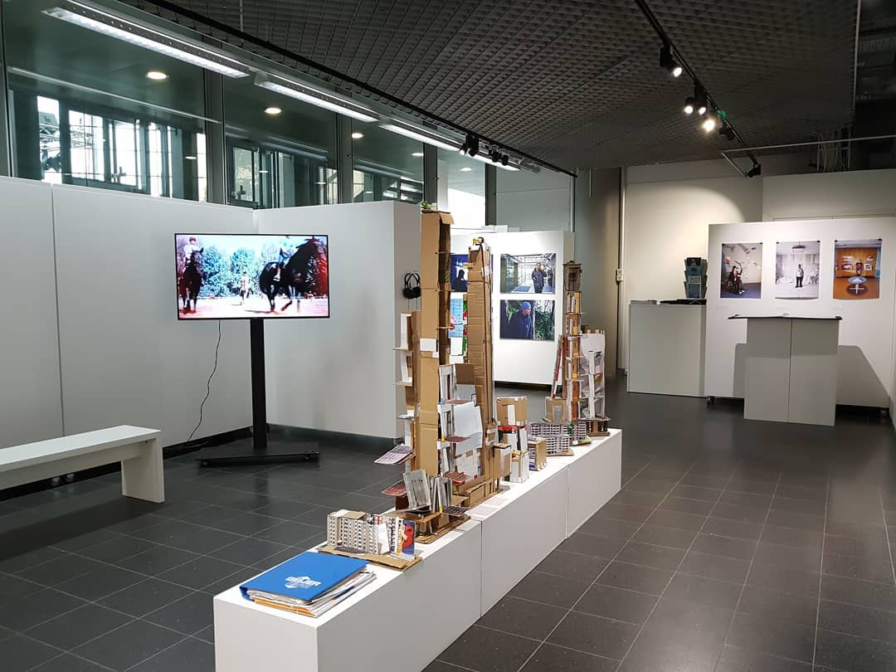

Slide 18
It may be that the person with disabilities requires support in all activities, throu the whole process of making art. Above all, support means aboving barriers to inclusion. At every stage of the work, It is good to thing.
How one can make sure that the decision made are the artist´s own and not the instructor´s. Decisions can mean everithing from choosing a subject to mixing colours, to the finishing of the work.

Slide 19
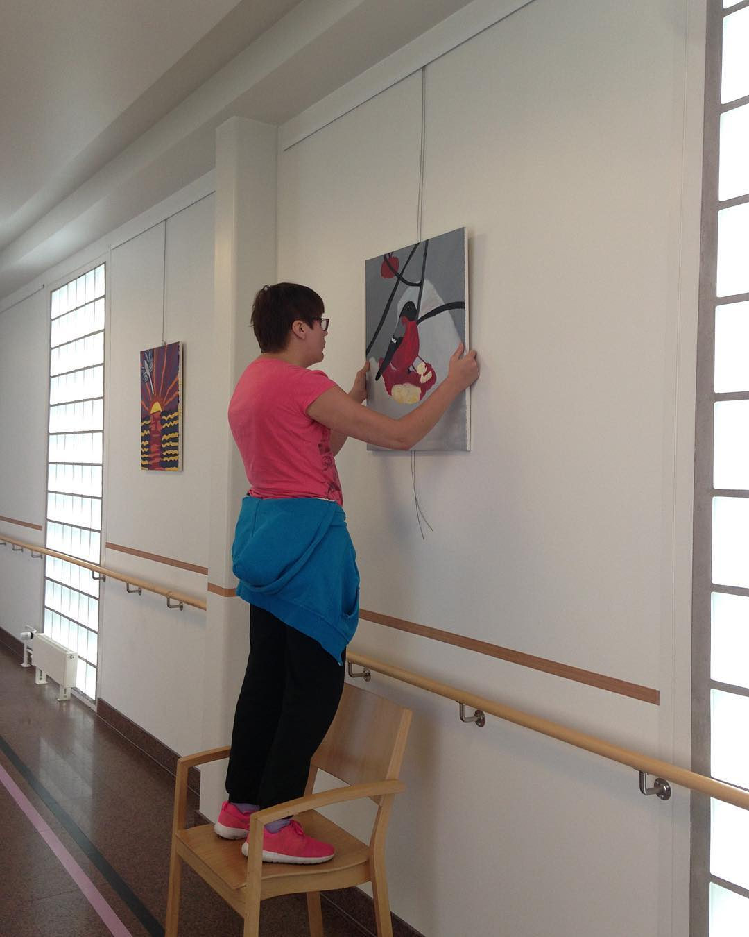

Slide 20
Who decides? Non of as can make a decision without knowing and understanding the options, this is also known as informed consent.

Slide 21
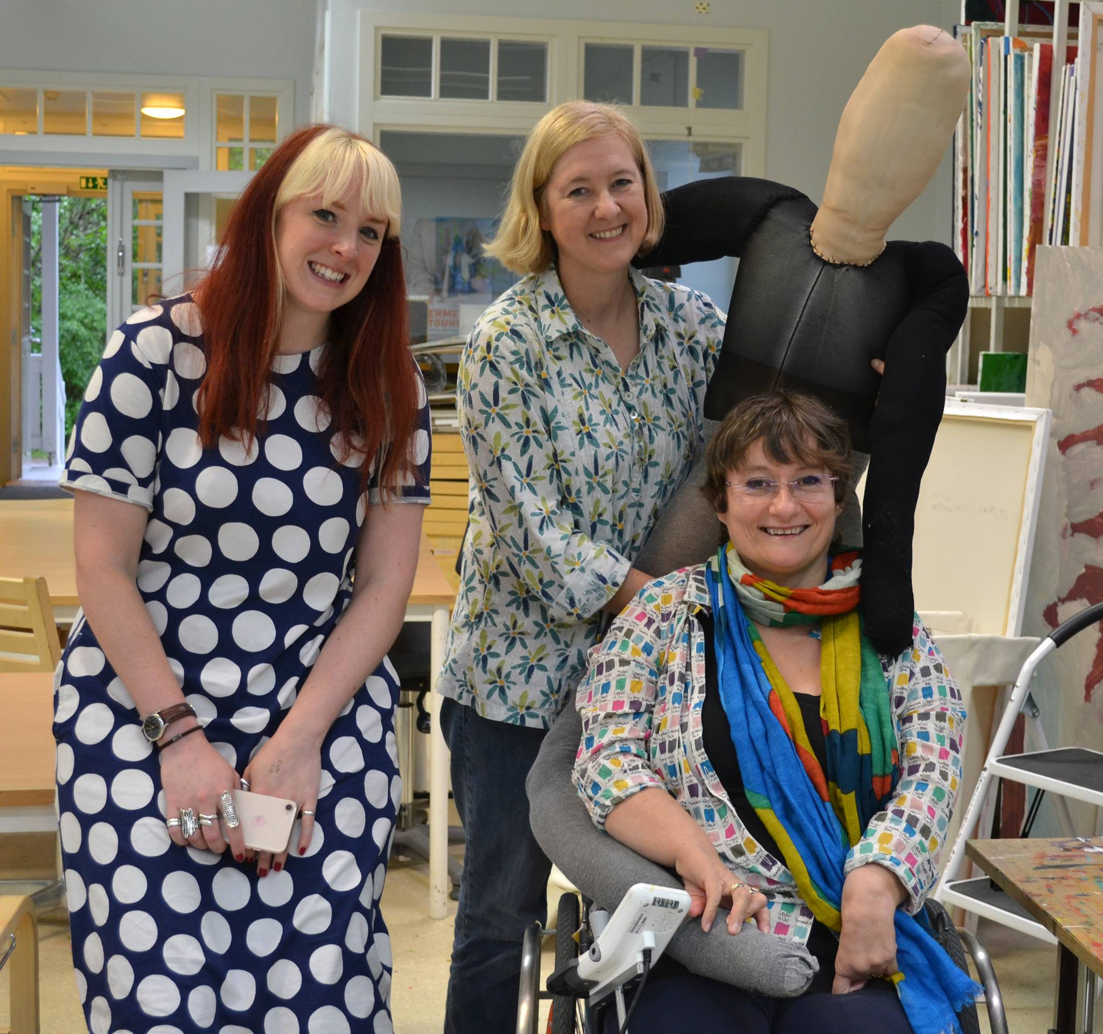

Slide 22
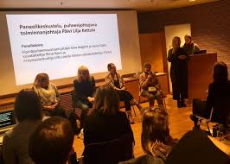

Slide 23
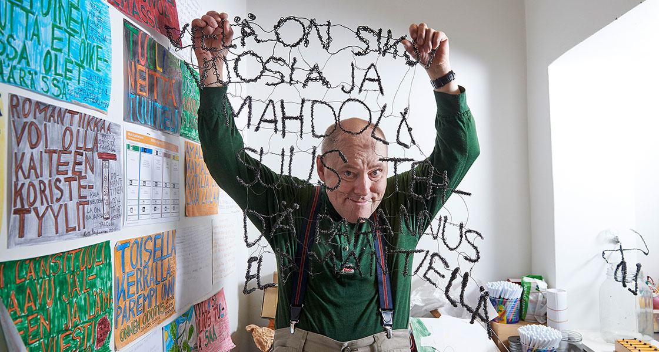

Slide 24
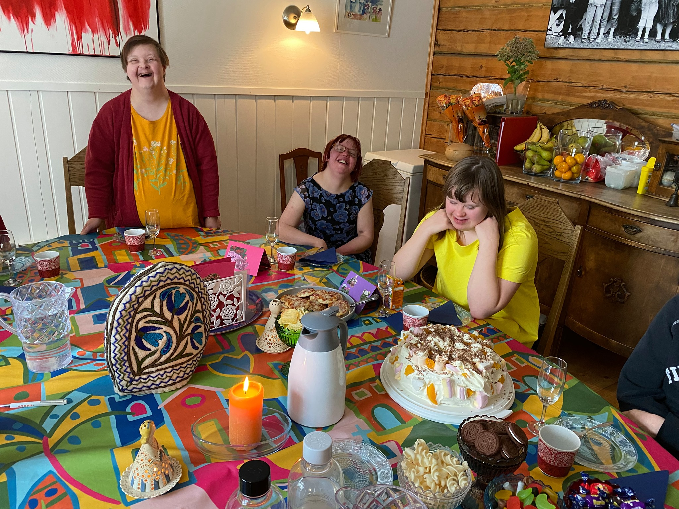

Slide 25
… the content of the art activities in culture could be:
• Description is – what I see, hear, smell (only observed facts);
• Interpretation is – what I think (about what I think I see);
• Evaluation is– how I feel (about what I think – is it good or bad?);

Slide 26
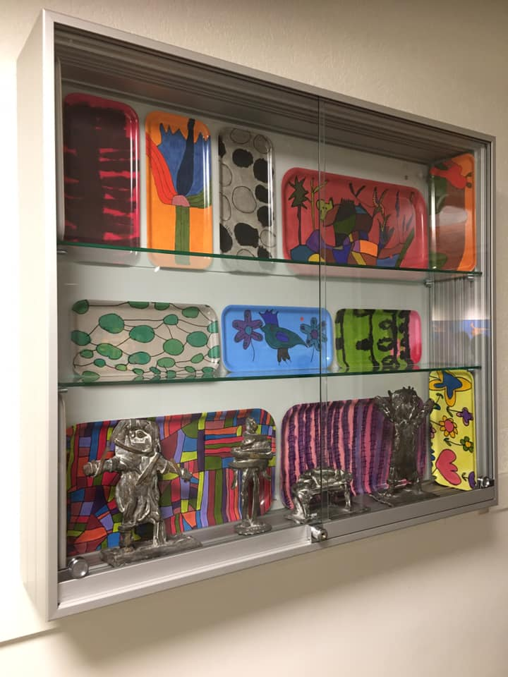

Slide 27
Works of art are often very personal. It is important to listen to what the artist wants and how they meant their work to be displayed in exhibitions. The basic of building an exhibition is that the works are presented with respect and as art.
If, for same reason, there aren´t enough resources to do anything else but hang the work up in a dark corridor with some blu tack , it is perhaps best to leave the exibition for another time.

Slide 28
Sources:
ITE art (online). 2021. From https://itenet.fi/en/
KAARISILTA (online). 2021. From https://www.kaarisilta.fi/
KETTUKI (online). 2021. From https://www.kettuki.fi/

Slide 29
Thanks for Your attention

