Slide 1
Language and Cognition
In cross-cultural perspective

Slide 2
Sapir-Whorf hypothesis
The strong version of S-W hyp. says that language determines our thought and that linguistic categories limit and determine cognitive categories. = linguistic determinism
Whereas the weak version of S-W hyp. says that linguistic categories and usage only influence thought and decisions.

Slide 3
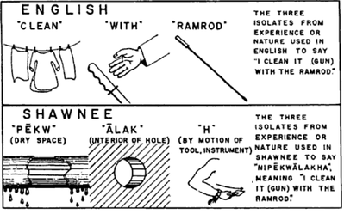

Slide 4
What is language?
There are several levels of meaning articulation in languages:
Phonological level
Nominal or categorical level
Sentential or propositional level
Narrative level (J. Bruner)
Every level (except the phonological) uses the elements of previous level.
These levels also represent developmental levels.

Slide 5
There are several levels in languages
1. Phonological
elements: phonemes = smallest units of speech in a language that distinguish one word from another.
English: g-lue and b-lue
Czech: ‚p-es‘ and ‚l-es‘ (b-ez, m-ez, n-es, v-ez…)
Consonants and vowels.
They differ from graphemes.
There is usually specific phoneme in every language.
? In English? In Czech
+ nereflektované rozlišování i/y: být/bejt, ale nikoli bít/bejt!

Slide 6
Number of phonemes in different languages

Slide 7
Extrémy v možném počtu fonémů:
Např. jazyk Rotokas z Papui-Nové Guinei, který pracuje jen s 11 fonémy. S 11 fonémy si vystačí i jazyk z melanéského ostrova Bougainville.
Čeština disponuje s 37 fonémy.
Naopak vysoký počet fonémů mají kavkazské jazyky (Klégr, Zima a kol., 1989, s. 20). Např. jazyk !xoo, který pracuje se 112 fonémy. Jazyk !xoo patří mezi Khojsanské jazyky vyznačující se různými klikavými a mlaskavými zvuky (https://en.wikipedia.org/wiki/Click_consonant ).

Slide 8
2. Nominal or categorical
the level of words and names and categories. Elements: morphemes.
This level comprises not only the morphemes but also what we denote by them.
Color perception and color labelling.

Slide 9

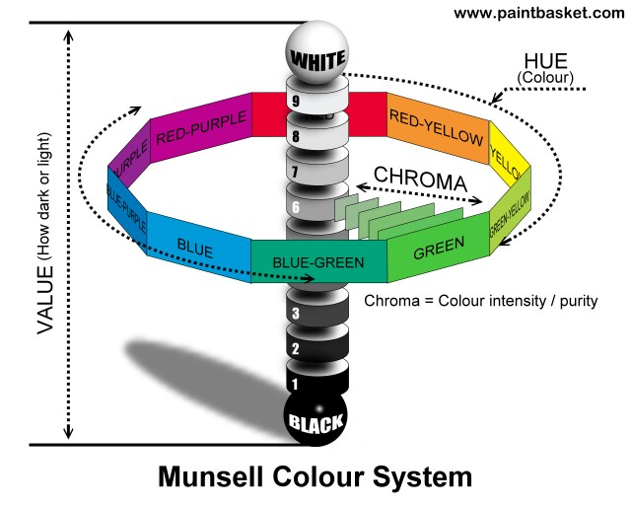
Berlin & Kay, 1968

Slide 10
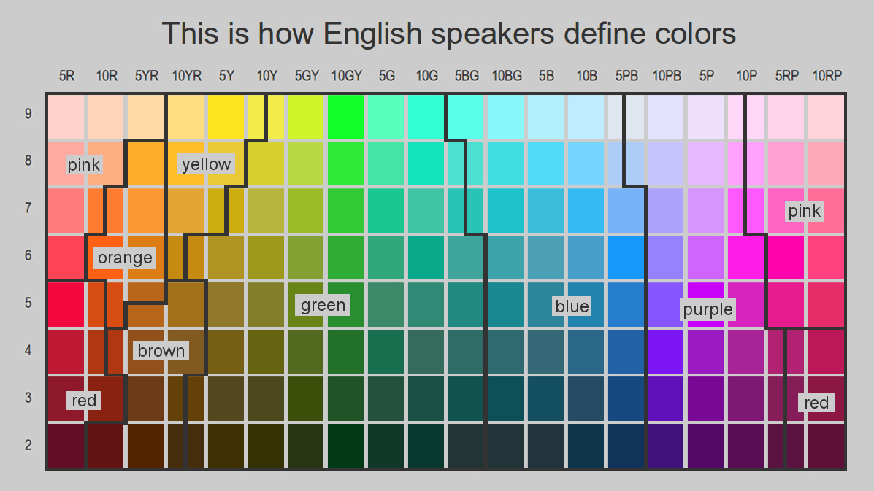
Lexicalisation = categorization

Slide 11
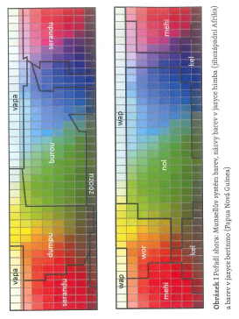
Munsell color system, (above) names of colors in Himba language from SW Africa; (below) names of color in Berinmo from Papua-New Guinea.

Slide 12
https://www.youtube.com/watch?v=gMqZR3pqMjg

Slide 13
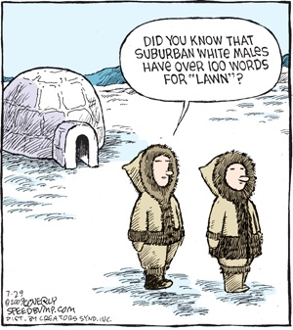

Slide 14
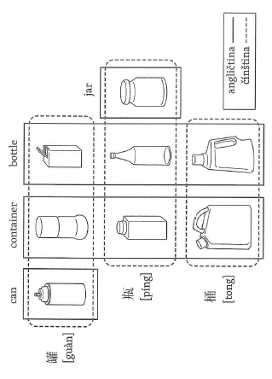
Containers- English and Chinese categorization: Classifiers

Slide 15
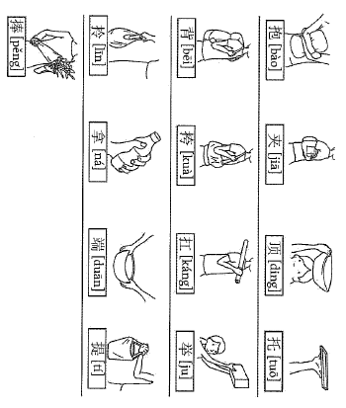
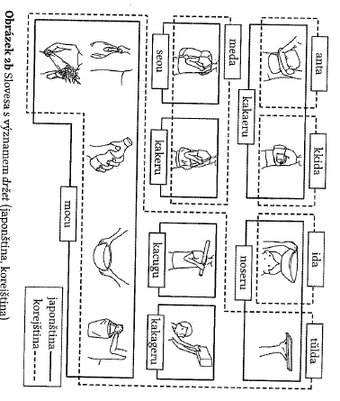
Verbs
Chinese verbs with a meaning to hold
Japanese and Korean categorization of verbs with a meaning to hold

Slide 16
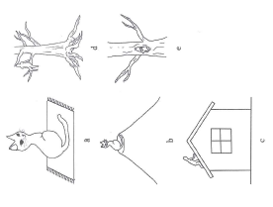
Prepositional system in Mexican mixtec

Slide 17
Classifiers and Grammatical gender
Masculine & feminine + neuter
Animate & inanimate
Australian Dyirbal: 4 categories of gr. gender:
Bayi: men, most fish, snakes, birds, insects, moon…
Balan: women, water, fire, violence, and other dangerous things, exceptional animals, stars.
Balam: edible fruit and vegetables
Bala – stones, trees, body parts, wind, miscellaneous (includes things not classifiable in the first three)
Hungarian hasn‘t genders.

Slide 18
Borgesova citace „jedné staré čínské encyklopedie“, která, máme-li jejímu autorovi věřit, dělí zvířata na:
a) patřící císaři
b) nabalzamovaná
c) zdomácnělá
d) prasátka
e) sirény
f) bájná
g) toulavé psy
h) zvířata zahrnutá do této kategorie
i) co jsou jako bláznivá
j) nespočitatelná
k) nakreslená tenoučkým štětcem z velbloudí srsti
l) a podobně
m) ta, co právě rozbila džbán
n) ta, co z dálky připomínají mouchy.

Slide 19
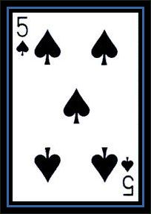
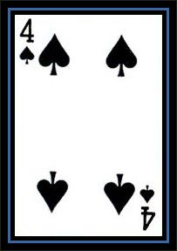
Systém číslovek:
Kmen Piraha zná jen 1, 2 a „mnoho“.
V úkolech počítání mají problém spočítat více než tři prvky.
Nedokážou říci, v čem je rozdíl mezi:

Slide 20
Směry:
Někde : vpravo-vlevo (egocentrické)
Jinde: sever-jih-východ-západ (absolutní; lepší schopnost orientace v prostoru!)
Jinde: po proudu-proti proudu řeky, k moři-od moře, dolů-nahoru atd.
Srov.: Pokorný, J. (2009). Lingvistická antropologie.

Slide 21
Systém času:
Dřív (vzadu, vlevo), později (vepředu, vpravo): čeština, angličtina
Dřív (nahoře), později (dole) : mandarínská čínština (jsou více citliví na vertikální vodítka).
Ajmarština má budoucnost vzadu.
Existují tzv. bezčasé (tenseless) jazyky: Ajmarština, Hopi, mayština, Bororo, mandarínská čínština, Sango, Tiwi aj.
Mayština nezná navíc ani slova pro: před a po (časově).

Slide 22
in English it is necessary to mark the verb to indicate the time of occurrence of an event you are speaking about: It's raining; It rained; and so forth. In Turkish, however, it is impossible to simply say, 'It rained last night'. This language, like many American Indian languages, has more than one past tense, depending on one's source of knowledge of the event. In Turkish, there are two past tenses—one to report direct experience and the other to report events that you know about only by inference or hearsay.

Slide 23
Perception of time
People from different cultures treat time differently: some are punctual, some are not.
Differences caused by different perception of time.
  Western world: precise measures of time (clock time)
    1h, 1m, 1s
  Arab cultures: 3 sets of time
    No time at all, now (of varying duration), forever (too long)
    Time measured by duration of events (event time)
  Africa: individual vs. tribal time
    In Swahili
      Sasa: Now, sense of immediacy
      Zamani: Past, connector of individual souls
Notes:
Arabs
Walking distance, for example, was sometimes measured by the event of cigarette smoking, and Islamic law sets the imprisonment time of robbers not by units of time, but by the time it takes for the robber to repent his crime (Hanif 1999). Thus, time in Arabic-speaking Islamic culture has historically been measured by the pattern of the task, not by the recorded day, hour, or minute (Goldman and Rojot 2003). There is consequently little emphasis on haste, which makes for a distinct separation between time and money (Levine 1997).
Burundi
In Central Africa, people are guided by the seasonal changes since they are anagricultural society. The obsession with the clock time did not yet catch up to them, nor will it do in the near future. Appointments people make are regulated by natural cycles and once again not by a mechanical clock. How people relate to time is based on activities of the cows, since they are the most common animals and the easiest to relate to. When someone wants to make a late afternoon appointment, they say “I’ll see you when the cows go out.” Being precise is seen as too much of a hassle and is not looked favorably upon. An hour earlier or later does not really matter, since of someone said they will be at a place in the midday, they will be there. Even though making appointments at night gets difficult, they do not see a need for quantities of time. They refer to a very dark night as the “Who are you?” night, since it is so dark they cannot see each other’s face. To make an appointment at night, they define on how dark or light it will be at that time. This society has no need for the precision of a clock. They are driven by forces of nature and rely on their biological clock. There is no need to hurry, for what is there now will still be there a few minutes later.
The Piraha Tribe
The Piraha Tribe which is located in the Amazon rainforest is the only culture in the world that does not have a creation myth. They have no numbers or a written language for that matter wither. They do not have past tense. Everything exists in the present. If it is not here right now, then it does not exist. The language of the Piraha tribe is very limited, consisting of humming and whistling. They do not write and do not memorize things. These people don’t tell stories of their ancestors and very few can remember their grandparents’ names. Since they have no way of talking about the past, it ceases to exist. This, they have no stories of where they came from or how the world was created. All they say is “The world is made.” Time is a quantity beyond their grasp. They rely purely on nature and their instincts, with which they are greatly intact. There are no numbers to give time value to. The only word they have for a quantity is hoi, or small, little in amount, close to one. They don’t see a need to define time, and have been able to survive for centuries without this notion. The Piraha refer only to the immediate personal experiences. They are not interested in the past nor the future. They live here and now. Everything is anchored in the present. They do not try to control nature nor organize forces beyond their grasp like the modern societies do. They are content with today’s day and live without a tomorrow in mind.

Slide 24
Consequences of different time perception
Western world
  Time is a commodity (can be bought and sold)
Arab cultures
  More attention is put on „now“ than to events in the future
  Time and money are separated
  You can´t arrange a meeting at a certain time.
African cultures
  Can´t arrange a meeting at a certain time.

Slide 25
Tykání a vykání: člověk musí rozlišovat sociální vztah a status toho, s kým mluví. Anglicky mluvící všem říkají you. ( – rozdíly v sociální oblasti)

Slide 26
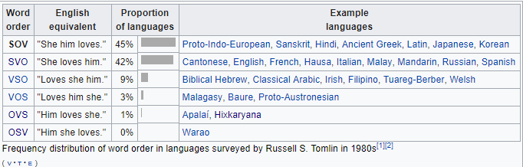
3. Level of sentence
Grammatical level (morphemes and their syntax). In a sentence we say something about something.
Elements: syntactic categories (subject, verb, object, attributes).
Propositions in logic.
Linguistic typology: according to subject–verb–object positioning or word order:

Slide 27
Morphological Typology (Manker, 2016)
Languages have a wide variety of morphological processes available for creating words and word forms (e.g. different types of affixation etc.).
However, languages vary with respect to what morphological processes are available, how frequently they are used, and what types of information can be encoded in these processes.

Slide 28
But languages often show elements of different morphological types – they are mixed.

Slide 29
Analytical and isolating languages
Analytical languages have sentences composed entirely of free morphemes, where each word consists of only one morpheme.
A canonically analytic language is Mandarin Chinese. Note that properties such as “plural” and “past” comprise their own morphemes and their own words.
[wɔ mən tan tçin lə]
1st PLR play piano PST
‘we played the piano’
English

Slide 30
Synthetic languages
Synthetic languages allow affixation such that words may (though are not required to) include two or more morphemes.

Slide 31
Agglutinative languages
Agglutinative languages have words which may consist of more than one, and possibly many, morphemes.
morphemes within words are easily parsed. There is 1:1 morpheme to meaning ratio – like “beads on a string”.
Turkish, Swahili, Hungarian…
el-ler-imiz-in (Turkish)
hand-plr.-1st plr.-genitive case = ‘of our hands’
ni-na-soma (Swahili)
I-present-read = ‘I am reading’

Slide 32
Fusional languages
Fusional languages may have morphemes that combine multiple pieces of grammatical information; that is, there is not a clear 1 to 1 relationship between grammatical information and morphemes.
Czech:
Děl-á-m-e
VERB stem – thematic suffix – both 1st person & present tense – plural
Muž-ovi a Muž-i (dative) …
English: He works, works + work‘s (plural, 3rd person, possesive)

Slide 34
Polysynthetic languages
typically have long "sentence-words" such as in Eskimo languages (West Greenlandic):
tusaa-nngit-su-usaar-tuaannar-sinnaa-nngi-vip-putit
‘hear’-neg.-intrans.participle-‘pretend’-‘all the time’-‘can’-neg.-‘really’-2nd.sng.indicative
‘You simply cannot pretend not to be hearing all the time’

Slide 35
Španělština preferuje více výroky v trpném rodě (oproti angličtině). Při posuzování např. nehody vede pouhý popis činu k mírně rozdílnému pojetí celé situace a tedy k odlišné penalizaci nehody.

Slide 36
4. Narrative level
Elements: characters, setting, events, goal-directed actions, background, outcomes, genres etc.
We remember and understand our lives as narratives.
Some psychologist (mostly psychoanalists and those working with term archetype) would say that the general frames of stories of all nations are very similar.

Slide 37
Argumenty proti lingvistickému relativismu:
S. Pinker (Language instinct): Hopiové ve skutečnosti dokážou o čase hovořit velmi sofistikovaně.
Pinker: Někteří lidé po mrtvici nedokážou mluvit, ale dokážou i přes to myslet. Tzn. neschopnost mluvit zde nenarušuje jiné kognitivní funkce.
Pinker: Hluchoněmý jedinec Ildefonso se naučil ASL v 27 letech. Poté sděloval zážitky ze svého předchozího života, což by teoreticky neměl být schopen, když neznal jazyk, který determinuje vědomí.
Chandler (1995): básně většinou využívají zcela jiná slova s jinými asonancemi atd., ale i přesto je význam básně zachován.
ALE!: Pinker jen dokazuje, že myšlení existuje mimo řeč, což se zase nijak nedotýká lingvistického relativismu.
Boroditsky: "Simply showing that speakers of different languages think differently doesn't tell us whether it's language that shapes thought or the other way around."

Slide 39
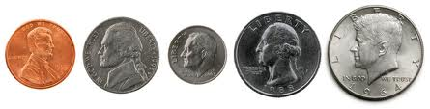
How culture influences our perception? – Values and needs
Example: Bruner & Goodman (1947). Value and needs as organizing factors in perception.
  N = 30, 10 year old, normal intelligence
  3 groups
    2 experimental: poor and rich families – coins (1x according to memory, 1x after presentation)
    1 control: cardboard discs of the same size
Notes:
Penny, nickel, dime, quarter, half-dollar (1

Slide 40
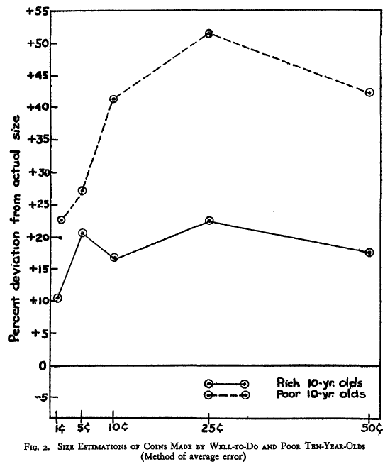
How culture influences our perception?
Results:
  Poor overestimate size of the coins considerably more than the rich.

Slide 41
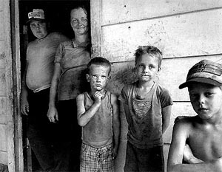
How culture influences our perception? – Values and needs
Bruner & Goodman conclusion:
  Need for money among the children from poor families (Boston slums) influenced their perception of the coins.
  Replicated in Hong Kong with similar results.

