Slide 1
AJ5415 Storytelling for Young Learners
Kateřina Tomková, 2060@mail.muni.cz
Block 2
Saturday, April 30, 2022

Slide 2
Our schedule today
0800-0830 Revision of Block 1 on March 5
0830-0900 Revising audio essays in the File Vault
0900-1000 Peer reviewing audio essays
1035-1135 Coffee break & watching webinar
1135-1200 Webinar gisting & discussion
1200-1230 PACE (TEMPO) & TIMING
1230-1300 STRESS & RHYTHM
1300-1330 THE ART OF READING
1330-1350 Summary, conclusions,
group & individual consultations

Slide 3
Resources
All in the course‘s site in the IS:
- this presentation
- Rowling speech with gaps
- Tomková Segmental pronunciation of English
- Tomková Suprasegmental pronunciation of English
- Tomková The best videos for teaching English pronunciation
- Your own minitalks in the File Vault
- Easter class in stress, rhythm and intonation

Slide 4
List of topics last year
„Klekánice“ Twighlight Witch = Dominika F.
My Father‘s Eclectic Tales = Ilona
Creative/Crime Storytelling + 9th Graders‘ Backtracking = Míša
Harry Potter Teaching English! = Dominika Š.
Picture-Perfect = Eva M.
The British School of Prague Experience = Ivo
Number Stories in Spain = Roman
The Brno Spanish Dragon Story = Anna
My Canadian Granny = Lucía
Naptime and Circletime Stories = Martina Doč.
Art School Film Posters = Petra L.
Heroes of Children‘s Own Stories = Luboš
Emily‘s Photobook + picture = Pavlína
WonderClass = Jana
Smasher

Slide 5
Discussion in pairs 0900-0930
Talk to the author of your favourite audio essay and pepare to reproduce it in the main session. Discuss:
What are your respective strengths and weaknesses?
What are the main points on your partner‘s recording?
What did you most appreciate/dislike?
Would you change the paper‘s headline?

Slide 6
Reproducing essays 0930-1000
Nina K. – Nighttime reading
(Lucie L. – AuPair story)
Lucie H. – Storytelling with a toddler rev. By Marta Iturre
Michal B. - Build-a-story cards
Martin K. – Pupils‘ own Limericks
(Joshua W. – Aboriginal storytelling rev. by Carmen E.)
Eva H. - My approach to storytelling
Eva Č. – Storytelling 1.0
(Jon Ander G. – Elmer the Elephant)
Kateřina B. – Doggie photostory
Nikola B. – Storytelling as escape from reality
Naďa F.

Slide 7
Authors online and absent
BR1:
Jan S. – Everyday storytelling
Jitka W. – The Canterville Ghost
(Petra S. – Grade 1 bilingual school: O for OWL)
BR 2:
Lucie F. – Emperor‘s new clothes
Míla Ch. – Reading picture books to children
BR 3:
Jason H. – Story of music
Marie Š. – A bit of Montessori
Absent:
Joshua W. – Aboriginal storytelling rev. by Carmen E.
Jon Ander G. – Elmer the Elephant
Carmen E.D. – Storytelling in preschool education
Jone C. – Vital themes, Inclusion
Marta I. – Tres con tango

Slide 8
Coffee break while watching and note-taking 1035-1135
In 5 groups, watch MacMillan Education ELT‘s Advancing Webinar of January 2021, “Storytelling for Young Learners“
Storytelling for Young Learners [Advancing Learning Webinar] – YouTube
https://www.youtube.com/watch?v=UL-wgRGrzr8
BR1: 00-10 mins: Joanne Mitten & webinar intro
Nina, Lucie H., Eva Č.
BR2: 0953-1955 : gender + society, skill+survival, modern;
Piaget, Vygotsky Michal, Martin, Eva H.
BR3: 1955-3000 : why stories in LL, L1 and L2 acquisition x
learning …whole child Nikča, NaĎa, Kateřina
BR4: 3000- 4015: why use stories … become a performer
Jan, Jitka, Lucie F.
BR5: 4015- 4958: teens and tweens … references Jason, Míla, Marie

Slide 9
Webinar gisting, discussion 1135-1200
Joanne Mitten =
ST common to all cultures; 44,000 yrs ago – cave paintings. Aesop‘s fables. Traditional Irish STs (bearers of old lore). Embedded in culture. C. Dickens (social commentary).
Gender and society. Victorian ghost stories, E. Brontë; skill + survival.
Modern stories in books, movies. Stories in LL. Education + psychology.
Piaget (individual) , Vygotsky (community).
Different age groups, their abilities. L1 exposure: repetition, recycling. Sounds at different levels.
Story choice. Pre-story and post-story tasks: pix, vocab, retelling, performing skills of teacher. Teens: specific needs.
Tweens (8-12) and teens. Choice and scaffolding of a story. Using different stories for retelling. Sketching. Picking a line or object in the story. Reenactment. Older pupils: songs, characterisation, cross-curricular activites (e.g. making a movie). 21st century skills: critical thinking, creativity, collaboration, communication, digital literacy, leadership, social skills, flexibility, motivation, productivity…

Slide 10
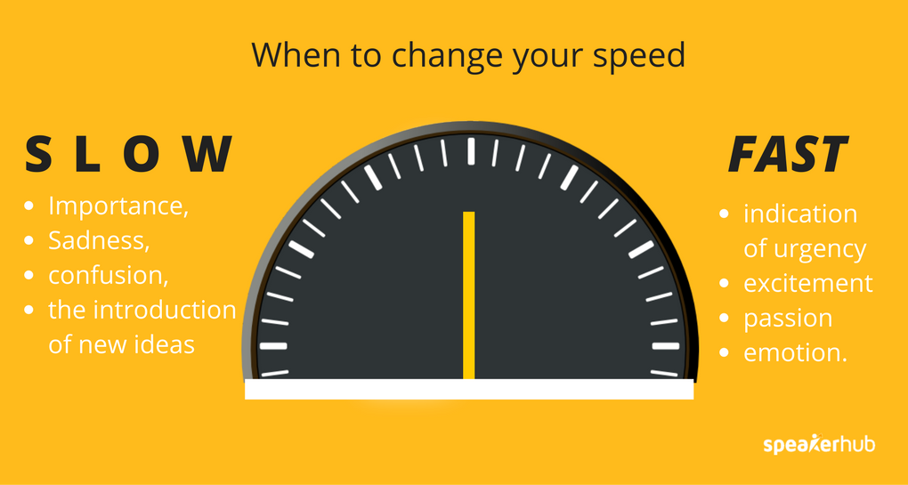
1200-1230 Voice in storytelling 1:
PACE (TEMPO) & TIMING

Slide 11
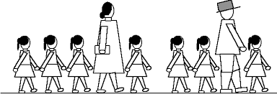
1230-1300 Voice in storytelling 2:
STRESS & RHYTHM

Slide 12
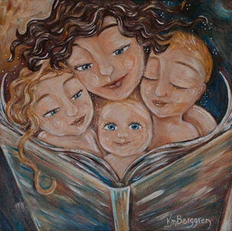
1300-1330 Voice in storytelling 3:
THE ART OF READING

Slide 13
Thank you for your attention and active part☺
Concluding remarks, questions, queries… ?
I am available for further group/individual consultations until 1350.
So long, live well, tell stories and never lose your passion!

