Slide 1
Czech life and culture
Marek Lollok, PdF MU

Slide 2
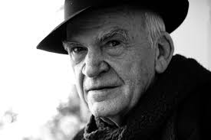
Milan Kundera
- born on 1st April 1929 in Brno
- Czech-French writer
exile in France since 1975

Slide 3
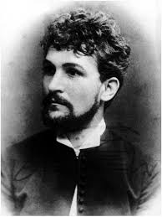
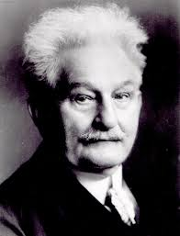
Leoš Janáček (1854-1928)
- composer, folklorist, musical theoretist
- young conservative, old avantgardist

Slide 4
Janáček´s operas
- Jenůfa (Její pastorkyňa, Her Stepdaughter) – premiered in 1904 in Brno
- Káťa Kabanová
- The Cunning Little Vixen
- The Makropulos Affair
- From the House of the Dead
- The Excursions of Mr. Broucek

Slide 5
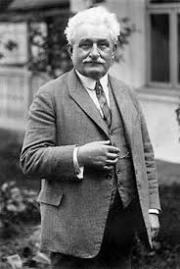
Janáček´s other works
- Sinfonietta
- Glagolitic Mass

Slide 6
Alfons Mucha (1860-1939)
-Art Nouveau Painter and decorative artist
- Slavic Epic: https://en.wikipedia.org/wiki/The_Slav_Epic

Slide 7
Tomaš Garrigue Masaryk (1850-1937)
- the first president of Czechoslovakia, sociologist, philosopher
- „father of the nation“
- https://www.youtube.com/watch?v=mCUYMZU-mwQ
- „Do not fear and do not steal“

Slide 8
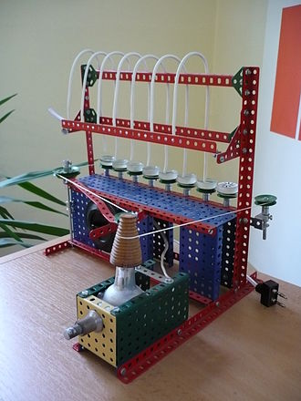
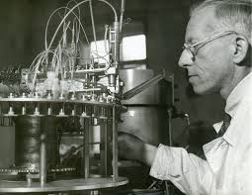
Otto Wichterle (1913-1998)
- chemist
- inventor of contact lenses

Slide 9
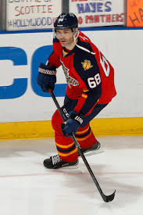
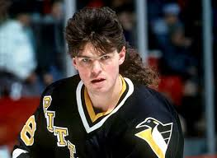
Jaromír Jágr (1972)
- hockey player
- one of the best European players in NHL
- member of Triple Golg Club

Slide 10
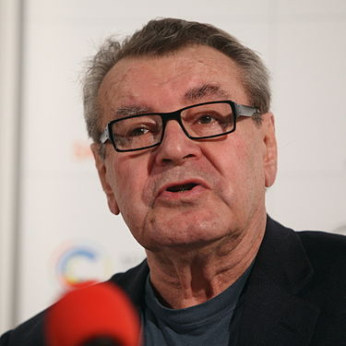
Miloš Forman (1932)
- film maker, director
- Oscar winner
https://www.youtube.com/watch?v=mCUYMZU-mwQ

Slide 11
Miloš Forman´s famous films
- Loves of a Blonde
- The Fireman´s Ball
- One Flew Over the Cuckoo´s Nest
- Hair
- Amadeus
- Valmont
- The People vs. Larry Flint
- Man on the Moon

Slide 12
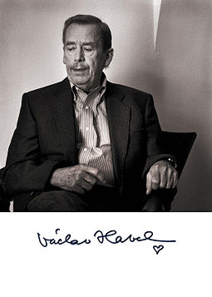
Václav Havel
- 5 October 1936 – 18 December 2011
- Czech writer, playwright, statesman
- „Truth and love must prevail over lies and hatred“

Slide 13
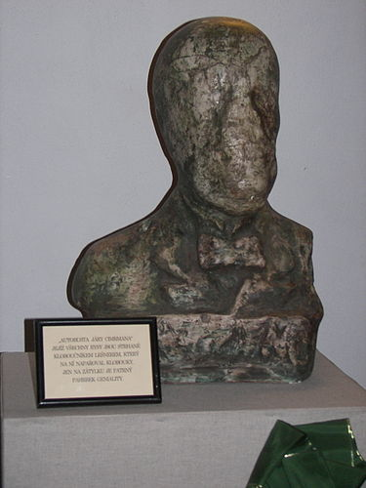
Jára Cimrman
- fictional character of universal talents
- the fictional personality (universal genius, inventor, sportsman, criminalist, poet, writer and philosopher…)
- „The Greatest Czech“
- Cimrmanology

Slide 14
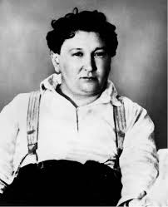
Jaroslav Hašek
- April 30, 1883 – January 3, 1923
- writer, humorist, satirist, journalist, bohemian and anarchist

Slide 15
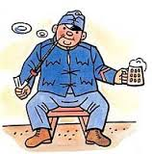
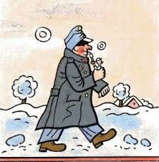
The Good Soldier Švejk
Josef Švejk by Josef Lada

Slide 16
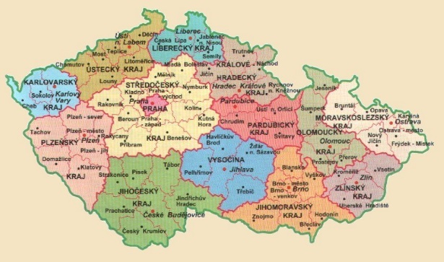
Česká republika (Czech Republic)

Slide 17
Třebíč
- situated in the Vysočina region (Highlands)
- UNESCO heritage: the St. Procopius´ basilica and the Jewish Quarter with Jewish cemetery
- virtual guide of the World Heritage Unesco

Slide 18
Zelená hora
- situated in the Vysočina region (Highlands)
- http://www.zelena-hora.cz/en

Slide 19
Olomouc
- historical town, students´town
- The Holy Trinity Column (on the Unesco list)
- Saint Wenceslas Cathedral
- Baroque fountains
- Museum of Art

Slide 20
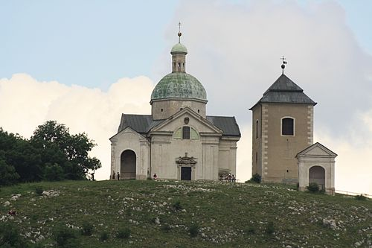
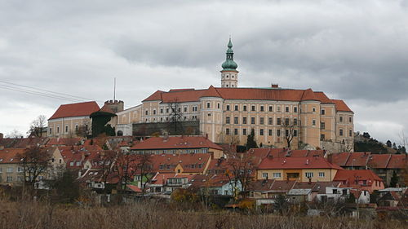
Mikulov
- lying on the border with Lowe Austria
- Mikulov Wine Trail
- Saint Wenceslas Cathedral

Slide 21
Děkuji za pozornost!
Marek Lollok, PdF MU
marek.lollok@seznam.cz

