Slide 1
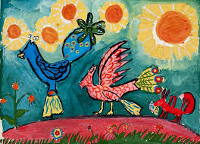
Integrating Art into the Curriculum
And gladly teach and gladly learn…

Slide 2
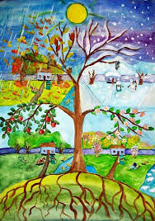
Definition
“an approach to teaching in which students construct and demonstrate understanding through an art form. Students engage in a creative process that connects an art form and another subject area and meets the learning objectives of both.”
http://artsedge.kennedy-center.org
edutopia.org

Slide 3
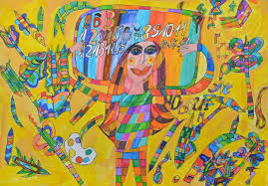
So Natural!
Children learn by playing, singing, acting and exploring the world. Use this natural process of children’s learning styles and celebrate the joy of learning .This style of teaching teaches them to individually explore. For them, learning comes alive.
Look at these examples of lessons….
Science: Students will learn the configuration of the planets around the sun.
The teacher shows pictures of the planets and provides an interesting fact about each. For example, "here is one cool fact about Venus, it is the hottest planet in the solar system.”

Slide 4
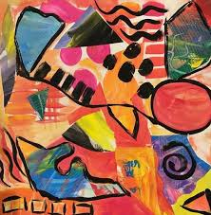
The students choose their favorite planet. Research 10 facts about that planet and draw a picture of it. Groups of children assemble to demonstrate the configuration of the planets around the sun. They can demonstrate the planets revolving around the sun and give their facts about each planet.
Some might choose to incorporate a song or dance. Be creative!
Social Studies: Students will identify the flags of European countries and explain their symbols.
The teacher shows a map of Europe and discusses countries required by the curriculum.

Slide 5
Students choose their favorite country with their family heritage in mind. The students research their selected country, write a report to be presented to the class or submitted electronically ,and make the flag of the country using materials provided. Paper, crayons, colored paper, cloth, glue, magazine pictures, newspapers…anything is artistically possible.
Language Arts: Students will retell a story read to them by the teacher. They will choose their favorite character, draw a picture of him/her and choose their favorite scene from the story. Students can group with others who choose the same character and share their drawings focusing on comparisons and contrasts of their renderings.

Slide 6
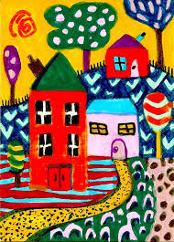
Think about it…..
Integrating art allows students to express themselves authentically with individuality, solve problems, and demonstrate what they learn and how they learn.
Students are given freedom to understand the world around them.
Integrating the arts does not take too much time or money and the benefits are tremendous.
Students express themselves, problem-solve, and interpret the world in their unique ways.

Slide 7
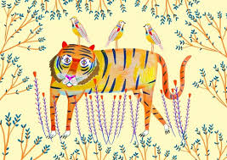
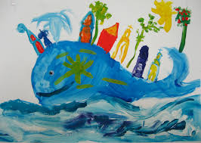
Lesson Plan Assignment
Design an Art integrated lesson plan. Please look in the Study materials area of our course. There you will find a template for a lesson plan and a sample art integrated lesson.
Begin by deciding what you want the students to learn. Add the art component( do you want them to draw, design, make an object?) Decide how you will introduce the lesson and subsequently how you will assess and evaluate the lessons.

