Slide 1

“Pinoy” English
Lucie Kadlecová

Slide 2

Segmental Features
Absence of labiodental fricatives /f/ and /v/
→ Replaced by bilabial stops /p/ and /b/ NOT UNIVERSAL – Ibanag
“Philippines” → GAM = /ˈfɪləpiːnz/ whereas PE = /ˈpɪlɪpiːnz/
“video” → GAM = /ˈvɪdioʊ/ whereas PE = /ˈbɪdioʊ/
Absence of interdental fricatives (continuants) /θ/ and /ð/
→ Pronounced as /t/ and /d/
“thick” → GAM = /θɪk/ whereas PE = /tɪk/
“breathe” → GAM = /briːð/ whereas PE = /briːd/
Reduced consonant system
alveolar fricative /s/ in PE can correspond to four phonemes in GAE = /s/, /z/, /ʃ/, /ʒ/
“spasm” → GAM = /ˈspæz.əm/ whereas PE /ˈspɑːsum/

Slide 3

Segmental Features
ALSO, reduced vowel inventory → /æ, e/ are both often pronounced as /ɑ or ɑː/ as shown in the previous example
No schwa sounds?
→ syllable structure of Philippine languages: V, VC, CV, CVC
1) structurally modified by inserting a vowel between the consonants
/ˈkʊlʌs.ter/ instead of /ˈklʌs.tər/
2) only the thirst consonant is retained
/lɑs/ instead of /læst/
3) splittin the cluster + adding vowel to initial consonant
/iskuːl/ instead of /skuːl/ ???

Slide 4
Segmental Features
Rhotic like GAM….But is it?
Arthritis → GAM = PE =
= PE /r/ is trilled, single tap, or rolled
= GAM /r/ is a retroflex liquid
Is /tʃ/ pronounced as /ts/ or /ts/ pronounced as tʃ - That is the question
Czech Republic = Spinach =
Pizza pie =
And many more…
such as Hamburger…

Slide 5
Suprasegmental Features
PE = syllable timed rhythm (→ absence of vowel reduction) VS. GAE stress-timed rhythm
However, the use of the schwa sound is on the rise.
No distinction in the final intonation of wh- questions and yes-no questions

Slide 6


Slide 7


Slide 8
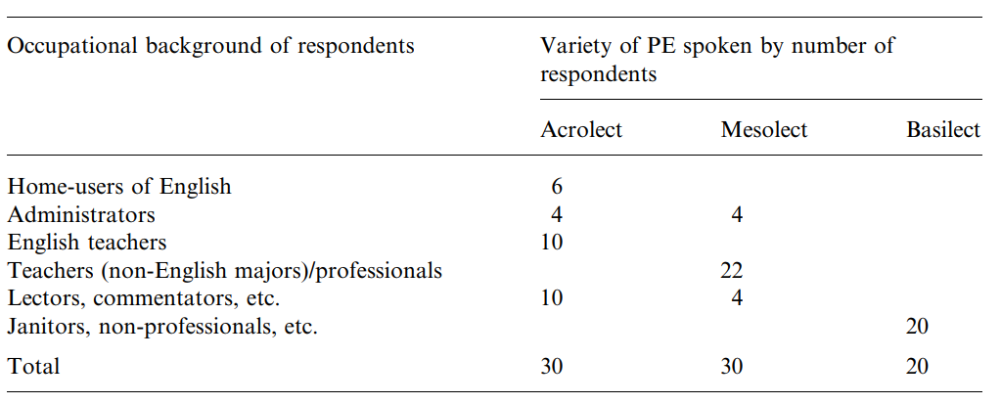
Sociolinguistic aspects
Retaining of the Filipino identity
Llamzon and Tayao
3 varieties:
Acrolect variety
Mesolect variety
Basilect variety

Slide 9
Segmental Analysis
At the acrolectal level
/f/ and /v/ pronounced
/θ/ and /ð/ pronounced
/s/, /z/, /ʃ/, /ʒ/ recognized
/tʃ/ as in GAE
/r/ = retroflex liquid
Clusters = full realization
At the mesolectal level
/f/ and /v/ pronounced
/θ/ and /ð/ variable
/s/, /z/, /ʃ/, /ʒ/ → /s/ in final + medial position
/ tʃ/ as in GAE
/r/ = rolled, one-tap
Clusters = full realization in initial position
At the basilectal level
/f/ + /v/ replaced by /p/ + /b/
/θ/ and /ð/ replaced by /t/ + /d/
/s/, /z/, /ʃ/, /ʒ/ → /s/
/tʃ/ often pronounced as /ts/
/r/ = rolled, one-tap
Clusters = not pronounced

Slide 10



Suprasegmental Analysis
Adolescence Complimentary Hereditary Pronunciation
Ancestors Despicable Ingredient Rehabilitate
Antecedent Complimentary Interpretative Rescue
Bamboo Despicable Itinerary Robust
Baptism Dioxide Kilometer Sabotage
Carton Direct Lieutenant Semester
Cemetery Documentary Menu Specifications
Centenary Economical Paraphernalia Spiritual
Centennial Economics Participate Subsequent
Certificate Formidable Pedestal Talented
Colleague Govern Percentage Thereby
Committee Government Precinct Throughout
Commentary Hazardous Preparatory Utensil

Slide 11

Thank you for your attention

Slide 12

Sources
Tayao, M.L. (2004). The evolving study of Philippine English phonology. World Englishes, 23, 77-90.
Llamzon, T.A. (1969). Standard Filipino English
"PHILIPPINE ENGLISH ." Concise Oxford Companion to the English Language. Retrieved December 6, 2022 from Encyclopedia.com: https://www.encyclopedia.com/humanities/encyclopedias-almanacs-transcripts-and-maps/philippine-english
Lewis, M.P., Simons, G.F. and Fennig, C.D. (eds.). 2016. Ethnologue: Languages of the World: Philippines. 19th ed [online]. Dallas, Texas: SIL International: Available at http://www.ethnologue.com/country/PH [Accessed Dec 6 2022].

Slide 13

Videos to watch
https://www.youtube.com/watch?v=UqlFT8zT8V8
https://www.youtube.com/watch?v=Dkt8ptI4D7U
https://www.youtube.com/watch?v=qFJaSf5cICk
https://www.youtube.com/watch?v=ZJCBnHZ0YJI
https://www.youtube.com/watch?v=fi1MvWnJvzQ

