Slide 1
Phonetics 2
Spring 2023
Week 1
Introduction + vowels

Slide 2
Introductions
What phoneme are you today? Why?
Walk around the class and tell as many people as possible.

Slide 3
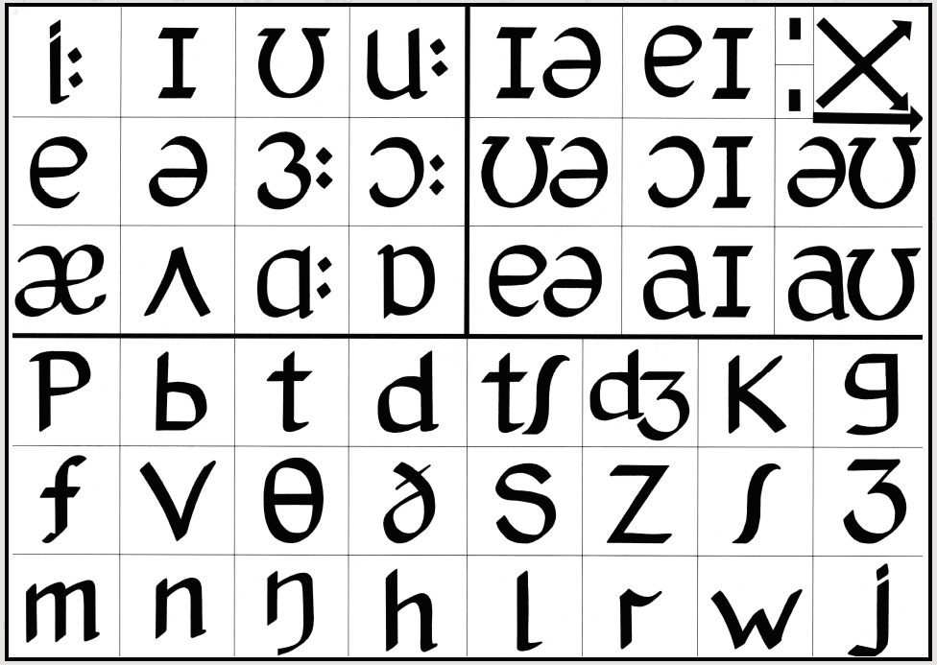

Slide 4
Phoneme chorus
We will make groups.
In your group, choose a word that has the same number of phonemes as the number of people in your group.
Practice saying the word together – each person can only say one phoneme
You will show us later.
Find a place to practice and come back at ………………

Slide 5
How did it go?
How did you feel?
How did the cooperation feel?
What is this activity good for?

Slide 6
Expectations
What do you expect to learn in this course?
What do you need to feel comfortable, to be able to learn and work well?

Slide 7
My expectations
Ask if things are not clear
Communicate about any problems
Be proactive
Use the opportunities to learn
Reflect on your own learning (and what it means for your teaching
Better in Czech than not at all

Slide 8
Requirements
1) Reading progress - MS Teams
2) Reflective journal - MS Teams
3) Teaching practice task - Read to a child - MS Teams
4) Jazz chant - MS Teams
5) Credit test - in person

Slide 9
Phonemes
Read out all the phonemes
Choose all the vowels
Put them in order of how easy they are to pronounce

Slide 10
Vowels
Units 6, 7, 18, 19

Slide 14


Slide 21
Chants
What are they? What are they good for?
Can they help you to learn?
Can they help you to teach?
Notes:
Talk about chants – think, pair, share
Do the chant Who‘s this as described in the book
Show them the information in the book. You have done this – what would you do next to provide more personalised dril to your students? Design an activity in your group and then we will show them to each other/discuss/try them out (depending on time)

Slide 22


Slide 23
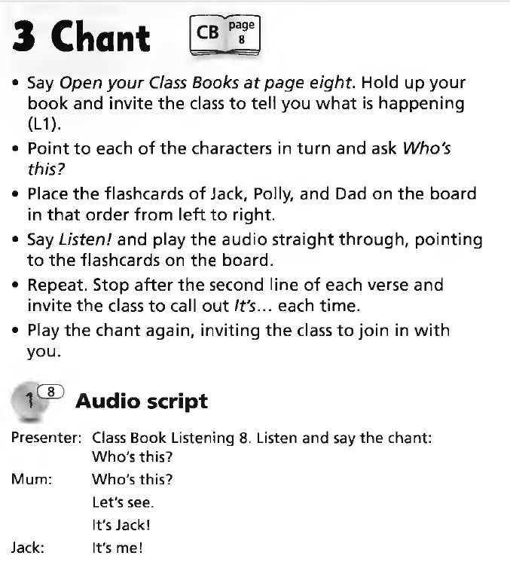
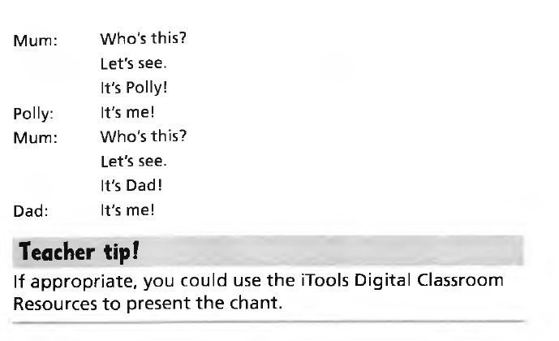

Slide 24
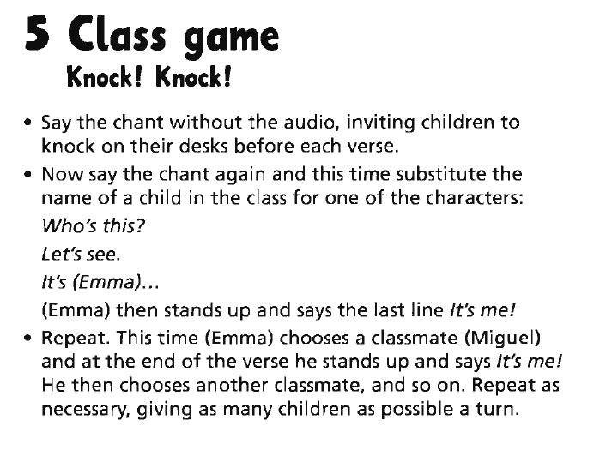

Slide 25
What is your plan for the semester?
How are you going to work on your English pronunciation?
How are you going to work on your transcription skills?
How is this going to fit in with your English lessons?
How is this going to fit in with your life?

