Slide 1
AJ5415 Storytelling for Young Learners
Kateřina Tomková, 2060@mail.muni.cz
Block 2
Saturday, May 11, 2024

Slide 2
Our schedule today
1415-1500 Revision of Block 1 on March 2; leftover stories & contexts by (Petr, Barbora,) Leona, Mont-
serrat, Sai Sai, (Natálie,) María, Lenka.
1500-1530 Presenting project recordings in the File Vault
1530-1600 Peer reviewing audio essays jin couples
1600-1700 Coffee break & watching webinar
1700-1730 Webinar gisting & discussion
1730-1800 DICTION in storytelling & reading:
The future of BOOKS. Back to oral history?
1800-1830 Debates: Storytelling, Shielding children from the war, the Environment,
Children‘s psychology across generations and continents
1830-1900 Summary, conclusions, group & individual
consultations

Slide 3
Resources
All in the course‘s site in the IS:
- this presentation
- Rowling speech with gaps
- Tomková Segmental pronunciation of English
- Tomková Suprasegmental pronunciation of English
- Tomková The best videos for teaching English pronunciation
- Your own video/audioessays in the File Vault
- Easter class in stress, rhythm and intonation

Slide 4
1415-1500: REVISION OF BLOCK 1, INDIVIDUAL CONTEXTS & STORIES
leftover stories & contexts by (Petr, Barbora,)
Leona:
Montserrat:
Sai Sai:
(Natálie)
María:
Lenka:

Slide 5

1500-1530: 9 projects self-presented in class

Slide 6
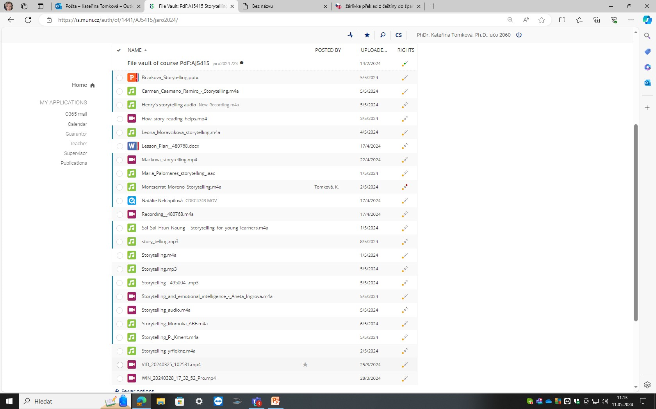
1500-1530 List of submissions, presenting one‘s own projects

Slide 7
Discussion 1530-1600
Talk to the author of your favourite audio essay. Discuss:
What are your respective strengths and weaknesses?
What are the main points in your partner‘s recording?
What did you most appreciate/dislike?
Would you change the paper‘s headline?

Slide 8
Coffee break while watching and note-taking 1600-1700
Using the method of jigsaw teamwork, watching MacMillan Education ELT‘s Advancing Webinar of January 2021, “Storytelling for Young Learners“
Storytelling for Young Learners [Advancing Learning Webinar] – YouTube
https://www.youtube.com/watch?v=UL-wgRGrzr8
Bilingual Kids: 00-10 mins: Joanne Mitten & webinar intro
Tug-of-War : 0953-1955 : gender + society, skill+survival,
modern; Piaget, Vygotsky
Artificial Blondies: 1955-3000 : why stories in LL, L1 and L2
acquisition x learning …whole
child
Flexi: 3000- 4015: why use stories … become a performer
Methodologists: 4015- 4958: teens and tweens … references

Slide 9
Webinar gisting, discussion 1700-1730
Joanne Mitten =
ST common to all cultures; 44,000 yrs ago – cave paintings. Aesop‘s fables. Traditional Irish STs (bearers of old lore). Embedded in culture. C. Dickens (social commentary).
Gender and society. Victorian ghost stories, A. Brontë; skill + survival.
Modern stories in books, movies. Stories in LL. Education + psychology.
Piaget (individual) , Vygotsky (community).
Different age groups, their abilities. L1 exposure: repetition, recycling. Sounds at different levels.
Story choice. Pre-story and post-story tasks: pix, vocab, retelling, performing skills of teacher. Teens: specific needs.
Tweens (8-12) and teens. Choice and scaffolding of a story. Using different stories for retelling. Sketching. Picking a line or object in the story. Reenactment. Older pupils: songs, characterisation, cross-curricular activites (e.g. making a movie). 21st century skills: critical thinking, collaboration, communication, science, arts…

Slide 10
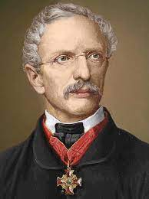
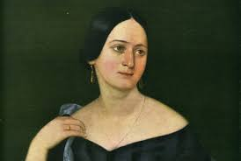
1730-1800 DICTION & IMMEDIACY in reading.
Other formats fine (e.g. 📚 Kids Book Read Aloud: WHY WE STAY HOME - SUZIE LEARNS ABOUT CORONAVIRUS by Harris, Scott and Rodis - YouTube ) but nothing can replace books read
live.
Czech folk tales collected by K.J. Erben:
Princess Goldie Waterboy and Old Man Knowall The Snow Maiden
Cook, Mug, Cook! The Firebird and the Clever Vixen Mr Long, Mr Broad and
Mr Sharpeye
Czech folk tales collected by Božena Němcová:
The Magic Sword The Gingerbread House The Forest Nymph
The Wise Goldsmith Prince Bayaya The Seven Ravens
The Clever Princess Peterkin
See also H. Halíčková‘s paper.

Slide 11
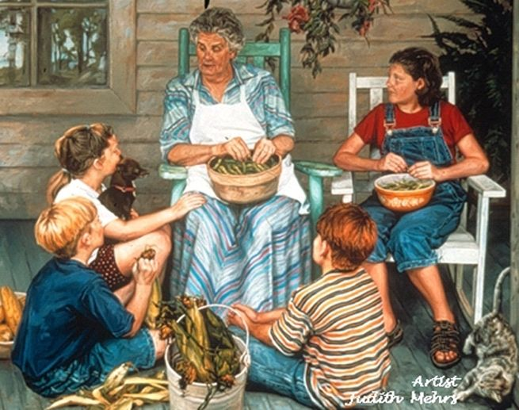
1800-1830 Debate: How/whether to speak about the war, the Environment, Children‘s psychology across generations and continents

Slide 12
1830-1850:
Concluding remarks, questions, queries… ?
I am available for further group/individual consultations until 1900.
THANK YOU FOR YOUR KIND ATTENTION!
So long, live well, tell stories and never lose your passion!

