Slide 1
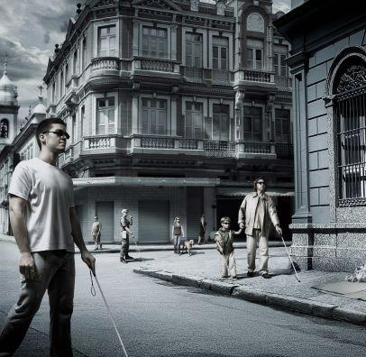
VISUAL IMPAIRMENTS

Slide 2
Did you know...
Over 40 million people in the world are blind, and over 120 million people have significant Low Vision conditions that cannot be corrected, cured or treated by conventional refraction, medicine or surgery. This number is expected to double by the year 2020.
Over 90% of these visually impaired people live in developing countries like India.
There are over 1.4 million visually impaired children age 0-14 years.

Slide 3
This term refers to people with irretrievable sight loss
It covers a wide spectrum of different impairments
It does not include those whose sight problems can be corrected by spectacles or contact lenses
If you are short sighted or long sighted, but you can see normally when you put your glasses on or wear your contact lenses, you are not visually impaired.

Slide 4
Categories of Visual Impairments
Low Vision
Functional Blindness
Blindness

Slide 5
ΣΧΟΛΙΚΕΣ ΜΟΝΑΔΕΣ ΓΙΑ ΠΑΙΔΙΑ ΜΕ ΤΥΦΛΩΣΗ (SCHOOLS FOR THE BLIND)
ΝΗΠΙΑΓΩΓΕΙΑ (KINDERGARTENS) 1. 1/θ Ειδικό Νηπιαγωγείο Τυφλών ΚΕΑΤ Καλλιθέας, Ελ. Βενιζέλου 210, Καλλιθέα, Τ.Κ. 176 75, Τηλ. 01- 95 88 066, 95 95 2. 1/θ Ειδικό Νηπιαγωγείο Τυφλών θεσσαλονίκης, στη Σχολή Τυφλών Β. Ελλάδας "Ο ΗΛΙΟΣ", Β. Όλγας 32, θεσσαλονίκη,Τ.Κ. 546 41, Τηλ. 031-830 095, εσωτ. 39.
ΔΗΜΟΤΙΚΑ ΣΧΟΛΕΙΑ (PRIMARY SCHOOLS) 1. 12/θ Ειδικό Δημοτικό Σχολείο Τυφλών, στο ΚΕΑΤ, Ελ. Βενιζέλου 210, Καλλιθέα, Τ.Κ. 176 75, Τηλ. 210- 95 88 066, 95 95 2. 4/θ Ειδικό Δημοτικό Σχολείο Τυφλών θεσσαλονίκης, στη Σχολή Τυφλών Β. Ελλάδας "Ο ΗΛΙΟΣ", Β. Όλγας 32, θεσσαλονίκη, Τ.Κ. 546 41, Τηλ. 231-857 722. 3. 2/θ Ειδικό Δημοτικό Σχολείο Τυφλών, Πάτρα. 4. 2/θ Ειδικό Δημοτικό Σχολείο Τυφλών Ιωαννίνων, λυκιδών Τ.Κ. 452 21, Ιωάννινα, Τηλ. 2651-78 608.
ΙΔΡΥΜΑΤΑ ΤΥΦΛΩΝ (FOUNDATION FOR THE BLIND) 1. Κέντρο Εκπαίδευσης και Αποκατάστασης Τυφλών (ΚΕΑΤ), Ελ. Βενιζέλου 210, Καλλιθέα, Τ.Κ. 176 75, Τηλ. 210-95 95 880,9582 760, PAX: 210 - 95 95 868. 2. "ΕΠΙΚΟΙΝΩΝΙΑ"- Κέντρο Διημέρευσης Ατόμων με Προβλήματα Όρασης και Πρόσθετες Ειδικές Ανάγκες, Λεωφ. Βουλιαγμένης, Πρώην Αμερικανική Βάση Ελληνικού, Ελληνικό, Τηλ. 210 - 96 31 441, PAX: 210 - 96 32 549. 3. Βρεφονηπιακός Σταθμός του ΚΕΑΤ, Μιχαήλ Βόδα 143, Τηλ.210 - 86 73 045 4. Φάρος Τυφλών Ελλάδος, Δοϊράνης 198 και Αθηνάς, Τ.Κ. 176 73, Καλλιθέα, Τηλ. 210 - 94 15 222, PAX: 210 -94 15 271.

Slide 6
5. Ίδρυμα Προστασίας Τυφλών Β. Ελλάδος "Ο ΗΛΙΟΣ"-Σχολή Τυφλών, Β. Όλγας 32, θεσσαλονίκη, Τ.Κ. 546 6. Ελληνικό Κέντρο Κινητικότητας και Προσανατολισμού για άτομα με Προβλήματα Όρασης(ΚΕ.ΚΙ.ΠΡΟ)
ΣΥΛΛΟΓΟΙ ΤΥΦΛΩΝ (ASSOCIATIONS FOR THE BLIND)
1. Πανελλήνιος Σύνδεσμος Τυφλών, Βερανζέρου 31, Τ.Κ. 104 32, Αθήνα, Τηλ. 210 - 52 45 455, 52 45 578, PAX: 52 22 122. 2. Σύλλογος Γονέων και Κηδεμόνων Τυφλών Παιδιών Ελλάδας, ΚΕΑΤ, Ελ. Βενιζέλου 210, Καλλιθέα, Τ.Κ. 176 75, Τηλ. 01-9595 880, 95 82 760, 95 88 066. 3. Σύλλογος Γονέων-Κηδεμόνων Μαθητών & Μαθητριών της Σχολής Τυφλών Β. Ελλάδας, Βασ. Όλγας 32, θεσσαλονίκη, Τ.Κ. 546 41. 4. Ένωση Τυφλών Β. Ελλάδας "Λουδοβίκος Μπράιγ", Διαλέττη23, Τ.Κ. 546 21, θεσσαλονίκη, Τηλ. 2310 -223 750

Slide 7
Legislation for students with visual impairment in Greece
Law 3699, passed in the fall of 2008, establishes the compulsory nature of education for students with disabilities and special educational needs, affirming that it is an integral part of public free education and promoting the principle of integrated education.
Students can be enrolled in: a) mainstream schools attending either the regular classroom with parallel support or special sections/classes of the school, or b) Special Education Schools.
The Special Education Schools cover pre-school, primary and secondary education levels.
As regards higher education, special examination arrangements are made for disabled or special needs students: e.g. oral examinations for blind pupils.

Slide 8
Curiccula for children with visual impairments
In Greece integrated education is a main principle. Most of the children with v.i. go to regular school with assistant by special teachers and provision of adaptative technology and specialized training techniques.
A curriculum for blind children is similar to the curriculum for sighted children with some specific adaptations

Slide 9
The main differences
The use of specialized teaching methods in teaching reading and writing with embossed Braille system (individualized education)
the appropriate adjustment, adaptation, transcription and illustration of teaching and other books in Braille system
teaching additional courses such as mobility, orientation and skills of daily living,
Providing support to blind students from special education staff eg specialized teacher psychologist, social worker, speech therapist

Slide 10
GUIDELINES FOR WORKING WITH CHILDREN WITH VISUAL IMPAIRMENTS

Slide 11
What should a teacher do in this case?

Slide 12
To give to the student at the same time clear explanations.
To systematically cultivate students' ability to listen carefully, and to remember.
To rationalize labor and material, to be clear and comprehensive in their descriptions and use effective teaching methods.

Slide 13
BRAILLE SYSTEM
Braille is a tactile writing system used by the blind and the visually impaired, and found in books, on menus, signs, elevator buttons. Braille-users can read computer screens and other electronic supports thanks to refreshable braille displays. They can write braille with a slate and stylus or type it on a braille writer, such as a portable braille note-taker, or on a computer that prints with a braille embosser.
Braille is named after its creator, Frenchman Louis Braille in 1829.

Slide 14
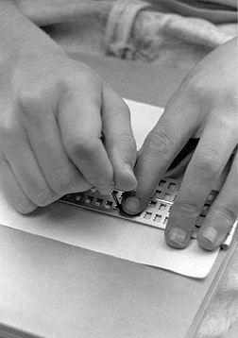
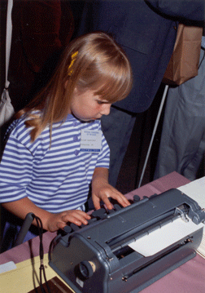

Slide 15
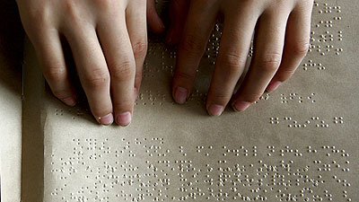

Slide 17
ORIENTATION & MOBILITY VENI-NON VIDI-VICI
It is a school subject for the kid with v.i. and a principle that is taught to him during his first years of his life

Slide 18
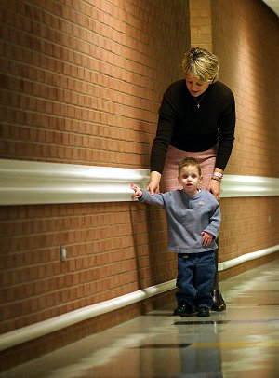

Slide 19
Developing body awareness, directionality, spatial awareness and practical knowledge associated with the characteristics of a given environment- creation of a mental map through kinesthetic sense
Room familiarization and routes within the school

