Slide 1
Environmental Education in primary school in Greece
Evangelia Karatsiki
417184
Masaryk University

Slide 2
Some general information about Environmental Education…
E.E is a new attempt that interferes in school life in order to make pupils aware of the relationship between man and the natural and social environment, aware of the problems associated with it and operate specific programs to contribute to the overall effort to deal with them.
This behavior is achieved by a series of strategies that help the person to know, to love and to protect the environment.

Slide 3
"It is impossible to protect something you do not love and love something you do not know about."

Slide 4
What we have to know about the environment/Aims…
Education around the environment
the acquirement of knowledge related to the environment and environmental problems, but also awareness of what is happening around us.
Education from and within the environment
The environment provides knowledge.The knowledge that is acquired from the environment, it is built by the direct experience and observation through activities that occur within the same environment in direct contact with things and phenomena. The environment is considered as means, field research and learning resource.

Slide 5
What we have to know about the environment/Aims…
Education for the environment
The improvement of the quality of the environment (and therefore quality of life) by applying appropriate environmental practices and participation in taking decision as a responsible man in preventing and solving environmental problems. The environment is considered an objective.

Slide 6
Environmental Education/Greece
According to the law number 1892/90,the environmental education is part of the programs of the schools of Primary and Secondary Education.
There are some schools in Greece that they do not finish at 2 o’clock as usual but they are open till 4 and teach the course of the Environmental Education.
About the schools that are not open till 4,have got some hours in the weekly schedule that are called “flexible zone” that the teachers can inform the pupils about different issues they find important for the children to know and a usual issue is “Environmental Education” as it is essential.
In addition, book with topics on environmental education has been published for using it in the primary school.

Slide 7
Topics of the Environmental Education in primary school.
Recycling
The town
Endagered animals
Energy saving
The space the planets
The seasons and the time
The water and its circle

Slide 8
The way that these topics can be taught…
Method Project: It is a new,complex but flexible process in Greece for primary school and it is based on experience learning.Many other methods and techniques can be incorporated the project and perform an Environmental Education program.
Discussion:small conversation about the topic in teams and then discussion that all the pupils of the environmental program participate.

Slide 9
The way that these topics can be taught…
Role play:it provokes the interest of the pupils and their emotional maturity and social development.Then they better understand the environmental problems and try to find solutions.
Analysis of concepts:The students with the help of teachers learn to organize and simplify complex and complicated concepts.
Here is an example.

Slide 10
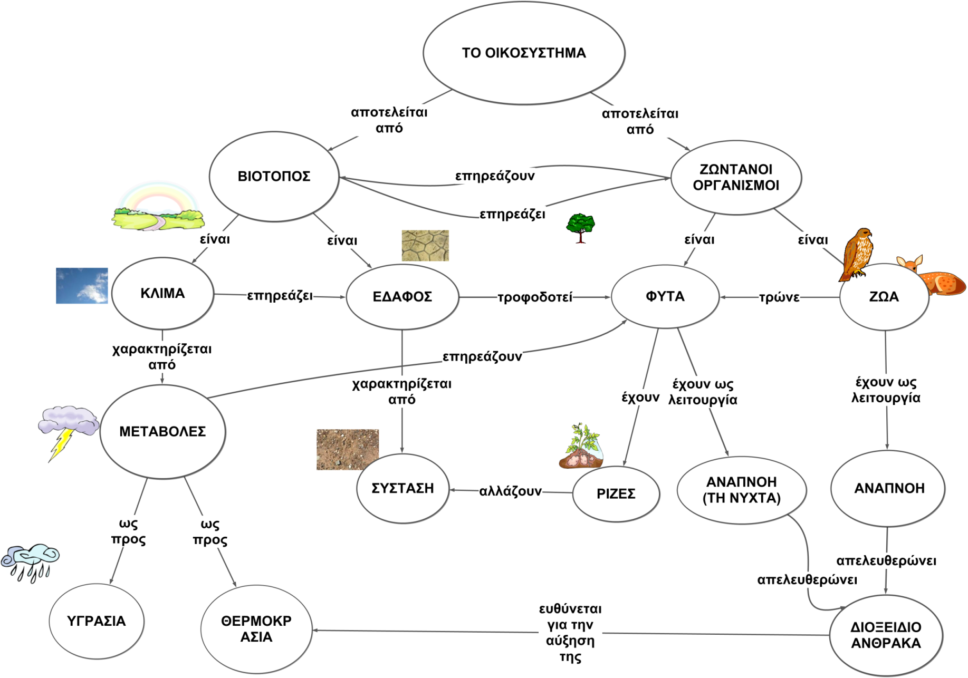
Example…

Slide 11
An activity that pupils can participate…
Understanding the importance of the forests
with all the senses…
Procedure:
Plan to visit the nearby forest
Dress in appropriate clothing,wear sneakers,hat, glasses and take their snack with them
Divide into group of five
The pupils will pick a safe place in the forest,stand by their group and note what they see around them.They can take pictures and record whatever it impresses them.
They relax, close their eyes, listen carefully the sounds around them and record the sounds
They take deep breaths and smell around
They notice from which plant they think comes every smell.

Slide 12
An activity that pupils can participate…
They touch the plants around them.
They also notice what they feel by touching them.
They Return to school.
The teacher invites experts biologists, naturalists to tell the pupils about the sounds they recorded, what birds they listened to.
The pupils, afterall, write their impressions about the visit at the forest.

Slide 13
My information…
http://www.env-edu.gr/Documents.aspx?subID=30
http://www.biomatiko.gr/programs.asp?ITMID=7
http://www.pi-schools.gr

Slide 14

Thank you…

