Slide 1
Course design

Slide 2
Designing a language course involves …

Slide 3


Slide 4
Designing a language course involves
Beliefs
Context
Assessment plan
Materials
Goals and objectives
Assessing needs
Content
Organization

Slide 5
„Teaching is an organic, unpredictable, challenging, satisfying, and frustrating process.“
Kathleen Graves: Designing language courses (2000:7)

Slide 6


Slide 7
„Designing a language course is a work in progress …“
(2000:9)

Slide 8
Choose a course:
You have taught and want to redesign
You are planning to teach
In which you are or have been a learner

Slide 9
Think of a language lesson (observed, taught, you took part in) that you thought was an excellent one.
Why was it excellent?

Slide 10
Beliefs about
Language
Social context of language
View of learning and learners
View of teaching

Slide 11

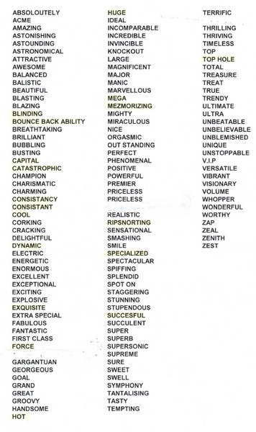

Language
What in the language you stress most

Slide 12

Social context
Language is used in certain society
Sociocultural issues (ways of greeting, eating, customs, products – literature, art …)
Sociopolitical issues (how the social group is viewed by other social groups, access to language …)

Slide 13



Learning and Learners
How people learn
Inductive vs. Deductive way
Different intelligences

Slide 14


Teaching
Teacher-centred
Student-centred

Slide 15
What would your starting motivating lesson look like?
Which would be the most interesting activity from the lesson ?

Slide 16
HW
Describe your group
Think about a starting motivating lesson for the group you have chosen
Demonstrate the most interesting activity from the lesson

Slide 17
HW
Write about your beliefs
Put it into moodlinka forum for other discussions
Make comments in moodlinka having read other contributions
Prepare a starting motivating lesson for the group you have chosen
Bring it to the next seminar
Describe your group
Demonstrate the most interesting activity from the lesson

