Slide 1


Textbooks – a problem?

Slide 2
Coursebook evaluation

Slide 3
What are the advantages of using a textbook?

Slide 4
Advantages
It provides:
a syllabus
security for the students
a set of visuals, activities, readings …
assessing tools (tests, evaluation tools)
consistency within a given level

Slide 5
It may include supporting materials:
teacher´s guide
cassettes, CDs
video
worksheets …

Slide 6
Disadvantages
The content may not be appropriate to your group
The content may not be at the right level
Some aspects of language may be preferred while others not
There may not be the right mix of activities
The activities may be boring
The material may go out of date
The timetable for completing the textbook may be unrealistic

Slide 7
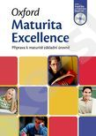
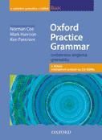


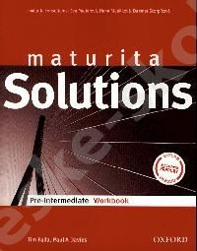
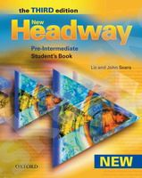

Textbooks to compare

Slide 8
Think of a textbook you were satisfied with.

Slide 9
Think of a textbook you were not satisfied with.

Slide 10
What were the differences?

Slide 11
Criteria for coursebook evaluation:

Slide 12
Price and availability
Add-ons and extras
Layout and design
Instructions
Methodology
Syllabus
Language skills
Topics
Cultural appropriacy
Teacher’s guide

Slide 13
Price and availability
a teacher’s book, workbook, audio-cassette or CD, even video-cassette
How much will the student have to pay?
And how much the teacher?

Slide 14
Add-ons and extras
Flash-cards or the pictures, maps, posters
Websites
Discussion pages
Is it worth the value (time and money)?

Slide 15
Layout and design
attractive and challenging ?
pictures, colours
Do I as a teacher like the design of the book?
Does it look like cheap commerce?

Slide 16
Instructions
In English or in Czech?
Are they clear and brief?
Will students understand without teacher’s help?

Slide 17
Methodology
Adequate to the age and the level of my students
balance between accuracy and fluency exercises
More acquisition or more learning and teaching?

Slide 18
Syllabus
the topics of my students’ interest?
logical sequence of topics?
the expected amount of grammar, vocabulary and pronunciation?

Slide 19
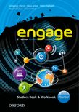
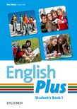
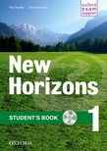
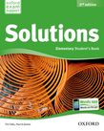
Textbooks for teenagers

Slide 20
Language skills
all skills covered in balance?
challenging activities offered?
open-ended and close-ended tasks?
natural spoken English?

Slide 21
Topics
a variety of topics?
adequate to the level and interest of my students?
other subjects integrated, too?

Slide 22
Cultural appropriacy
Any multicultural items?
Unprejudiced?
Enrich my students’ worldview?

Slide 23
Teacher’s guide
Answers for my students’ curious questions?
differentiated activities for a heterogeneous class?
Help with my lesson and syllabus planning?

Slide 24
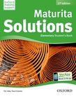
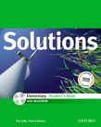
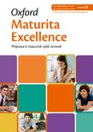
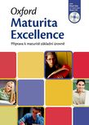
Aim - e.g. Maturita exam

Slide 25
Other factors to consider:
Context (your institution, parents …)
Your beliefs
Your understandings about how people learn languages
Your students´needs and interests
You as a teacher

Slide 26
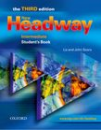
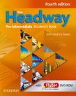
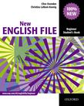
Secondary and language schools

Slide 27
An ideal coursebook does not exist.

Slide 28
Bring additional materials!

Slide 29
Supplementary materials
Books, magazines
Pictures, posters, maps and cards
Real authentic material
Toys
Visualizers
Video equipment and data-projector
Audio equipment
Musical instruments
Smart or interactive boards
Computer!

Slide 30
Options:
projects,
film making,
theatre performances,
online homework …

