Slide 1
Teacher

Slide 2
A good English teacher has to:
Make students active
Make students study at home
Prepare entertaining lessons
Deal with lazy students
Work with large classes
Work with mixed ability classes
Face the stress
Be an actor, lawyer, nurse, psychologist, accountant, idealist, musician …
Be good at geography, history, art, biology, physical education
Be flexible, creative, enthusiastic, optimistic, hardworking, well-dressed
Be strict but fair, honest …

Slide 3
Practical teaching skills are what we need
Just talking about teaching is like talking about food and leaving the listeners hungry.

Slide 4
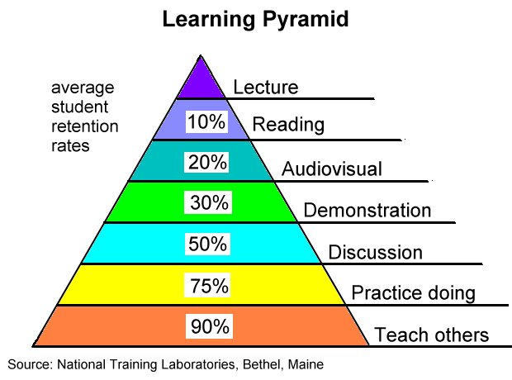

Slide 5
Types of a teacher
1 explainer
2 involver
3 enabler

Slide 6
Relax!
Allow some mother-tongue use
Listen and be adaptable
Go to a conference or a seminar
Observe your lessons mutually
Give private lessons
Read professional books and magazines
Think positive
don’t be too hard on yourself!

Slide 7
Experience and advice
motivated teachers can easier motivate students – a Socrates – Commenius project /2001-2004/- Motivating teachers/motivating students
listen to students, let them open up and trust you
give all of them chance to show up- their strong parts
dont be afraid to make mistake
keep your word, students need to know what to expect from you
follow sense of justice and humor

