Slide 1
Czech Educational System
Katerina Lojdova
lojdova@ped.muni.cz

Slide 2
Introduction
Introduce yourself: where are you from, what do you study?
What do you know about Czech republic?
Why do you study here?

Slide 3
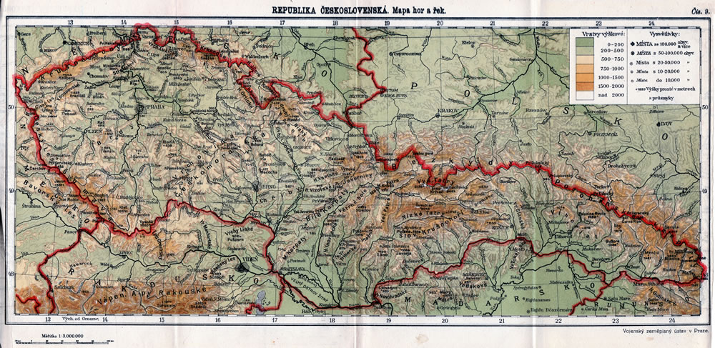
Brief historical overview
1918: Czechoslovakia

Slide 4
The Czechoslovak Socialist Republic
was the official name of Czechoslovakia from 1960 until shortly after the Velvet Revolution in 1989.

Slide 5
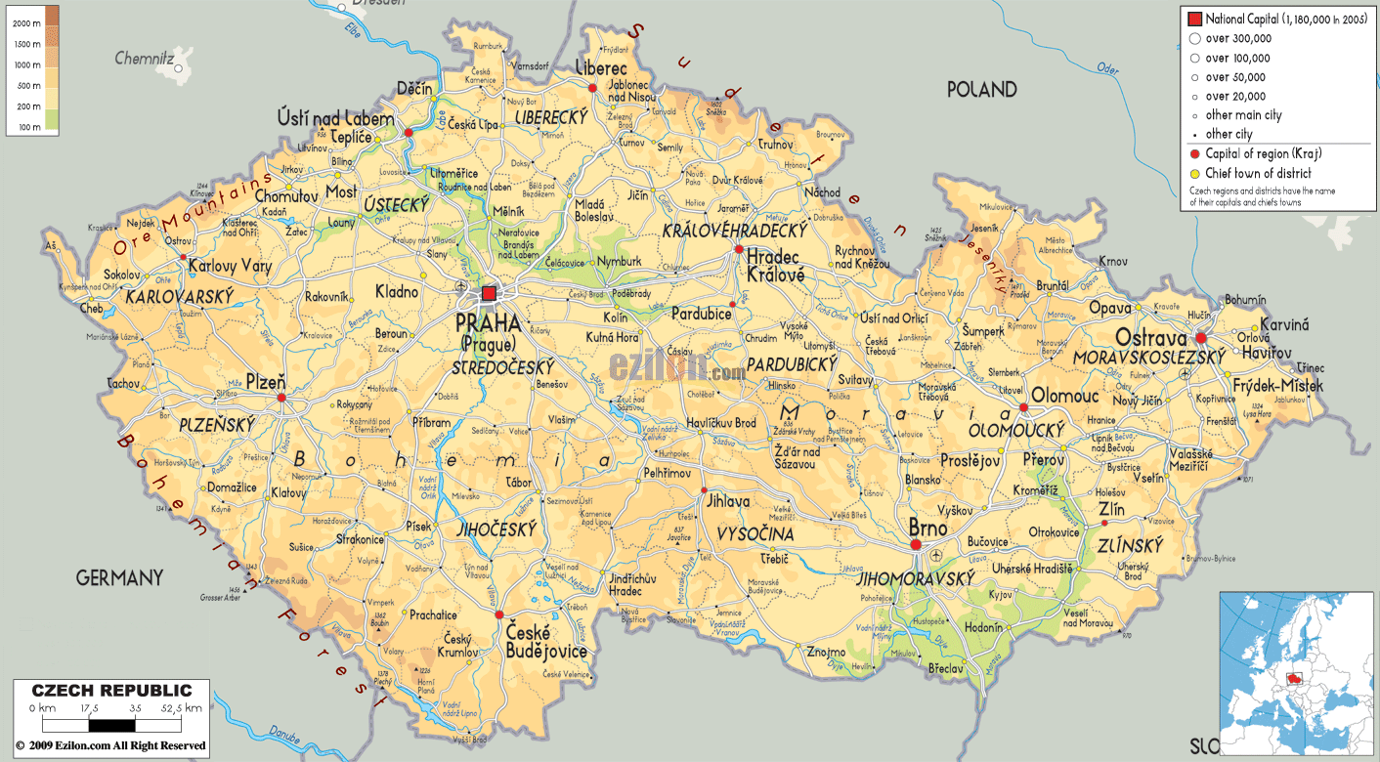
Introduction
1993: Czech republic

Slide 6
Basic facts
Compulsory school attendance
Literacy rate
Classification system: 1 – 5
Preschool enrollment is guaranteed for children in their last year before entering elementary school
Elementary education takes 9 years, usually from ages 6-15
Elementary education is divided into two stages: primary (grade 1 – 5) and lower secondary (stage 6-9)
In addition, children have the option to apply for gymansium or concervatory

Slide 7
Basic facts
Upper secondary education can be general or vocational
Upper secondary education takes 3 – 4 years and is mandatory
Tertiary education: Bologna process

Slide 8
Presentation (about 10 minutes)
Comparsion of educational system in your country and czech educational system in terms of:
A) ISCED
B) Goals of basic education
C) Subjects in basic education
D) Key competencies
E) Interesting facts
Essay on comparsion of educational system in your country and czech educational system (if you have both courses in IS): 3 pages

