Slide 1

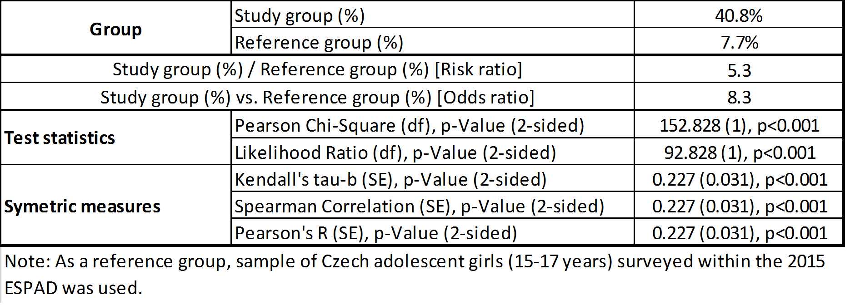
Prevalence of substance use and suicide attempts among adolescent girls in institutional setting
Pavla Dolezalova, Ladislav Kazmer, Barbora Orlikova, Ladislav Csemy
pdolezalova1@gmail.com
National Institute of Menthal Health
Centre of Epidemiological and Clinical Research in Addictions, Klecany, Czech Republic
Background
Figure 1
Last year prevalence (%, 95% CI) of illicit substance use, study group vs. reference group
Figure 2
Last month prevalence (%, 95% CI) of licit substance use, study group vs. reference group
Results
Suicide represents a major public and mental health concern. Suicides are the second leading cause of death among young women aged 15-29 in Czechia (WHO, 2017).
More than 90% of suicides occur among persons with mental health disorders (Moscicki, 1997). Epidemiological studies have demonstrated a correlation between number of risk factors, including substance use disorders and suicide behavior (Brown et al., 2017; Maniglio, 2011).
In this paper, we compare the prevalence of substance use and suicide attempts among the Czech adolescent girls living in institutional settings with those obtained from the recent ESPAD study (2015).
The prevalence of illicit drug use among adolescent girls living in institutional setting was found to be several times higher (2-11times) as compared to the reference group sampled from the Czech school-aged population.
The prevalence of suicide attempts was found to be 5times higher among the girls from institutional settings (41%) as compared to those sampled from a common school setting (8%).
The differences in both substance use and suicide behavior between the compared groups of adolescent girls were proved to be highly significant (p<0.001).
Figure 3
Prevalence of lifetime suicide attempts (%, 95% CI), study group vs. reference group
Methods
Conclusions - key points
Objectives and Aims: To determine the prevalence of both substance use and suicide behavior among adolescent girls living in institutional settings. Comparison of the rates with those obtained from the sample of the Czech adolescent girls coming from an ordinary (i.e. a non-institutional) milieu.
Methods: We conducted a study using quantitative tools. We conducted a quantitative survey with questionnaires on both substance use and suicide behavior. The study group was surveyed among adolescent girls in institutional settings. As a reference group, a sample of the Czech adolescent girls surveyed within the recent 2015 European School Survey Project on Alcohol and Other Drugs (ESPAD, N=2 886) was used (ESPAD, 2016).
Target/study group: 122 adolescent girls living in institutional settings, aged 15-18. The target group is generally characterized by a high-risk behavior and a variety of mental health, education, and/or social problems.
Adolescent girls in institutional settings are highly vulnerable individuals in terms of their mental health perspective.
We emphasize the enhancement of a high quality of care of the girls living in institutional settings; e.g.:
the implementation of screening for suicide risk could serve as a preventative measure; harm reduction services for drug abusers, and psychotherapy could moderate risks associated with this vulnerable group of girls.
Focus on comprehensive approach and improved education of staff in topics on both suicide behavior and substance abuse.
Table
Differences in the prevalence of lifetime suicide attempts between the study group and reference group
References
This work was supported from the Ministry of Education, Youth and Sports of the Czech Republic under grant numbers 0057/PP/2016 and PRCH-IP-0059/2017, and by the project “Sustainability for the National Institute of Mental Health”, under grant number LO1611, with a financial support from the Ministry of Education, Youth and Sports of the Czech Republic under the NPU I program.
Brown, R., C., Plener, P., L., (2017) Non-suicidal Self-Injury in Adolescence, Current Psychiatry Reports, 2017, 19, 3.
European Monitoring Centre on Drugs and Drug Addiction (2016). ESPAD Report 2015. Results from the European School Survey Project on Alcohol and Other Drugs, Luxembourg: Publications Office of the European Union.
Maniglio, R. (2011). The Role of Child Sexual Abuse in the Etiology of Suicide and Non-suicidal Self-injury. Acta Psychiatrica Scandinavica, 124: 30–41.
Moscicki, E. (1997). Identification of Suicide Risk Factors Using Epidemiologic Studies. Psychiatric Clinics of North America, 20: 499-517.
WHO (2017). Suicide data. Retrived 5.5. 2017 from: http://www.who.int/mental_health/prevention/suicide/suicideprevent/en/

