Slide 1
Integrating Art,Music,and Drama into the Curriculum
An overview of what we do

Slide 2
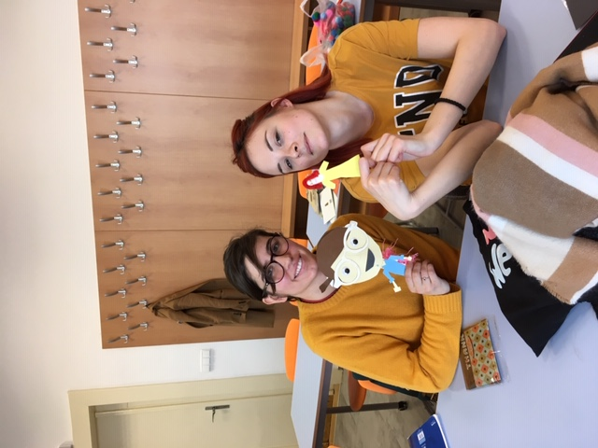
Arts Integration
The best of what we know about how students learn
We learn through the senses: what we see, hear, touch, taste, or smell
Art, Music, and Drama covers all bases. In addition they are engaging .
Students learn to integrate lessons. By that I mean,
They learn how to write lesson plans that have learning
Objectives that benefit both an arts objective and
content area objective.

Slide 3
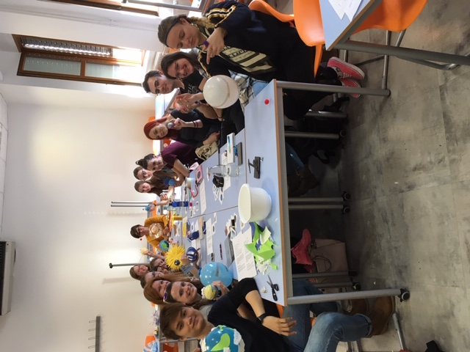

Slide 4
English is practiced
WE speak Art, Music, and Drama
Art lessons begin simply with an engaging story. Students are asked to draw their favorite character,discuss the application of this activity to an elementary classroom, and brainstorm a variety of ways to assess the products of AI(Arts Integrated)lessons.
Other activities include becoming a sculptor and a piece of living sculpture.
Activities using masks, emogies, and found objects are quite popular.
I brought postage stamps from the US and a roll of commerative quarters to explore appreciation of the artwork and the culture depicted.

Slide 5
Music
Our exploration of Music begins with a question : Is this Music?
Rain Song, Stomp,Vienna Orchestra’s music with homemade instruments from vegetables, or my version of sliding.
We make instruments from whatever I bring and we have a “concert.”
Students design lessons that integrate music with Social Studies focusing on music of the era, while Music and Physical Education allows us to sing songs about body parts.

Slide 6
Drama
Drama activities center around our creation of puppets.
We make puppets with super powers, puppets with disabilities, mini puppets, and maxi puppets. Each puppet has a charm. Dare I say beauty.
Acting, pretending, laughing, and self-discovery occur in abundance in this part of our class.
Writing the lesson plans seems to come easily when we integrate drama. Acting out an event in History, pretending to be a well respected author/writer/actor brings out abilities I have not seen during the semester.

Slide 7
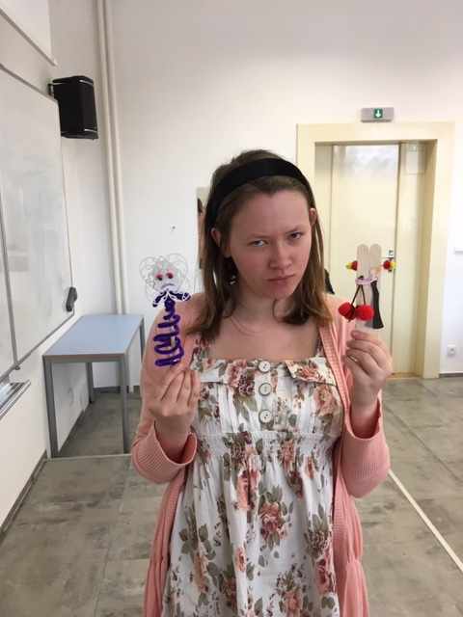

Slide 8
I learned
No project has ever been left behind.
No project has ever been offered to me as a gift.
I am the one who is inspired. The nature and extent of Masaryk University students’ creativity demonstrated to me that they can create something
(often beautiful) out of whatever I bring. They create lessons that are personalized and reflect deep beliefs or loyalty.
Therefore, I can now tell you that the word integrate means to make whole. Arts Integration brings together separate parts of the curriculum that work together for the benefit of each part.(for example, Math/Music)

