Slide 1
Essentials of disability studies, lecture 2
Objects:
Functionalist approach in practice
Interpretivist (humanistic) approach

Slide 2
Homework: Whistleless as an example of functionalist approach
Which moments of the film show following functions of whistle:
Whistle as an instrument of social control
Whistle as the array of competencies for being integrated (can you precise which competencies are mentioned)

Slide 3
Mapping the space of pink town
There are three main groups: birds, people, and mammals. Are they equal in terms of freedoms and the access to rights?
What is the main difference among them in terms of boundaries and frontiers?
Which definition is better in terms of recognising the social landscape of the town:
they live together;
next to each other;
they share some common places, but live separately from each other

Slide 4
Methods of teaching
Who applies:
Observation
Modelling
Imitation
Other ways of teaching
Why do all teachers not have any doubts regarding the necessity to teach whistling?

Slide 5
General conclusions to the movie: the theory by Karl Polanyi
Whistle is an economical value of individuals, his or her usability, its measure
Two types of connections between people: reciprocal and redistributive. Who among film characters establishes each of the connections?
The absence of market-focused instruments
Preindustrial town or authoritarian society? The apology of naturalness

Slide 6
Education&disability
Utilitarian vs. humanistic view on
Children and childhood
Education and the impact of teaching
Disability

Slide 7
Main elements of approaches
The notion of child (in terms of childhood, development, child participation, child being and child becoming)
The mission of education (the conflict between the interests of authorities &society &public and the interests of individuals)
The interpretation of disability (medical, social, cultural)

Slide 8
Functionalist approach: the notion of child
Theorised pre-sociological concept of child:
Innocent child or child-angel
Child as tabula rasa (blank slate)
Child as a source of evil or child-devil
Child as naturally developed
What do you think which of discourses were recruited by functionalist approach?
Introduction to childhood studies / ed.by Kehily M. J. London: Open university press, 2009
James Al., Jenks, Ch., Prout, Al. Theorizing childhood, London: Polity, 1998

Slide 9
The notion of developmentalism
The focus on the transfer towards adulthood, independence, and socialisation
The priority of development as utilitarian aim-centered process
Teachers and helping professionals as main experts regarding the content and methods of education

Slide 10
The variety of theories and practices
Behaviorism as the core scheme for motivating and keeping focus on learning
Social learning by Bandura: observation, imitation, and modeling
Psychoanalisis as the grounds for interpreting deviation

Slide 11
Functionalist approach: two main tracks of education, special education and quasi-special education
The mode of correction
Education as an instrument of social control
The universal set of competencies and strategies
The mode of forming psychic
The monopoly of external sources for forming psychic
Individualization of education

Slide 12
In the terms of which discourse is the disabled child described:
“The psyche of a mentally retarded [‘oligophrenic’] child is completely different to that of a normal child … immature higher intellectual processes in combination with extremely rigid behaviour create … a distinctive type of mental development”

Slide 13
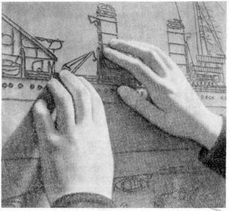
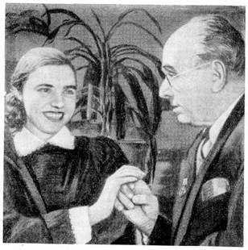
The school for multisensory deprived children in Zagorsk
Teacher as a demiurge of child development who takes all “leading reins” of child development
Consistent individual approach to teaching child
Effort to achieve the highest level of performance

Slide 14
Questions to the quotations
How does the author define the child?
How is disability constructed?
Which educational methods are recruited?
Further information the documentary movie by BBC The Butterflies of Zagorsk

Slide 15
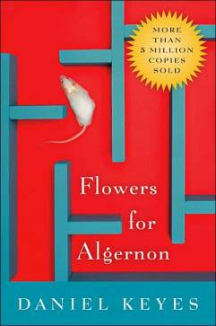
The consistent critique:
Flowers for Algernon
The eponymous Algernon is a laboratory mouse who has undergone surgery to increase his intelligence by artificial means. The story is told by a series of progress reports written by Charlie Gordon, the first human test subject for the surgery, and it touches upon many different ethical and moral themes such as the treatment of the mentally disabled

Slide 16
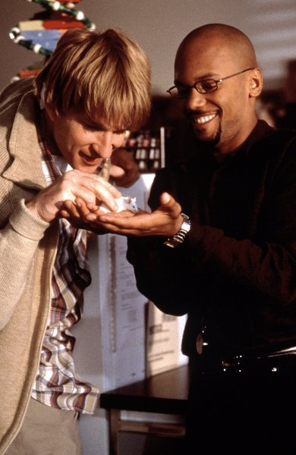
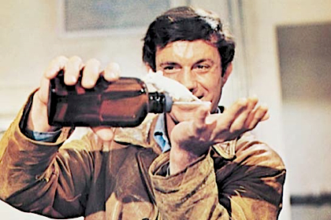
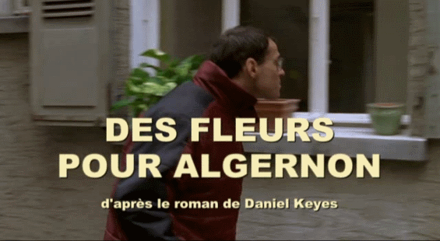
Three adaptations
Flowers for Algeron

Slide 17
Main strands of critique
Utilitarian approach, predominance of usability as a main trait for evaluating people
Ignorance of emotional life, its subordination to cognitive processes
Overvaluing professional knowledge
Obvious connotation between the level of IQ and the social status

Slide 18
Interpretivism or
Person-centered teaching
The child as an agent and participant, prioritising child being
Disability as the neutral array of characteristics
Education as a way to Self-concept, to learn to be in coherence with self

Slide 19
Humanistic education
Teacher as a facilitator between the child and ??? (and the child, networks)
Integrative approach: connections between social prescriptions, feelings and reflections (interpretations)
The mission of educational process: better recognition and own personal aims of students (better understanding)

Slide 20
Cultural model of disability
Disability as a type of culture
Resistance to both medical and social models of disabilities as prescriptions to people with disabilities
Recognising mode of life and accomodating it by other peoples

Slide 21
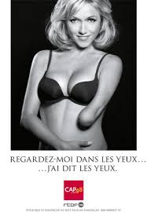

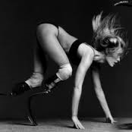
Culture of disability

Slide 22
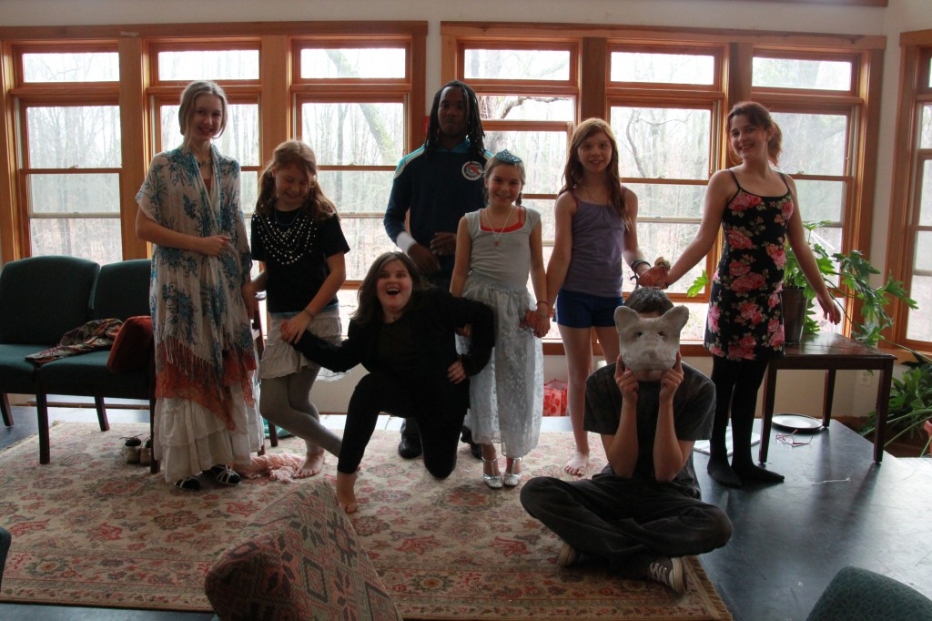
Sudbury schools’ network

Slide 23
The task
Arguments pro et contra of such approach in terms of integrating children with disability

Slide 24
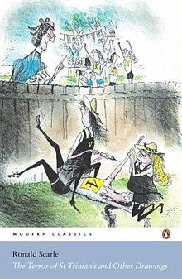

Other examples of humanistic approach to education
Waldorf education
Storyline project
St Trinian’s school as a fictional example

Slide 25
Storyline project
Storyline is a strategy and method for active learning, adapted education and partnership. The learning process is built up through episodes which form a story line. The process is directed by key questions and well planned activities focusing on learning experiences and outcomes.
Further information: http://www.storyline-scotland.com/tag/published-article/

