Slide 1
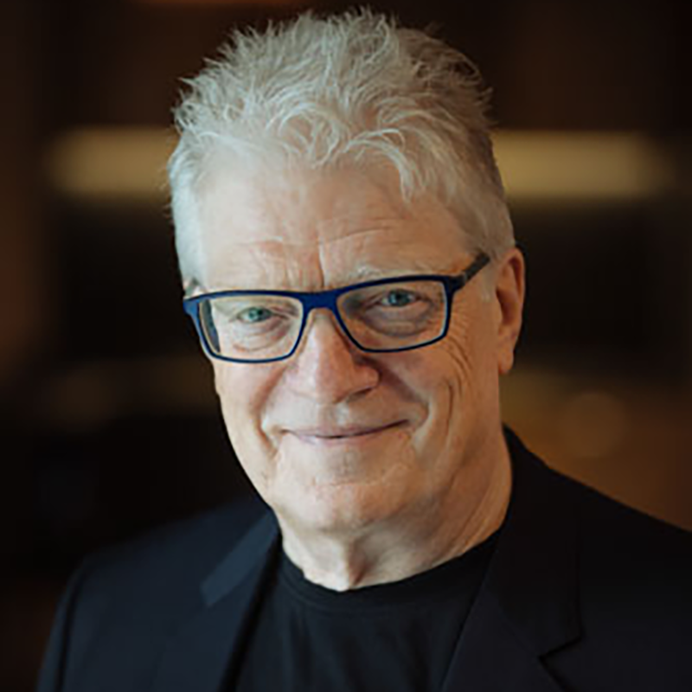
Sir Ken Robinson

Slide 2
Sir Ken Robinson ( 4 of March 1950- 21 of August 2020)
He was a British author.
Speaker.
International advisor on education.
Professor in Art education ( Univ. of Warwick).
Expert on education, art, creativity and innovation.
Director of the Arts in Schools Project around U.K. ( 1985-1988)

Slide 3
BIOGRAPHY
He was born in Liverpool, he was one of seven children from a working-class family.
Robinson contracted polio at the age of four.
He attended an special school due to his physical effects of polio.
His studies: Primary, grammar school, University in English and Drama.
PhD in Drama and Theatre Education.

Slide 4
Ideas on education.
Education has to develop on three fronts.
DIVERSITY: By offering a broad curriculum and
encourage individualisation of the learning process.
PROMOTE: Curiosity through creativity teaching depending in high quality teacher training and development.
FOCUS: On creativity through alternatives didactics processes less standardised testing, giving a creative approaches to learning.

Slide 5
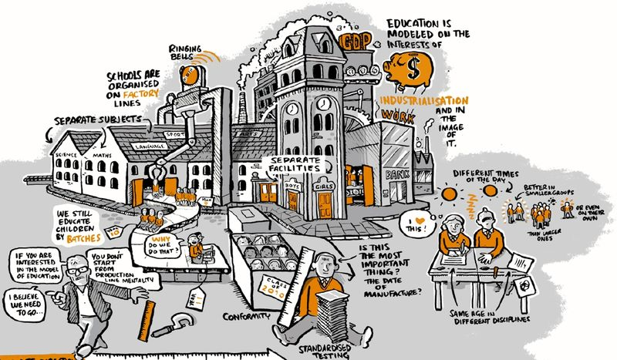
Standardized

Slide 6
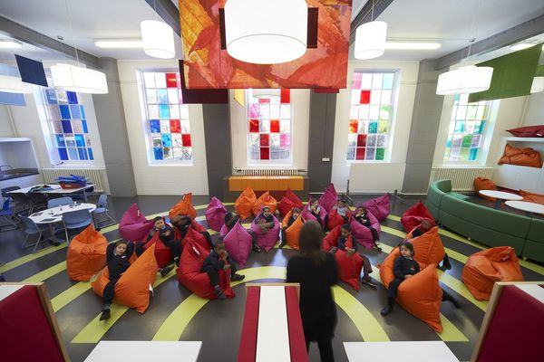

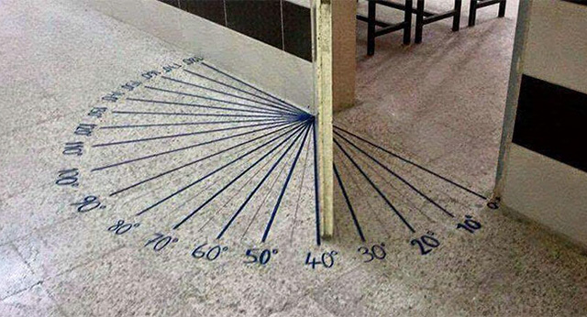
Creative

Slide 7
Testimony
https://www.youtube.com/watch?v=LHJGo_g7Its
This is an example of individualisation of the learning process.

Slide 8
Equality- Diversity- Inclusion
Legislation in U.K.
In U.K. it is illegal to discriminate on the grounds of : Age, disability, sex, sexual orientation, marriage and civil partnership, pregnancy and maternity, religion or belief, race or gender reassignment.
Exist many forms of discrimination: Direct, indirect, associative and perception.
Forms of discrimination: Harassment or bullying.

Slide 9
Examples of discrimination
https://youtu.be/C-uyB5I6WnQ
https://www.youtube.com/watch?v=2g88Ju6nkcg
These are two examples of discrimination.

