Slide 1
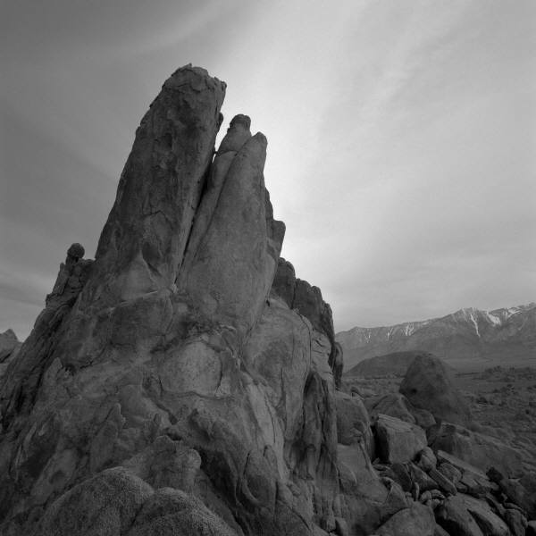
November lights
Current Events 2021 in 15 slides

Slide 2
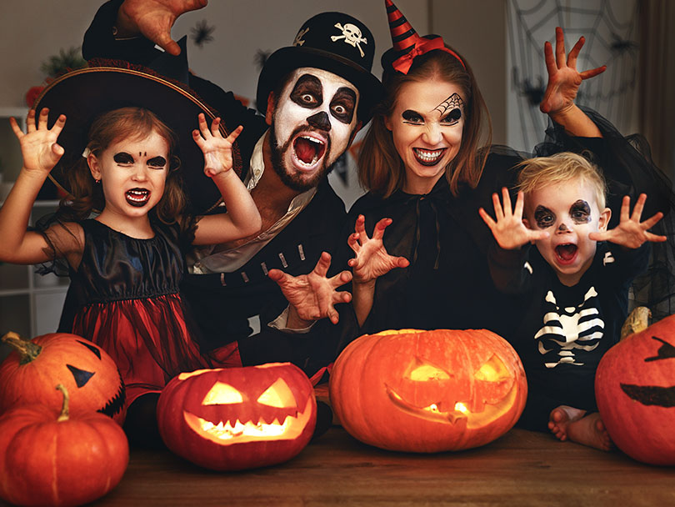
Halloween

Slide 3
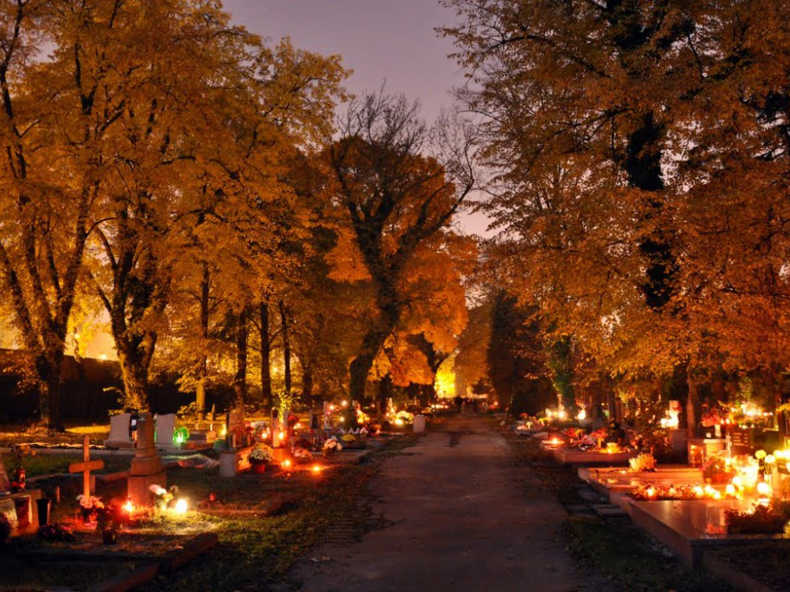
Nov. 1+2: All Saints and All Souls Day

Slide 4
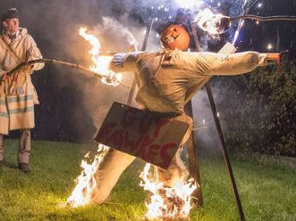
Guy Fawkes Night

Slide 5
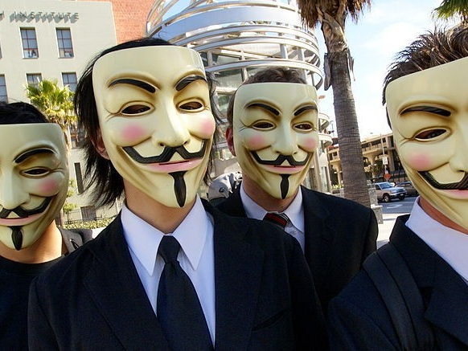
the Anonymous (V for Vendetta)

Slide 6
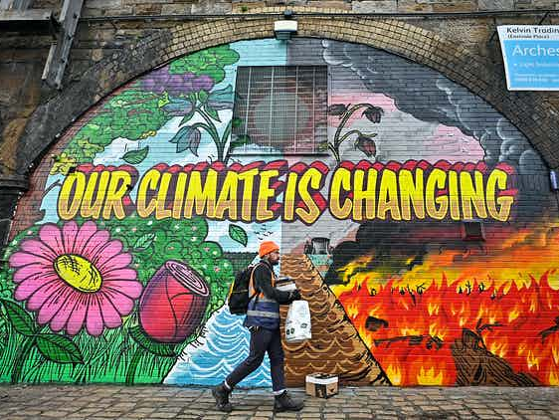
Glasgow Greta Thunberg to world leaders at COP26: "You can shove your climate crisis up your arse!" - YouTube

Slide 7

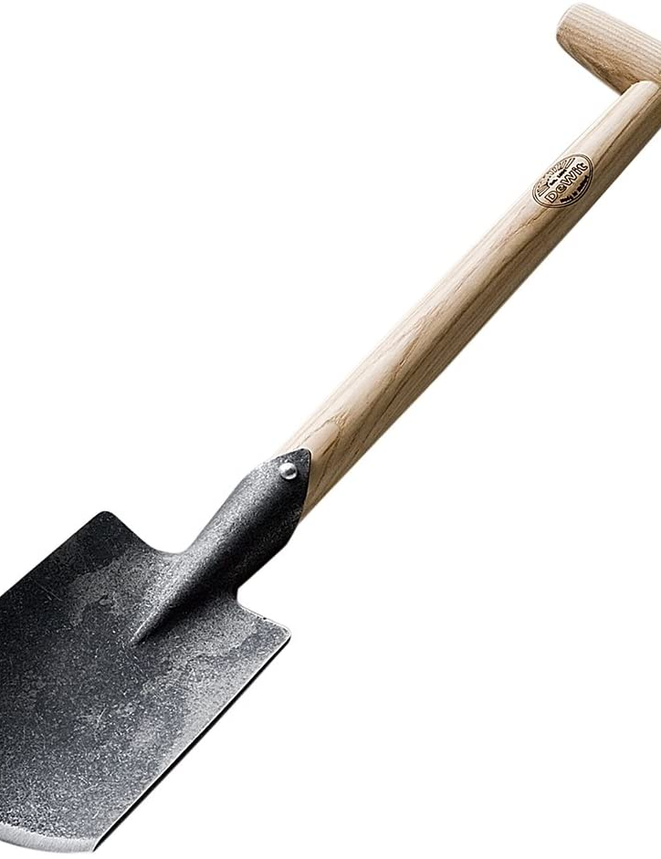
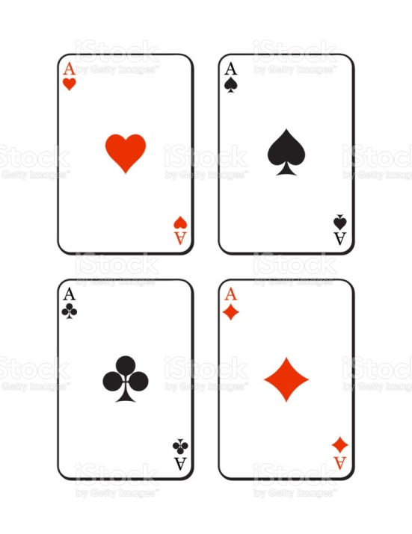
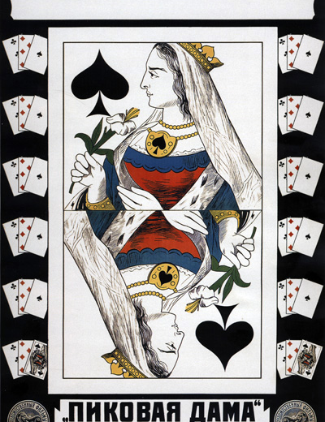
SHOVEL
SPADE
HEARTS, SPADES, CLUBS AND DIAMONDS
QUEEN OF SPADES

Slide 8
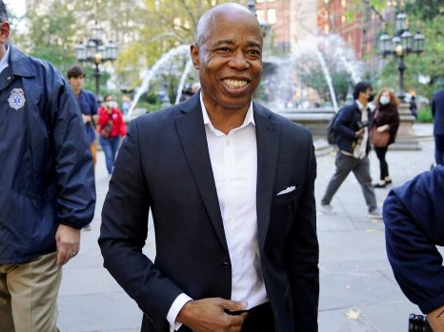
Eric Adams AAVE Eric Adams After Winning NYC Mayor's Race: 'End All Of This Division' - YouTube

Slide 9
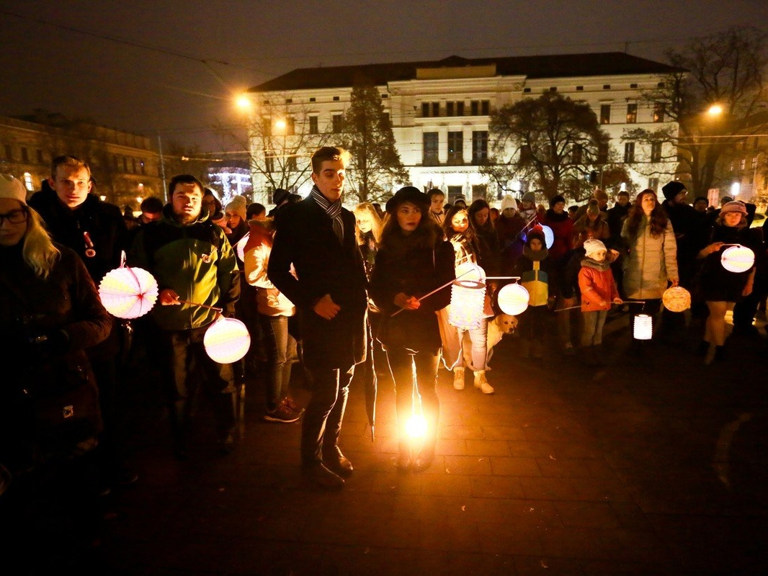
The October Revolution torchlight parade

Slide 10
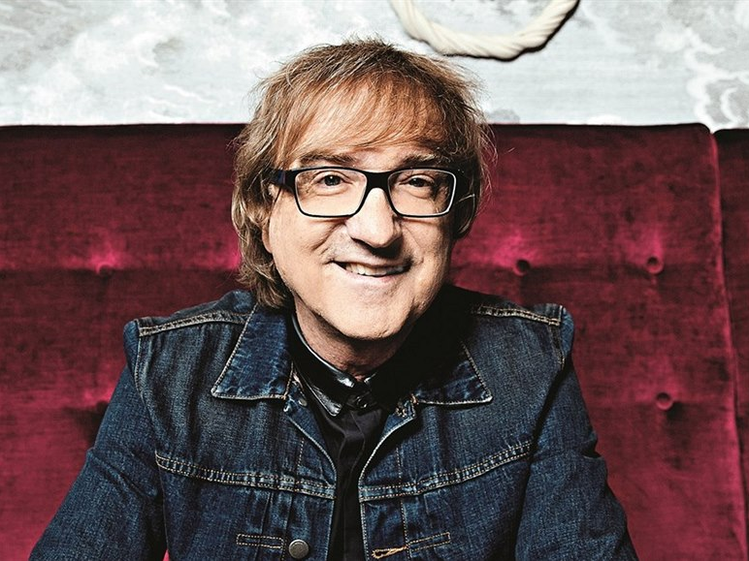
A light gone – Miro Žbirka 1952-2021

Slide 11

Why Is Veterans Day Important? - YouTube

Slide 12
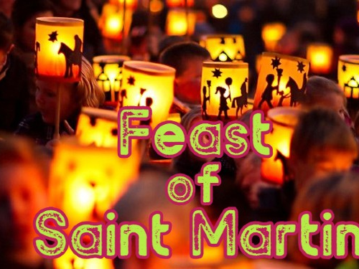
Ich geh mit meiner Laterne - Laternenlieder | Kinderlieder deutsch - Sankt Martin Lied - YouTube

Slide 13
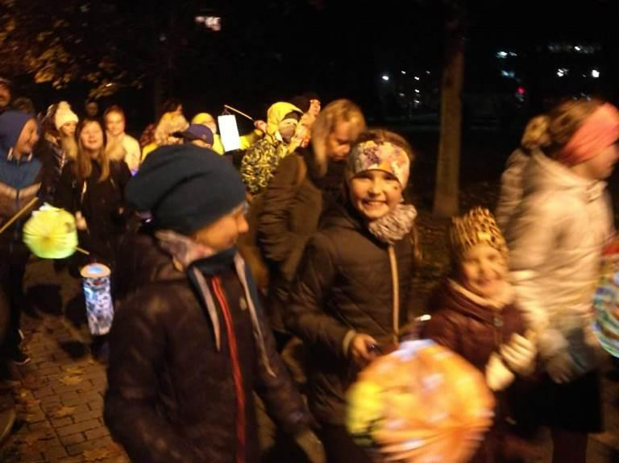
The Velvet Revolution, 1989

Slide 14
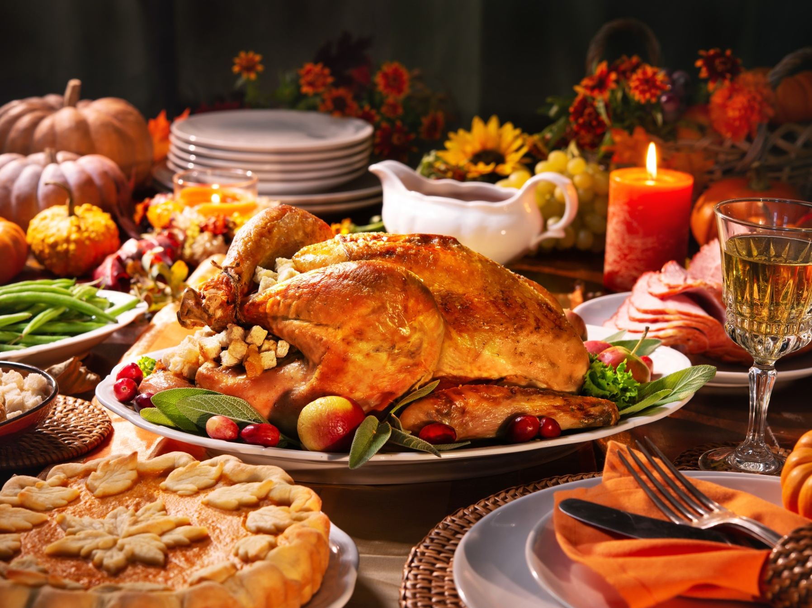
Thanksgiving Day A Thanksgiving Miracle - SNL - YouTube

Slide 15
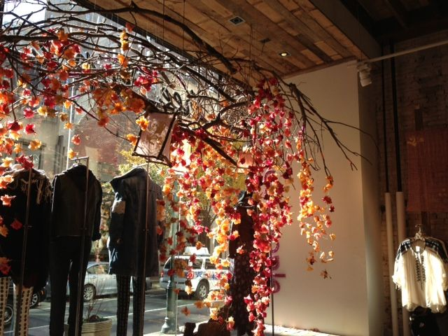
Be thankful! *** Thank you.

