Slide 1
Czech life and culture
Marek Lollok, PdF MU

Slide 2
Simon Mawer
- The Glass Room: http://www.simonmawer.com/TheGlassRoom.htm
- Mendel´s Dwarf: http://www.simonmawer.com/Mendel.htm

Slide 3
Readers and reading in the Czech Republic
- public libraries (2013): 5.381
- loans (thousands): 64.208
- registered readers per thousand inhabitants: 136,1
- loans per thousand inhabitants: 6.109

Slide 4
Titles published
- total titles (2013): 17.876
- fiction: 5.190
- fiction share: 29%
- titles published per thousand inhabitants: 1,7

Slide 5
Reading (2013)
- 84% read at least one book over the year
- 32% visited at least one public library
- domestic libraries: 250 volumes
- 33 minutes reading books per day
- number of book purchased: 2,3 volumes

Slide 6
Reading (2013)
- the most popular autor: Michal Viewegh
- the most popular book: Betty McDonald: The Egg and I

Slide 7
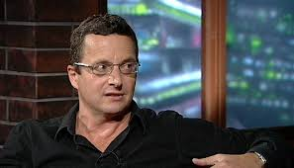
Michal Viewegh
- novelist, playwright, screenwriter
- born on 31st March 1962 in Prague
- full-time writer
- 2012 suffered an aortic dissection
http://www.viewegh.cz/en/knihy.php

Slide 8
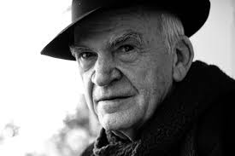
Milan Kundera
- born on 1st April 1929 in Brno
- http://www.kundera.de/english/Bibliography/bibliography.html
- Czech-French writer
exile in France since 1975

Slide 9
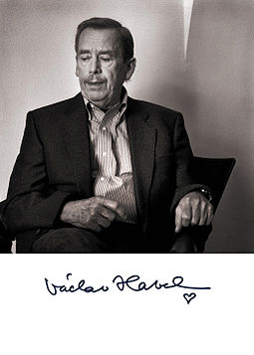
Václav Havel
- 5 October 1936 – 18 December 2011
- Czech writer, playwright, statesman
- „Truth and love must prevail over lies and hatred“

Slide 10
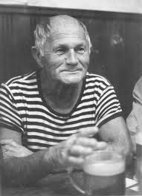
Bohumil Hrabal
- 28 March 1914 in Brno – 3 February 1997 in Prague
- studied law; worked as an insurance agent, manual labourer, paper-packer, stagehand…
- Pearls of the Deep; Palaverers
film adaptations by J. Menzel
Closely Observed Trains
I Served the English King

Slide 11
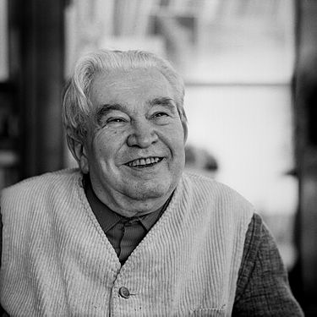
Jaroslav Seifert
- 23 September 1901 – 10 January 1986
- writer, poet and journalist
- 1986 Nobel Prize–winner

Slide 12
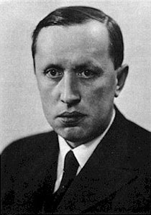
Karel Čapek
- 9 January 1890 – 25 December 1938
- writer, playwright, dramatist, essayist, journalist, literary reviewer, and art critic
- the word robot in his play R.U.R.
- The Makropulos Affair; The White Disease

Slide 13

War with the Newts
- science fiction novel
- people x salamanders

Slide 14
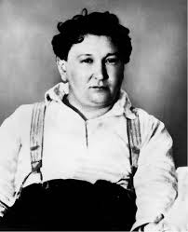
Jaroslav Hašek
- April 30, 1883 – January 3, 1923
- writer, humorist, satirist, journalist, bohemian and anarchist

Slide 15
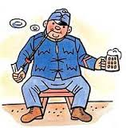
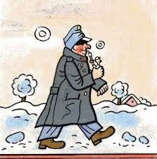
The Good Soldier Švejk
Josef Švejk by Josef Lada

Slide 16
Franz Kafka
- 3 July 1883 in Prague – 3 June 1924
- German-language writer
- The Metamorphosis
- The Trial
- The Castle

Slide 17
Děkuji za pozornost!
Marek Lollok, PdF MU
marek.lollok@seznam.cz

