Slide 1
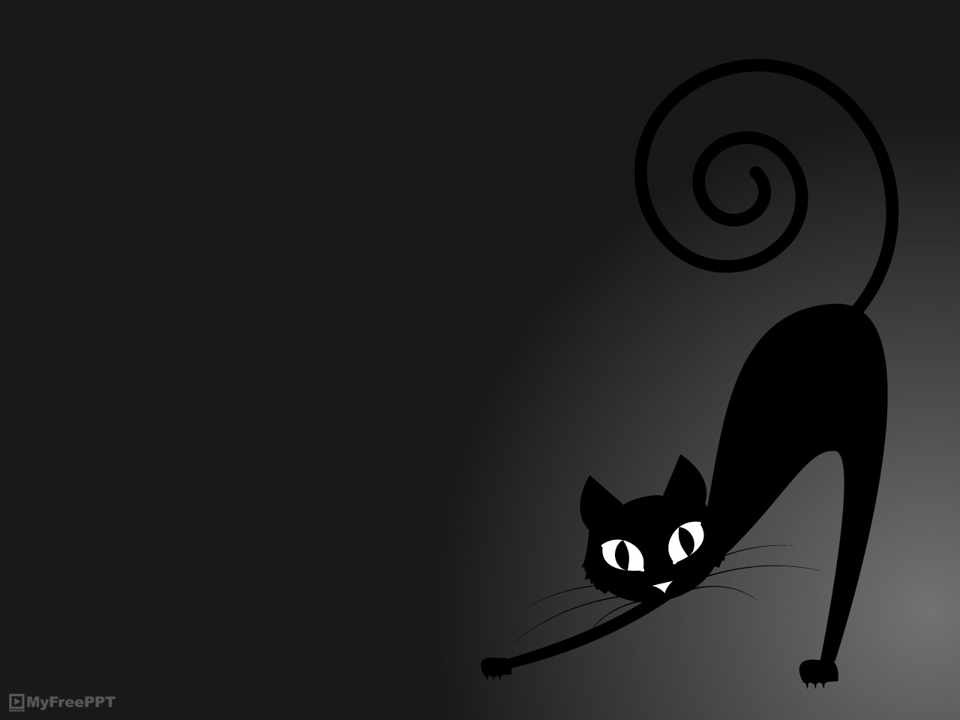

PRACTICAL Ph&Ph 2:
Suprasegmental
pronunciation of English

Slide 2
Prosodic (suprasegmental) features include:
Stress
Rhythm
Intonation
… and secondary features such as voice quality, tempo and loudness.

Slide 3
Suprasegmental features
… influence all the segments in both their realisations and overall perceptions.
… are important indicators of the speaker‘s gender identity, age, level of education and social status, more so than individual words and sounds.
… in lay terms, they could be characterised as the way a speaker uses his/her voice.

Slide 4
Stress in English a) Three basic facts
The prominent syllable of each content word is stressed.
Stress is a combination of loudness, pitch and sometimes longer duration (length).
Grammar words and those considered unimportant to the utterrance are weak forms (reduced words and syllables).

Slide 5
Stress in English b) Idiosyncracies
The alterations of stressed (accented) and unstressed (reduced) syllables are referred to as gradation and are the result of the historical development of English where the Germanic OE underwent the influence of French.
Compare the stress patterns of German, French and your mother tongue.

Slide 6
Stress in English c) Vowels as carriers of voice
Vowels have their full qualities in stressed syllables.
Rarely, they have their full qualities as strong vowels in words such as impact [ˈɪmpæʔt].
The schwa /ə/ or the syllabic /n/, /l/, /r/ are used in most unstressed syllables.
More in Gimson Word Stress in the course‘s Learning Materials in the IS.

Slide 7
Rhythm in English a) Timing of stresses
Czech and Slovak are syllable-timed lanuages. Each syllable, stressed or unstressed, is allowed an equal amount of time.
English is a stress-timed language. Utterrances can be divided into stress groups, i.e. logical segments of speech containing one stressed syllable plus no, one or more unstressed syllables before and after it. Stress groups have the same duration no matter how many syllables they contain, see e.g. a Halloween rhyme with stress groups divided by bar lines:

Slide 8
Rhythm in English b) Exercise
ˈTrick or |ˈtreat |ˈTrick or|ˈtreat|
ˈGive me |ˈsomething|ˈnice to|ˈeat|
ˈIf you |ˈdon’t |ˈI don’t |ˈcare|
ˈI will |ˈsmell your|ˈunder |ˌwear.

Slide 9
English stress and rhythm c) The three rules
You only stress words you wouldn’t leave out in a text message
Stressed syllables are at constant distances from each other
Any unstressed syllables at the beginning of a stress group are said very quickly.

Slide 10
Rhythm in English d) How it works
Simple stress patterns are common in casual speech and their perception is key for intelligibility.
Regular stress and rhythm can be important in news reporting and lecturing where the regularity and predictability contributes to comprehension.
Try how the above rules work on a more complicated Halloween rhyme:

Slide 11
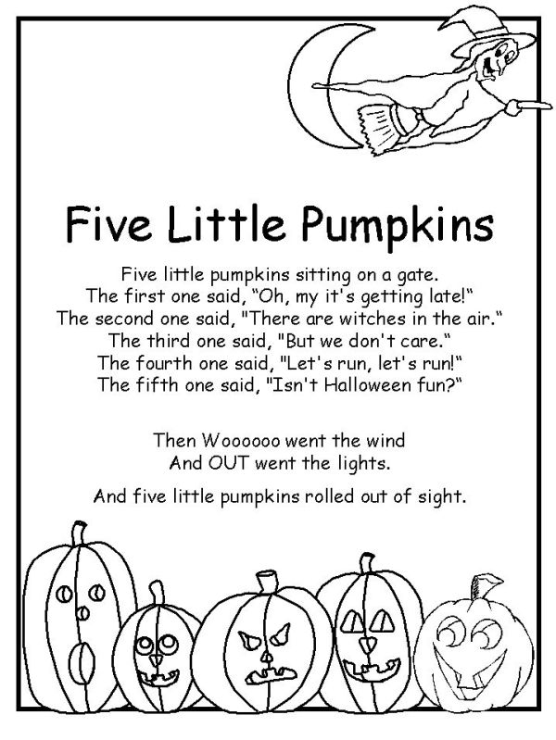
Rhythm in English e) Exercise
Applying the rules above, try to read this other Halloween rhyme:

Slide 12
Rhythm in English f) More in the IS
For more practice, see Gimson Sentence Stress in the course‘s Learning Materials in the IS.

Slide 13
Intonation in English a) Why not treated here
… can only be learned by observation of appropriate models.
… will take care of itself if stress and rhythm are well grasped and the nucleus is correctly signposted.
… is often an indicator of a regional/social dialect.

Slide 14
Intonation in English b) The nucleus
… is the key stress in a segment of speech. Cz/Sl = end, Eng = nucleus.
Workout music source.
- Let‘s go to the theatre.
– The Players‘ Theatre?
This is a pre-recorded Halloween revision of suprasegmental behaviour in English.

Slide 15
Prosodic behaviour in GenAm and GB compared
#1, #2
GenAm devotion to vowels;
vowels more open, nasal setting
GB devotion to consonants
voice carries more
voice carries less

Slide 16
#3, #4
tempo slower, louder in vol.
tempo faster, quieter in
volume
volume decreases during utterrance
volume increases during utterrance

Slide 17
#5, #6, #7
more items stressed
fewer items stressed
narrower pitch range
wider pitch range
volume used for emphasis
pitch used for emphasis

Slide 18
Reflection point:
Do the above speech habits indicate differences in mentalities, degree of speakers‘ confidence or just generally accepted language behaviour?
In what ways do our mother tongues‘ suprasegmental behaviours differ?

Slide 19
Have a spooky Halloween!
Sources:
Gimson‘s Pronunciation of English
Gimson, A.C. A practical course of English pronunciation
Collins and Mees Practical Phonetics and Phonology
Meier, P. Accents and Dialects for the Stage and Screen

Slide 20


