Slide 1
Alternative schools in the Czech Republic
Mgr. Petra Vystrčilová, Ph.D.

Slide 2
Inrtoduction
There are many different possible understandings of the term alternative schools.
We can see the alternative from the view of the organizer, financing or the padagogical perspective.
Generally, the alternative can be realized in all types of schools (private, public, state) - if the school is different from the mainstream standard schools in an eductional system.
Schools with different methods and teaching organization that aim to bring the curriculum closer to children, mostly by the form of game, discussion, problem solving, individual work etc.
There are differences in the school curriculums, types of assessment and evaluation, relationship between the school and parents or local community (Průcha, 2004).
There are also standard schools that apply some alternative programmes (like in just one class).

Slide 3
Overview of the most known alternatives
Waldorf pedagogy
Montessori pedagogy
Dalton plan
Jenaplan
Step by Step
Healt Promoting School
Open Learning

Slide 4
Alternatives in the Czech Republic
Waldorf (kindergarten, primary and sedondary school [lower and higher])
Montessori (kindergarten, primary and lower sedondary school)
Dalton (kindergarten, primary and sedondary school [lower and higher])
Jenaplan (primary school)
Step by Step (kindergarten, primary school)
Healt Promoting School (kindergarten, primary and sedondary school [lower and higher])
Integrated Thematical Learning (kindergarten, primary school)
Forrest/nature school (kindergarten, higher secondaryschool)
Lesní / přírodní škola (MŠ, SŠ)
Teaching home (primary and lower secondary school)

Slide 5
On alternative schools principles generally
the idea to support the natural desire to get to know the new things
partnership between teacher and student, supporting students‘ qualities and originality (mistake is understood as gate to a higher level of learning, not a delict)
cooperation with family, school as a community of students, teachers and parents
child‘s active participation, support for cooperation and develoment of communication
Responsibility (involvement) transition to chidren
Integration of subjects (globalism, thematical integrated learning, experience-based learning, practical learning)
child-centered enviroment (available aids)
Lessons are not limited by the bells ringing, but the students‘ concern and weariness
verbal assessment
individual educational goals

Slide 6
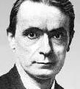
Waldorf Pedagogy
Founder: Rudolf Steiner (1861 – 1925)
Founded: 1919 (town Waldorf)
Based on the philosophical stream of anthrophilosophy (the study of the spiritual base of a man as an individual who is in the centre of attention and the world is reflected in)
School ensures the complex development of a child in practical and artistic fields, discovers child‘s abilities, however does not beset children with encyclopedical knowledge.
No textbooks, no grade repeating, verbal assessment

Slide 7
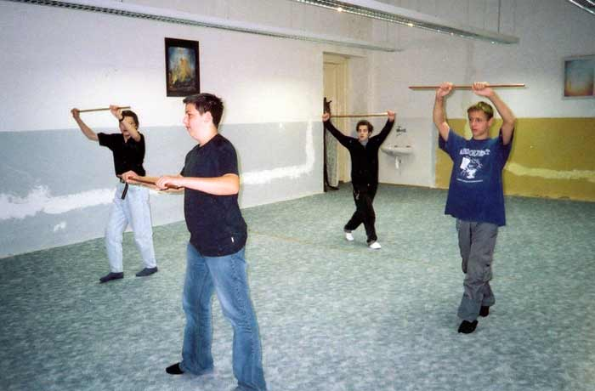
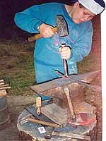
Waldorf Pedagogy
Teaching are divided into main and minor (professional) subjects.
Main subjects (mother language, math, geography, history, science, psysics, chemistry) are taught in the two-hours blocks dedicated to just one subject for 3 or 4 weeks.
The main subject is changing three times a year: so called epochal learning.
Professional subjects (forreign languages, religion, eurythmy) are taught in the classical way of one-hour lessons.
Significant part of the learning are image, rhytm and movement = eurythmy (specific subject, aesthetical and rhytmical learning).
Monthly festival celebrations are typical for Waldorf.

Slide 8
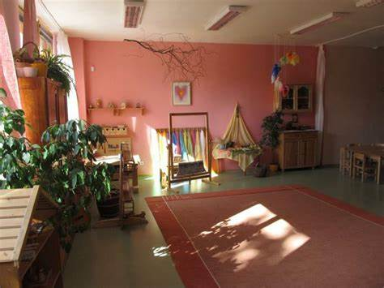
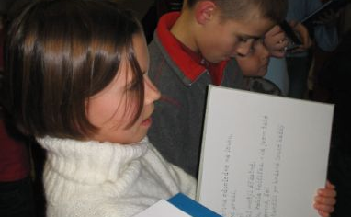
Waldorf Pedagogy
Twelve classes (the same collective)
1st – 8th class: lower grade (one teacher teachs all the subjects)
9th – 12th class: upper grade (professional teachers)
13th class: – possible final upper-secondary leaving examination
The aids are mostly teacher-made materials, students‘ work and epochal excercise books; textbooks and books just are supplemental
Verbal assessment
Specific architecture (natural enviroment, pastel colors).

Slide 9
Waldorf Pedagogy
Positives
Development of creativity, independence, sense for responsibility and self-reflection
Varied curriculum
Interesting learning methods
Negatives
Little link up to the standard educational system
Students‘ freedom can be criticized as excessive.
Puts not enough emphasis on the standard, formal university education of teachers.
Forces students a specific educational style, does not respond to scientific criticism

Slide 10
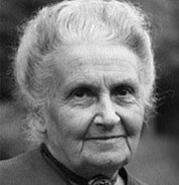
Montessori Pedagogy
Founder Maria Montessori (1870 – 1952)
Founded 1907 (Řím – Cassa di Bambina)
Dildren differ in learning abilities and talents, to the pace of child‘s learning should be individual („Help me to do it myself.“)
From concrete to abstract, focus on human being, individual development.
Fields of learning: practical life, sensual education, language education, math, psychomotor, musical and artistic abilities, cosmic education.

Slide 11
Montessori Pedagogy
Cosmic education is a study about everything around us
To be free means to be independent and responsible
Silence and calm support concentration on work
Work has to be accomplished.
Mistake is a natural part of learning.
Student is in the centre, teacher in the background.
Mixed classes (three grades)

Slide 12
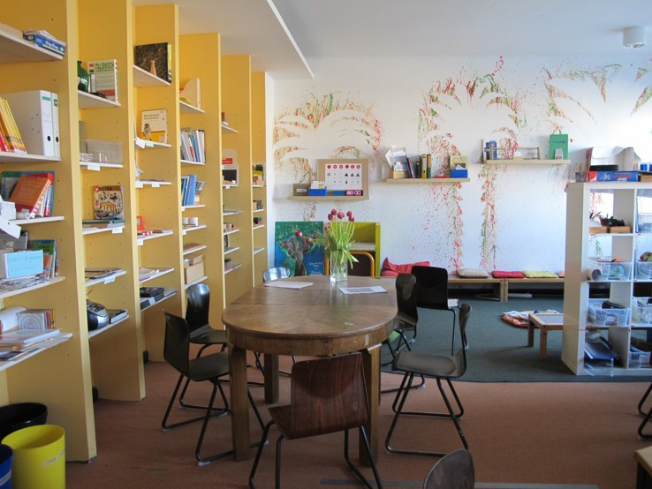
Montessori Pedagogy
Support for natural movement, wakling on the ellipse.
Specially developed system of aids to each learning fields.
Sensitive phases (ages of more sensitivity of child) are used to obtain some skills.
Learning is based on weekly cycles.
Sompulsory team lections, market of teachers (programmes are offered to a child who aslo choose his teacher)
Tribas classrooms, cca 20 pupils in each class.

Slide 13
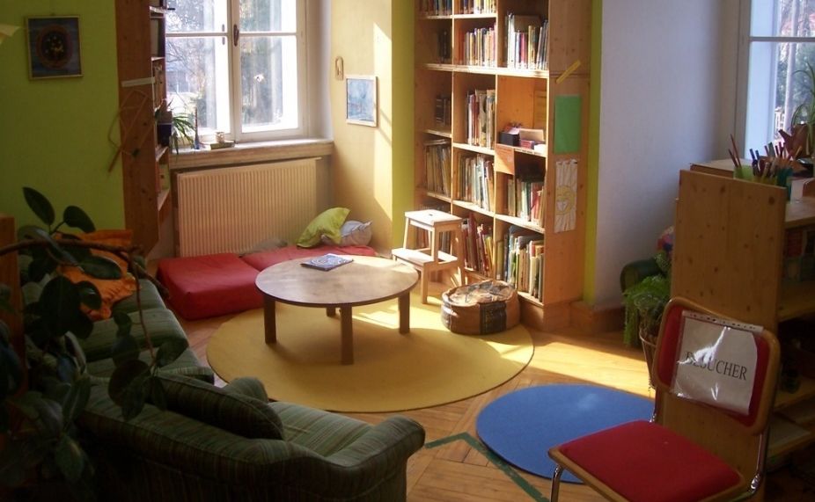
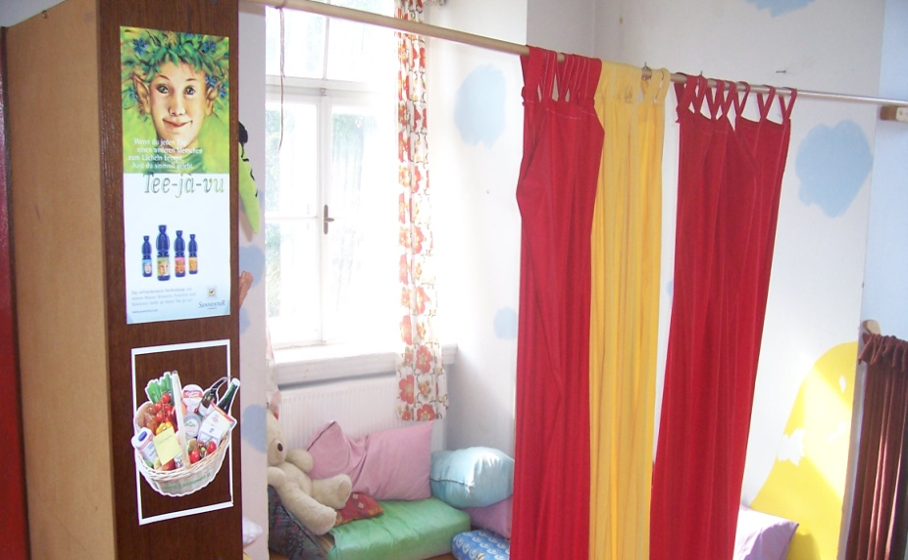
Montessori Pedagogy
Freedom of choice and child‘s responsibility.
Prepared background – libraries, aids…
Teacher supervises, konsultes – is a guide in learning.
Student‘s self-assessment and self-evaluation is promoted.
Teacher assesses student‘s work twice a year and student‘s profile (more teachers) once a year.
Parents participate in the school managing and the lessons too.
School transition – a year acclimatization.

Slide 14
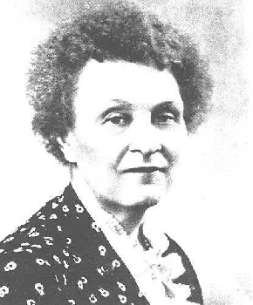
Dalton plan
Founder Helen Parkhurst (1886 – 1973)
Founded 1920 (town Dalton, USA)
Dalton is not a method or a system but an influence.
Main idea of the Dalton plan is the development of student‘s individuality by the way of self-education.
Three fundamental principles: 1) freedom (and responsibility), 2) independence, 3) cooperation
Freedom does not mean anarchy – student choose time and place that are ideal for him to learn.

Slide 15
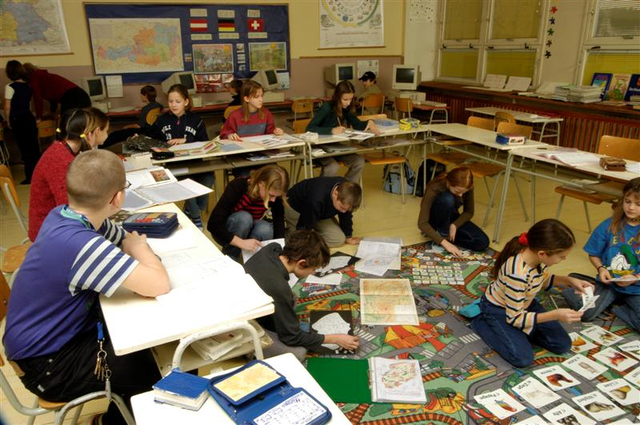
Dalton plan
Child behaves independently and is responsible for his/her own learning outcomes.
Teacher plays the role of assistant, guide.
Student can cooperate with the others in problem solving.
Cooperative groups (the problem is solved together) and helping groups (the work is independent although there is a possibility to consult with a classmate) are used.
Longterm tasks are an important part of Dalton. Long-lasting, prescribed objectives in the form of contract between a teacher and a student – and the next objective can be solved only after the fulfilment of the first one.

Slide 16
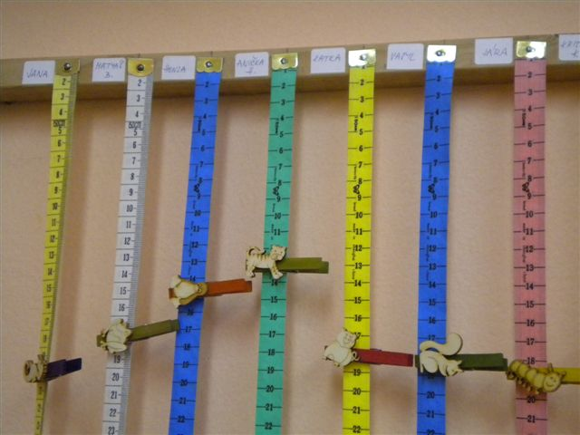
Dalton plan
Teacher plays an important role, however has to resign to the dominant position. He also prepares plans, tests and exams, communicates with students and their parents.
No lessons in a tradition sense (no bell ringing), class is divided into the different subject districts with the aids for each grades.
Curriculum is divided into 10 contracts to learn each month.
Student signs a monthly contract of learning outcomes with the teacher.
Student is allowed to begin the work on the next task only after succesful managing of the previous one.
The system of colors that symbolize days in a week, each subjects or dalton meters.

Slide 17
Dalton plan
Positives
Learning variability
Education to freedom
Education to responsibility
Education to cooperation
Negatives
Curriculum repeating is insufficient.
Knowledge obtaining is not systematic.
Lack of discussion about curriculum.
The relying on student‘s indepencence is too optimistic.

Slide 18
Health Promoting School
Health promoting school has been a part of the WHO‘s programme Health for All since the half of the 1980‘.
The project is based on friendly athmosphere, healthy learning, and open partnership.
Health promoting school develops independence, creativity, responsibility, cooperation, positive self-concept and self-evaluation, tends to increase stimulation of school enviroment, to improve methods of verbal assessment and to increase respect to ethnic and social minorities.
Methodology of the School Health Promotion Program
There are aproximately 92 Health promoting schools in the Czech Republic (for. example in Prague, Blansko, Jihlava, Karviná, Ostrava, Zlín).

Slide 19
Step by Step
The Step by Step programme has been running in the Czech Republic since the year of 1994 in nursery schools and since 1994 in „basic“ schools (primary + lower secondary).
Origins in USA
Individual approcach to a child, inclusion of children with special educational needs, cooperation in teams, partnership of family, school and broader society.
Child‘s day work is managed accorging to the daily plans.
Pupils also works individually or in groups in the activity centres along with their preferences.

Slide 20
Integrated Thematical Learning
The model is created by an American S. Kovalik.
Integration means interconnecting the curriculum, knowledge and information.
The curriculum of all sublects is integrated into a specific framework. A year-long theme is composed of month-long and week-long thematic frameworks.
An acquired knowledge is applied in practice, so children realize the purpose of the curriculum.
There are three schools based on this programme in the Czech Republic. In most cases, in the standard schools are applied just some elements of the ITL

Slide 21
Project-based Learning
Origins can be found in the begin of the 20th century in the US pragmatic pedagogy and philosophy, mostly by J. Dewey and W. H. Kilpatrick
In the Czech Republic since the 1990‘ (J. Kašová).
The purpose is to solve the problem that is concrete, meaningful, real, based on life and child‘s experience.
The projects can be realized in many different forms and can last for different time (a day, week or year-long projects, a project realized in just one subject or a project integrating more subjects).

Slide 22
Open Learning
The movement of Open Learning is based on the ideas of pedagogical reformism.
Since the 1960‘ in the world, since the 1990 ‘ in the Czech Republic.
Aims for the humanization the learning, respect the individual needs, move from transmissive to constructivistic teaching style.
The openness is meant both inside (change of learning and teaching methods, forms and organization of school) and outside (school‘s relation to its enviroment, families…)
Associates principles and stimulli from different traditional and alternative learning conceptions.

Slide 23
Alternative schools in Brno
Waldorf
Plovdivská
Montessori
Gajdošova, Pastviny, Five Star v Brně Bohunicích
Dalton
Husova, Chalabalova, Křídlovická, Mutěnická, Staňkova ad.
Step by Step
Heyrovského, Stará, Vejrostova

Slide 24
Literature
Grecmanová, H.-Urbanovská, E. Waldorfské školy. Olomouc, 1996.
Valenta, Z. Waldorfská pedagogika a jiné alternatívy. UP, Olomouc 1993.
Rýdl, K. Principy a pojmy pedagogiky Marie Montessori. Public History: 1999.
Zelinková, O. Pomoz mi, abych to dokázal. Portál: Praha 1997.
Röhner, R., Wenke, H. Daltonské vyučování. Stále živá inspirace. Brno: Paido, 2003.
Wenke, H., Röhner, R. Ať žije škola. Daltonská výuka v praxi. Brno: Paido, 2000.
www.waldorf.cz
www.iwaldorf.cz
www.montessori.cz
www.montessori-ami.org
www.dalton.cz
www.dalton.org

