Slide 1
A CHOICE FROM THREE TOPICS BY A LIFELONG ENTHUSIAST IN ENGLISH
PhDr. Kateřina Tomková, Ph.D. – Owner of the TomCat Playgroup
Lecturer at Depts. of English and American Studies at the Faculties of Art and Education

Slide 2
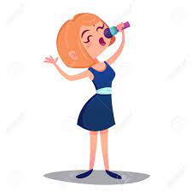
Please vote for the topic you do NOT wish to hear about:
a)
Bilingualism at the TomCat Playgroup
b)
English or Czenglish Pronunciation
aneb
Anglická výslovnost pro nadšence i profesionály
c)
English in song lyrics

Slide 3
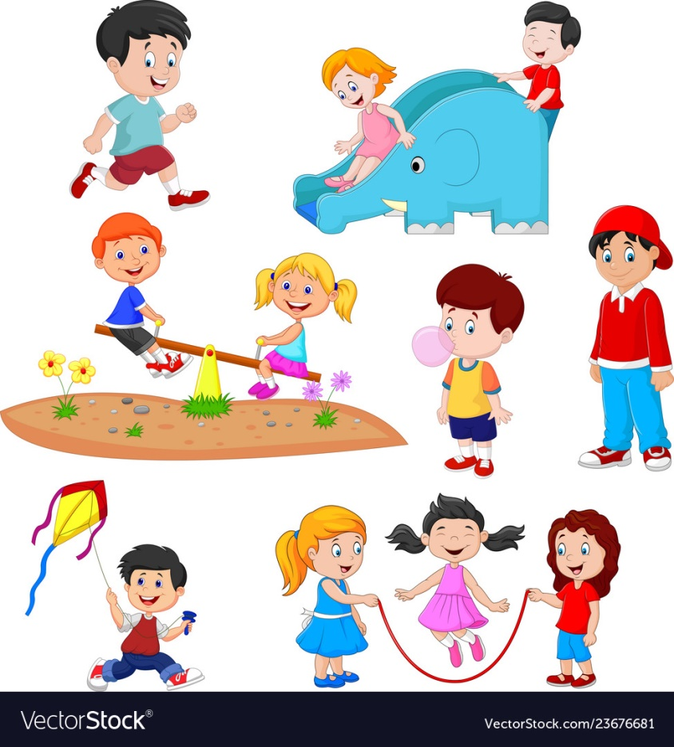
a) Bilingualism at the TomCat Playgroup
Priorities:
1 Safety & Security
2 Politeness, Manners
3 English
All was facilitated by hierarchy.

Slide 4
b) English or Czenglish Pronunciation aneb Anglická výslovnost pro nadšence i profesionály
Meant for students, teachers, scholars, researchers, business people, artists and anyone else striving for comfortable intelligibility communicating in English.
Lists common pronunciation errors and ways to avoid them.
Stresses the importance of suprasegmental features.

Slide 5
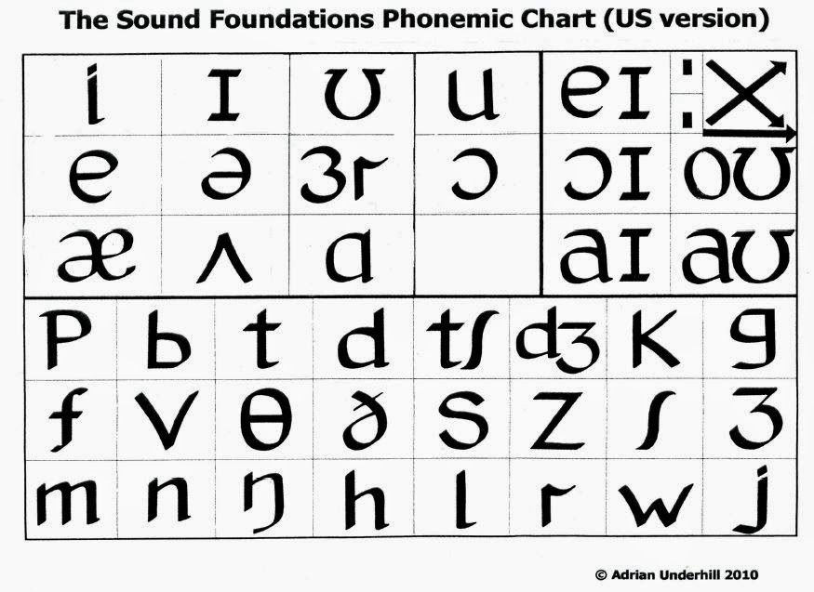
Pronunciation charts of RP (GB) and GenAm

Slide 6
5 features of English pronunciation that make the difference between harshly foreign and more authentic accents:
1 STRESS (2 ASSOCIATED ASPIRATION OF /p/, /t/, /k/)
3 REDUCTIONS
4 VOICING
5 LINKING / LIAISON
I organized events in a hotel. A unique performance. Camden Town. My name‘s Tom.

Slide 7
Recurrent pronunciation errors at bachelor and master defences
Segmental: th voiced: the other x the udder
th voiceless: thousand, mythical
open ash: static, chapter, Germanic, classified,
pragmatic
Liaison: in terms_ of_ importance, of_ other_ elements,
impressive_ accomplishment, co’mmunicative_ goal

Slide 8
Recurrent pronunciation errors 2
Misplaced stresses: ‘admirable, characte‘ristic, co’mmunicate, con‘sider, con’tinue, con‘tribute, con‘vincing, hi‘storical, intelligi’bility, it‘self, par‘ticular, per ‘cent, persu‘asive, phe‘nomenon, suc‘cessful
Mispronounced names: Grice, Trudgill, Deborah, Sarah, Noah

Slide 9
Recurrent pronunciation errors 3
Mispronounced words: ambi’guity, to ‘analyse, a’nonymous, s/he ‘analyses, a’nalysis sg., a’nalyses pl., basic, change, com‘pose, com’ponent, con‘sist, cri’terion, de‘cisive, de‘cision, de‘termine, di’mension, di’ploma, e’xamine, focus, half, hy’pothesis sg., hy’potheses pl., insist, le‘gitimite, novel, o‘ccur, o‘ccurrence, own, problem, ‘process, pro’cession, psycho‘logical, their, they´re, theo‘retical, theore’tician, theorist, theory, thesis, theses, u’nanimous

Slide 10
c) English in song lyrics
see U3V paper

Slide 11
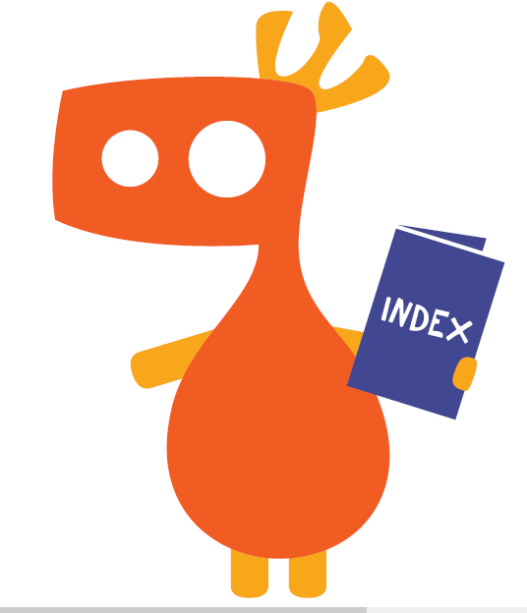
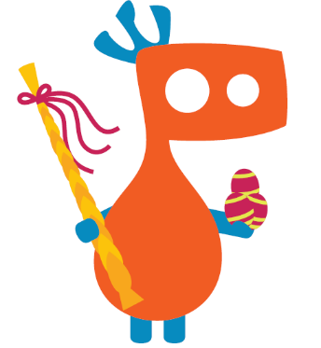

Slide 12
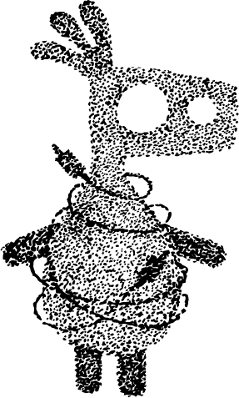
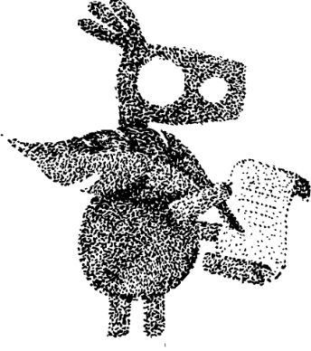
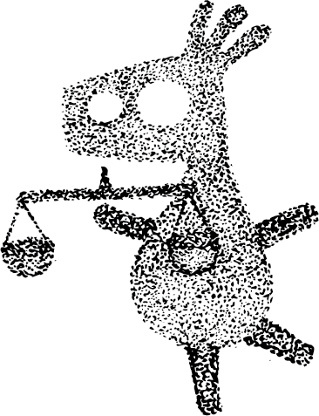
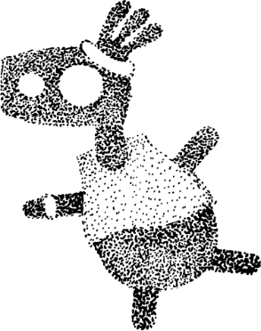
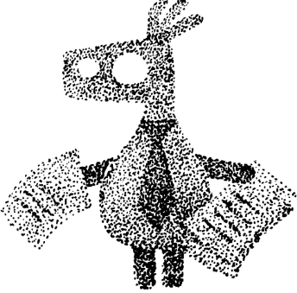
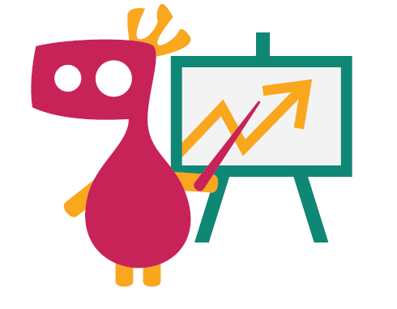
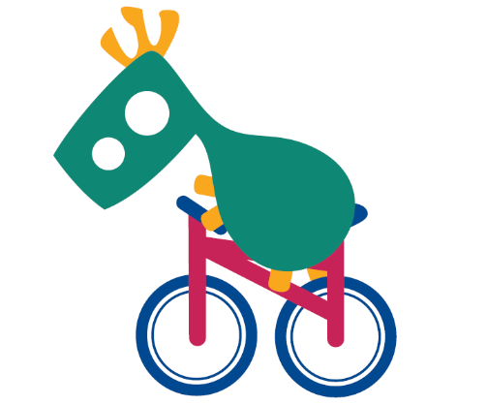

Slide 13
