Slide 1
ENGLISH IN THE SONG LYRICS OF OUR YOUTH
PhDr. Kateřina Tomková, Ph.D.
Lecturer at Department of English and American Studies both at the Faculty of Arts and Faculty of Education; Owner of the TomCat Playgroup; Lifelong pop music enthusiast

Slide 2
WELCOME on St Nicholas Day!
Thank you for your interest in English pop-song lyrics and for getting here through the snow

Slide 3
INTRO OF LECTURER, PURPOSE & DISCLAIMER
Bringing back memories
Having fun
Experiencing ‘moments of enlightment’
Please don’t blame me if your favourite song is not included

Slide 4
PATTERNS
PRONUNCIATION
GRAMMAR
VOCABULARY
PHRASES, PHRASAL VERBS, COLLOCATIONS

Slide 5
PRONUNCIATION PATTERNS
In pop-music: British or American English? – Why?
Segmental rather than suprasegmental pronunciation unless it is rap or hip hop
Quick pronunciation only intelligible thanks to rhythm:
You’re the one that I want
Grease
Features of coherent speech: assimilation (miss you, kiss you, Monsieur le Maire)
Les Miserables

Slide 6
PRONUNCIATION PATTERNS
* Place names: Kansas, Massachussetts, Michigan; Missouri, Tucson,
Az.
* Proper names: Beelzebub
Queen - Bohemian Rhapsody
Who would have blushed in a song by the Smiths? The Smiths - Heaven Knows I'm Miserable Now (Official Music Video) - YouTube
‘What she asked of me at the end of the day
… … … … … … … … would have blushed…’
Caligula
Whose deadly toy does Sting want to save his son from in his song ‘Russians’?
Sting - Russians - YouTube
… … … … … … … … … … ... …’s
Oppenheimer

Slide 7
PRONUNCIATION PATTERNS
Odyssey, Odysseus, Ulysses
Sean
Graham
Ralph, Ralph Fiennes

Slide 8
GRAMMAR PATTERNS
Repetitive action/thought process: I keep thinking about you
Present perfect tense: I’ve been waiting for a girl like you
Future tense: … and I always will;
Will you still love me when I‘m no longer young and beautiful?
1st conditional: When I‘m 64
2nd conditional: If I could turn back time; If I were you
3rd conditional: I should have learnt to play the guitar

Slide 9
GRAMMAR PATTERNS
Translate into Czech:
Question tags: You don‘t really care for music, do you?
Infinitive of purpose: Born to be alive
Emphasis: Love, love me do
Pronouns: I need somebody, not just anybody
… ne jen tak kohokoliv

Slide 10
Colloquial GRAMMAR PATTERNS
Double negative: I can’t get no satisfaction
Karaoke - Saturday Night Live - YouTube
Wanna = want to
Gonna = going to
Gotta = got to = have to = must

Slide 11
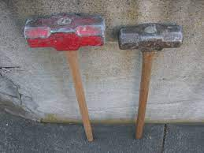
UNEXPECTED VOCABULARY
Basic crops: ječmen, žito
barley, rye
Machinery: buchar
sledgehammer
Behavior, human qualities: nedůsledný
inconsistent

Slide 12
LEXICAL PATTERNS: Words, Collocations, Situational phrases
What is the English for:
Hromy a blesky
Dean Reed & Václav Neckář: Thunder And Lightning
Je z něj šplhoun
Everly Brothers: Well he’s the teacher’s pet now
Hrát si na maminku a tatínka
Tammy Wynette: I Don’t Wanna Play House
Můžem to vyřešit
Beatles: We Can Work It Out

Slide 13
LEXICAL PATTERNS: Situational phrases
Věříš na …?
Cher: Do you believe in life after love?
Sveď to na…
Jackson Five: Blame It On The Boogie
Mě z toho neobviňuj
Rag & Bone Man: Don’t put the blame on me
Pak jsem zbouchnul Mary
Bruce Springsteen: … then I got Mary pregnant…
Slibuju, že se polepším
Pink: I promise to be better…

Slide 14
LEXICAL PATTERNS: Proverbs
mlčeti zlato
Tremeloes: Silence Is Golden

Slide 15
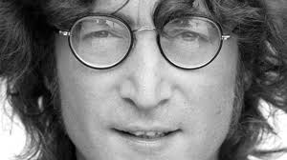
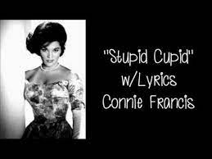
SURPRISING / UNEXPECTED MEANINGS
Imagine
Stupid Cupid

Slide 16
COVERS: English
CCR, Rod Stewart: Have you ever seen the rain
Sting, Dasha: Fields of Barley
Rihanna, the Baseballs: Umbrella

Slide 17
COVERS: Czech
Triky a pověry, Vy ženy ženy, co jste na Italy…
Dej mi pár okovů Ray Charles > Karel Hála
Supermuž Jackson Five > Marie Rottrová
Sedmkrát Dooby Brothers > Black Milk
Boky jako skříň Meghan Trainor > Ewa Farna

Slide 18
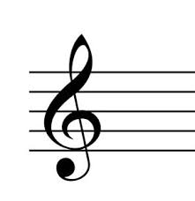
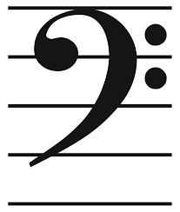
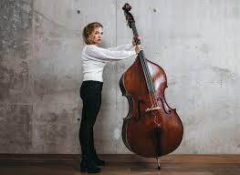
MISHEARD LYRICS
Meghan Trainor: All About That Bass NO TROUBLE TREBLE

Slide 19
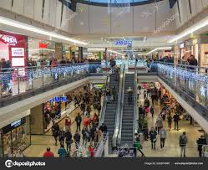
CHRISTMAS FORMATS
Do you recognize this tune played in Czech shopping malls (galeries) before Christmas?
12 Days Of Christmas | Kids Songs | Super Simple Songs - YouTube
Enjoy Chris Mann’s Covid-19 version!
THE 12 DAYS OF QUARANTINE - A Chris Mann Music Parody - YouTube

Slide 20
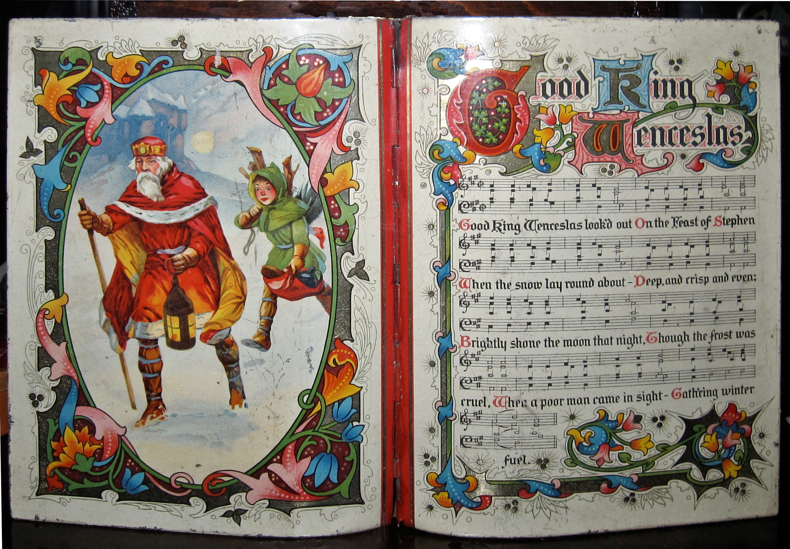
CHRISTMAS FORMATS
… and this tune, even more relevant to us Czechs?
Good King Wenceslas

Slide 21
LET’S DO SOME CAROLING !

Slide 22
QUESTION TIME

