Slide 1

Practical Ph&Ph:
Segmental pronunciation of English

Slide 2
Before starting about vowels, diphthongs and consonants, a brief revision of…
… the physiology of speech, so one could explain sound production to more technically-minded pupils
… the disciplines of Phonetics and Phonology, the concepts of the sound and the phoneme, allophonic (narrow, phonetic) and phonemic (broad) transcriptions;
… the main concepts in articulatory, acoustic and auditory phonetics;
… the fact that everything is intertwined in speech, namely segmental and suprasegmental pronunciations;
… the vowels and diphthongs, being the most sonorous sounds and carriers of voice, being particularly impacted by suprasegmental (prosodic) behaviour both within a short unit such as the word and in connected speech.

Slide 3

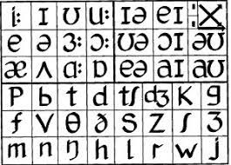
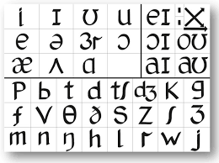
Adrian Underhill‘s Sound Foundations pronunciation charts for GB and GenAm

Slide 4
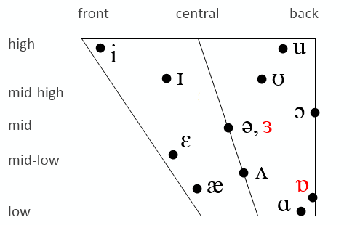
English vowels
High and low can also be referred to as close and open. The sounds in red plus [ɔ] are exclusive to GB (General British, a replacement term for RP, in the U.S. also referred to as SSBE=Standard Southern British English). Notice that length (duration) is no longer marked in modern transcriptions and charts as duration depends largely on what
follows.
Source - https://www.sltinfo.com/ess101-simple-vowels-summary/
In GenAm, vowels are generally more open and
nasal, which makes AmE more suitable for
singing. The British [ɒ] and [ɔ] have merged with [ɑ], the
long [ɑ:] is raised to [æ], both mixed vowels [ə]
and [ɜ] are rhoticised to [ɚ] and [ɝ].

Slide 5
Cz/Sl problems with E vowels
Not disposing of such phonological distinction in their own language, the Czechs and Slovaks replace [æ] with [e]: my pet ret
… [ɪ] with [i]: just a leetle beet
… [ʊ] with [u]: book, foot, hood
We can say they don’t build and maintain the desired degree of openness on certain vowels. This, combined with final-consonant devoicing, can render some word chains virtually indistinguishable, e.g. med-met-mad-mat.
The long mixed vowel /ɜː/ is often replaced by /ɔː/, saying warm meaning worm and ward meaning word.
Remedial training: check any authentic English/American audio materials and Trim‘s English pronunciation illustrated in Study Materials.

Slide 6
Pre-fortis shortening
All vowels, diphthongs and even voiced consonants become much shorter if they are followed by voiceless (=fortis) consonants /p/, /f/, /k/, /t/, /ʃ/, /s/, /tʃ/, e.g. making the /ɒ/ in dock a millisecond shorter than in dog.
To make things more complicated, in AmE /t/ after /n/ is often dropped, making the only difference between the affirmative I can and the negative I can‘t the duration of the open ash. This is very well explained by Rachel in this video:
https://www.youtube.com/watch?v=Vp7xmbtylqI

Slide 7
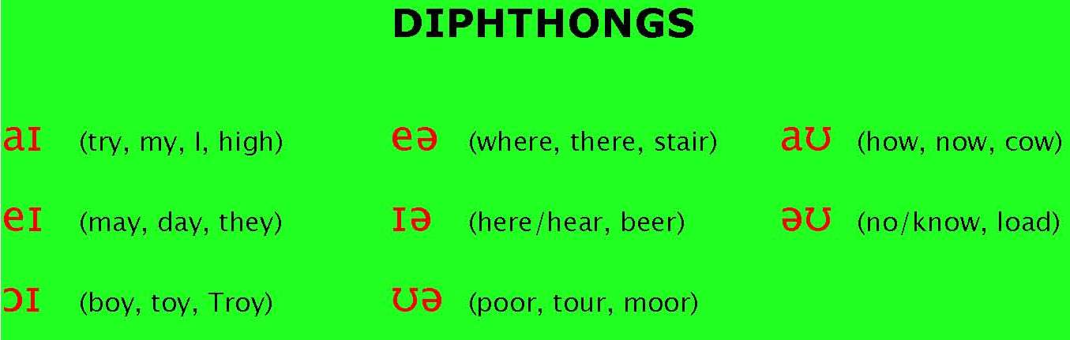
English diphthongs
1) gliding to /ɪ/, 2) centring (lowering to /ə/, non-existent in AmE), 3) gliding to /ʊ/.
/ʊə/ has disappeared in modern GB, merges with long /ɔː/.
/əʊ/ has a less central start in GenAm than in GB and sounds like /oʊ/.

Slide 8
The pronunciation of English vowel letters in open and closed syllables (consonants are the closing elements; the “magic E opens syllables). Hence, reduplication is necessary to keep the short pronunciation (lad-laddie).
There are many exceptions, e.g. have, love and examples on the following slide, still reduplications and the magic E work most of the time.
In open syllables: “long pronunciation“ In closed syllables “short pronunciation“
A mate mat
E Pete pet
I, Y I, my it, myth
O poke Spock
U dispute put, putt

Slide 9
Problem of Czech/Slovak speakers with /eɪ/(understandable as they follow the rule on slide 8):
In words such as ancient, angel, arrange, Cambridge, change, manger, range, strange, Cz/Sl students often erroneously replace the diphthong /eɪ/ with the monophthong /e/.
There is a lot of monophthongisation in various regional and social dialects of English but never of this kind.
Remedial training: check any authentic English/American audio materials.

Slide 10
Comprehending British English: smoothing of triphthongs
For some time now in GB, particularly in its posher forms, the sequence
/aɪə/, /eɪə/ or /ɑʊə/
is smoothed. The diphthong‘s central element is weakened or totally eliminated, changing pronunciation of fire, layer and tower to [ˈfaːə], [ˈleə] and [ˈtɑːə].
Well documented in this video grom the Guardian:
https://www.theguardian.com/lifeandstyle/video/2014/sep/22/secrets-posh-accent-video-riot-club-vowels

Slide 11
Comprehending British English: the disappearance of /ʊə/
Words containing the /ʊə/ diphthong such as sure, pure, cure and endure now realise the phoneme /ʊə/ as long /ɔː/.
Discussion point: Should a learner try to imitate this?

Slide 12
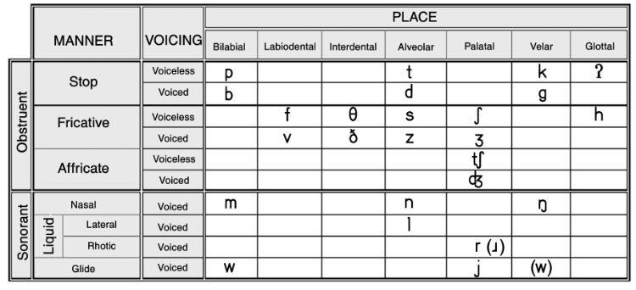
English consonants

Slide 13
Sonority and articulatory energy
Sonority (voicing; categories voiced vs. voiceless) and articulatory energy (tension; categories lenis vs. fortis) are two counteracting qualities of consonants. Most English consonants come in pairs and are either voiced lenis or voiceless fortis.
Voiced lenis are consonants where vocal energy is required on the vocal tract but lips and tongue are rather idle. One cannot whisper voiced lenis consonants: /b/, /v/, /g/, /d/, / z/, / ʒ /, /dʒ/.
Voiceless fortis are consonants where no energy is invested on the vocal folds but lips and tongue work harder. One can whisper voiceless fortis consonants: /p/, /f/, /k/, /t/, /s/, / ʃ/, /t ʃ/.
The only exception in English is /h/ which is voiceless lenis (just a breath, no energy involved anywhere).

Slide 14
The problem with final-consonant devoicing (neutralisation)
In Czech and Slovak, voiced consonant phonemes in final positions, /b/, /v/, /g/, /d/, / z/, / ʒ /, /dʒ/, are devoiced (neutralised) into their voiceless counterparts /p/, /f/, /k/, /t/, /s/, / ʃ/, /t ʃ/.
Examples: slib [-p], lev [-f], blog [-k], pád [-t], bez [-s], masáž [-ʃ], bridž [-tʃ].
The neutralisation even occurs before a vowel in speech. Then the subsequent vowel begins with a glottal stop: slib a přísaha [ˈslipʔʌˈpr̝iːsʌhʌ], lev a tygr, blog i článek, pád i vzestup, bez agendy, masáž aorty, bridž i kanasta.
Certain non-native speakers acquire voicing and linking (liaison) habits naturally through observation, others must train hard to eliminate the “harsh Czech accent“.

Slide 15
Voicing and linking (liaison)
These terms reflect the speech habit of making one word blend with another without a glottal stop
Linking /w/: go on [ˌgəʊˈʷɒn]
Linking /j/: carry on [ˌkʰæriˈʲɒn]
Linking /r/: car and house [ˌkʰɑːrənˈhɑʊs]
Intrusive /r/: Buddha images [ˈbʊdəʳɪmədʒəz]
Remedial training: check any authentic English/American audio materials.

Slide 16
Aspirations of voiceless plosives under stress
Voiceless plosives /p/, /t/ and /k/ are aspirated if they occur in the beginning of a stressed syllable.
Aspiration does not occur if the voiceless stop is preceded by a /s/. Sometimes the /s/ is disguised in spelling as x = /ks/.
Compare pool [ˈpʰuːɫ], tool [ˈtʰuːɫ], cool [ˈkʰuːɫ] with spool [ˈspuːɫ], stool [ˈstuːɫ], school [ˈskuːɫ].
Compare tend [ˈtʰend] and extend [əkˈstend].
Lack of aspiration can result in /p/,/t/,/k/ being perceived as their voiced counterparts /b/, /d/ /g/, e.g. Pompei as Bombay, tick as dick, cool as ghoul.

Slide 17
Other problems pronouncing consonants
Voiceless plosive/t/, instead of being alveolar and aspirated, is often dental, causing Tom being perceived as Dom.
Both the dental fricatives, voiceless /θ/ and voiced /ð/, are replaced by their alveolar counterparts /s/ and /d/. As a consequence, the expressions I think it‘s a good thing and the other may be perceived as I sink it‘s a good sing and dee udder.
-ING endings often do not finish with a velar /ŋ/ but with a /ŋk/ or alveolar /n/, erasing the phonological difference between e.g. sing, sin and sink.
Another frequent mistake is the fluctuation between /v/ and /w/.
Remedial training: see Trim‘s English pronunciation illustrated in Study Materials.

Slide 18
Tomková‘s Pronunciation assessment form
NAME, PTS |  | 40
Stress & rhythm |  | -15
Voicing & liaison |  | -7
Vowels /æ/, /ɪ/ |  | -2, -2
Dental fricatives /ð/ and /θ/ |  | -2, -2
Voiceless alveolar plosive /t/ |  | -2
-ing endings |  | -2
Long mixed vowel /ɜː/ |  | -2
/v/ and /w/ |  | -2
Words mispronounced |  | -2

Slide 19
Articulatory settings in Cz/Sl and English
The term was coined by the South-African linguist Barbara Honickman and is understood as a set of prevailing tongue movements and positions for each language. It is investigated in Russia as articulatory basis.
When speaking English, the tongue tip (apex) operates around the upper teeth, the blade being relatively idle and resting. Its position is concave.
When speaking Czech or Slovak, the apex is relatively idle and the blade approximates the hard palate rather often to produce palatal sounds, ď [ɟ], ť [c], ň[ɲ] and ľ [ʎ]. Its position is convex.

Slide 20
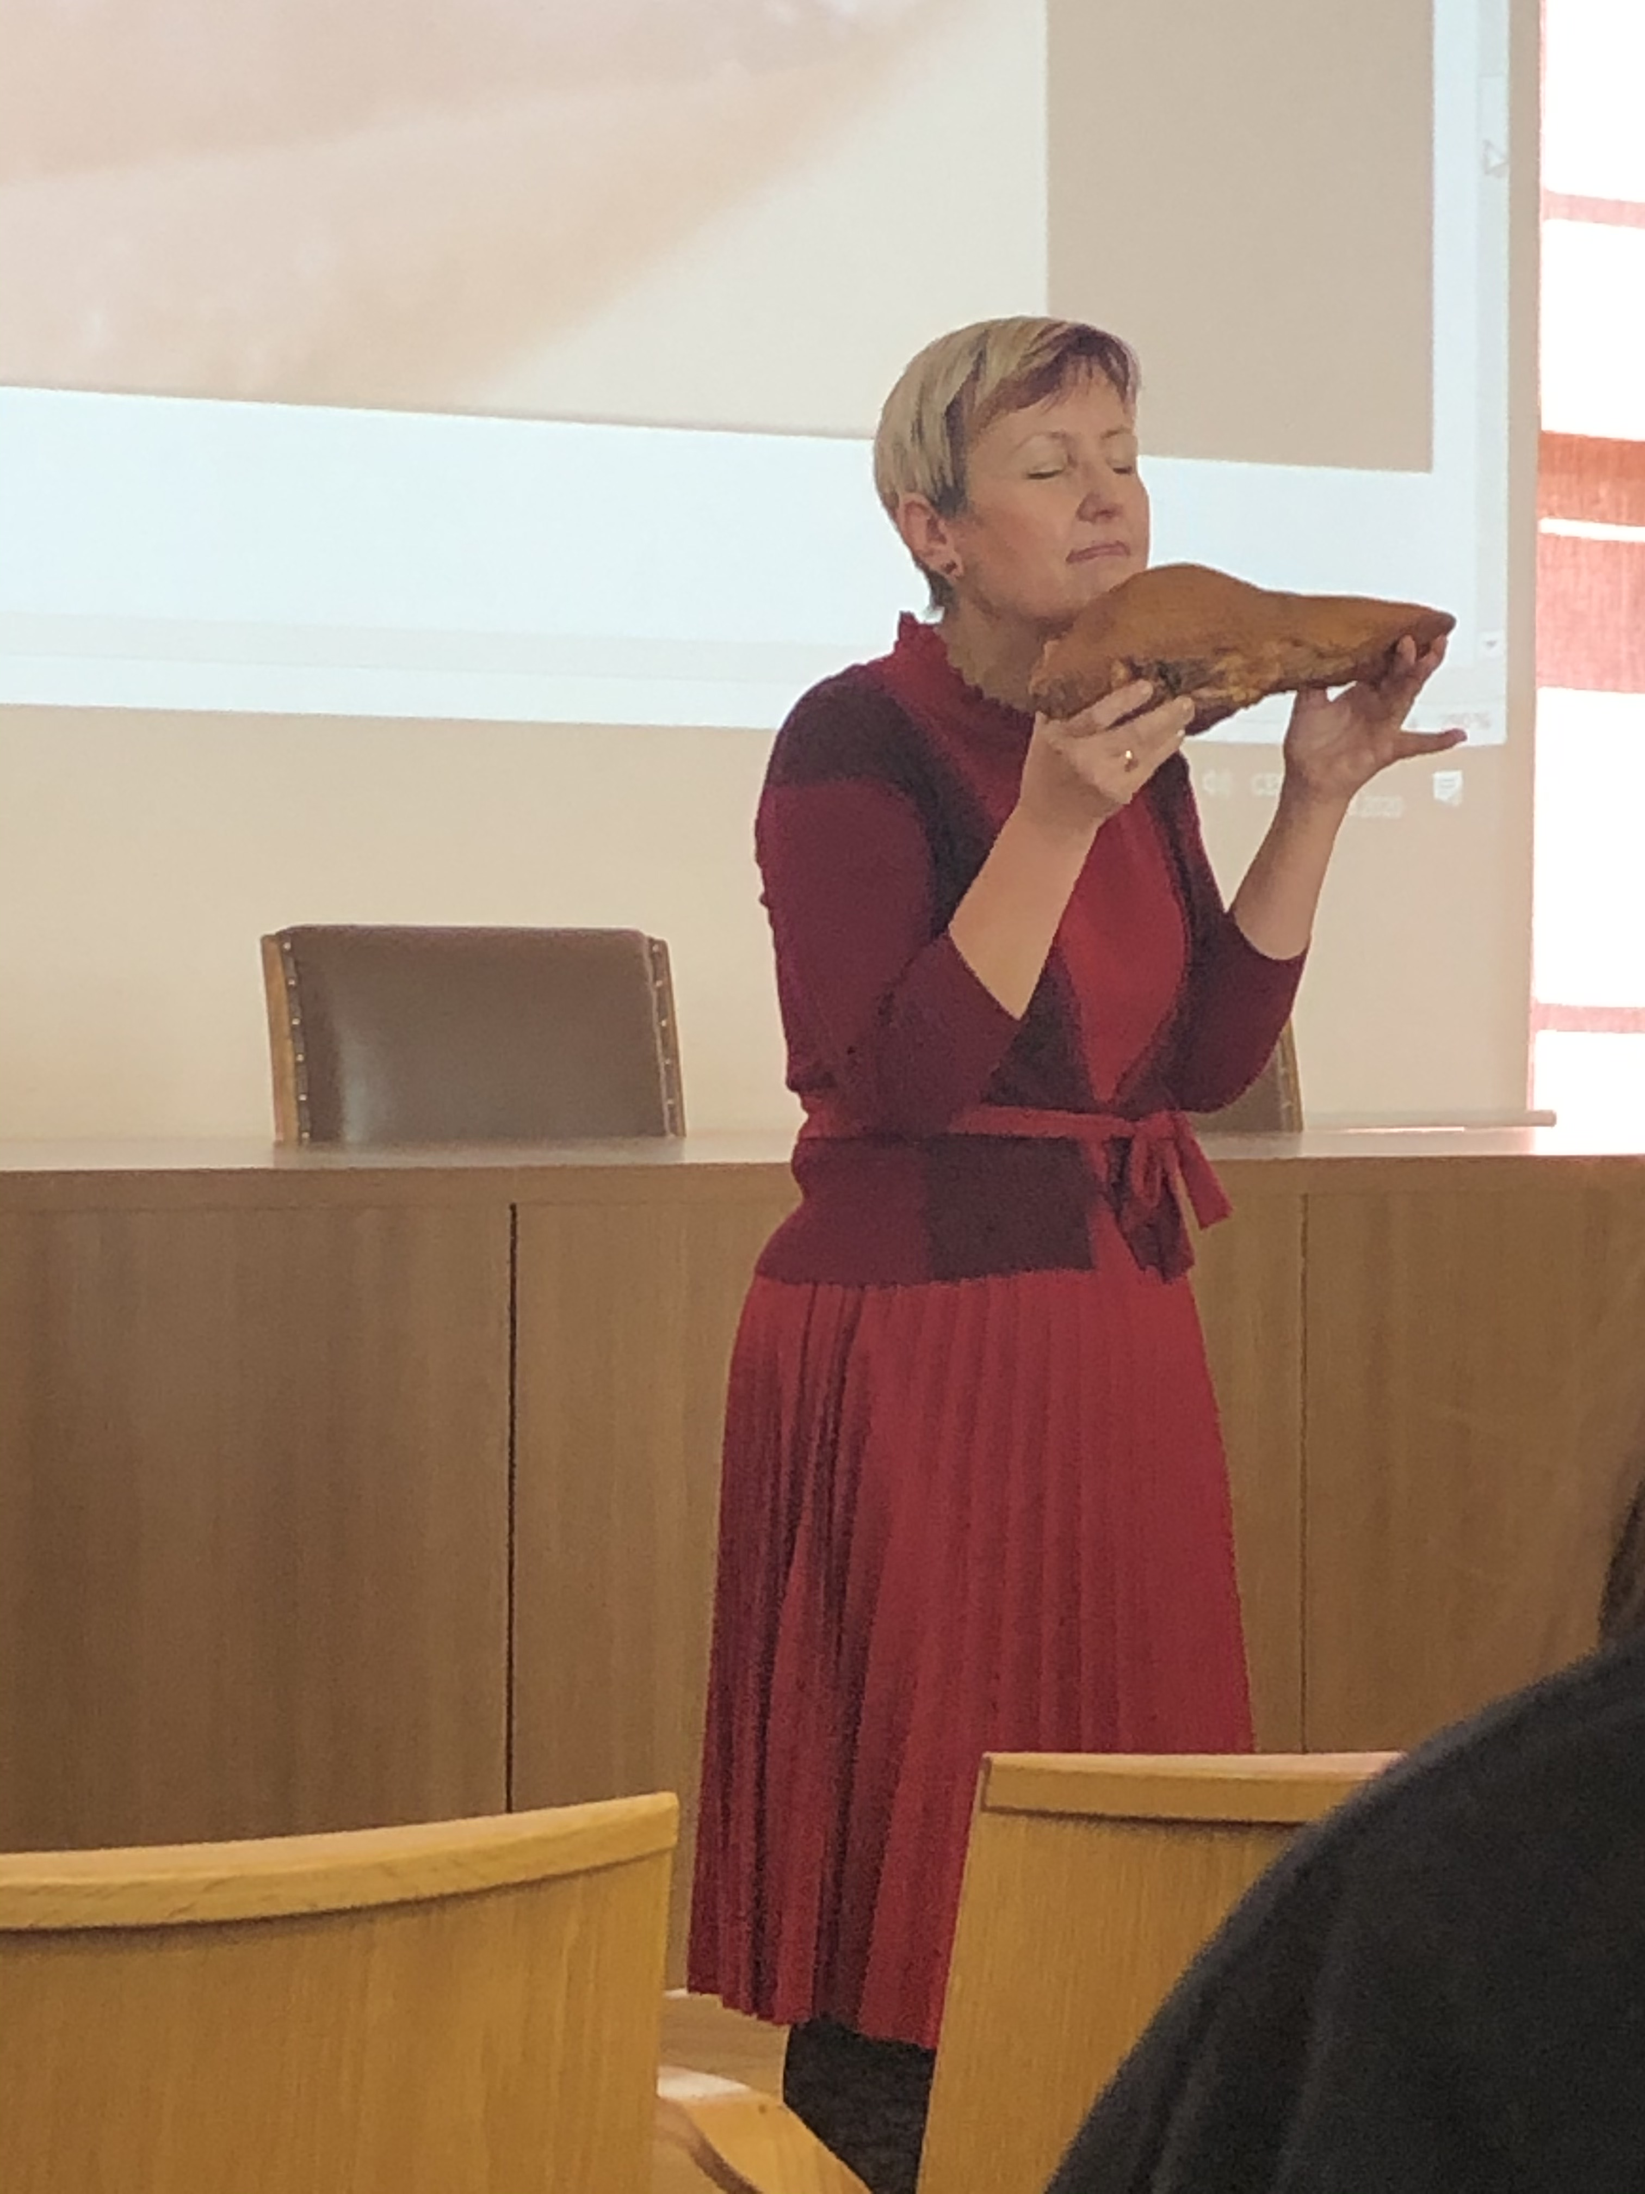
Articulatory settings in Cz/Sl and English documented on a beef tongue, P&P March 2020

Slide 21
Sources
Gimson
Roach
Collins and Mees
Life
Teaching practice

Slide 22
Thank you for your attention!

