Slide 1

Bettering the World
through Literature
An Introduction

Slide 2

The power of stories
Now let´s get on and change the world, one page at a time.
(Mem Fox, Reading Magic, 2001)

Slide 3
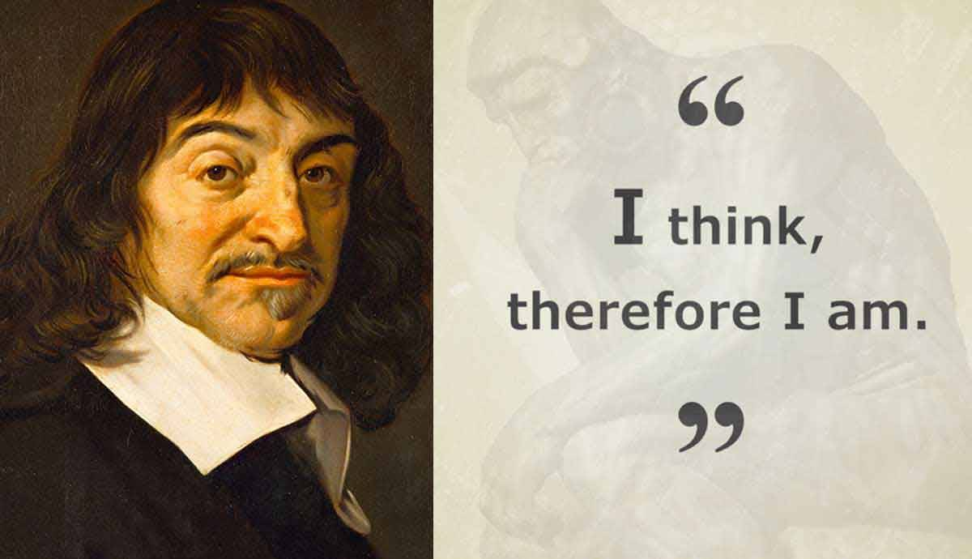
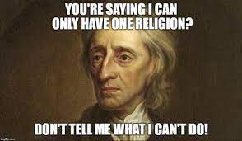
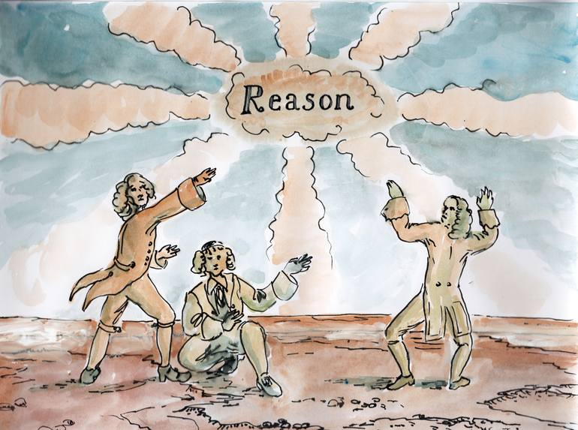
18th-century Enlightenment
reason logic chronology linearity
Input Outcome
teach it – learn it – know it – apply it
Doesn’t work?
Change the methods!
Change the teachers!
Change the curriculum!
…. (and on and on …)

Slide 4

A learner is a complex human being , not an empty vessel
Affective filter
Brain studies - the reading brain
Mental health
Wellbeing, SEE learning
The 4 c’s: critical thinking, creativity, communication and collaboration
CREATIVE THINKING

Slide 5
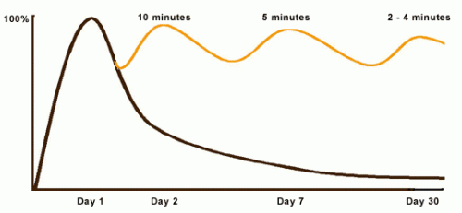
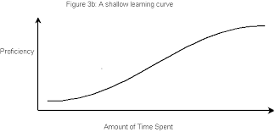
Power of reading, power of learning

Slide 6

Human connection and sharing

Slide 7
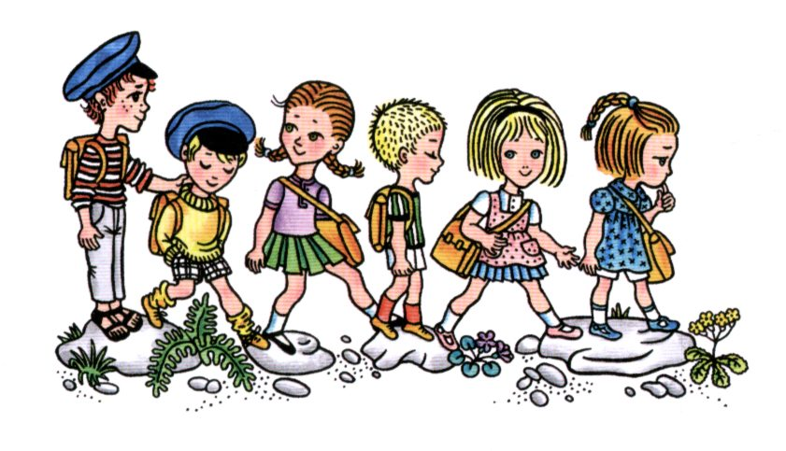
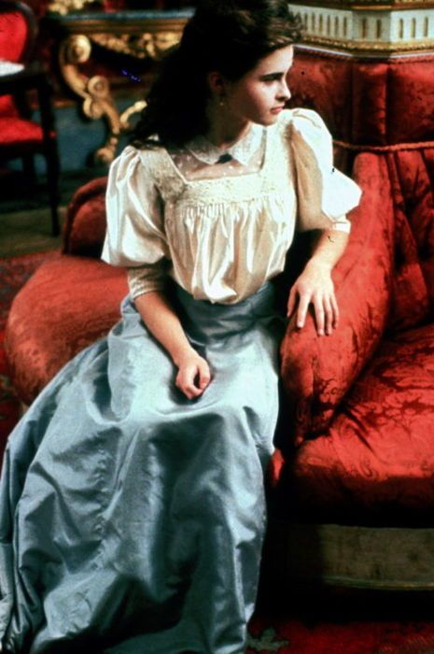





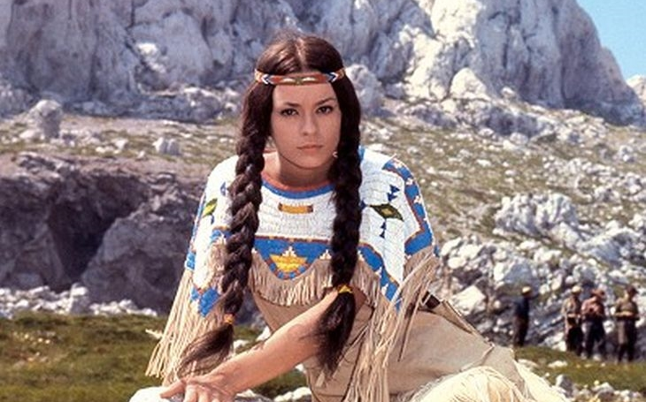
Adding complexity, adding experience

Slide 8
Course format and requirements
Teacher Talk
Input on: the science of reading, types of books and types of reading
Planning the reading
choose a place
choose a person
choose a book
create the setting
plan the time and frequency

