Slide 1
Interview as a Diagnostic Method
Pedagogic-psychological diagnostics

Slide 2
Interview
Diagnostic (cognitive) interview – focuses on personal motives, beliefs, experiences, preconceptions, opinions, and values of the individual; it reveals facts about personal, health, family or social history; the course, methods, and outcomes of learning. It makes it possible to obtain information based on direct personal contact between the interviewer and the speaker.
Research interview – contributes to exploring a particular issue in order to better understand or get to know social reality; it contextualizes an individual’s subjective view of a given process or phenomenon.
The boundaries between the individual types of interview are permeable.

Slide 3
The diagnostic interview and its stages
Preparatory phase
Before the interview; basic information (e.g. the anamnesis) of the pupil/parent (family situation, school results and grades, health situation, extracurricular activities, etc.).
To conduct the interview; the goal of the interview; estimate the approximate length of the interview; ecide on how to record the interview (recording, notes, observation sheet, etc.)
Introductory phase
The confidentiality of the provided information; The option not to respond; it is better to proceed from the relatively positive characteristics to those less favorable; enough space to express themselves;
Enough space to express themselves; a positive atmosphere and to encourage the respondent with active listening (nonverbal communication).

Slide 4
The diagnostic interview and its stages
Developing the interview
In the later stages of the interview, cognitively or emotionally more challenging questions usually continue; the interviewer should be able to respond to the speaker's personality and tailor the order of the questions, language or wording to fit the given situation.
Conclusion
Each interview should be concluded in such a manner that further contact with the respondent can follow later.
The teacher strives for emotional closure.

Slide 5
Principles of conducting the interview
The context of the interview should be reflected as well as the relationship between the speakers (e.g. Is the pupil maybe upset after a failed test? Would the pupil prefer to spend the break with their classmates?)
A clear goal for the interview should be set.
It should be actively sought after establishing a relationship of trust (e.g. not talking with the pupil in a lofty tone, maintaining eye contact, nodding, using words like hmm..., etc.).
A suitable place should be chosen to conduct the interview.
Simple language should be used, without technical terms, and adjusted to the age of the pupil.

Slide 6
Principles of conducting the interview
The order of the question and the dramaturgy of the interview should be well designed (at the beginning, more general and fewer personal questions should be asked).
Positive feedback should be provided ("your answers help me to understand what is going on..." or, "I think I learned a lot of new information from you...”).
Nonverbal communication should be noted (voice intonation, accent, pace, any changes in facial expressions, blushing, looks, sweating, tearfulness, folding arms across the chest, coughing). Changes are important, e.g. the pupil starts to crumple up a handkerchief, etc.
Own beliefs and stereotypes about the pupil should be reflected to avoid the halo effect (the so-called first impression error).

Slide 7
Anamnesis and the anamnestic interview
“Anamnesis is one of the methods that helps us to gain such information from the pupil’s previous life that could contribute to clarify the current situation.” (Zelinková; 2001, 31-34)
Anamnesis types according to their focus:
Personal (Developmental) – includes data about the prenatal and perinatal development of the individual
Family (Related to upbringing) – includes basic information about the family
School – monitors the development of the individual within the institutional education, behavior towards classmates and teachers, reactions to school etc.
Social – examines the development of the individual from the viewpoint of integrating into peer groups, the individual’s interests, and leisure time activities.

Slide 8
Family anamnesis
Family (Related to upbringing) –
includes basic information about the family (e.g. family structure, number of family members, age of parents, etc.).
It also reflects the relationships between family members, type and style of upbringing, behavior of the individual in the family, difficulties in upbringing, and the socio-economic situation of the family.

Slide 9
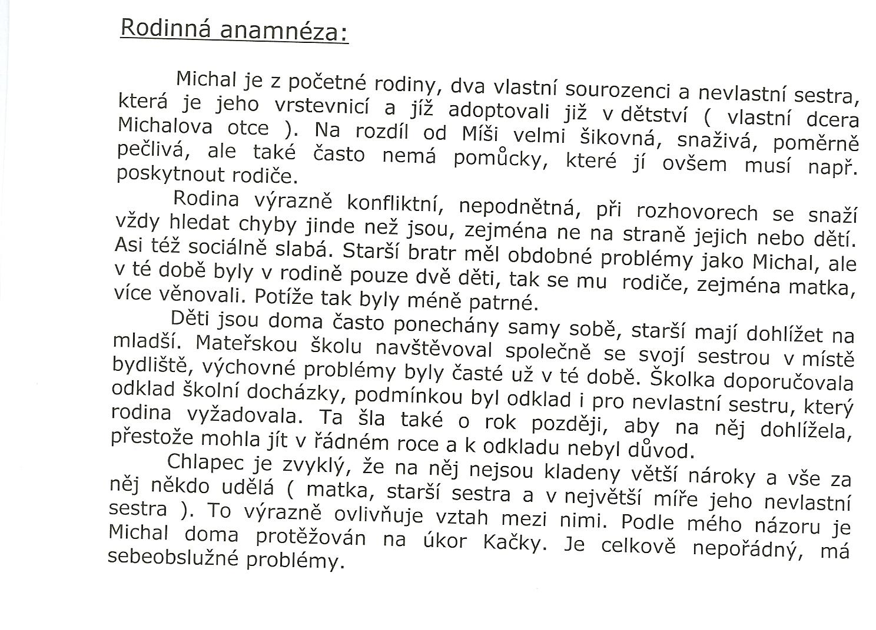

Slide 10
School anamnesis
School – monitors the development of the individual within the institutional education
e.g. entering nursery or primary school, adaptation
to the (pre-)school environment, etc.),
behavior towards classmates and teachers, reactions to school routines and standards, lists of schools attended.

Slide 11
Social anamnesis
Social – examines the development of the individual from the viewpoint of integrating into peer groups, the individual’s interests, and leisure time activities.

