Slide 1
1(a
le
af
fa
ll
s)
one
l
iness

Slide 2
Breaking tradition:
Experimentation in Modernist Poetry
narrative techniques
stream of consciousness
unreliable narrators, multiple perspective
dirsrupted chronology
language and style
fragmented syntax, experimenting with punctuation, typography
minimalism and omission
thematic experimentation
formal innovations

Slide 3
Structuralism
concerned with language in a very general sense - with signs, signification, and all codes of communication
Ferdinand de Saussure

Slide 4
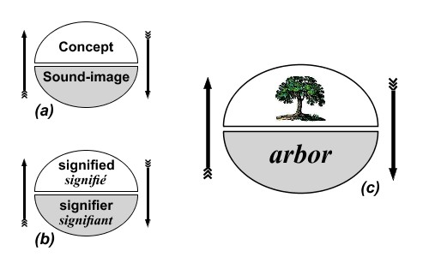

Slide 5

Impressionism
the general impression produced by a scene or object
the changing effects of light and color
using quick brush strokes to capture the mood of a particular moment

Slide 6
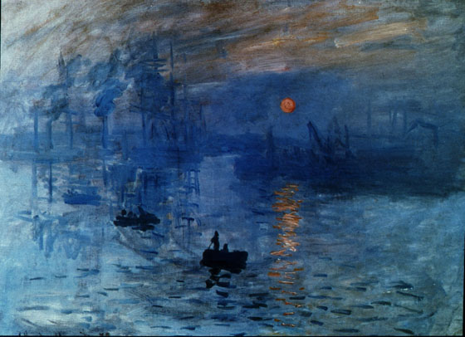
Claude Monet: Impression

Slide 7
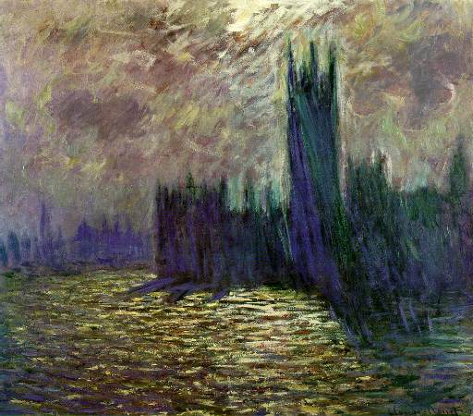
Claude Monet: Houses of Parliament,London

Slide 8
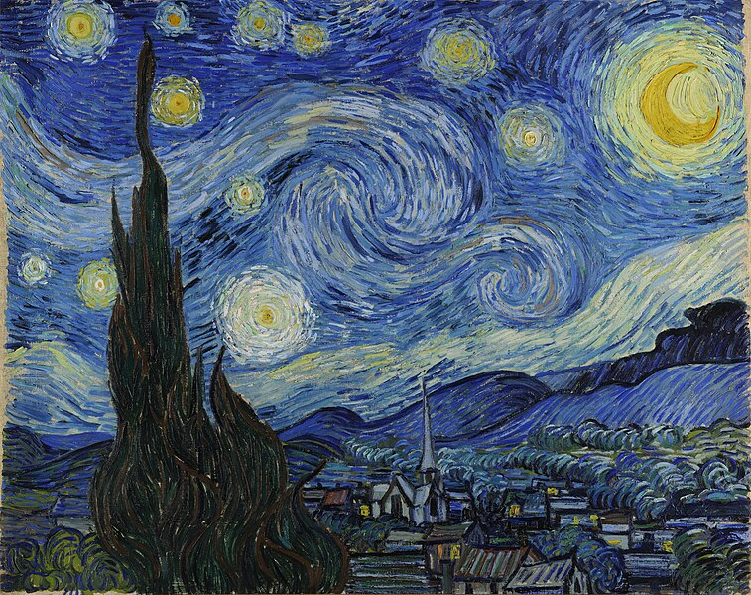
Vincent Van Gogh: The Starry Night

Slide 9
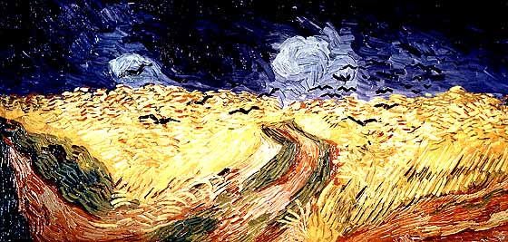
Vincent Van Gogh: Wheatfield with Crows

Slide 10
Cubism
objects are broken down into geometrical shapes
cubist work can portray the subject from multiple perspectives
emphacizing two-dimensionality of the canvas

Slide 11
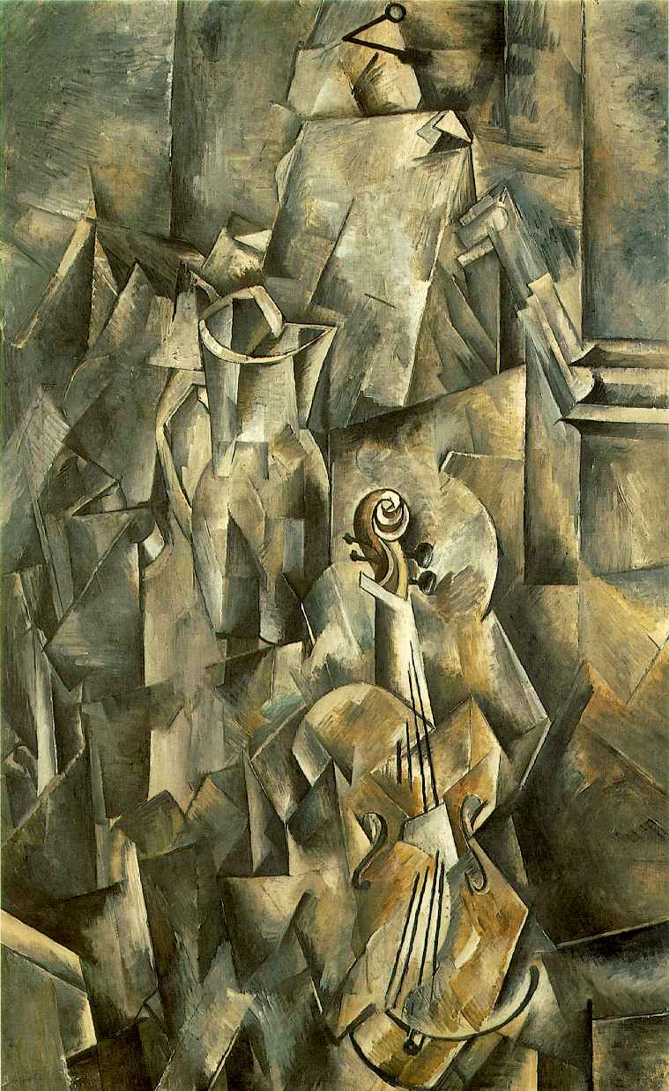
Georges Braque: Violin and Pitcher (1910)

Slide 12
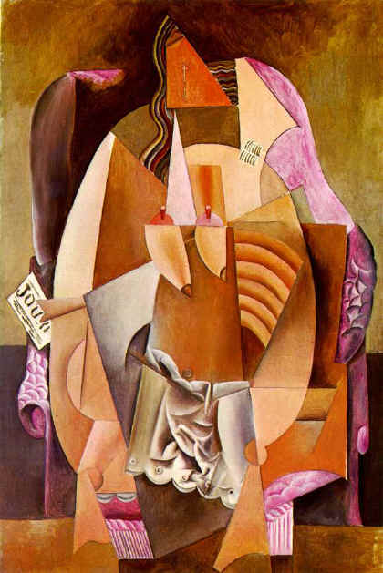
Pablo Picasso: Woman in an Armchair (1913)

Slide 13
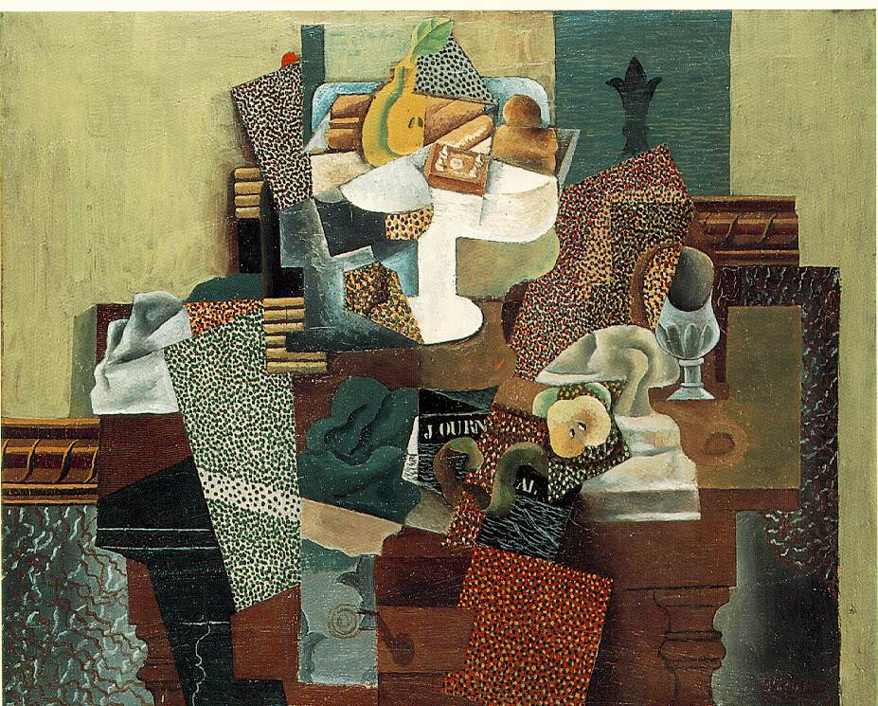
Pablo Picasso: Still-life with Fruit-dish on a Table

Slide 14
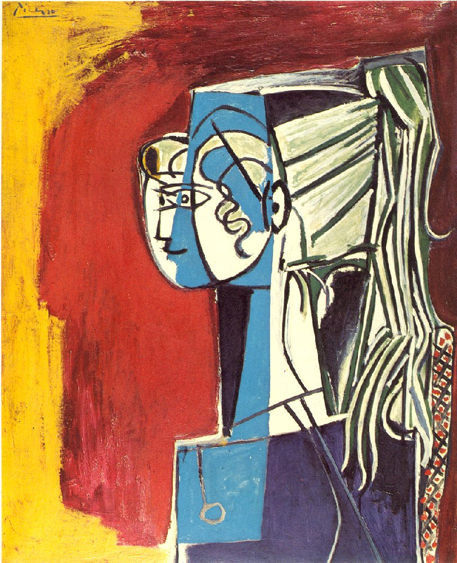
Pablo Picasso: Portrait of Sylvette

Slide 15

Paul Klee: Southern (Tunisian) Gardens

Slide 16
Surrealism
influenced by Sigmund Freud’s theories
surrealists attempted to express the workings of the unconscious mind
illogical, dreamlike, fantastic images and events

Slide 17
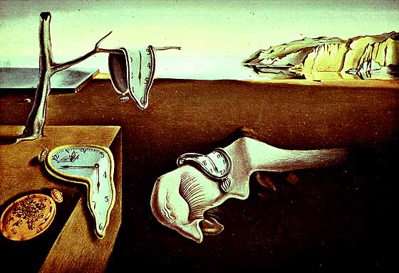
Salvador Dali: The Persistence of Memory

Slide 18
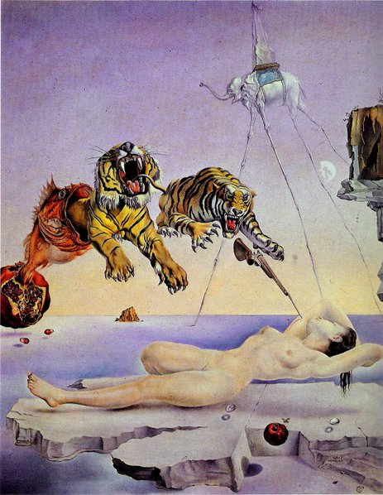
Salvador Dali:
Dream Caused by the Flight of a Bumblebee around a Pomegranate a Second Before Awakening

Slide 19
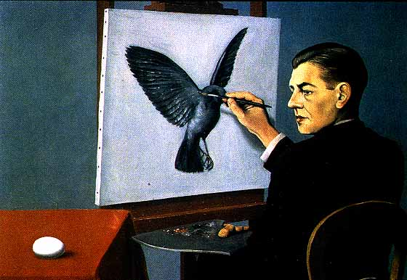
René Magritte: Clairvoyance

Slide 20
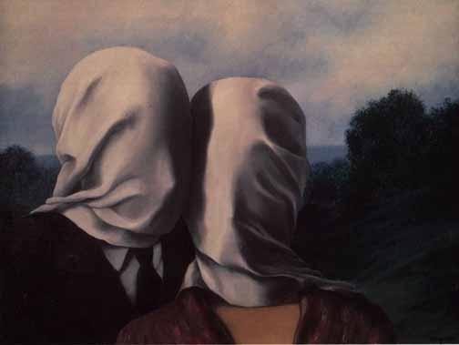
René Magritte: The Lovers

Slide 21


Slide 22
Henri Matisse:The Swimming Pool

Slide 23


Slide 24
Paul Klee: Legend of the Nile

Slide 25
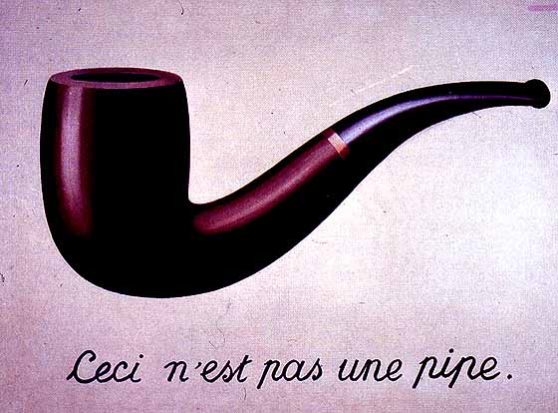

Slide 26
René Magritte: The Treason of Images

Slide 27
e. e. cummings
1(a
le
af
fa
ll
s)
one
l
iness

Slide 28
e. e. cummings
Plato told
him:he couldn’t
believe it(jesus
told him;he
wouldn’t believe
it)lao
tsze
certainly told
him,and general
(yes
mam)
sherman;
and even
(believe it
or
not)you
told him:i told
him;we told him
(he didn’t believe it,no
sir)it took
a nipponized bit of
the old sixth
avenue
el*;in the top of his head:to tell
him
[1944]
* The sixth avenue elevated railway was torn down and the scrap metal was sold to the Japanese who supposedly used it to make munition

