Slide 1


Data in run:
analysis of various information and data
in cross-disciplinary task
Lukáš Rokos

Slide 2
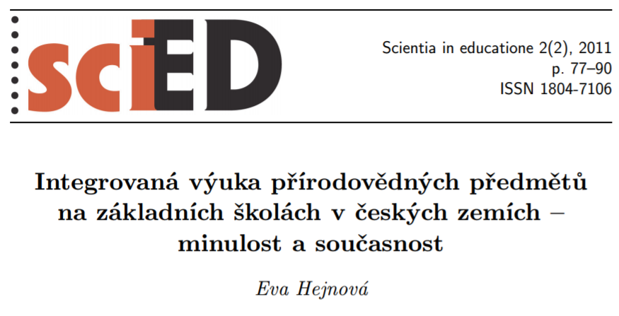
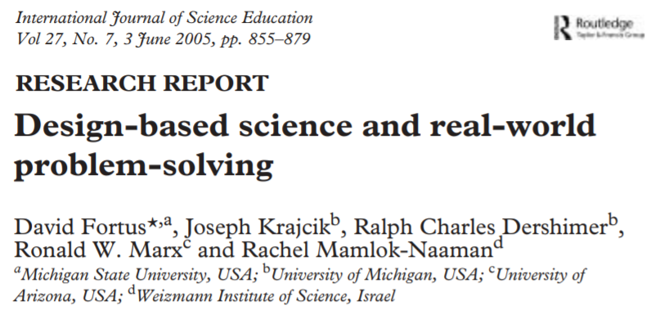

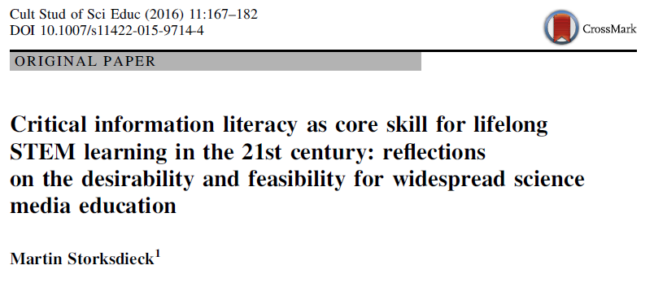
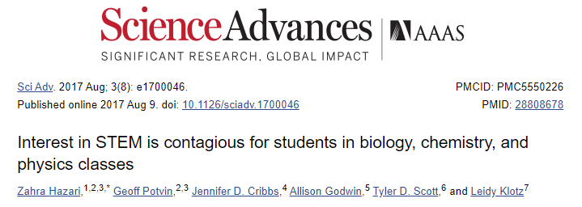
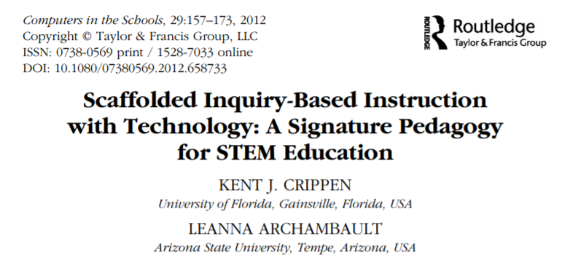
Interdisciplinarity and integration
Notes:
There are many studies that support the use of visualisations in STEM education. Whether it is about how pupils and students work with data and are able to visualize it, use in science fields as well as in engineering, but also the general meaning of diagrams, graphics and other visual representations in STEM disciplines. There are some examples of which approaches work more or less, and how to present data clearly, which is also an important skill for pupils and students to learn. A specific approach that we will focus on in the contribution is the use of concept cartoons in relation to constructivism and argumentation. Most of the knowledge about the use of visuals in science education is summarized in the publication of John G. Gilbert.

Slide 3

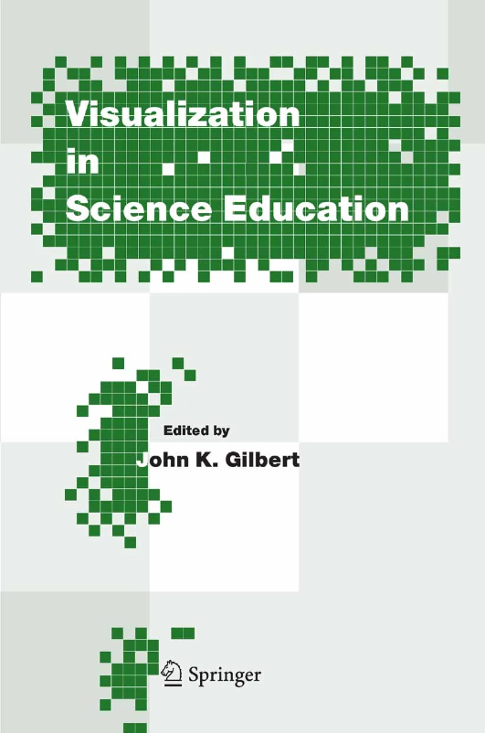
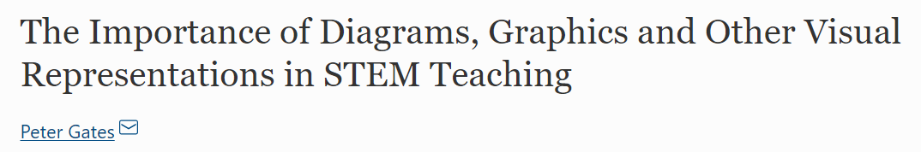
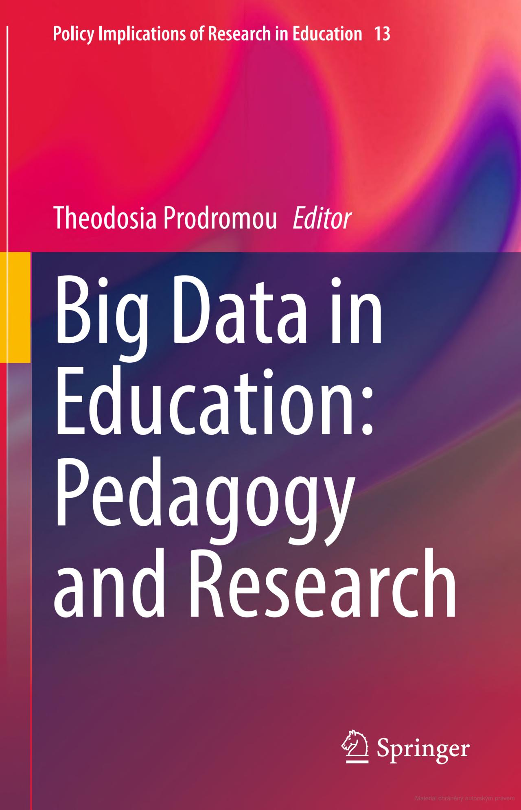
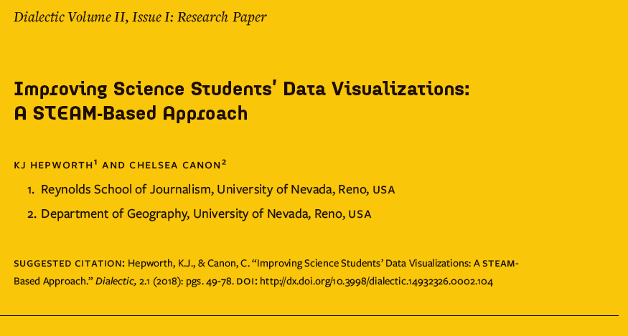
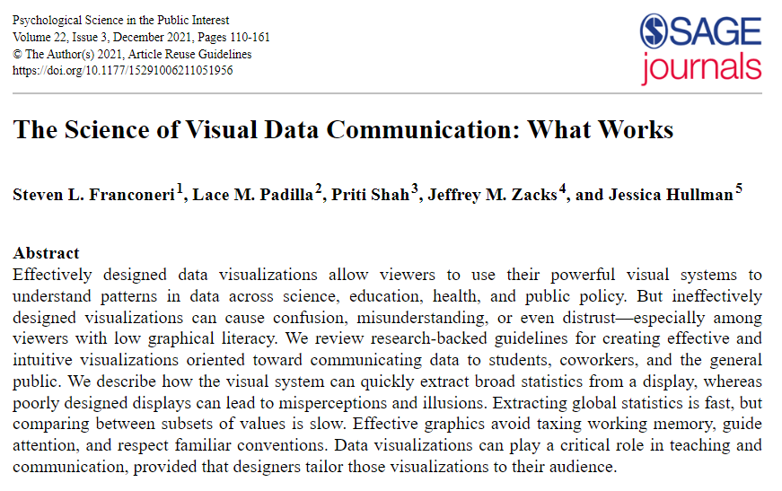
Importance of data
Notes:
There are many studies that support the use of visualisations in STEM education. Whether it is about how pupils and students work with data and are able to visualize it, use in science fields as well as in engineering, but also the general meaning of diagrams, graphics and other visual representations in STEM disciplines. There are some examples of which approaches work more or less, and how to present data clearly, which is also an important skill for pupils and students to learn. A specific approach that we will focus on in the contribution is the use of concept cartoons in relation to constructivism and argumentation. Most of the knowledge about the use of visuals in science education is summarized in the publication of John G. Gilbert.

Slide 4



Integration and cross-curricular tasks
Czech curricular documents
Man and Nature
Man and the world of work
Mathematics and its application
Physics, Chemistry, Biology
Work with laboratory equipment,
Use of digital technologies
Work with technical materials,
Design and models
Mathematics
Notes:
There are many studies that support the use of visualisations in STEM education. Whether it is about how pupils and students work with data and are able to visualize it, use in science fields as well as in engineering, but also the general meaning of diagrams, graphics and other visual representations in STEM disciplines. There are some examples of which approaches work more or less, and how to present data clearly, which is also an important skill for pupils and students to learn. A specific approach that we will focus on in the contribution is the use of concept cartoons in relation to constructivism and argumentation. Most of the knowledge about the use of visuals in science education is summarized in the publication of John G. Gilbert.

Slide 5
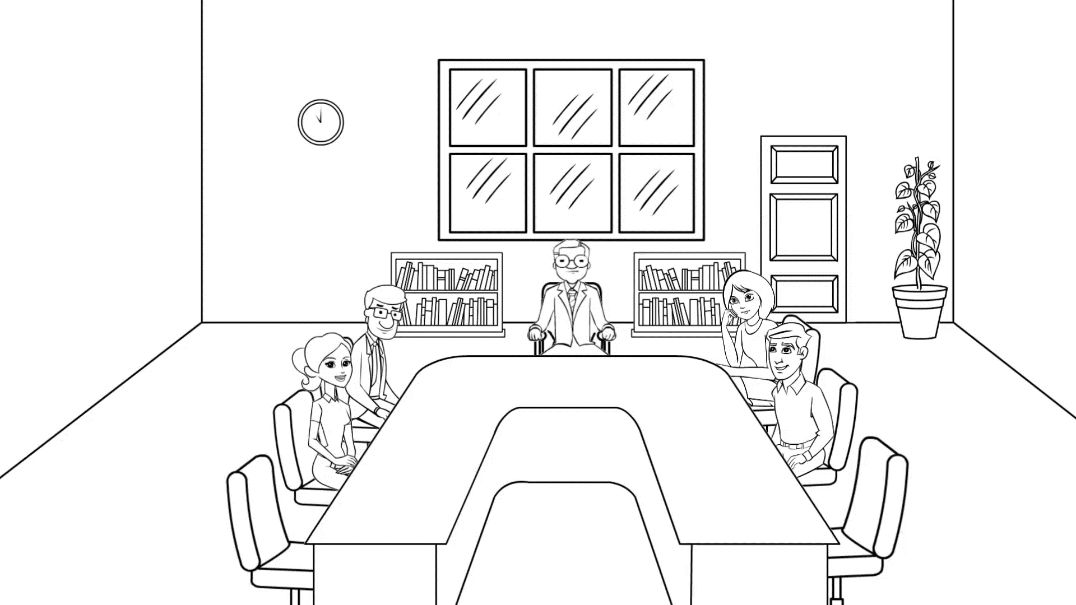
Integration and cross-curricular tasks
Notes:
There are many studies that support the use of visualisations in STEM education. Whether it is about how pupils and students work with data and are able to visualize it, use in science fields as well as in engineering, but also the general meaning of diagrams, graphics and other visual representations in STEM disciplines. There are some examples of which approaches work more or less, and how to present data clearly, which is also an important skill for pupils and students to learn. A specific approach that we will focus on in the contribution is the use of concept cartoons in relation to constructivism and argumentation. Most of the knowledge about the use of visuals in science education is summarized in the publication of John G. Gilbert.

Slide 6
Research methods
Research methods
Quantitative
Qualitative
Mixed methods research
Case Study
Ethnography Study
Grounded Theory Study
Phenomenological Study
Content Analysis Study
Notes:
It is possible to identify four areas summarizing the answers to the question "why?".
1. Cognitive aspects
abstraction
simplification
embodiment
2. Pedagogical frame
motivation
coummunication and collaboration
cultural activity
3. Didactic reasons
observation
representation
reasoning
4. Scientific practices
knowledge development
modeling
problem solving and creativity
We will return to the selected aspects, but we will emphasize the area of ​​"scientific practices" due to the close connection with STEM education.

Slide 7

Task introduction
This inquiry task consists of tracking the results of three different marathons. This challenge isn't just about running; it's about analyzing, understanding and discovering the deeper meaning of the conditions and other factors that can affect every step of the race. You have three races in front of you, three unique results – and your task is to find the factors that may have affected this runner's overall result.
Every runner evaluates his or her results from time to time. A pervasive desire for improvement leads him or her to challenges that not only test physical limits, but also the ability to understand every step, every heartbeat, and every result in training or a race.
You are now at the starting line of this inquiry challenge, where you will find that all the data brings important information. And if they are properly visualized, they will help you better understand the various factors that influence the overall results.
Notes:
As already mentioned above, look at visualizations and their importance in developing scientific practices within pupils and students learning.
scientific practises related to the use of visual information (Evagorou et al. 2015)
asking questions and defining problems
analysing and interpreting data
experimenting
modelling
students can build their own models, and the discussion of the models helps to better understand STEM topics (Hepworth & Canon, 2018)
similar to activities we want to do with students at classes when we include some visualisations and/or ask them to create their own visualisations

Slide 8


Marathon
How long is exactly a marathon run? Find out why it is this distance.
Find some other interesting facts about marathon run.
What information would you need to know about this runner?
Notes:
As already mentioned above, look at visualizations and their importance in developing scientific practices within pupils and students learning.
scientific practises related to the use of visual information (Evagorou et al. 2015)
asking questions and defining problems
analysing and interpreting data
experimenting
modelling
students can build their own models, and the discussion of the models helps to better understand STEM topics (Hepworth & Canon, 2018)
similar to activities we want to do with students at classes when we include some visualisations and/or ask them to create their own visualisations

Slide 9
Runner’s Card
Notes:
As already mentioned above, look at visualizations and their importance in developing scientific practices within pupils and students learning.
scientific practises related to the use of visual information (Evagorou et al. 2015)
asking questions and defining problems
analysing and interpreting data
experimenting
modelling
students can build their own models, and the discussion of the models helps to better understand STEM topics (Hepworth & Canon, 2018)
similar to activities we want to do with students at classes when we include some visualisations and/or ask them to create their own visualisations

Slide 10
Runner’s Card – equipment
Notes:
As already mentioned above, look at visualizations and their importance in developing scientific practices within pupils and students learning.
scientific practises related to the use of visual information (Evagorou et al. 2015)
asking questions and defining problems
analysing and interpreting data
experimenting
modelling
students can build their own models, and the discussion of the models helps to better understand STEM topics (Hepworth & Canon, 2018)
similar to activities we want to do with students at classes when we include some visualisations and/or ask them to create their own visualisations

Slide 11
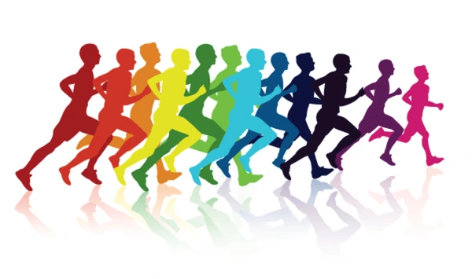
Marathon results
The aforementioned runner ran three different marathons and achieved the following results.
Marathon 1
2:52:27
Marathon 2
4:36:40
Marathon 3
3:15:15
Notes:
As already mentioned above, look at visualizations and their importance in developing scientific practices within pupils and students learning.
scientific practises related to the use of visual information (Evagorou et al. 2015)
asking questions and defining problems
analysing and interpreting data
experimenting
modelling
students can build their own models, and the discussion of the models helps to better understand STEM topics (Hepworth & Canon, 2018)
similar to activities we want to do with students at classes when we include some visualisations and/or ask them to create their own visualisations

Slide 12

Marathon results
Try to guess why the total time of each race is different? What could have influenced them?
Notes:
As already mentioned above, look at visualizations and their importance in developing scientific practices within pupils and students learning.
scientific practises related to the use of visual information (Evagorou et al. 2015)
asking questions and defining problems
analysing and interpreting data
experimenting
modelling
students can build their own models, and the discussion of the models helps to better understand STEM topics (Hepworth & Canon, 2018)
similar to activities we want to do with students at classes when we include some visualisations and/or ask them to create their own visualisations

Slide 13
Pace I.
Marathon 1 |  |  |  | Marathon 2 |  |  |  | Marathon 3
km | time | 22 | 3:59 | km | time | 22 | 4:57 | km | time | 22 | 4:30
1 | 4:02 | 23 | 4:00 | 1 | 4:28 | 23 | 4:57 | 1 | 4:33 | 23 | 4:42
2 | 4:05 | 24 | 3:59 | 2 | 4:24 | 24 | 4:53 | 2 | 4:26 | 24 | 4:47
3 | 4:04 | 25 | 4:04 | 3 | 4:29 | 25 | 4:47 | 3 | 4:21 | 25 | 4:42
4 | 4:02 | 26 | 3:58 | 4 | 4:26 | 26 | 5:04 | 4 | 4:21 | 26 | 4:32
5 | 4:07 | 27 | 3:59 | 5 | 5:09 | 27 | 11:21 | 5 | 4:20 | 27 | 4:30
6 | 4:02 | 28 | 4:01 | 6 | 4:28 | 28 | 12:22 | 6 | 4:22 | 28 | 4:31
7 | 4:07 | 29 | 4:03 | 7 | 4:33 | 29 | 6:29 | 7 | 4:26 | 29 | 4:41
8 | 4:07 | 30 | 4:00 | 8 | 4:15 | 30 | 7:50 | 8 | 4:32 | 30 | 4:38
9 | 4:02 | 31 | 4:06 | 9 | 4:34 | 31 | 6:24 | 9 | 4:22 | 31 | 4:41
10 | 4:09 | 32 | 4:03 | 10 | 4:37 | 32 | 6:01 | 10 | 4:32 | 32 | 4:33
11 | 4:10 | 33 | 4:06 | 11 | 5:10 | 33 | 10:04 | 11 | 4:35 | 33 | 4:26
12 | 4:05 | 34 | 4:05 | 12 | 4:57 | 34 | 8:37 | 12 | 4:33 | 34 | 4:44
13 | 4:01 | 35 | 4:08 | 13 | 4:44 | 35 | 8:38 | 13 | 4:28 | 35 | 4:50
14 | 4:07 | 36 | 4:03 | 14 | 4:37 | 36 | 7:53 | 14 | 4:24 | 36 | 5:07
15 | 3:59 | 37 | 4:08 | 15 | 4:44 | 37 | 7:10 | 15 | 4:29 | 37 | 5:17
16 | 4:01 | 38 | 4:02 | 16 | 4:46 | 38 | 7:49 | 16 | 4:30 | 38 | 5:17
17 | 3:59 | 39 | 4:05 | 17 | 5:13 | 39 | 7:52 | 17 | 4:28 | 39 | 4:58
18 | 3:58 | 40 | 4:10 | 18 | 5:07 | 40 | 11:38 | 18 | 4:27 | 40 | 5:07
19 | 4:02 | 41 | 4:20 | 19 | 5:07 | 41 | 15:46 | 19 | 4:35 | 41 | 4:50
20 | 4:02 | 42 | 4:19 | 20 | 5:40 | 42 | 11:45 | 20 | 4:36 | 42 | 4:47
21 | 4:02 | 43 | 1:16 | 21 | 5:00 | 43 | 4:06 | 21 | 4:27 | 43 | 0:59
What caught your eye in the data?
Notes:
As already mentioned above, look at visualizations and their importance in developing scientific practices within pupils and students learning.
scientific practises related to the use of visual information (Evagorou et al. 2015)
asking questions and defining problems
analysing and interpreting data
experimenting
modelling
students can build their own models, and the discussion of the models helps to better understand STEM topics (Hepworth & Canon, 2018)
similar to activities we want to do with students at classes when we include some visualisations and/or ask them to create their own visualisations

Slide 14

Pace II.
The following graph shows the average pace within individual races. Rank them from best to worst.
Notes:
As already mentioned above, look at visualizations and their importance in developing scientific practices within pupils and students learning.
scientific practises related to the use of visual information (Evagorou et al. 2015)
asking questions and defining problems
analysing and interpreting data
experimenting
modelling
students can build their own models, and the discussion of the models helps to better understand STEM topics (Hepworth & Canon, 2018)
similar to activities we want to do with students at classes when we include some visualisations and/or ask them to create their own visualisations

Slide 15
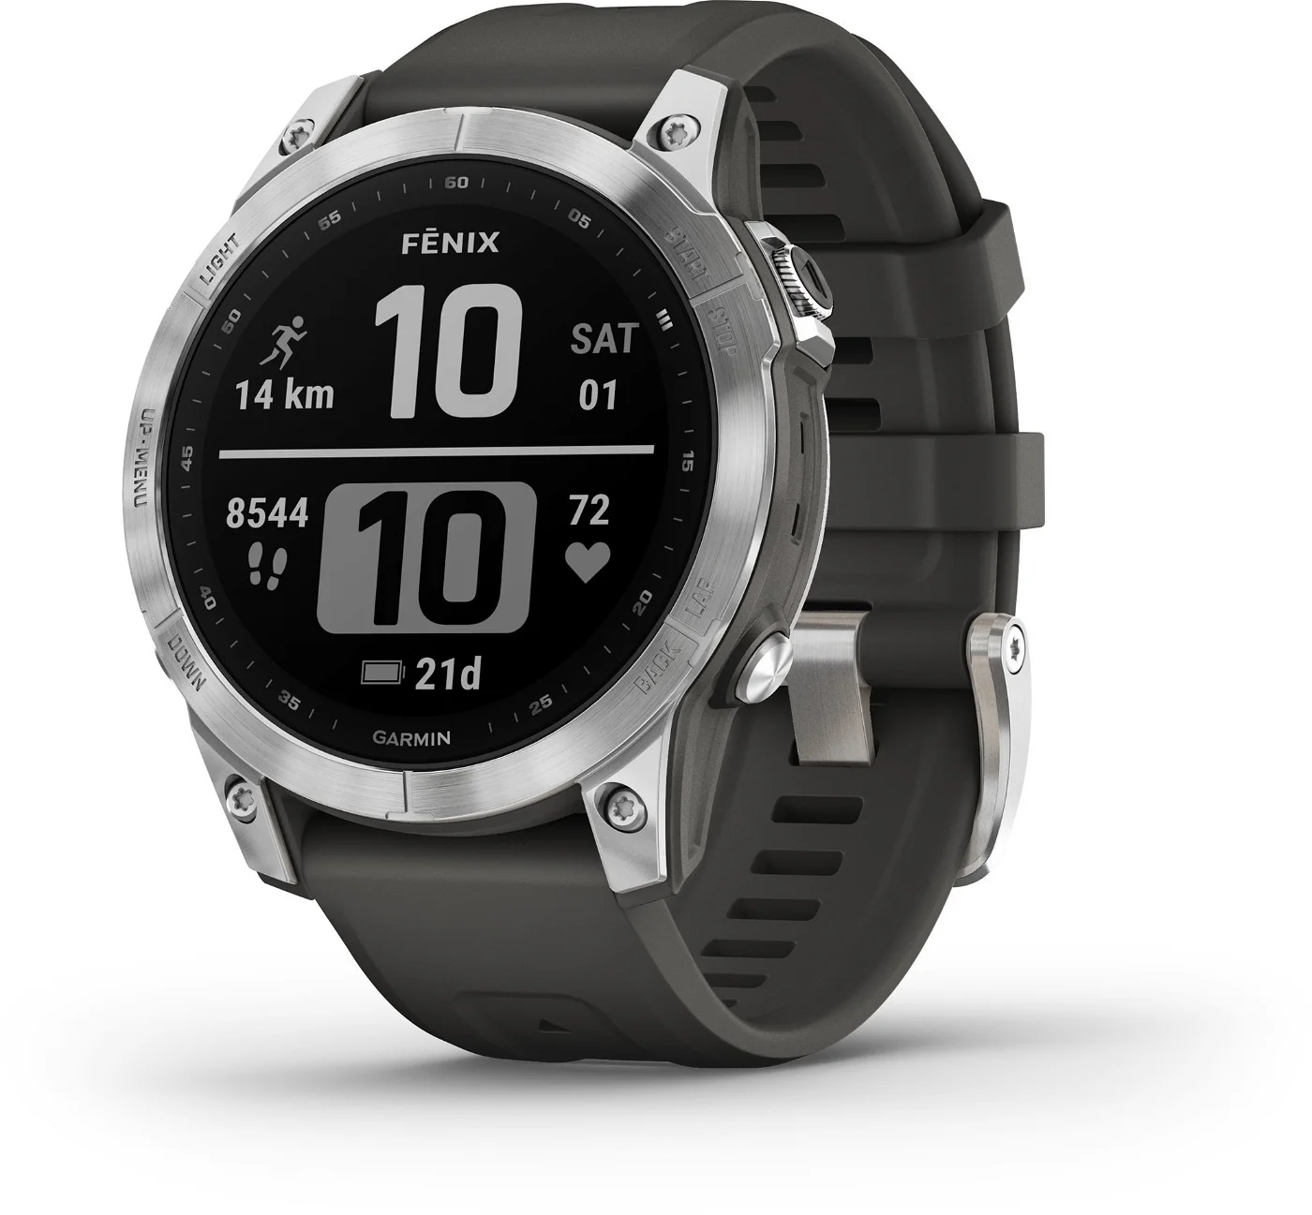
Pace III.
Which pace will match the specific marathons above? Complete the data in the table below.
 | Time | Pace
Marathon 1 | 2:52:27
Marathon 2 | 4:36:40
Marathon 3 | 3:15:15
4:04
6:32
4:37
Notes:
As already mentioned above, look at visualizations and their importance in developing scientific practices within pupils and students learning.
scientific practises related to the use of visual information (Evagorou et al. 2015)
asking questions and defining problems
analysing and interpreting data
experimenting
modelling
students can build their own models, and the discussion of the models helps to better understand STEM topics (Hepworth & Canon, 2018)
similar to activities we want to do with students at classes when we include some visualisations and/or ask them to create their own visualisations

Slide 16



Routes I.
Go back to your hypotheses about the factors that may have influenced the results. Do you need to know more data to decide which factors are relevant? If yes, write which factors are involved.
One of the factors that can affect performance is the environment in which the race took place. Look at the route maps and write how they differ.
Marathon 1
Marathon 2
Marathon 3
Notes:
As already mentioned above, look at visualizations and their importance in developing scientific practices within pupils and students learning.
scientific practises related to the use of visual information (Evagorou et al. 2015)
asking questions and defining problems
analysing and interpreting data
experimenting
modelling
students can build their own models, and the discussion of the models helps to better understand STEM topics (Hepworth & Canon, 2018)
similar to activities we want to do with students at classes when we include some visualisations and/or ask them to create their own visualisations

Slide 17
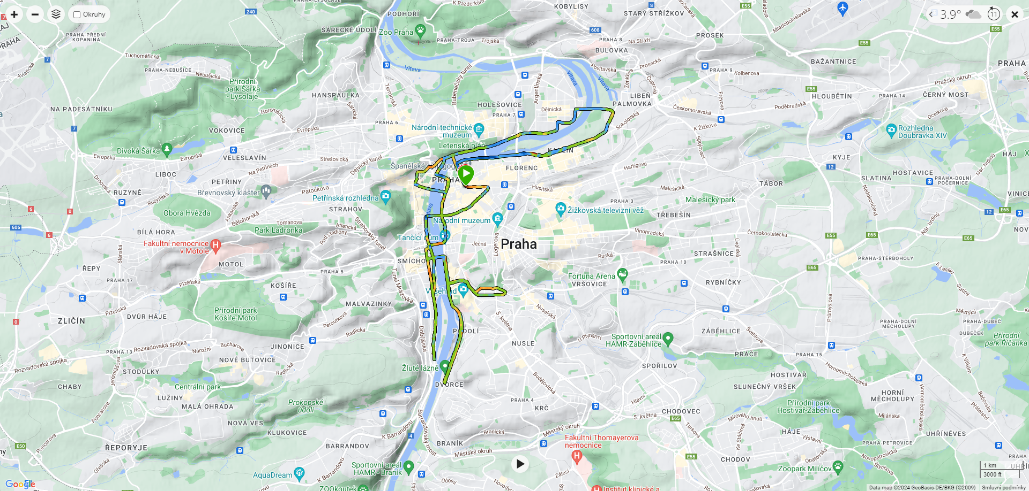
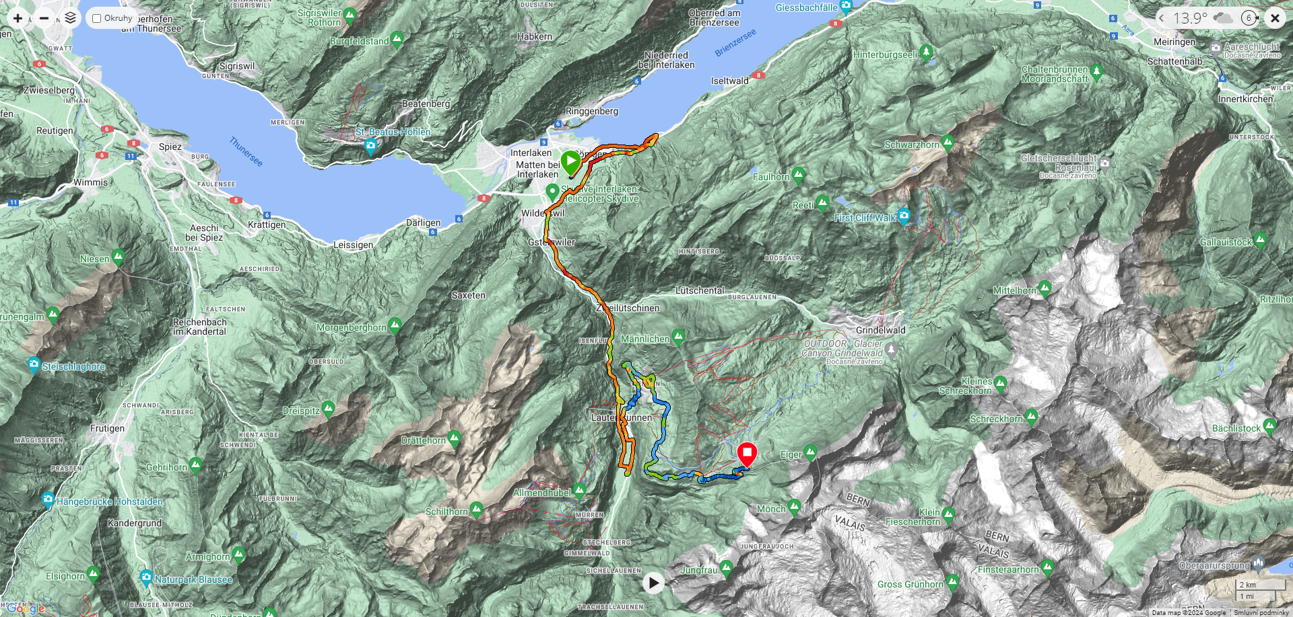
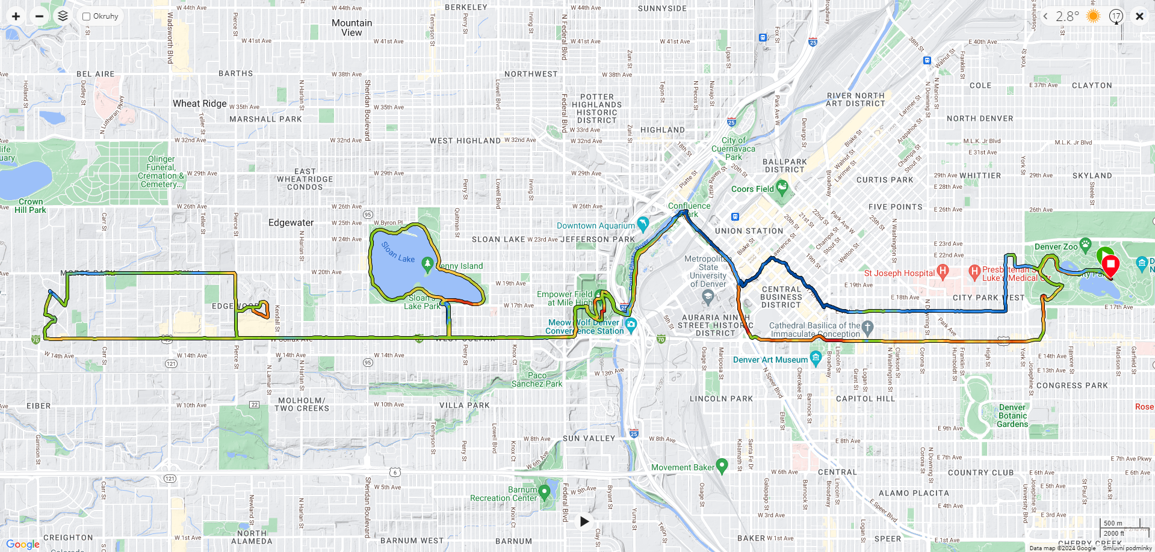
Routes II.
Maraton 2
Maraton 1
Maraton 3
Notes:
As already mentioned above, look at visualizations and their importance in developing scientific practices within pupils and students learning.
scientific practises related to the use of visual information (Evagorou et al. 2015)
asking questions and defining problems
analysing and interpreting data
experimenting
modelling
students can build their own models, and the discussion of the models helps to better understand STEM topics (Hepworth & Canon, 2018)
similar to activities we want to do with students at classes when we include some visualisations and/or ask them to create their own visualisations

Slide 18


Profile I.
Let's go back to our runner's results. The following table provides a detailed description of the routes in relation to the ascent and descent on individual kilometers.
Notes:
As already mentioned above, look at visualizations and their importance in developing scientific practices within pupils and students learning.
scientific practises related to the use of visual information (Evagorou et al. 2015)
asking questions and defining problems
analysing and interpreting data
experimenting
modelling
students can build their own models, and the discussion of the models helps to better understand STEM topics (Hepworth & Canon, 2018)
similar to activities we want to do with students at classes when we include some visualisations and/or ask them to create their own visualisations

Slide 19
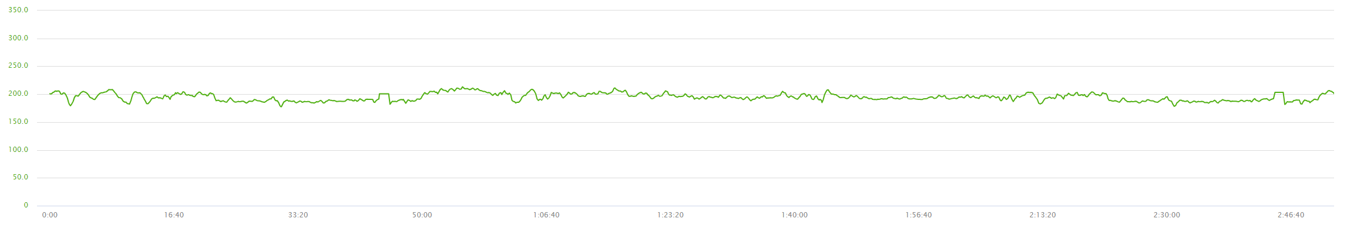
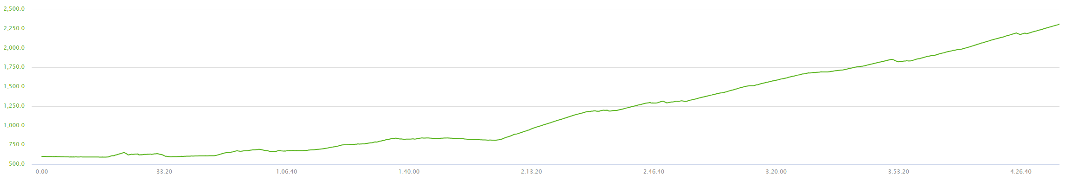
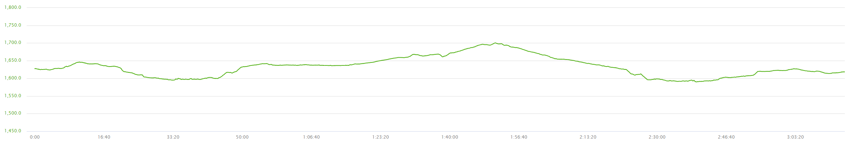
Profile II.
Marathon 1
Marathon 2
Marathon 3
Notes:
As already mentioned above, look at visualizations and their importance in developing scientific practices within pupils and students learning.
scientific practises related to the use of visual information (Evagorou et al. 2015)
asking questions and defining problems
analysing and interpreting data
experimenting
modelling
students can build their own models, and the discussion of the models helps to better understand STEM topics (Hepworth & Canon, 2018)
similar to activities we want to do with students at classes when we include some visualisations and/or ask them to create their own visualisations

Slide 20



Races and records I.
Match specific race names to their routes. Find the fastest men's and women's times on these routes.
Notes:
As already mentioned above, look at visualizations and their importance in developing scientific practices within pupils and students learning.
scientific practises related to the use of visual information (Evagorou et al. 2015)
asking questions and defining problems
analysing and interpreting data
experimenting
modelling
students can build their own models, and the discussion of the models helps to better understand STEM topics (Hepworth & Canon, 2018)
similar to activities we want to do with students at classes when we include some visualisations and/or ask them to create their own visualisations

Slide 21
Races and records II.
Match specific race names to their routes. Find the fastest men's and women's times on these routes.
Men’s: Eliud Kiptanui – 2:05:39 (2010, KEN)
Women’s: Lonah Salpeterová – 2:19:46 (2019, ISR)
Men’s: Jonathan Wyatt - 2:49:01 (2003, NZ)
Women’s: Maude Mathys - 3:12:56 (2017, CH)
Men’s: Tyler McCandless – 2:21:08 (2022, US)
Women’s: Brittany Lee Charboneau – 2:52:56 (2017, US)
Notes:
As already mentioned above, look at visualizations and their importance in developing scientific practices within pupils and students learning.
scientific practises related to the use of visual information (Evagorou et al. 2015)
asking questions and defining problems
analysing and interpreting data
experimenting
modelling
students can build their own models, and the discussion of the models helps to better understand STEM topics (Hepworth & Canon, 2018)
similar to activities we want to do with students at classes when we include some visualisations and/or ask them to create their own visualisations

Slide 22
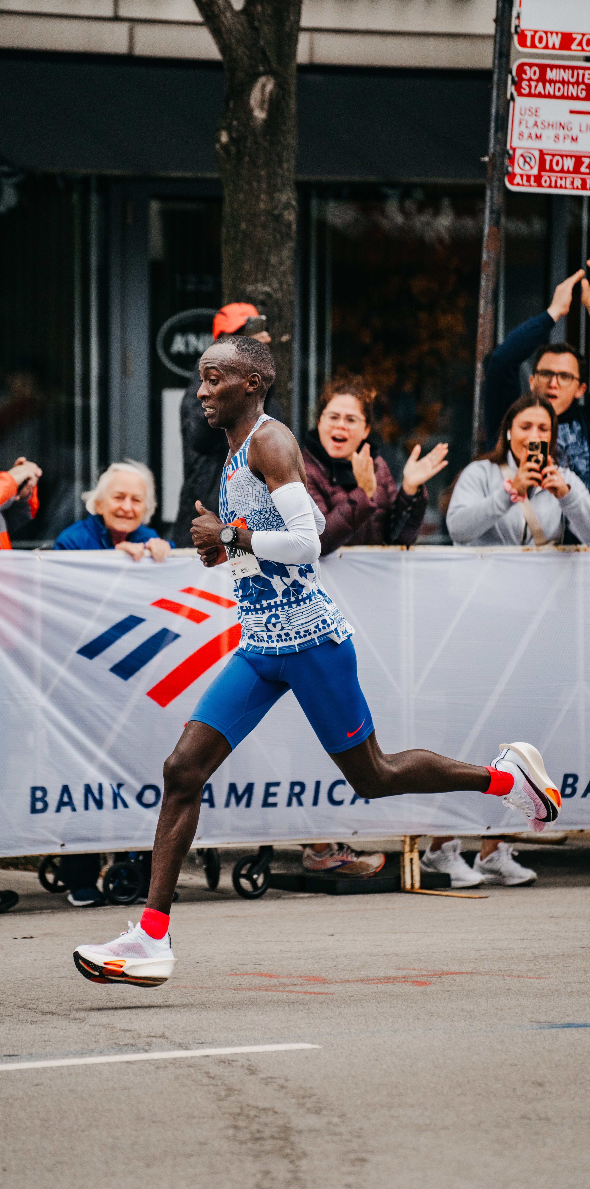
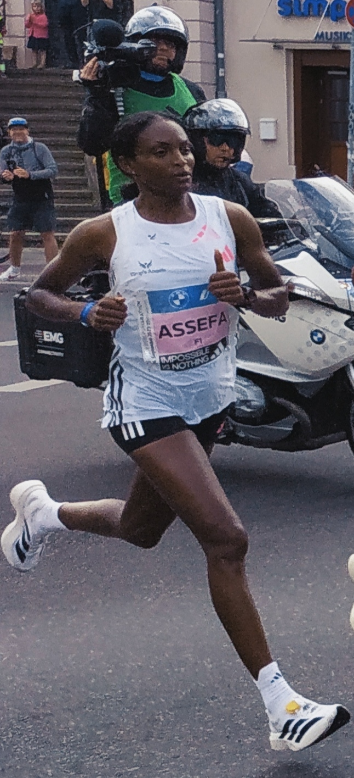
World records
Find out the world records in the men's and women's category. Where were these times performed? Calculate the pace of the world record holders during their performances. How do you proceed with the calculation? Record your calculation and add the results to the table.
 | Time | Pace | Place
Men's | 2:00:35 | 2:51 | Chicago, 2023
Women's | 2:11:53 | 3:07 | Berlin, 2023
 | Time | Pace | Place
Men's | 2:00:35 | 2:51 | Chicago, 2023
Women's
 | Time | Pace | Place
Men's
Women's
Notes:
As already mentioned above, look at visualizations and their importance in developing scientific practices within pupils and students learning.
scientific practises related to the use of visual information (Evagorou et al. 2015)
asking questions and defining problems
analysing and interpreting data
experimenting
modelling
students can build their own models, and the discussion of the models helps to better understand STEM topics (Hepworth & Canon, 2018)
similar to activities we want to do with students at classes when we include some visualisations and/or ask them to create their own visualisations

Slide 23
Calories
If you use a sporttester, you know that another value you get for individual exercises is calorie consumption. Can you find any relationship from the data below?
 | Time | Pace | Ascent | Calories
Marathon 1 | 2:52:27 | 4:04 | 241 | 2 576
Marathon 2 | 4:36:40 | 6:32 | 2 024 | 3 846
Marathon 3 | 3:15:15 | 4:37 | 207 | 2 892
Notes:
As already mentioned above, look at visualizations and their importance in developing scientific practices within pupils and students learning.
scientific practises related to the use of visual information (Evagorou et al. 2015)
asking questions and defining problems
analysing and interpreting data
experimenting
modelling
students can build their own models, and the discussion of the models helps to better understand STEM topics (Hepworth & Canon, 2018)
similar to activities we want to do with students at classes when we include some visualisations and/or ask them to create their own visualisations

Slide 24
Running in higher altitude I.
Let’s focus on a marathon at a higher altitude and explore the role of altitude in influencing results. Discuss the effect that lower oxygen content has on the physical performance of runners.
Notes:
As already mentioned above, look at visualizations and their importance in developing scientific practices within pupils and students learning.
scientific practises related to the use of visual information (Evagorou et al. 2015)
asking questions and defining problems
analysing and interpreting data
experimenting
modelling
students can build their own models, and the discussion of the models helps to better understand STEM topics (Hepworth & Canon, 2018)
similar to activities we want to do with students at classes when we include some visualisations and/or ask them to create their own visualisations

Slide 25
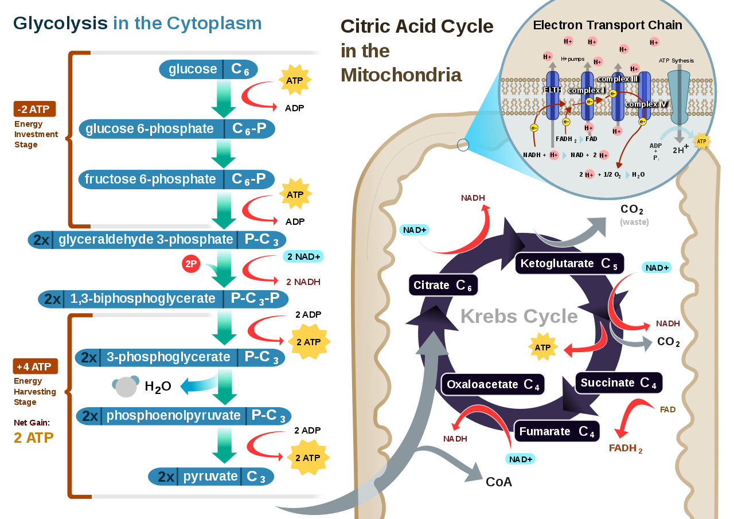
Running in higher altitude III.
cellular respiration
C₆H₁₂O₆ + 6 O₂ → 6 CO₂ + 6 H₂O + energy
Notes:
As already mentioned above, look at visualizations and their importance in developing scientific practices within pupils and students learning.
scientific practises related to the use of visual information (Evagorou et al. 2015)
asking questions and defining problems
analysing and interpreting data
experimenting
modelling
students can build their own models, and the discussion of the models helps to better understand STEM topics (Hepworth & Canon, 2018)
similar to activities we want to do with students at classes when we include some visualisations and/or ask them to create their own visualisations

Slide 26

Running in higher altitude III.
Consider the substances and energy in the reaction above and try to draw a simple model (picture, diagram etc.) that explains how a runner can obtain and use energy before and/or during a race. Try to include all the factors you have already discussed in this assignment in the diagram. Use arrows and labels in the model to show the flow of energy and the cycle of matter.
Notes:
As already mentioned above, look at visualizations and their importance in developing scientific practices within pupils and students learning.
scientific practises related to the use of visual information (Evagorou et al. 2015)
asking questions and defining problems
analysing and interpreting data
experimenting
modelling
students can build their own models, and the discussion of the models helps to better understand STEM topics (Hepworth & Canon, 2018)
similar to activities we want to do with students at classes when we include some visualisations and/or ask them to create their own visualisations

Slide 27
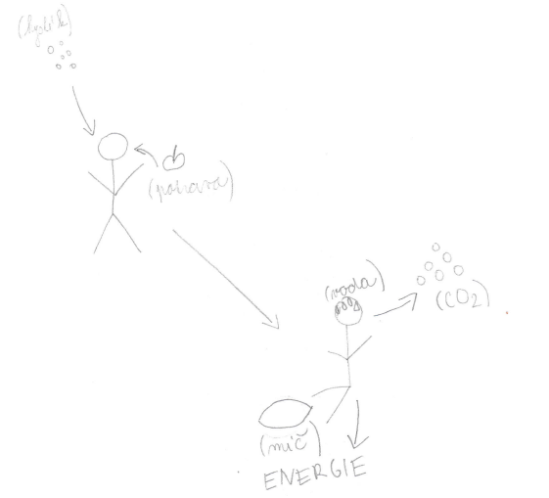
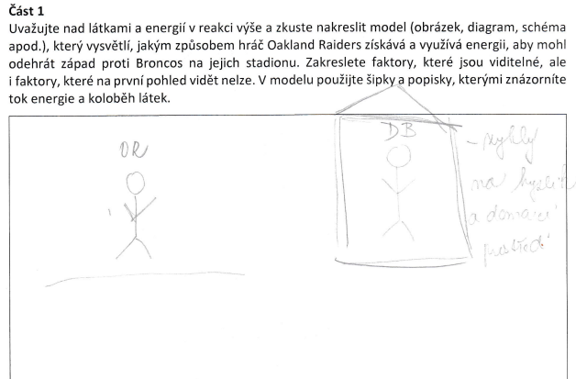
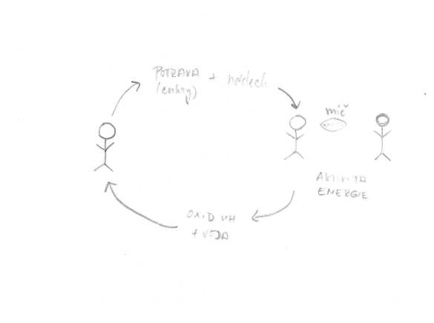
Running in higher altitude IV.
oxygen
example of visual model created by students #1
food (sugars)
food
+ breath
ball
used to oxygen and home environment
CO₂
activity
CO₂
carbon dioxide
energy
+ water
(ball)
ENERGY
Notes:
Example of visual model created by students #1

Slide 28
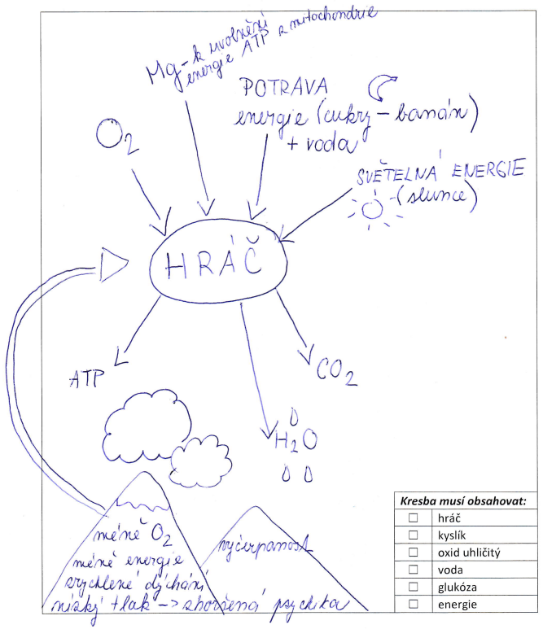
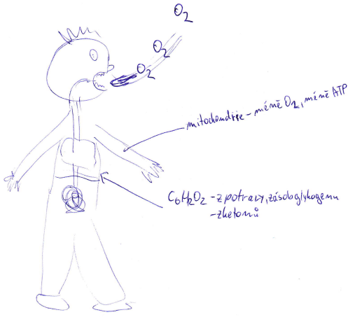

Running in higher altitude IV.
more examples of model created by students #2
Mg – to release ATP energy from mitochondria
FOOD
energy (sugars – banana)
+ water
LIGHT ENERGY
(sun)
mitochondria
– less O₂, less ATP
PLAYER
C₆H₁₂O₆
– from food, glycogen supply
– from ketones
less O₂
less energy
tiredness
rapid breathing
low pressure
Notes:
more examples of visual models created by students

Slide 29
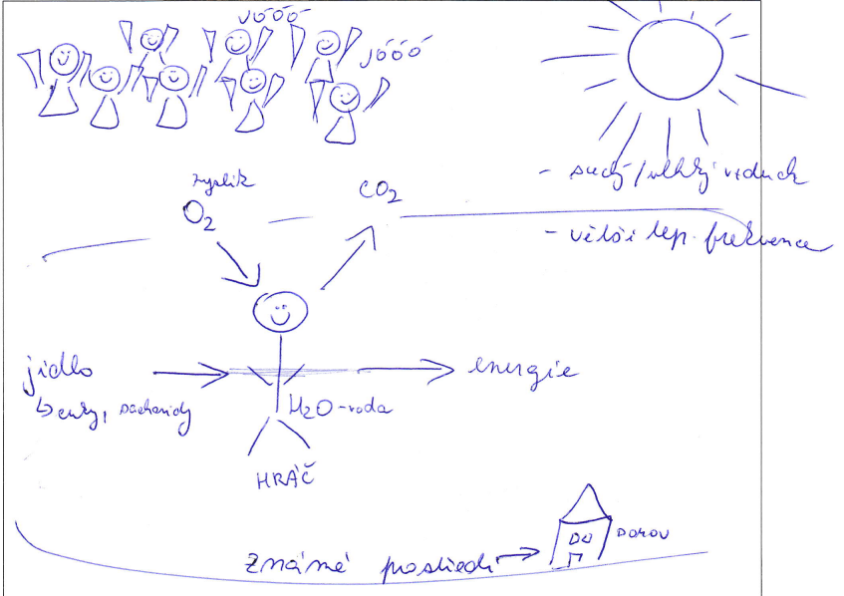
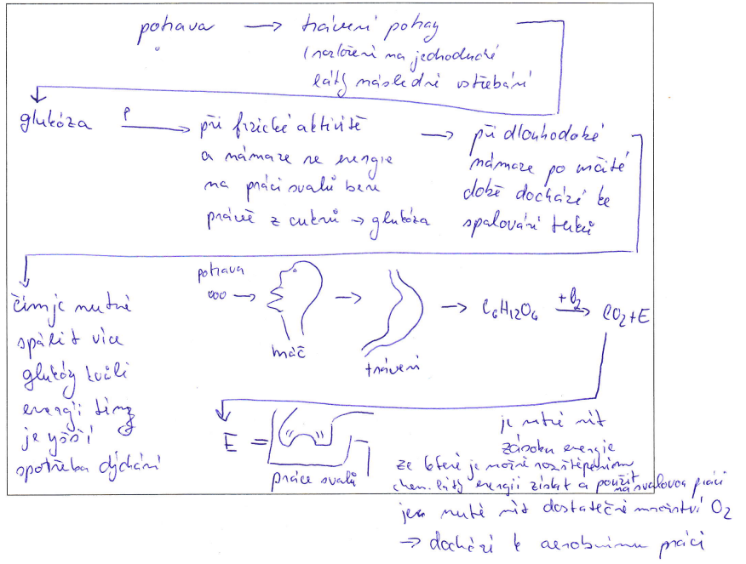
Running in higher altitude IV.
food
digestion of food
– split into simple substances, subsequent absorption
glucose
during physical activity, energy for muscle work is taken from sugars – glucose
during long-term activity, after period of time, fats are burned
oxygen
dry/moist air
higher heart rate
food
the more glucose that needs to be burned for energy, the higher the respiratory consumption
food
energy
player
digestion
– sugars, carbohydrates
water
it is necessary to have a supply of energy from which it is possible to obtain energy by splitting a chemical substance and use it for muscle work
PLAYER
home
muscle work
familiar environment
it is necessary to have a sufficient amount of O₂ – aerobic work occurs
Notes:
more examples of visual models created by students

Slide 30
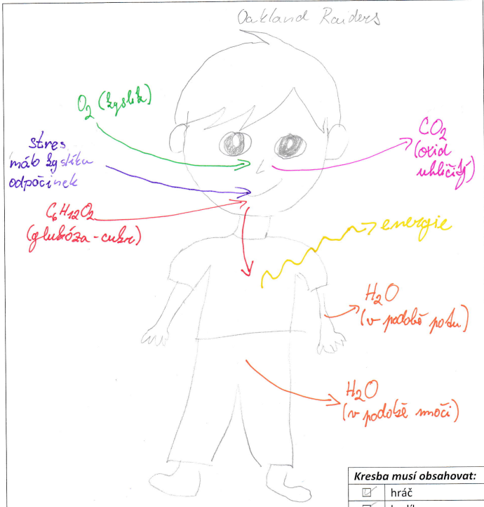
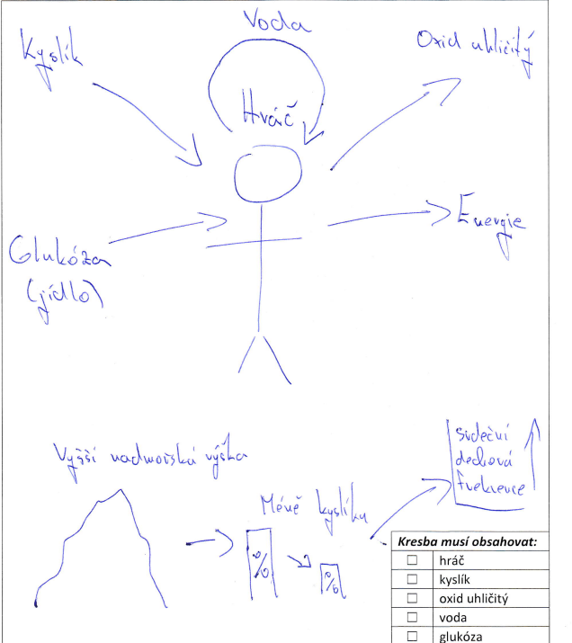
Running in higher altitude IV.
stress
low oxygen
rest
energy
glucose – sugar
in the form of urine
in the form of sweat
Notes:
more examples of visual models created by students

Slide 31
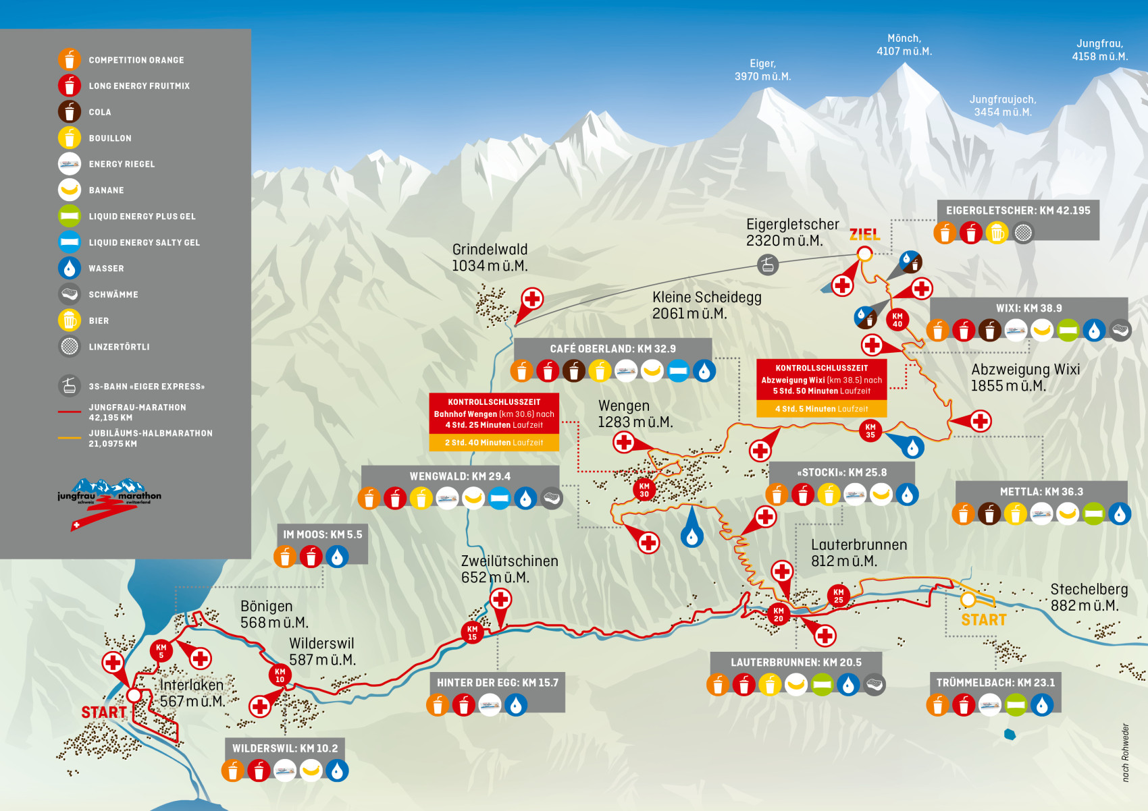
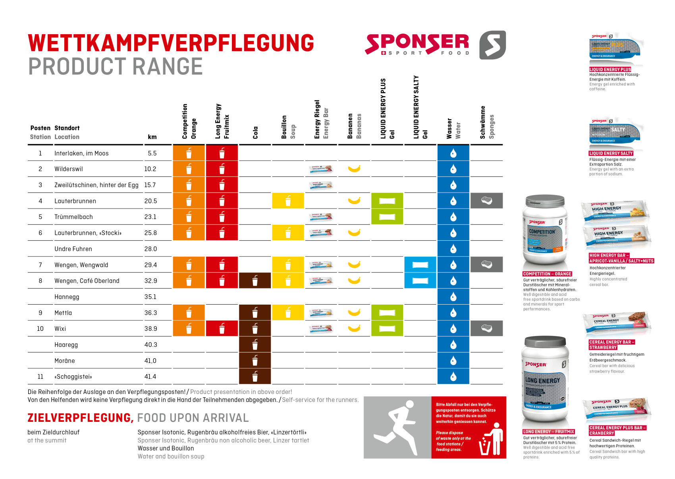
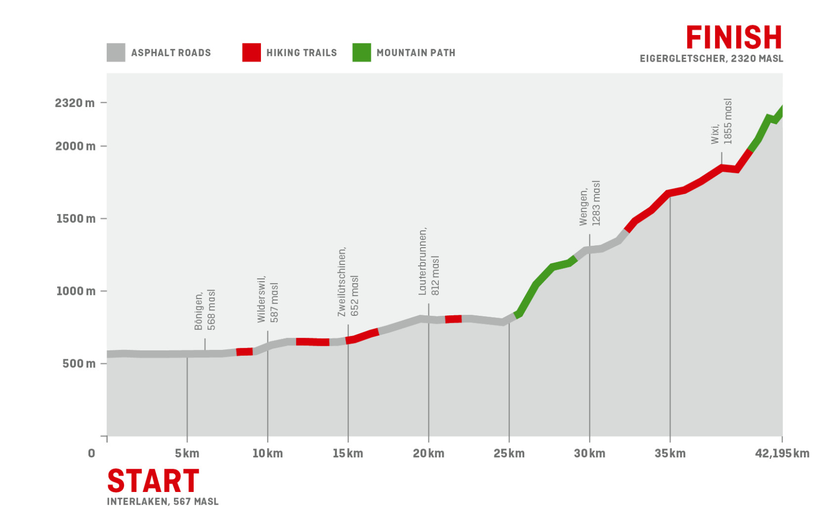
Running in higher altitude IV.
Notes:
As already mentioned above, look at visualizations and their importance in developing scientific practices within pupils and students learning.
scientific practises related to the use of visual information (Evagorou et al. 2015)
asking questions and defining problems
analysing and interpreting data
experimenting
modelling
students can build their own models, and the discussion of the models helps to better understand STEM topics (Hepworth & Canon, 2018)
similar to activities we want to do with students at classes when we include some visualisations and/or ask them to create their own visualisations

Slide 32
Conclusions
You are on the finish line of this inquiry activity. Write the main conclusions you reached. Focus mainly on which data helped you identify some of the factors affecting the runner's performance. What other factors have you discovered?
Notes:
As already mentioned above, look at visualizations and their importance in developing scientific practices within pupils and students learning.
scientific practises related to the use of visual information (Evagorou et al. 2015)
asking questions and defining problems
analysing and interpreting data
experimenting
modelling
students can build their own models, and the discussion of the models helps to better understand STEM topics (Hepworth & Canon, 2018)
similar to activities we want to do with students at classes when we include some visualisations and/or ask them to create their own visualisations

Slide 33
Conclusions
Let's return to the beginning…
Research methods
Quantitative
Qualitative
Mixed methods research
Notes:
As already mentioned above, look at visualizations and their importance in developing scientific practices within pupils and students learning.
scientific practises related to the use of visual information (Evagorou et al. 2015)
asking questions and defining problems
analysing and interpreting data
experimenting
modelling
students can build their own models, and the discussion of the models helps to better understand STEM topics (Hepworth & Canon, 2018)
similar to activities we want to do with students at classes when we include some visualisations and/or ask them to create their own visualisations

Slide 34


Conclusions I.
How would you use and analyse the data?
Notes:
As already mentioned above, look at visualizations and their importance in developing scientific practices within pupils and students learning.
scientific practises related to the use of visual information (Evagorou et al. 2015)
asking questions and defining problems
analysing and interpreting data
experimenting
modelling
students can build their own models, and the discussion of the models helps to better understand STEM topics (Hepworth & Canon, 2018)
similar to activities we want to do with students at classes when we include some visualisations and/or ask them to create their own visualisations

Slide 35
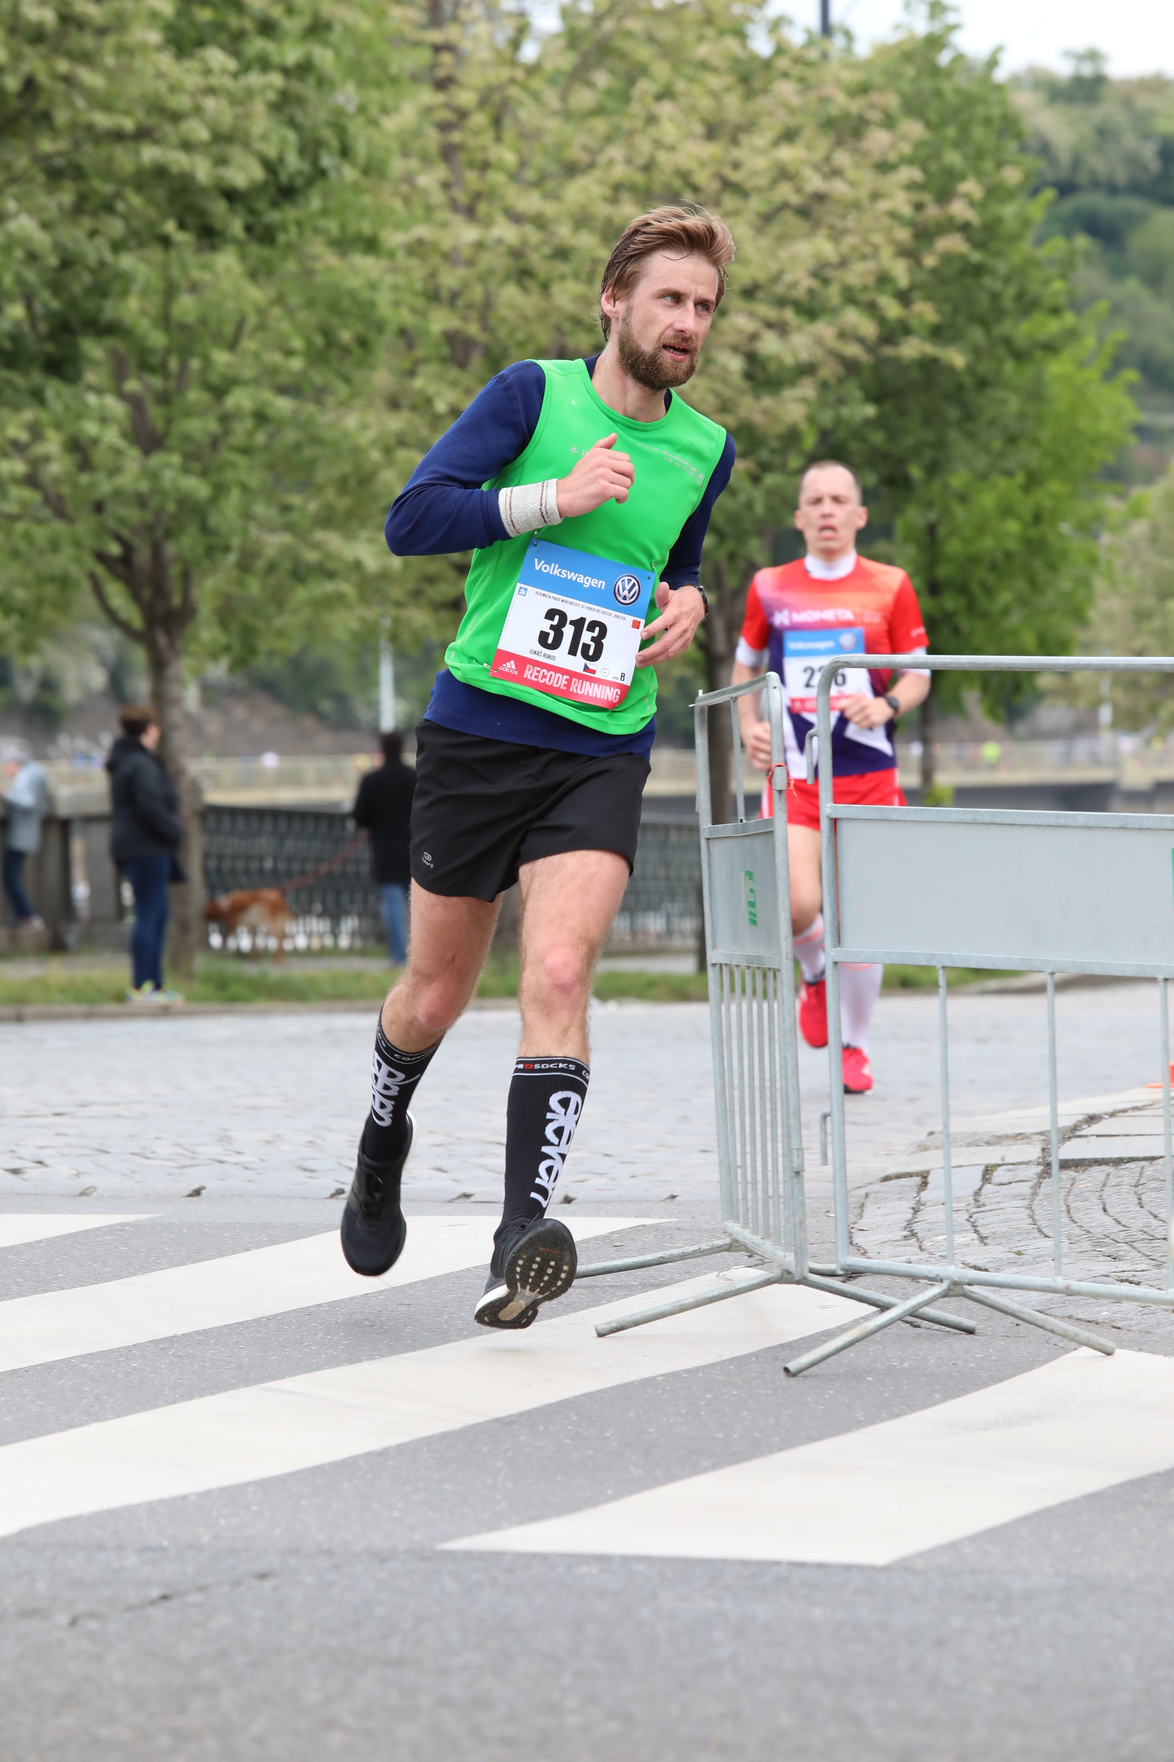
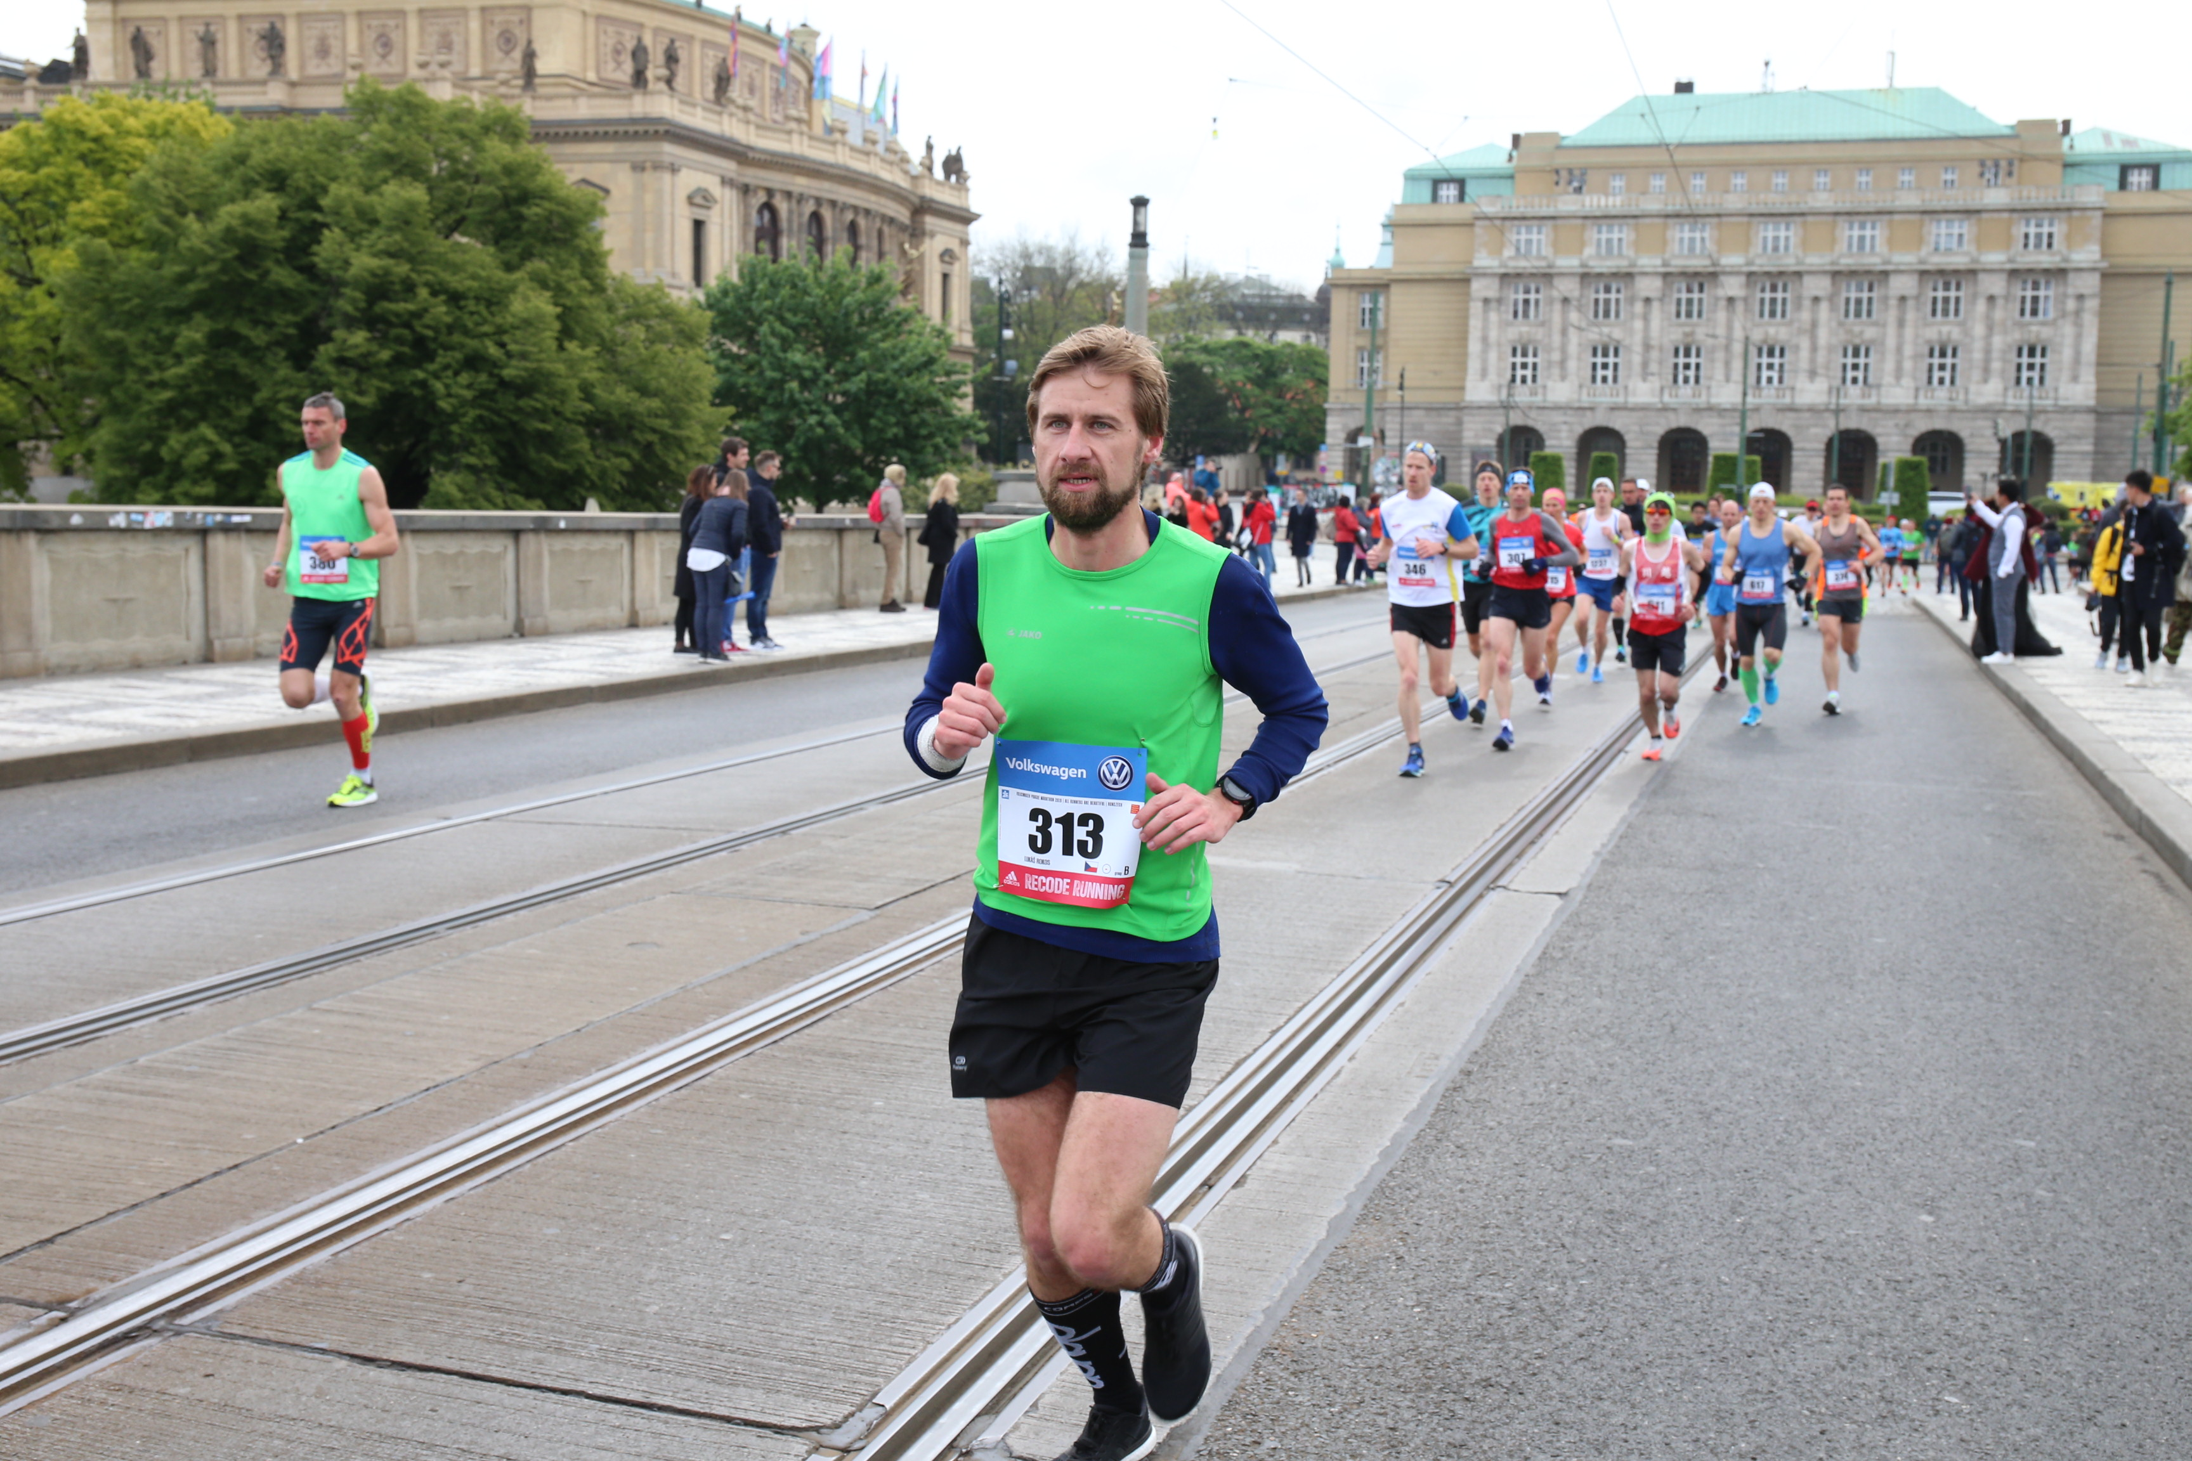
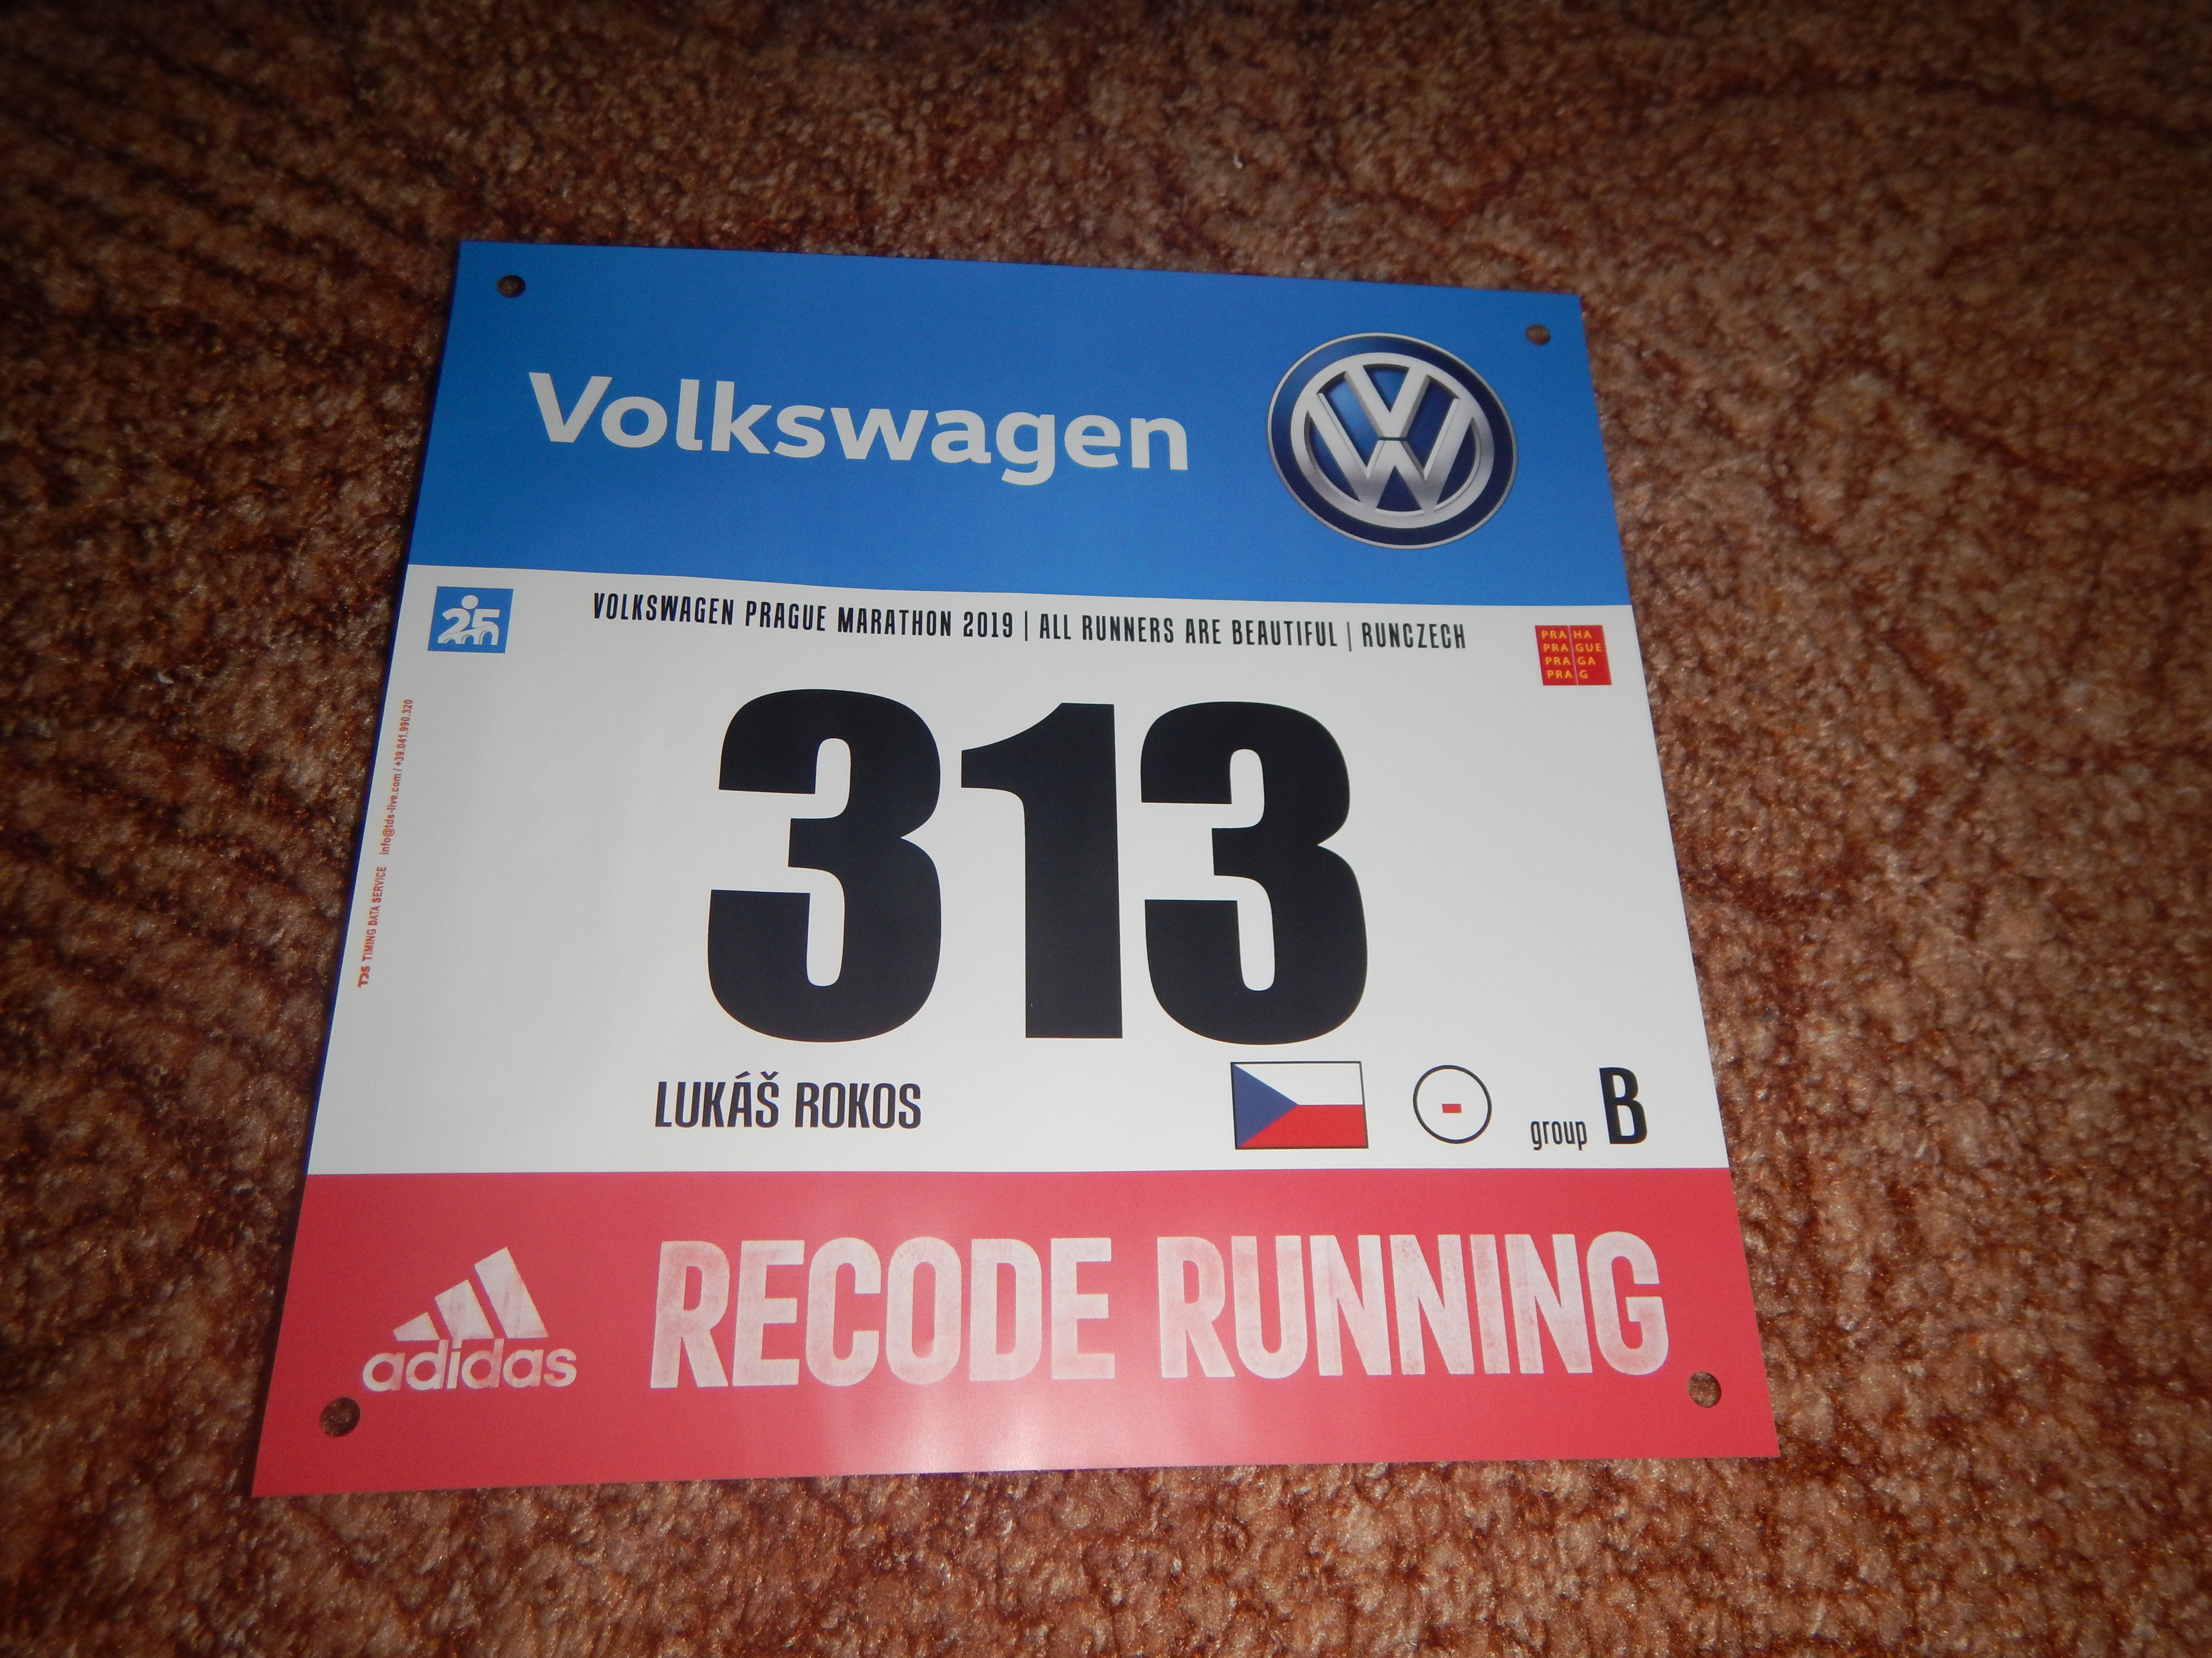
Conclusions II.
Notes:
As already mentioned above, look at visualizations and their importance in developing scientific practices within pupils and students learning.
scientific practises related to the use of visual information (Evagorou et al. 2015)
asking questions and defining problems
analysing and interpreting data
experimenting
modelling
students can build their own models, and the discussion of the models helps to better understand STEM topics (Hepworth & Canon, 2018)
similar to activities we want to do with students at classes when we include some visualisations and/or ask them to create their own visualisations

Slide 36
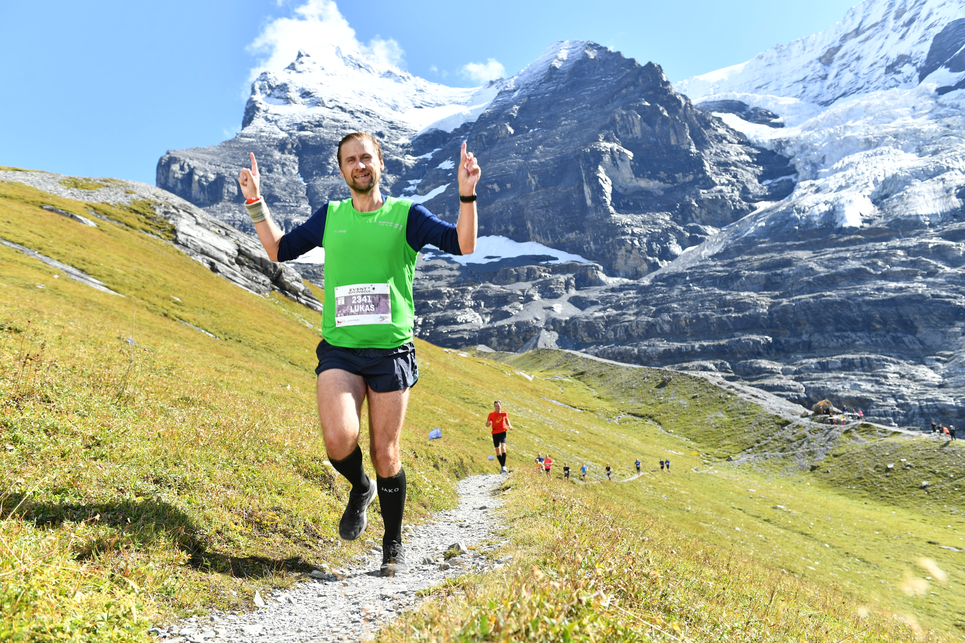
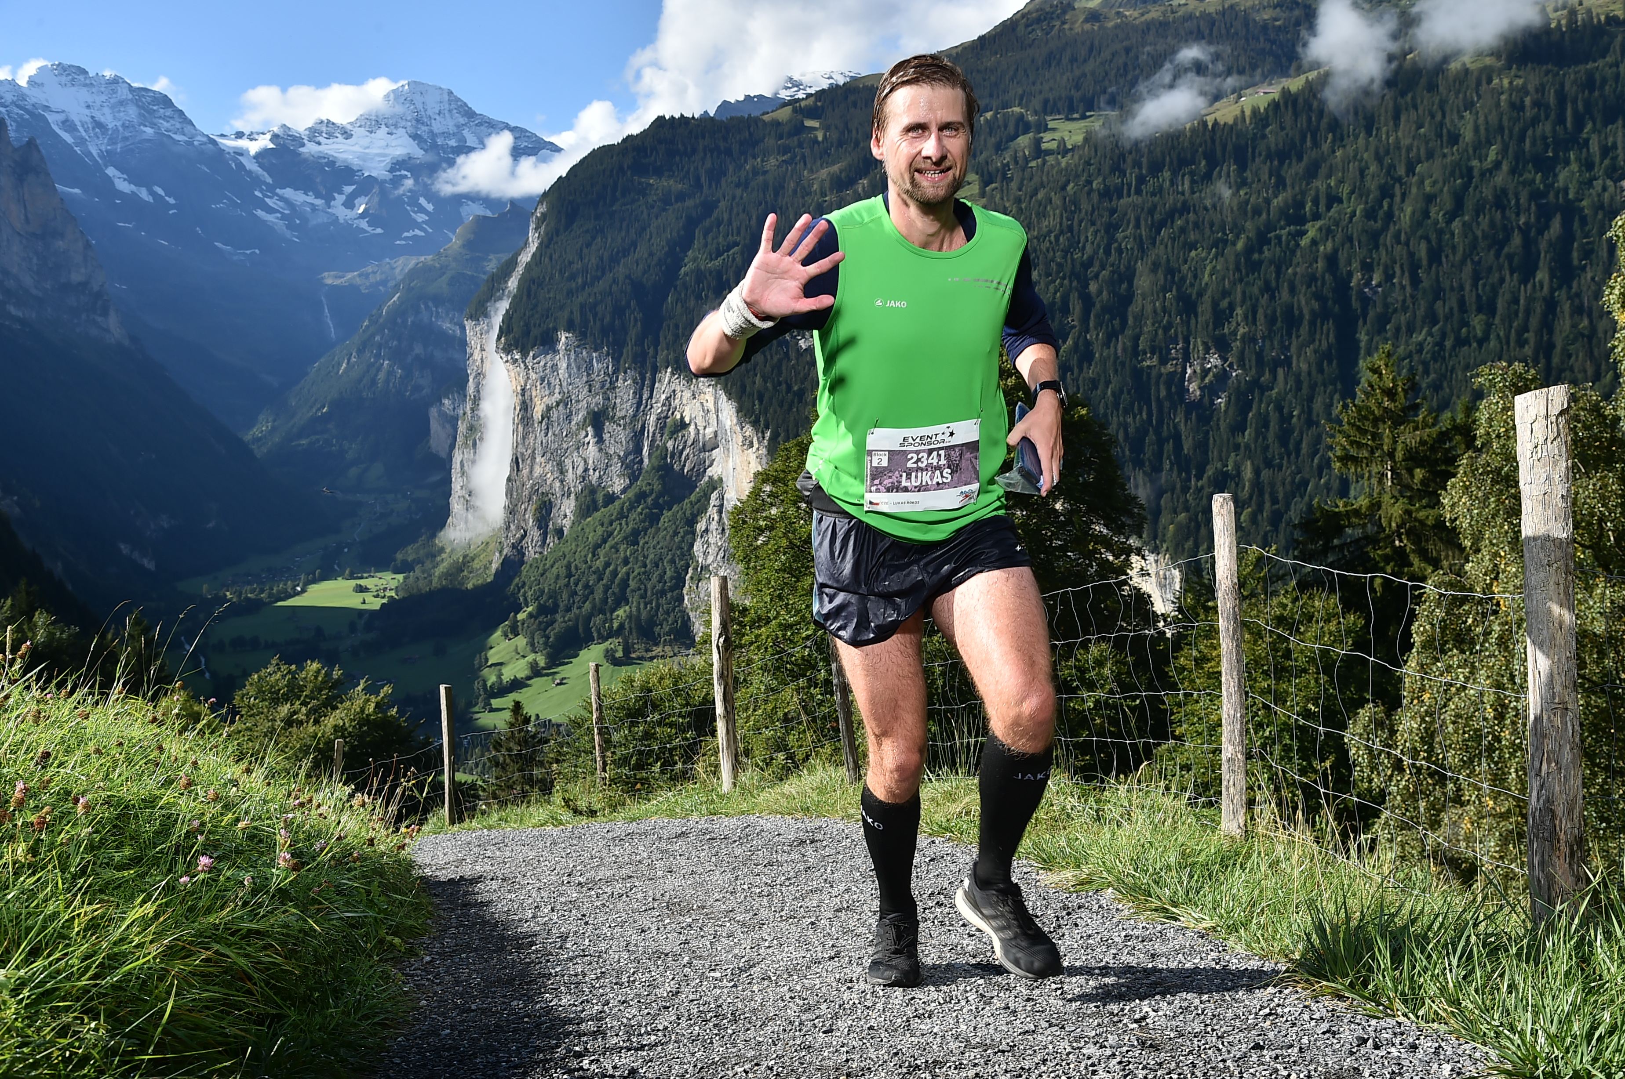
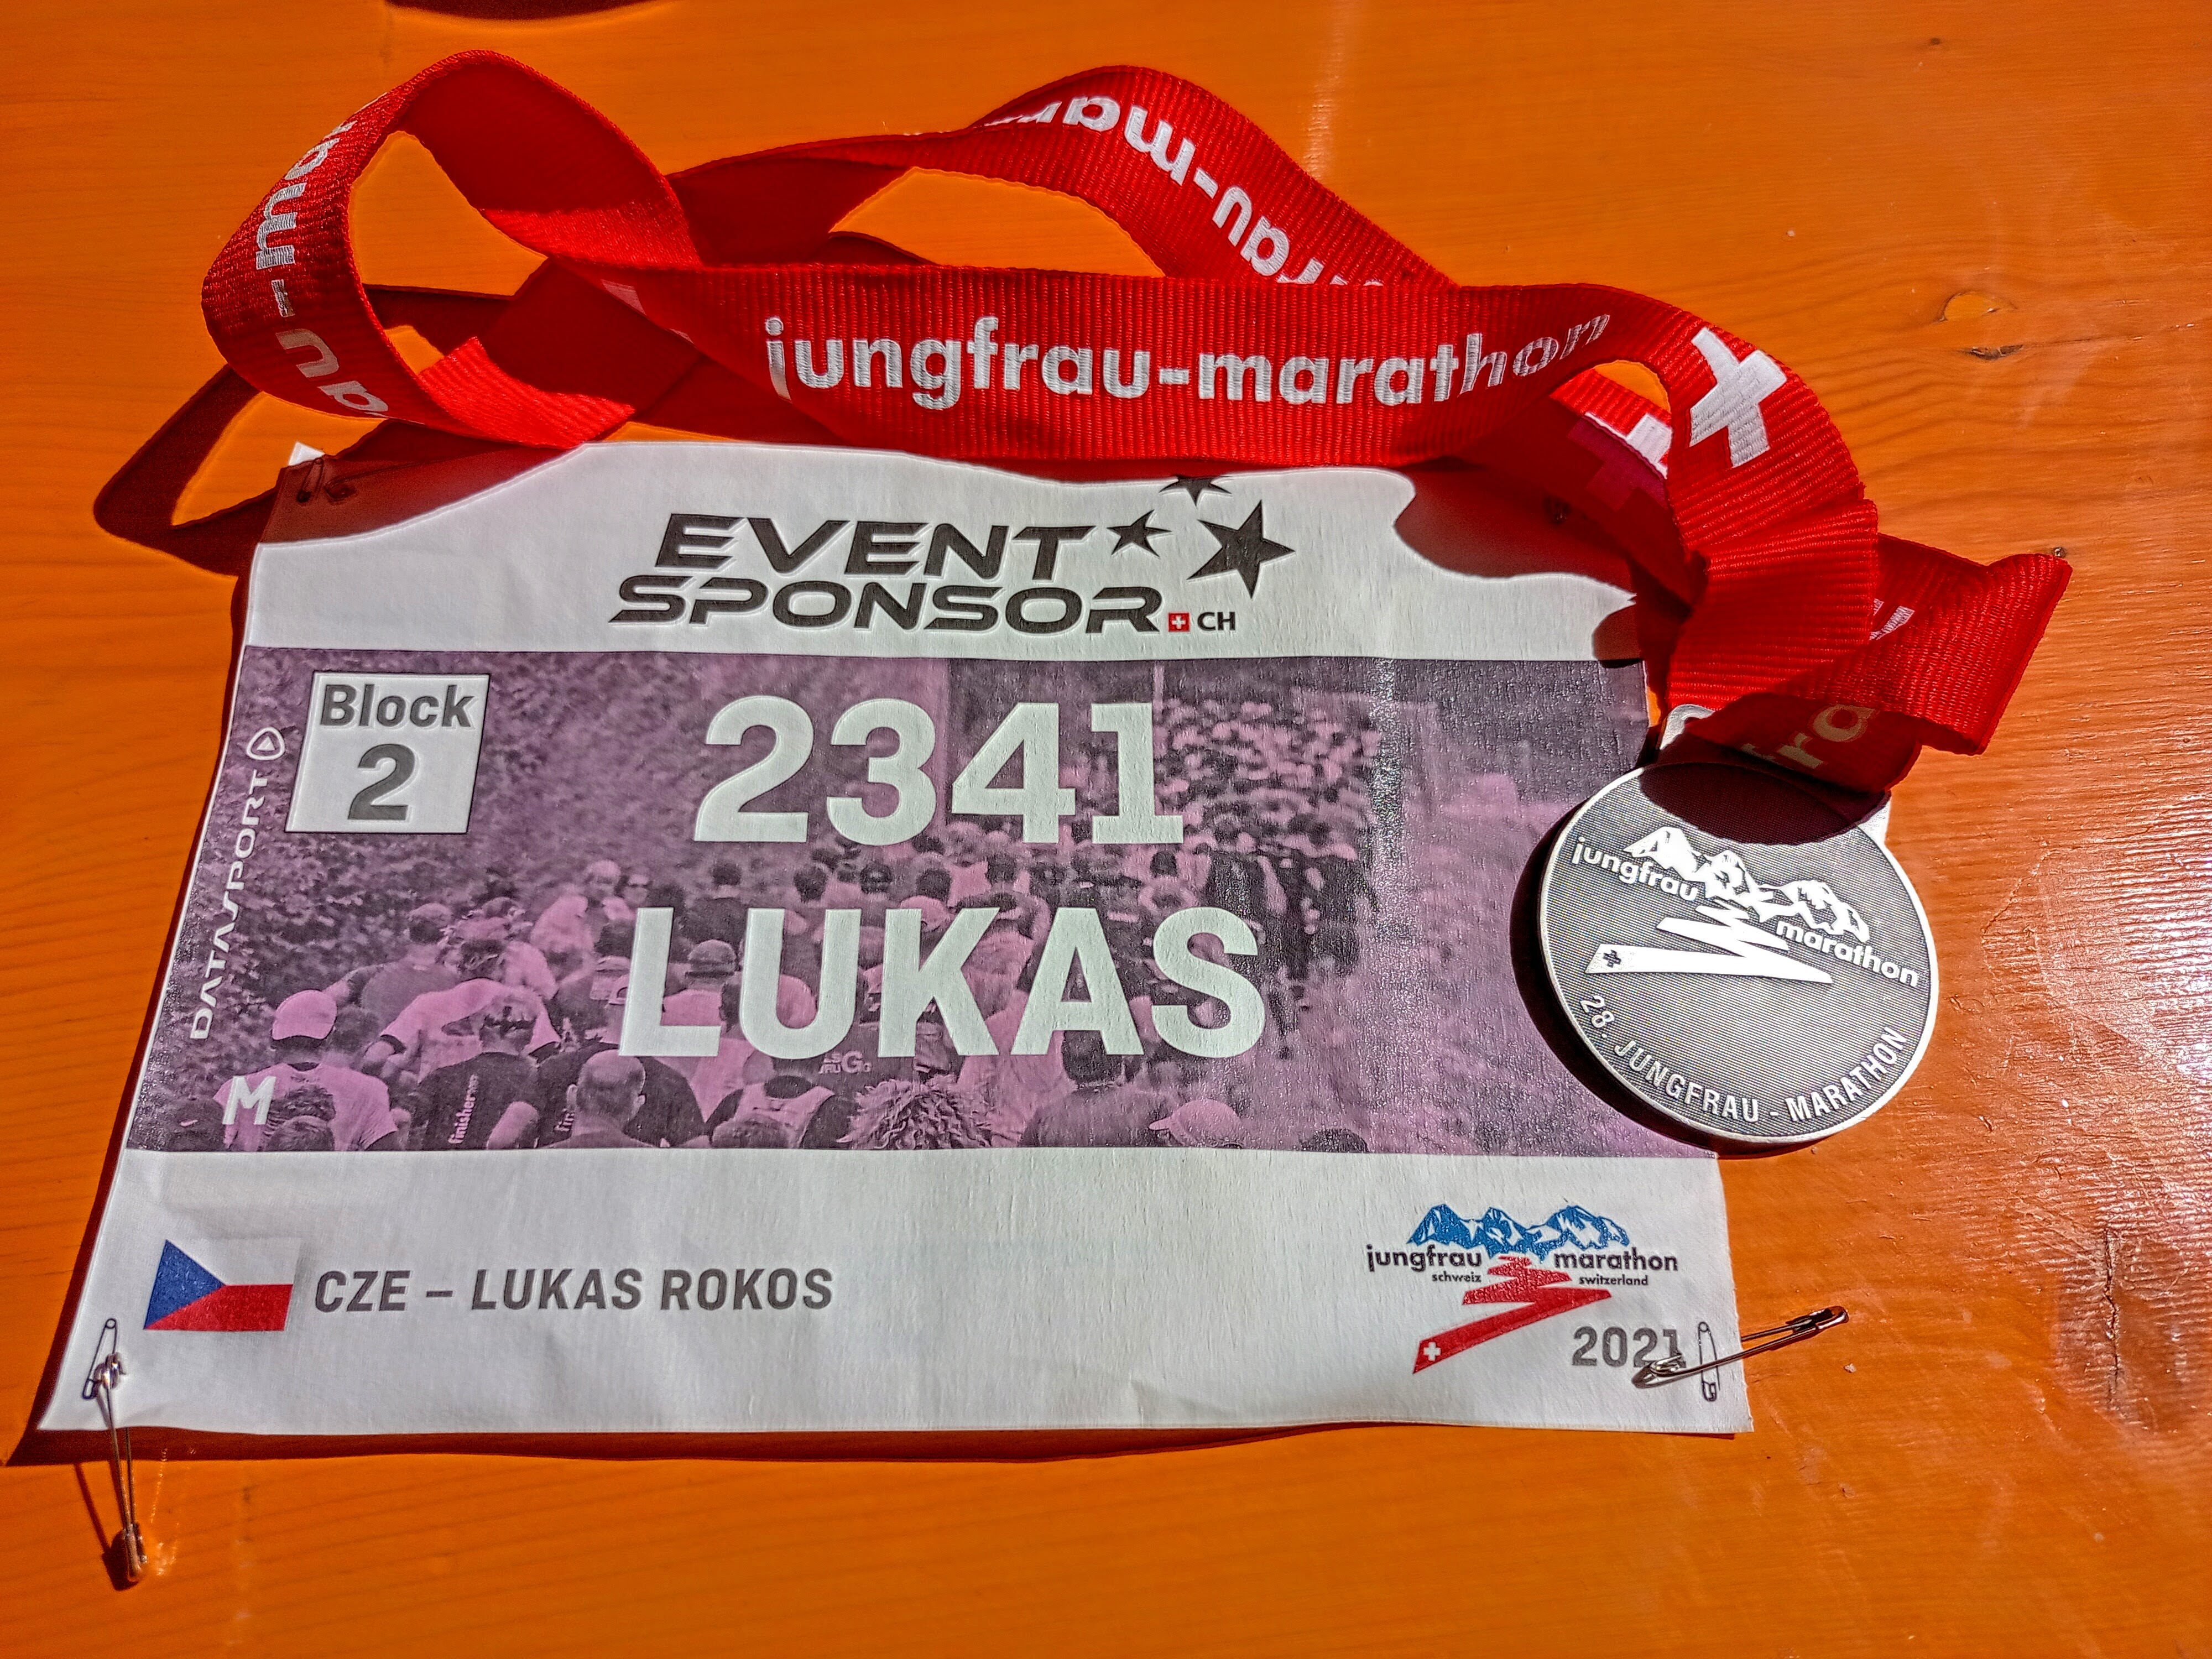
Conclusions III.
Notes:
As already mentioned above, look at visualizations and their importance in developing scientific practices within pupils and students learning.
scientific practises related to the use of visual information (Evagorou et al. 2015)
asking questions and defining problems
analysing and interpreting data
experimenting
modelling
students can build their own models, and the discussion of the models helps to better understand STEM topics (Hepworth & Canon, 2018)
similar to activities we want to do with students at classes when we include some visualisations and/or ask them to create their own visualisations

Slide 37
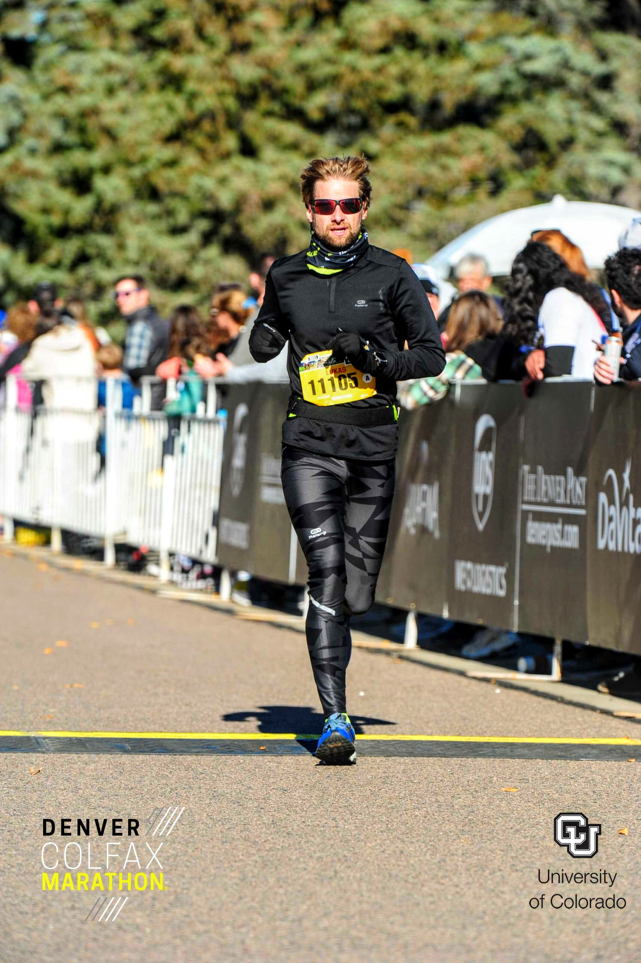
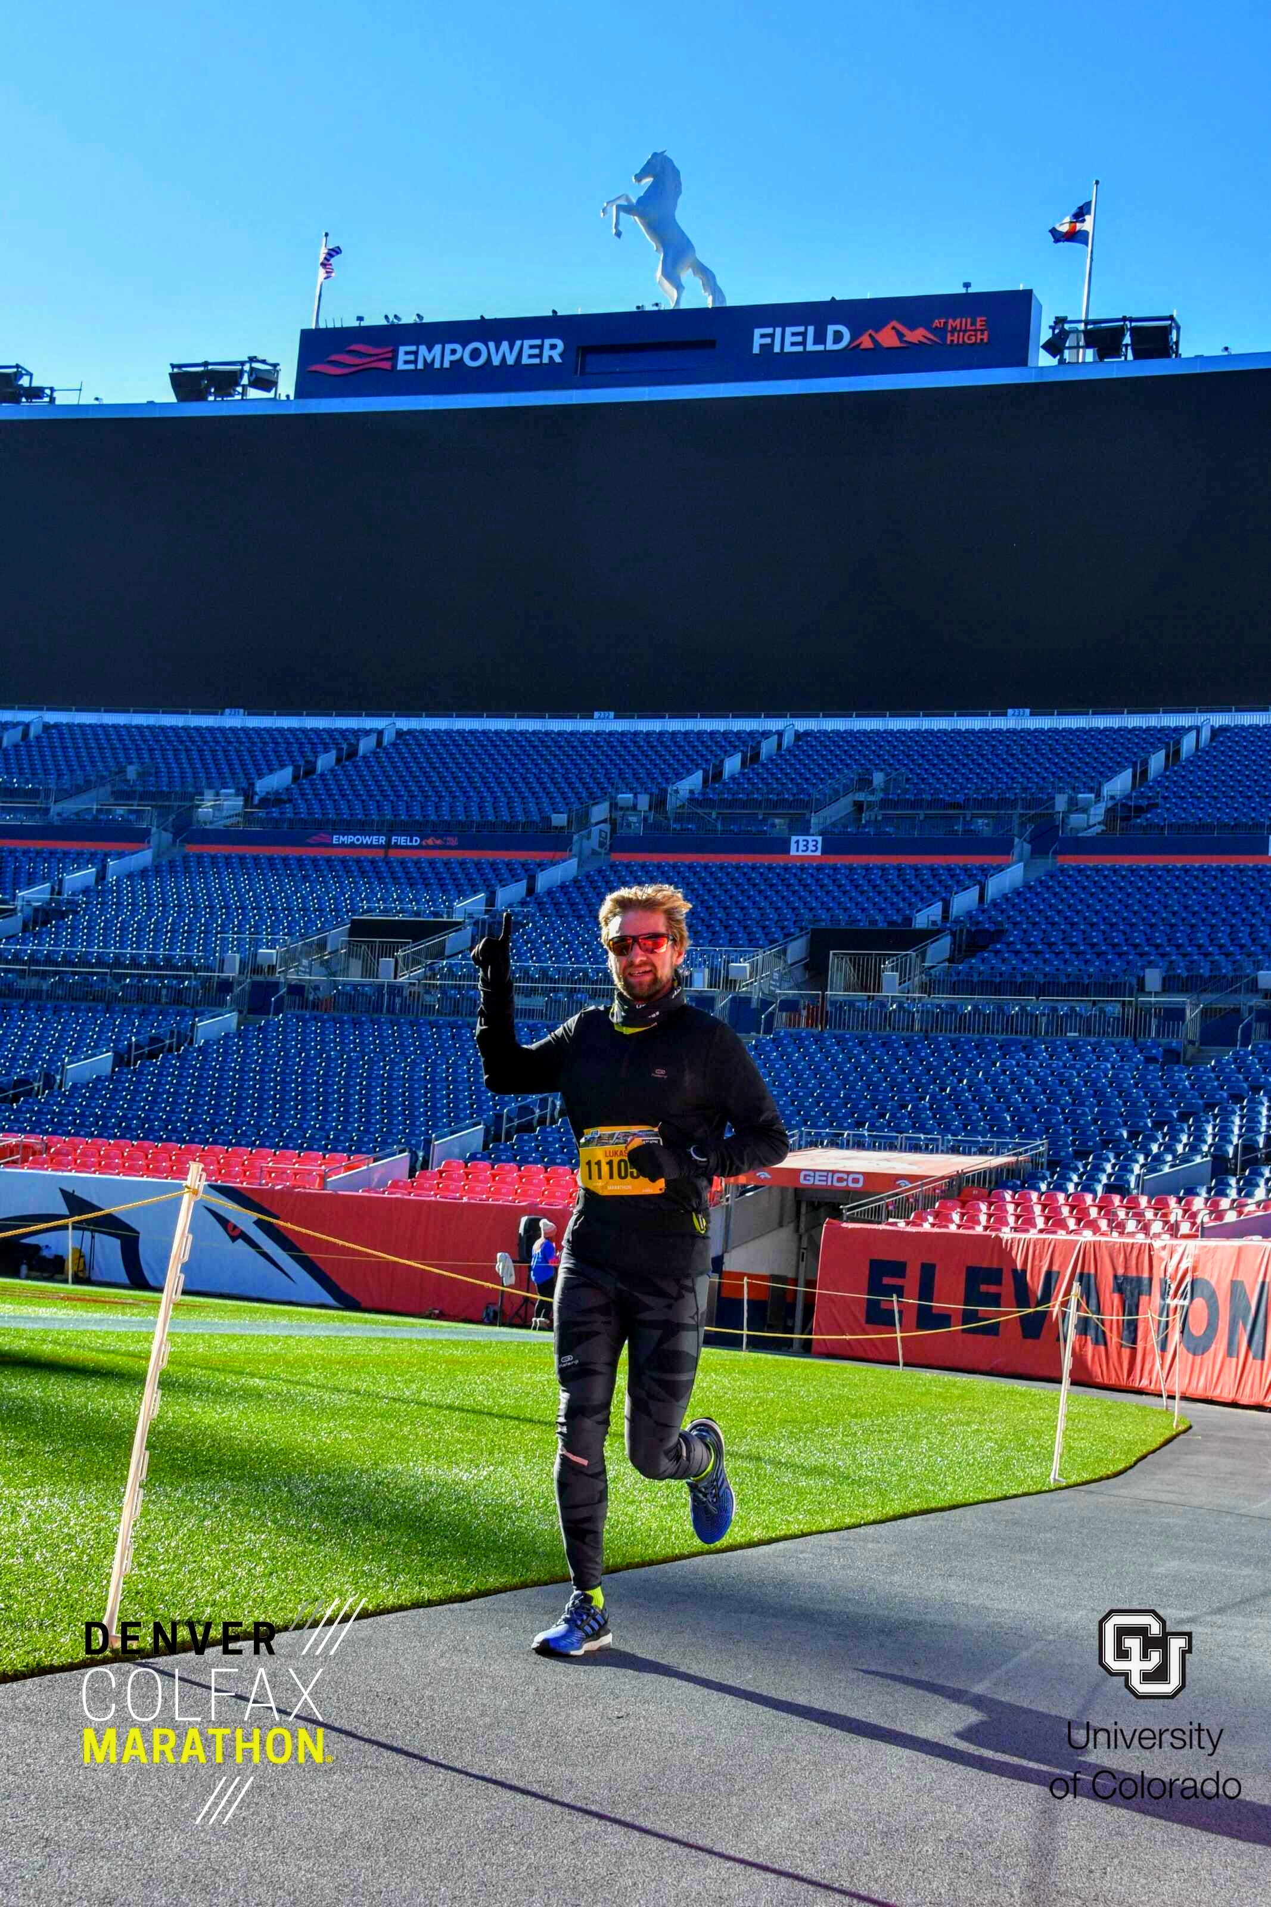
Conclusions IV.
Notes:
As already mentioned above, look at visualizations and their importance in developing scientific practices within pupils and students learning.
scientific practises related to the use of visual information (Evagorou et al. 2015)
asking questions and defining problems
analysing and interpreting data
experimenting
modelling
students can build their own models, and the discussion of the models helps to better understand STEM topics (Hepworth & Canon, 2018)
similar to activities we want to do with students at classes when we include some visualisations and/or ask them to create their own visualisations

Slide 38
Thank you
for your attention!
Lukáš Rokos

