Slide 1
Erasmus+ BIP in Brno
Supporting curriculum through integrated STEAM education practices
(2024-1-CZ01-KA131-HED-000226917-3)
Petra Antošová (antosova@ped.muni.cz) Brno, 6.9.2024

Slide 2
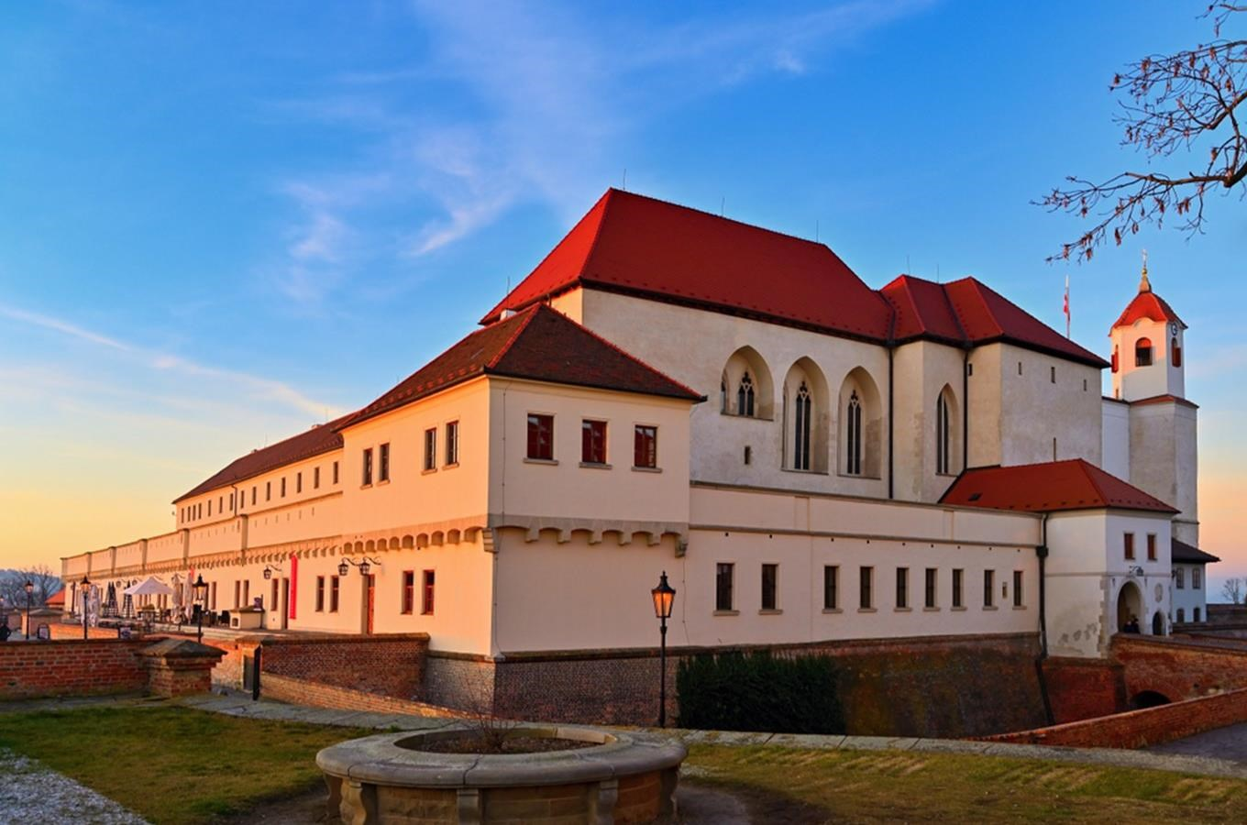
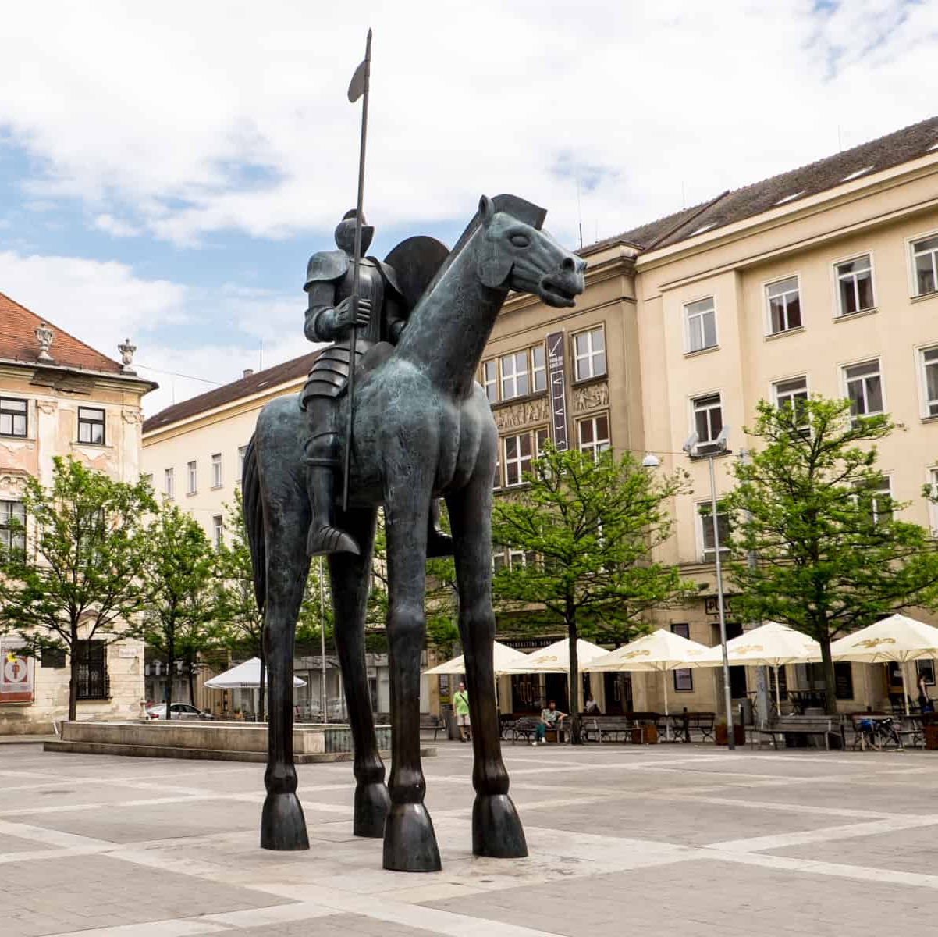
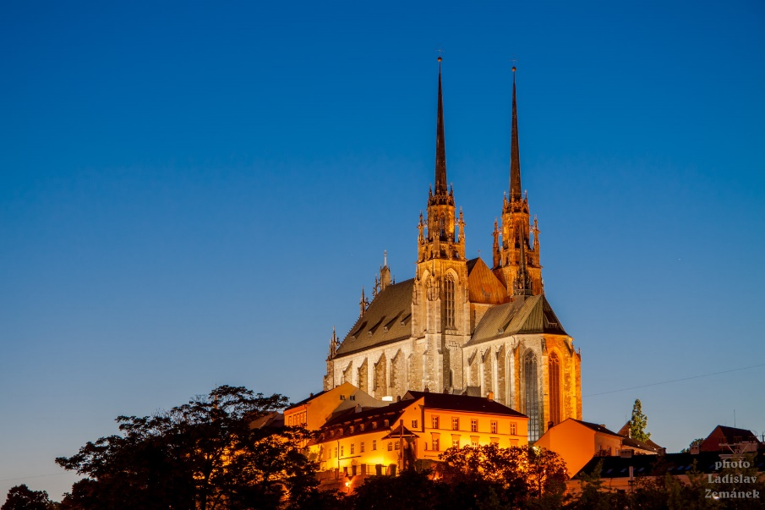
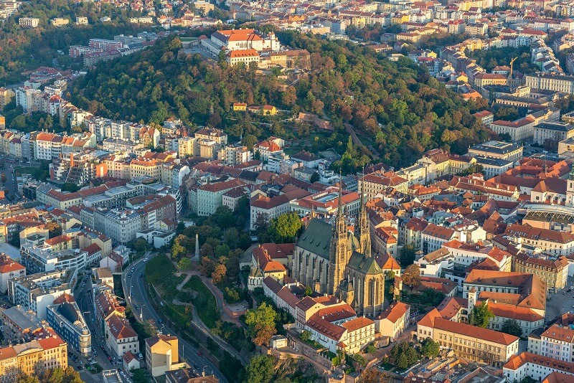
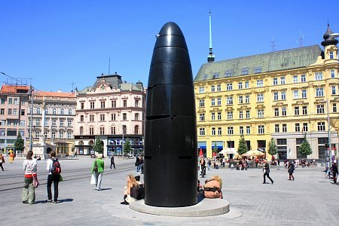
Welcome to the Masaryk University, Brno!

Slide 3
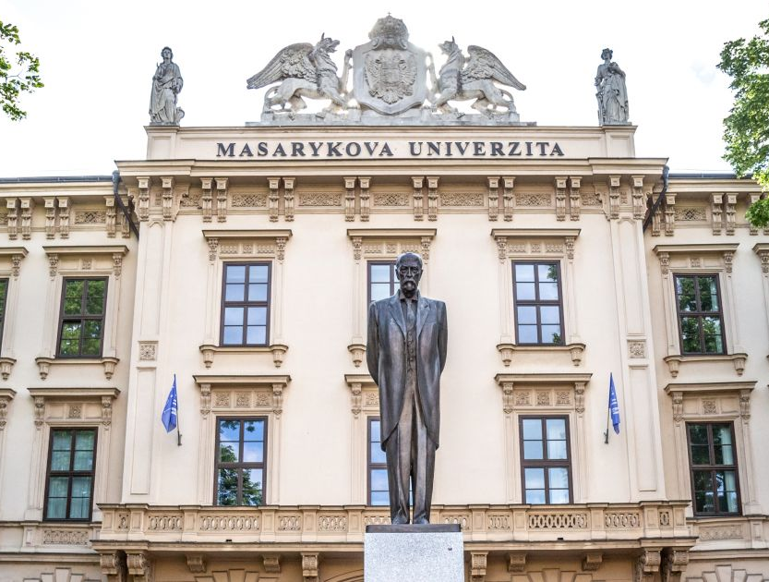
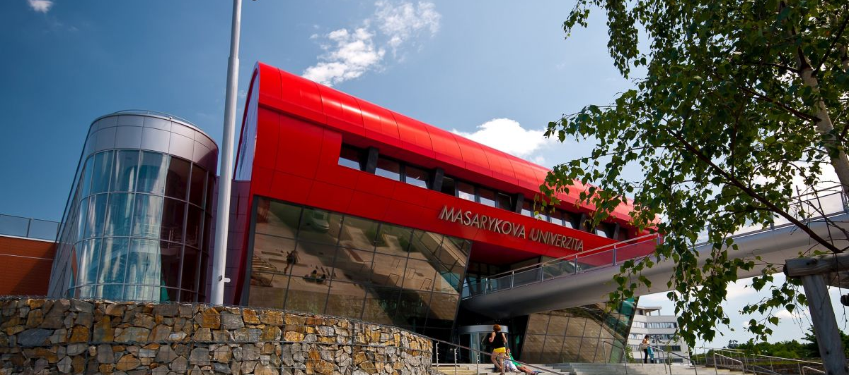
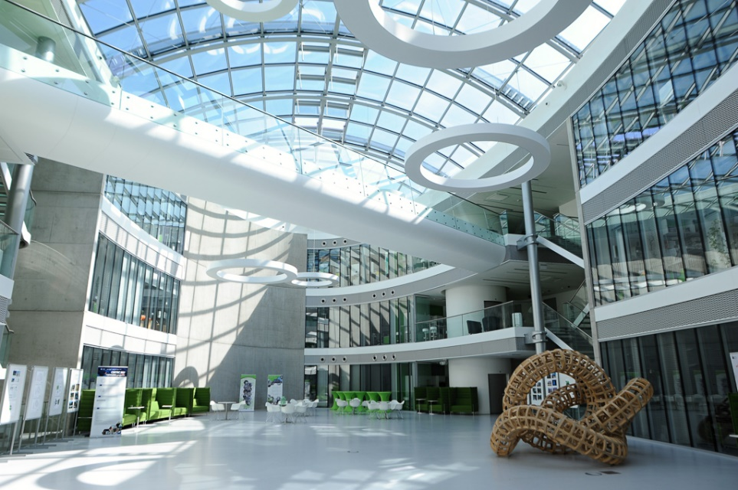
Welcome to the Masaryk University, Brno!

Slide 4
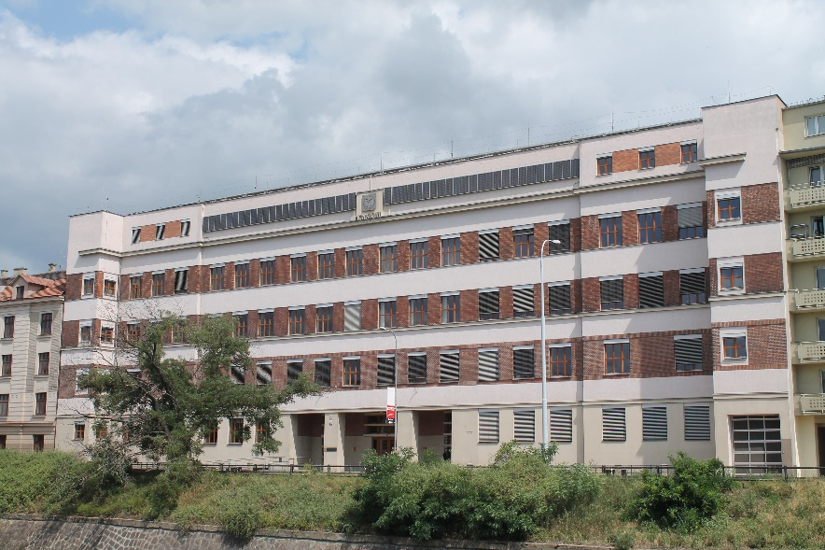
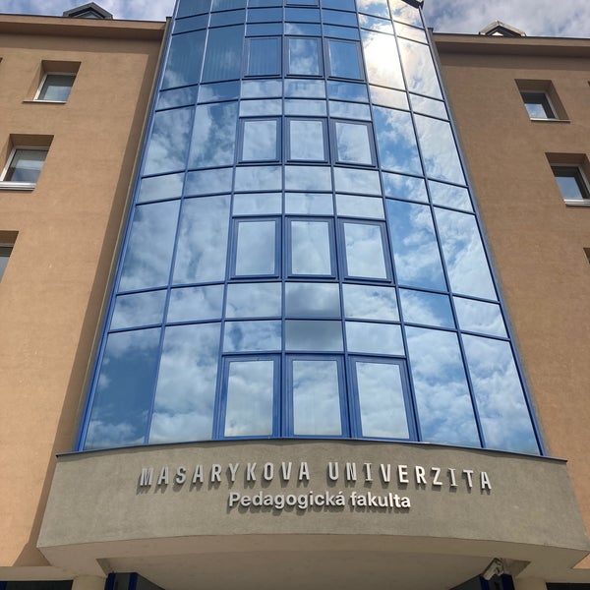
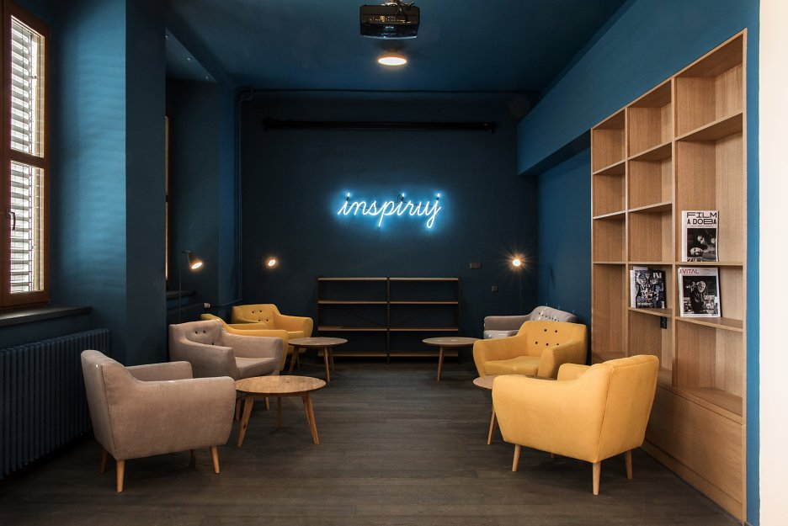
Welcome to the Masaryk University, Brno!

Slide 5
Programme of this kick off meeting
Basic information about travelling, accommodation and BIP programme
Introduction of organisers and teachers
What is STEAM education and how our countries deal with it
Introduction of students
Group work – experiences with STEAM, expectations on BIP

Slide 6
Basic information
Supporting curriculum through integrated STEAM education practices
Online part – September 6th (now)
In-person part – September 9th till September 13th
Lectures, workshops, informal meetings Poříčí 31, 2nd floor, classroom 32

Slide 7
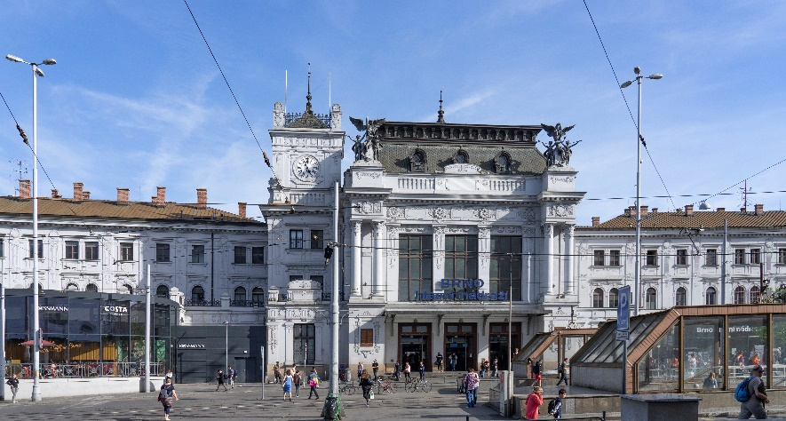
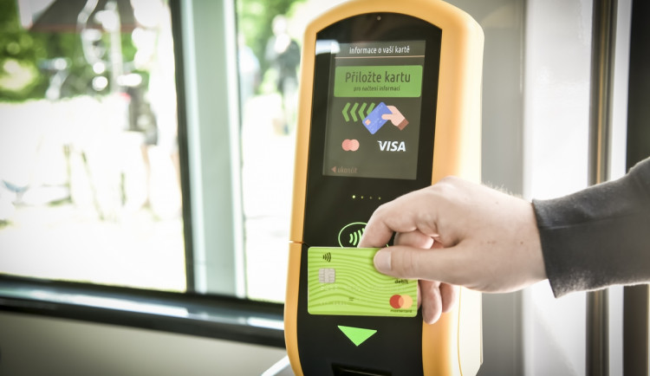
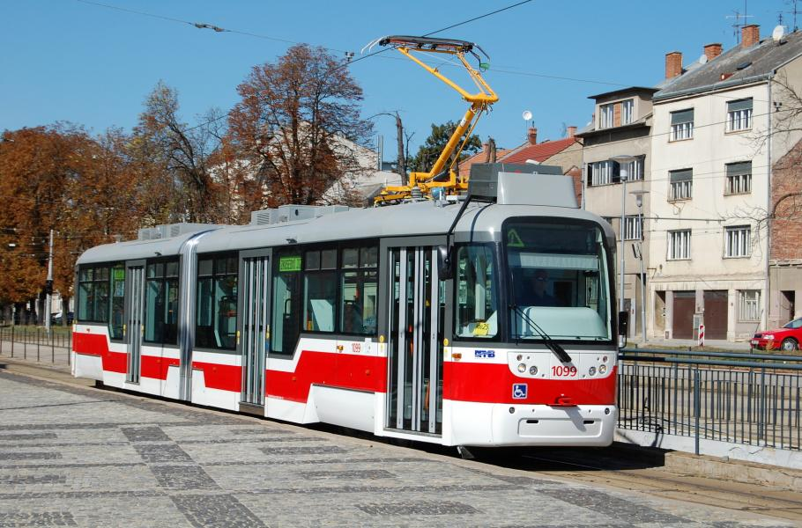
Basic information – travelling
You can use several applications to search for connections, like IDOS
For the Faculty of Education (Poříčí 31), it takes 3 stops from the main train station (the stop Václavská); for the accommodation, it takes 4 more stops (the stop Lipová or Arena Brno, the stop will change the name in a few days).

Slide 8
Basic information – accommodation
Room will cost 1100 CZK per night (around 44 euros) for 2 persons or 800 CZK per night (around 32 euros) for 1 person + city tax 40 CZK per night (around 1,6 euros)
Payment is possible after arrival by card or by cash (in CZK)
Upon arrival (from 14:00) it is necessary to show a valid document (ID or passport) and fill out the registration form, on the day of departure, the room must be vacated by 11:00
Address: Vinařská 5, block A3, phone: 549492713

Slide 9
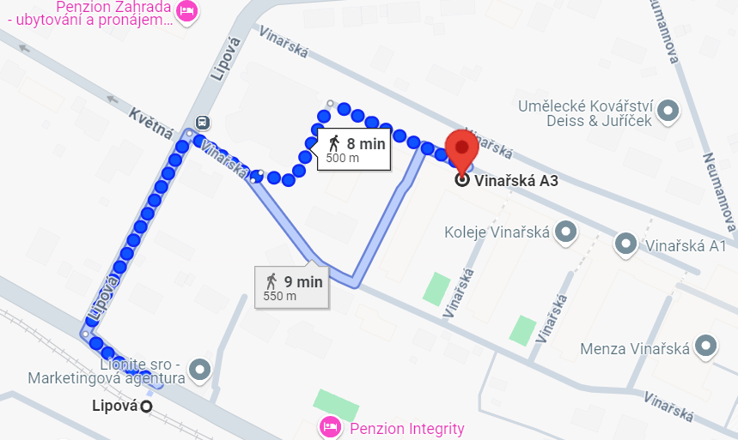
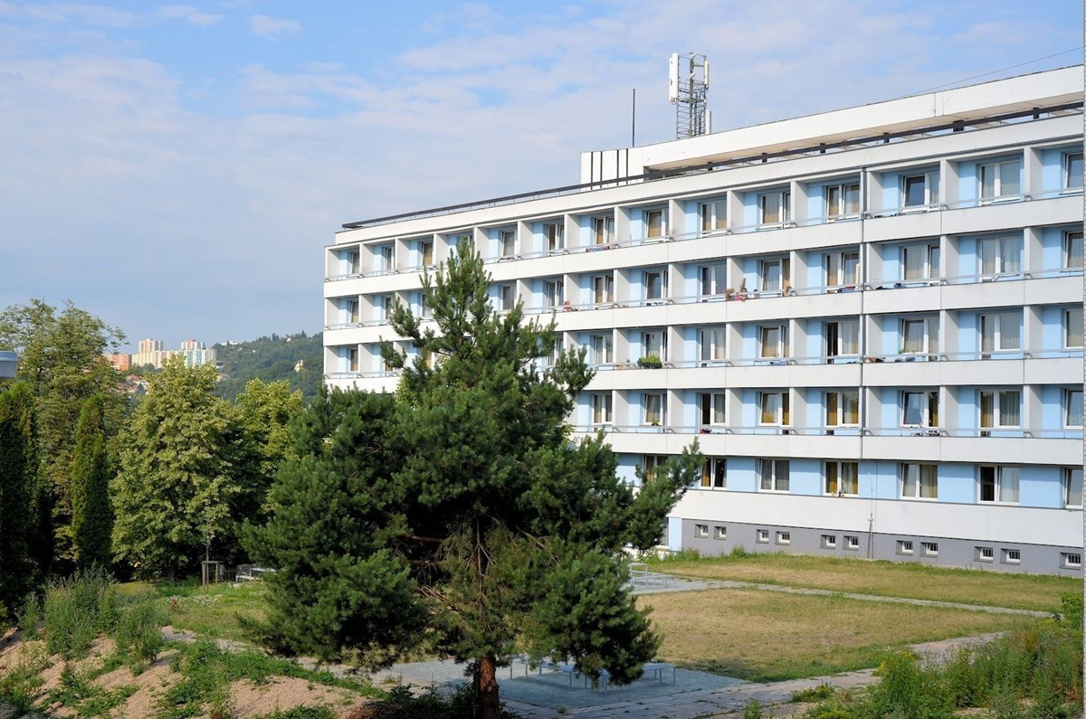
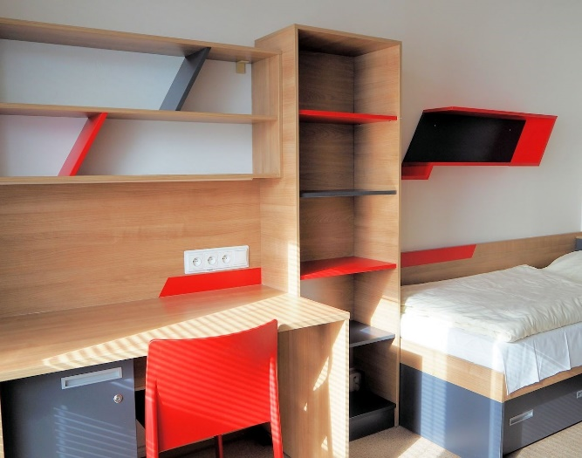
Basic information – accommodation

Slide 10
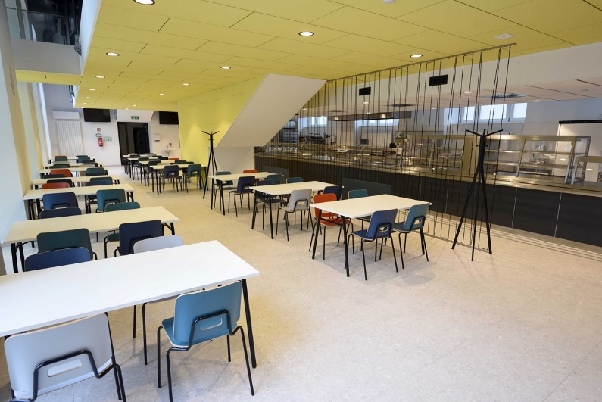
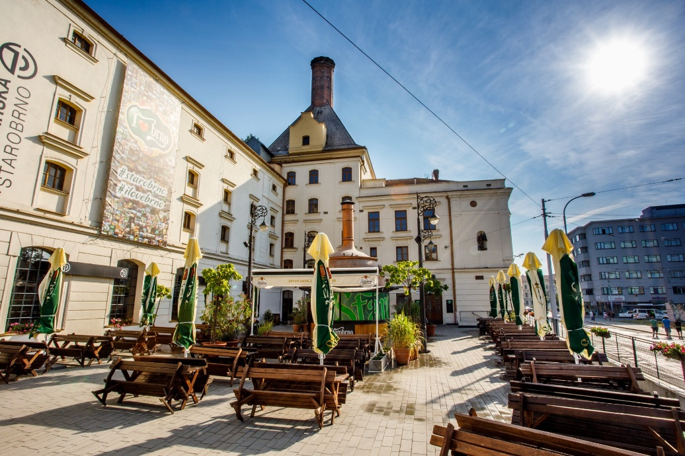
Basic information – food
Lunches are provided at the canteen of the Faculty of Education, Poříčí 7
Everyday snack during a coffee break
Farewell dinner on Thursday at Pivovarská Starobrno, Mendlovo náměstí

Slide 11
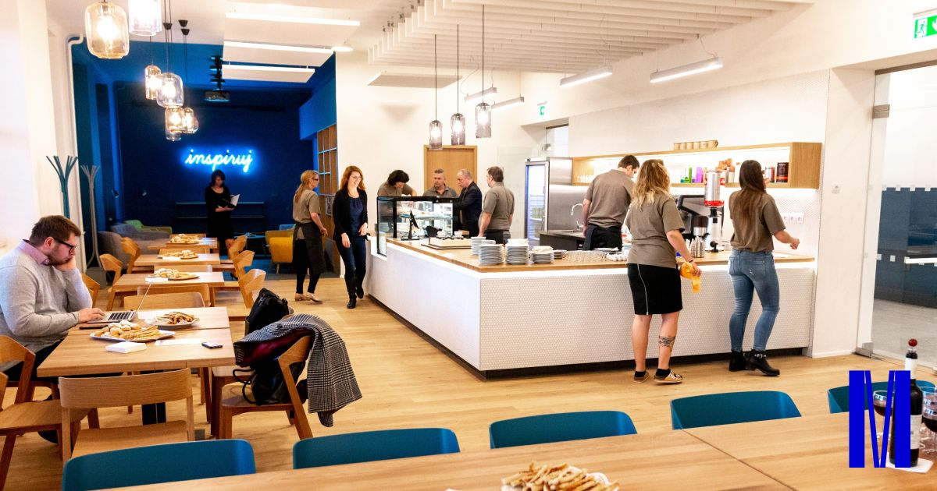
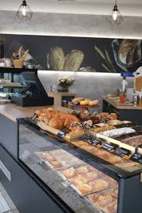
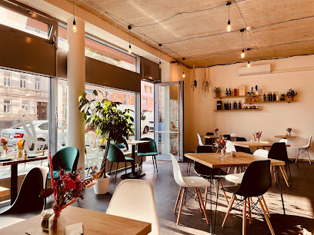
Basic information – food
Breakfasts are not included, you can use many cafes, bakeries and shops in Brno
Kafinet (Poříčí 31) Klásek bakery (Hybešova 46) Maybe (Vídeňská 18a)

Slide 12
Programme
Friday, September 6 – ONLINE Link: https://teams.microsoft.com/meet/345314713578?p=hyL7VYqEMSL4EfG7CW
9:00-10:30 | Kick-off meeting. General introduction to the program, contents, and assessment. Practical information.
10:30-11:00 | Coffee break
11:00-13:00 | Group presentation. Initial perspectives about STEAM Education and discussion of some topics.
Monday, September 9
8:30-9:00 | Registration
9:00-9:30 | Welcome speech
9:30-10:30 | Lecture: Content analysis of databases of STEM learning tasks with a focus on geography, mathematics and modern technology Tereza Šimčíková (Masaryk University)
10:30-11:00 | Coffee break
11:00-13:00 | Workshop: Data in run Lukáš Rokos (University of South Bohemia in České Budějovice)
13:00-14:00 | Lunch break
14:00-16:00 | Workshop: Robotics at the Faculty of Education Karel Picka (Masaryk University)
17:30 | Walk through Brno

Slide 13
Programme
Tuesday, September 10
9:00-12:00 | Workshop: Outdoor Mathematics with MathCityMap Ana Barbosa (Polytechnic Institute of Viana do Castelo)
12:00-13:00 | Lunch break
13:00-15:00 | Workshop: STEAM approach in building automatons: wheels and axles Ana Peixoto (Polytechnic Institute of Viana do Castelo)
15:00-15:30 | Coffee break
15:30-17:30 | Workshop: STEAM approach in building automatons: wheels and axles Ana Peixoto (Polytechnic Institute of Viana do Castelo)
Wednesday, September 11
9:00-10:30 | Lecture: Gender awareness in STEAM education: why and how? [online] Ana Belén Rodríguez Raposo (University of Santiago de Compostela)
10:30-11:00 | Coffee break
11:00-13:00 | Workshop: Robotics in STEAM Education: A Hands-On Journey with Graph Theory Challenges Teresa Fernández Blanco, Antía Fernández López and Cristina Lois Prados (University of Santiago de Compostela)
13:00-14:00 | Lunch break
14:00-16:00 | Workshop: Robotics in STEAM Education: A Hands-On Journey with Graph Theory Challenges Teresa Fernández Blanco, Antía Fernández López and Cristina Lois Prados (University of Santiago de Compostela)

Slide 14
Programme
Thursday, September 12
9:00-10:30 | Lecture: AI and its use from the legal point of view Michal Antoš (Law office AKSKP)
10:30-11:00 | Coffee break
11:00-13:00 | Workshop (half group): Virtual Reality and its use in natural sciences, medicine and education David Antoš (Masaryk University)
13:00-14:00 | Lunch break
14:00-16:00 | Workshop (half group): Woodcraft and modern tools (engraving, 3D print) Jitka Šťastná (Masaryk University)
18:00 | Farewell dinner
Friday, September 13
9:00-10:30 | Group work.
10:30-11:00 | Coffee break
11:00-13:00 | Group presentation. Joint discussion and closing session.
13:00-14:00 | Lunch

Slide 15
Assessment
Participation in lectures and workshops
Quality of the projects developed
Group presentation
Self-evaluation
10 points scale

Slide 16
Groups
Rita Natércia Fernandes da Silva | Sofía Vázquez Rodríguez | Alberto Ferro Vázquez | Chiara Anastasi
Catarina Rafaela Barbosa da Costa | Inés Domínguez Abruñedo | Anna Ruggeri | Martin Košťál
Ana Gabriela Soares Cardoso | Marta Maria Fernandes Machado | Aída de Pedro López | Fabio Genovesi
Iolanda Magalhães da Silva | Jaime Ferro Vilas | Sara Riolo | Lydie Kotrlová
Marie Gabriela Silva Rio | Lucía Trashorras Cendán | Leonardo Fragapane | Salome Černá

Slide 17
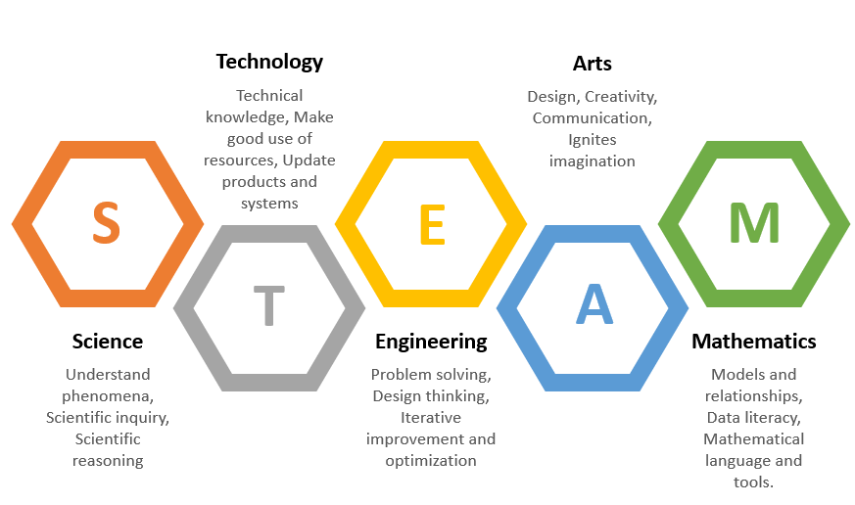
STEAM Education

Slide 18
STEAM Education
Created in the USA in 1990s
Number of students in these fields is significantly decreasing and their lack of interest in studying STEM subjects is increasing
Important fields for development and growth of economies
In the first wave of STEM was implemented in higher education, later the level of secondary schools, at the end primary schools, where it lays the foundations of knowledge, skills and attitudes that are crucial for further education
STREAM (R – writing, mastering the language of science)
STEAMIE (IE – include everyone, everyone can be educated, inclusion in education)

Slide 19
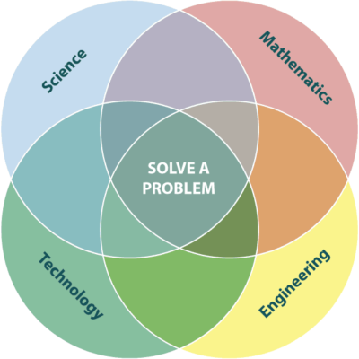
STEAM Education – Problem-solving
The need for problem-solving approach can be dated to the half of the 20th century (International Mathematical Olympiad)
https://www.youtube.com/watch?v=RGoJIQYGpYk

Slide 20
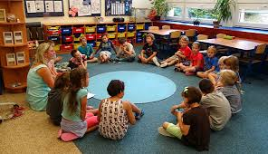
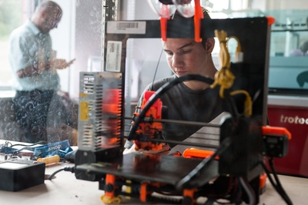
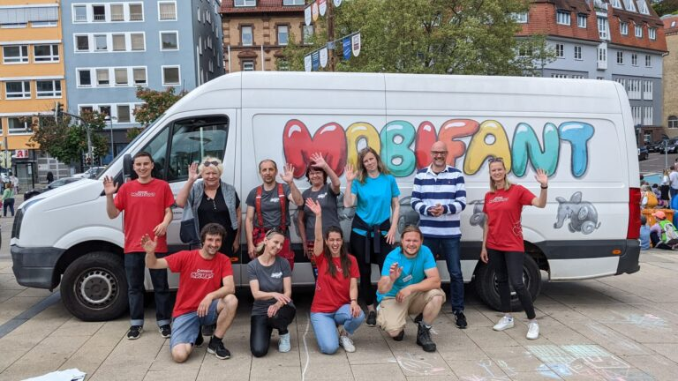
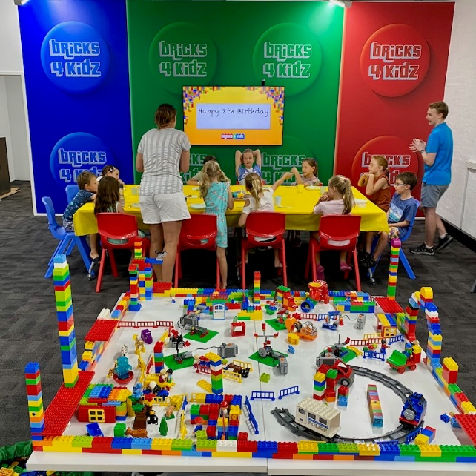
STEAM Education in Czechia
Most visible in alternative schools, where, thanks to block teaching, there is room for the introduction of stem education
Projects on STEM – EduStem (Polybus), Fablab …
Bricks 4 Kidz
University level South Bohemian University in České Budějovice, Masaryk university

