Slide 1
Presented by Šimčíková Tereza
STEM LEARNING TASKS’ DATABASES
FOCUS ON GEOGRAPHY, MATHEMATICS
AND MODERN TECHNOLOGY

Slide 2
TABLE OF CONTENTS
1
Introduction
2
Theoretical part
3
Methodology
4
Results
5
Trying out the task

Slide 3
INTRODUCTION
What am I actually going to talk about?
How and why did I choose this topic?

Slide 4
THEORETICAL PART

Slide 5
STEM EDUCATION
History and origin of STEM
Different perspectives on STEM
Expansion in the world

Slide 6
STEM EDUCATION
The Role of Geography in STEM
The Role of Mathematics in STEM

Slide 7
EDUCATIONAL DATABASE
EDUCATIONAL DATABASE
definition and meaning
use of databases

Slide 8
MODERN TECHNOLOGY
IN EDUCATION
the importance of MT
ways of using MT
integration of MT

Slide 9
METHODOLOGY

Slide 10
TEACHENGINEERING
STEM LEARNING
SCIENCE BUDDIES

Slide 11
RESULTS

Slide 12
RESULTS
Common features of databases

Slide 13
RESULTS
Common topics of tasks
What topics were most used in the analyzed learning tasks?
What topics were most used in the analyzed learning tasks?

Slide 14
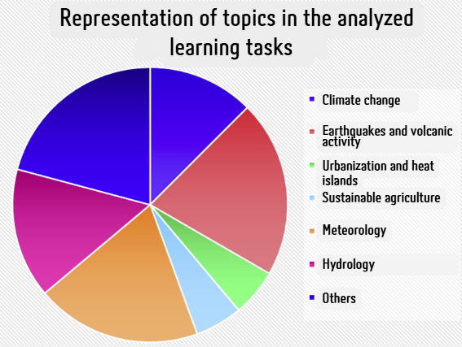
RESULTS
Common themes of some tasks
Climate change
Earthquakes and volcanic activity
Urbanization and heat islands
Hydrology and water resources
Sustainable agriculture
Meteorology

Slide 15
RESULTS
Typical task structure
Introductory part - presentation of the topic, motivation
Main part - theoretical basis, practical activity, data analysis
Final part - presentation of results, discussion

Slide 16
Trying out the task
Let's try to solve one of the analyzed tasks!
ll

Slide 17
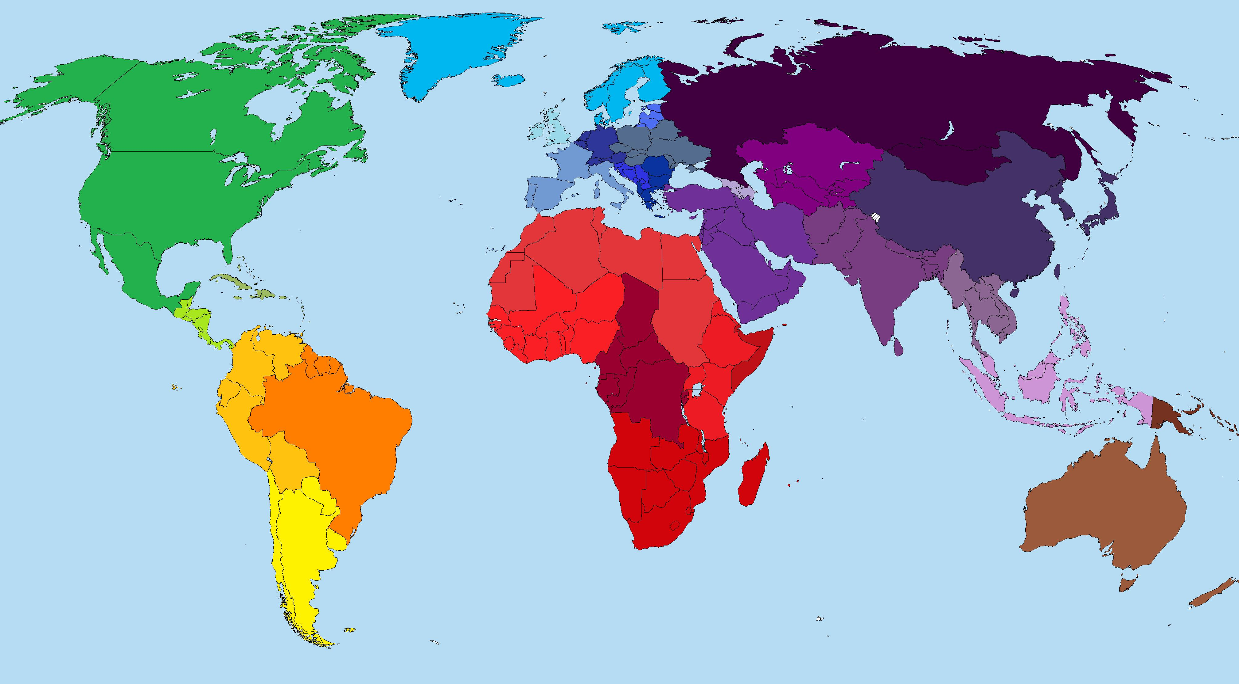
Tato fotka od autora Neznámý autor s licencí CC BY-SA

Slide 18
Engage:
Complete the Engage section of the worksheet. Identify the continent you live on and think about how it has changed over time.
Explore:
Access the Earthquakes Living Lab online and explore seismic activity in four regions: Chile, Southern California, Japan, and San Francisco.
Choose Southern California region
Compare the real-time earthquake map with a map of tectonic plates. Look for correlations and note observations on why earthquakes occur along plate boundaries.

Slide 19
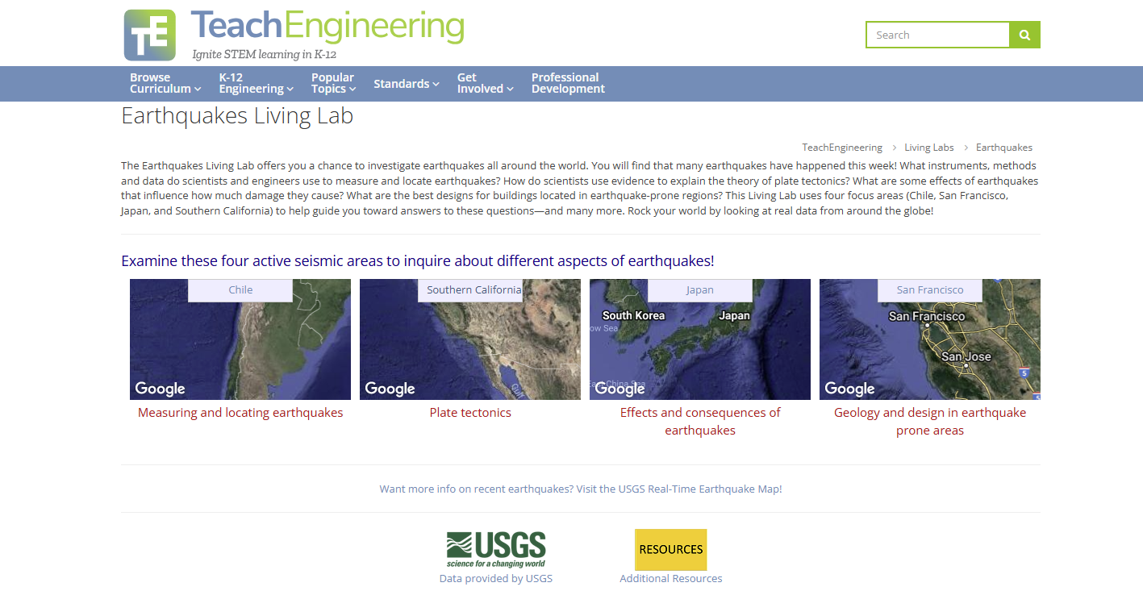

Slide 20
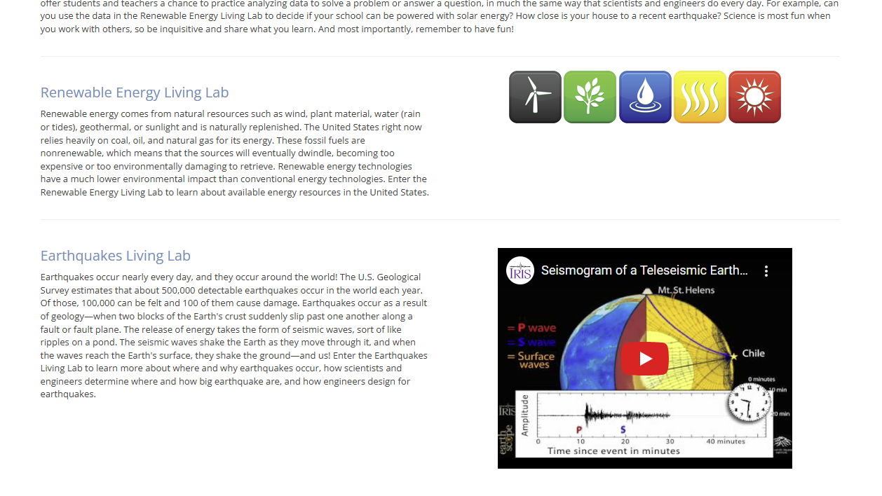

Slide 21
Explain:
Return to the Earthquakes Living Lab and investigate the theory of plate tectonics. Use the information provided to answer questions about the causes and evidence supporting continental movement.
Elaborate:
Find and record evidence of how continents have moved. Look into sea floor spreading, fossils, earthquakes, and volcanoes using the provided resources.
Relate this information to how engineers design buildings in earthquake-prone areas.
Evaluate:
Write a two-paragraph essay supporting or refuting Alfred Wegener’s hypothesis of continental drift based on the evidence gathered.

Slide 22
Task evaluation
ll

Slide 23
How would you rate the difficulty of this task?
Which parts of the assignment were the most difficult and why?
Do you think that the students of the specific age group would be able to handle this task without much difficulty? If not, what would need to be changed?
ll

Slide 24
How long did it take you to complete the task?
What would be the estimated time your future students would need to complete this task?
What factors might affect the time required for this task (level of knowledge, access to technology, motivation)?
ll

Slide 25
How well was the task linked to individual subjects?
Were all subjects represented in a balanced way, or did one dominate?
How could the assignment be modified to reflect all subjects better?
ll

Slide 26
What would you change about this assignment if you were to give it to your students?
What adjustments would you do to make the task more suitable for the students you will be teaching?
How would you motivate students to complete the task?

Slide 27
How would you rate your own readiness to assign and guide students in this task?
What would you need to develop further to feel more confident in assigning similar tasks?
What kind of support would you seek (from colleagues, professional literature, digital resources)?
ll

Slide 28
THANK
YOU!

