Slide 1
CZECH EDUCATIONAL SYSTEM
Radek Pospíšil pospisil@ped.muni.cz

Slide 2
Seminar work
Comparsion of educational system in your country and Czech educ. system in terms of:
A) ISCED
B) Goals of basic education
C) Subjects in basic education
D) Key competencies
E) Interesting facts

Slide 3
Seminar work – presentation
Seminar work - presentation is for max. 10 slides
You can use paper or online literature
You can use videos, photos, graphs, tables
You will upload this presentation in IS – Homework Vault

Slide 4
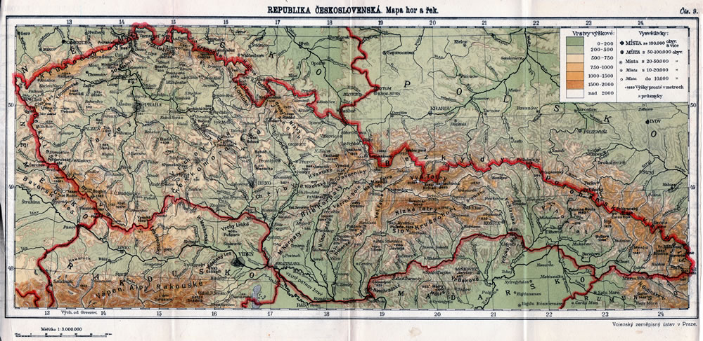
Brief historical overview
1918: Czechoslovakia

Slide 5
The Czechoslovak Socialist Republic
was the official name of Czechoslovakia from 1960
under the influence of Soviet Union
education influenced by soviet school system: - Makarenko school
- no alternatives
- methodical guides
after the Velvet Revolution in 1989
- restauration of free school

Slide 6
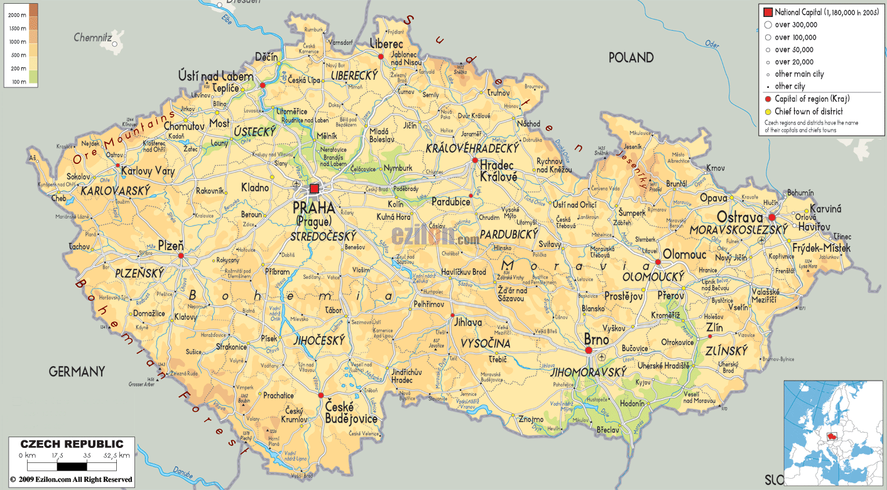
Introduction
1993: Czech republic

Slide 7
Basic facts
Compulsory school attendance
Literacy rate 96 %
Classification (grades) system: 1 – 5
Preschool enrollment is guaranteed for children in their last year before entering elementary school
Preschool education from agaes 3-6
Elementary education takes 9 years, usually from ages 6-15
Elementary Education is compulsory
Elementary education is divided into two stages: primary (grade 1 – 5) and lower secondary (stage 6-9)
In addition, children have the option to apply for gymansium or concervatory (high school level)

Slide 8
Basic facts
Upper secondary education (high school) can be general or vocational
Upper secondary education takes 3 – 4 years and is mandatory
State exam called Maturity leaving exam four subjects (Czech langugage, foreign language, two subject must-choose) Maturity leaving certificate
Tertiary education: Bologna process
Bachelor and Master degree university studies

Slide 9
ISCED
The International Standard Classification of Education is a classification of education approved by UNESCO in 1976.
It belongs to the family of economic and social classifications of the United Nations.
The second version, known as ISCED 1997, was approved in November 1997 as part of an effort to increase the comparability of statistics in education.
The classification covered two measurable variables: levels (introduced by 7) and areas of education (introduced by 25).
In the 2011 version, ISCED introduces 9 levels (instead of the previous 7) by dividing tertiary pre-doctoral education into three levels.

Slide 11
Educational reform
1989 – 2005
How education changed?

Slide 12
Basic education
Educational reform

Slide 13
Framework Educational Programme for Basic Education
www.msmt.cz/file/9481_1_1/
defines initial education as a whole
The Framework Educational Programmes devone binding educational norms across various stages: pre-school education, basic education and secondary education (for pupils and students from 3 to 19 years of age)are based on a new education strategy, stressing key competencies, their interlinking with
are based on a new education strategy, stressing key competencies, their interlinking with educational contents and the application of acquired knowledge and skills in practical life;
build on the concept of life-long learning
formulate the expected level of education that should have been attained by all students who have completed the educational stage in question
promote the educational autonomy of schools as well as teachers’ professional responsibility for the outcomes of the educational process

Slide 14
Objectives of basic education
Create preconditions for pupils to acquire basic learning strategies and motivate them to life-long learning
Stimulate and encourage pupils to creative thinking, logical reasoning and problem solving
Guide pupils to engage in efficient, effective, open communication on all aspects of their life
Develop pupils’ abilities to cooperate and to value their own work and achievements as well as the work and achievements of others
Guide pupils so that they should become free and responsible individuals who exercise their rights and meet their obligations
Induce in pupils the urge to express positive feelings and emotions in their behaviour, ways of acting and when experiencing important situations in their lives; develop in them sensitivity and responsiveness towards other people, the environment and nature

Slide 15
Objectives of basic education
Teach pupils to actively develop and protect their physical, mental and social health and to be responsible for it
Guide pupils to tolerance and consideration for other people, to a respect for their culture and spiritual values; teach pupils to live together with others
Help pupils to discover and develop their own abilities and skills in the context of actual opportunities and to use their abilities and skills in combination with their acquired knowledge when making decisions regarding the aims of their own life and profession

Slide 16
Educational fields
Language and Language Communication (Czech Language and Literature, Foreign Language)
Mathematics and Its Applications (Mathematics and Its Applications)
Information and Communication Technologies (Information and Communication Technologies)
Humans and Their World (Humans and their World)
Humans and Society (History, Civic education)
Humans and Nature (Physics, Chemistry, Natural Sciences, Geography)
Arts and Culture (Music, Fine Art)
Humans and Health (Health Education, Physical Education)
Humans and the World of Work (Humans and The World of Work)

Slide 17
Key competencies
learning competencies;
problem-solving competencies;
communication competencies;
social and personal competencies;
civil competencies;
working competencies

Slide 18
Cross-Curricular Subjects
Cross-curricular subjects in the FEP BE are subjects related to contemporary present-day issues and represent an important and inseparable part of basic education. They represent an important formative element of basic education.
This contributes to the pupils’ comprehensive education and positively influences the formation and development of their key competencies.
Cross-curricular subjects represent a mandatory part of basic education. Schools must include all cross-curricular subjects contained in the FEP BE10 into Stages 1 and 2 of education. Not all crosscurricular subjects, however, must be represented at each grade level. It is the school’s responsibility to, over the course of basic education, gradually offer pupils all thematic areas contained in the individual cross-curricular subjects.

Slide 19
Cross-curricular subjects
Personal and Social Education
Democratic Citizenship
Education towards Thinking in European and Global Contexts
Multicultural Education
Environmental Education
Media Education

